Slide 1
Public Meeting
U.S. Highway 85
From 7 Miles North of Buffalo to Ludlow
Harding County
NH 0085(105)134 PCN 07C7
Jeff Lansink, PE
Houston Engineering, Inc.
Feb. 16, 2023
Notes:
Good evening and welcome to the Public Meeting to discuss planned improvements to US Highway 18.
My name is Jeff Lansink with Houston Engineering.
SDDOT representatives here with me this evening are:
Craig Smith, Region Engineer, Mitchell
Ron Peterson, Area Engineer, Yankton
Rod Gall, Area Engineering Supervisor, Yankton
Travor Diegel, Road Design Engineer
Fred Leetch, Right of Way
Steve Johnson, Chief Bridge Engineer
Kevin Marton, Bridge Hydraulic Engineer
Hopefully everyone had a chance to sign in and picked up a handout. Included in the handout is the power point of which you may follow along.

Slide 2
Purpose of the Meeting
Involve the public in the planning and design process
Provide a project overview
Background information
Proposed project
Project schedule
Gather input and comments
Notes:
We are here tonight to involve the public in the design process. We would also like to share with you the project scope, what the current design layout is, and the schedule. After the presentation we want to gather public input in the form of exchange of ideas and/or discuss any concerns you may have.

Slide 3
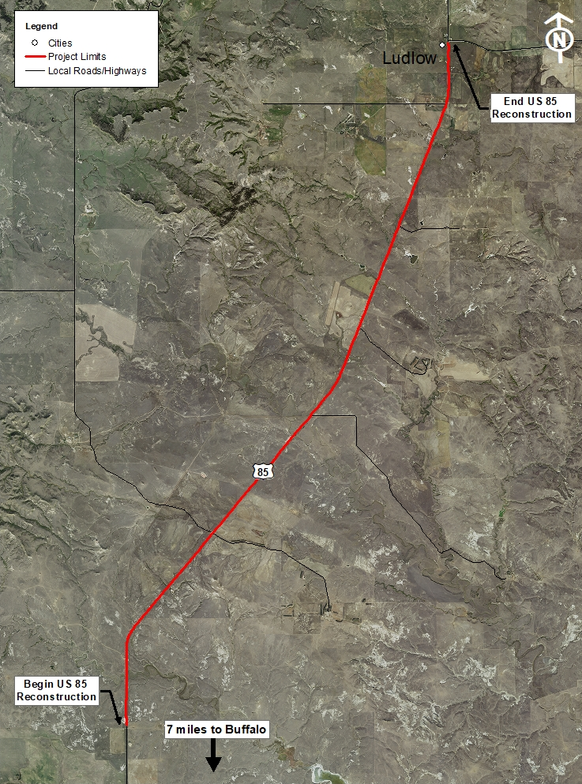
Project Limits
Notes:
The proposed project is approximately 12 miles in length. Grading will begin at RM134.00 and continue north to the Ludlow Corner.

Slide 4
Background Information
Grading & Bridges in 1960
Surfacing in 1961
Resurfaced in 1983 & 2010
Notes:
The bridges over Jones Creek, Bull Creek and Big Nasty Creek were constructed in 1960

Slide 5
Traffic
2021 Average Daily Traffic (ADT) = 1266
2041 Projected ADT = 1659
20.8% Average Truck Traffic
Notes:
Existing traffic is over 1200 vehicles per day for U.S. Highway 85. The 20 year projected ADT is 1659. The average Truck Traffic is 20.8%.
Traffic Volumes and Vehicle Types are used to establish a base line for what type of facility is needed to safely handle traffic now and into the future. For example the number of lanes, width of lanes, width of shoulders, and surfacing types and thicknesses are all determined by the projected traffic volume and truck percentages.
With the current and projected traffic volumes a 2 lane facility (with 8 foot shoulders) and passing lanes in each direction will safely handle the traffic at an acceptable level of service.

Slide 6
Crash History
4 Year Period from 2017 to 2021
27 Reported Crashes
10 Animal Hit
4 Fixed Object Off Road
3 Rear End
3 Other
Rural Principal Arterial
Reported Crash Rate = 1.28
Statewide Weighted Crash Rate = 1.47 (crashes per million vehicle miles of travel)
3 Overturn off road
2 Overturned on road
1 Parked Vehicle
Notes:
Crash data is important to identify potential safety hazards.
4 of these crashes resulted in an injury.
1 Fatality

Slide 7
Highway Deficiencies
Vertical Curves
Narrow Shoulders – 2 feet Asphalt, 4 feet gravel
Surfacing
Structures
Notes:
6 vertical curves at a 60 mph design speed.
Narrow shoulders (2’ AC and 4’ Gravel’).
Structures are at the end of their useful life

Slide 8
Proposed Improvements
Widen Roadway – 8-foot Shoulders
Passing Lanes NB and SB
Replace Bridges at Jones Creek, Bull Creek and Big Nasty Creek
Interim Surfacing (final in 2028)
Notes:
Shoulders widened to 8 feet.
Passing lanes will be added in both directions
Interim surfacing – In response to public comments on stacking of vehicles behind slow vehicles
Replace bridges over Jones Creek, Bull Creek and Big Nasty Creek. Constructed in the early 1960’s. Over 60 years old

Slide 9
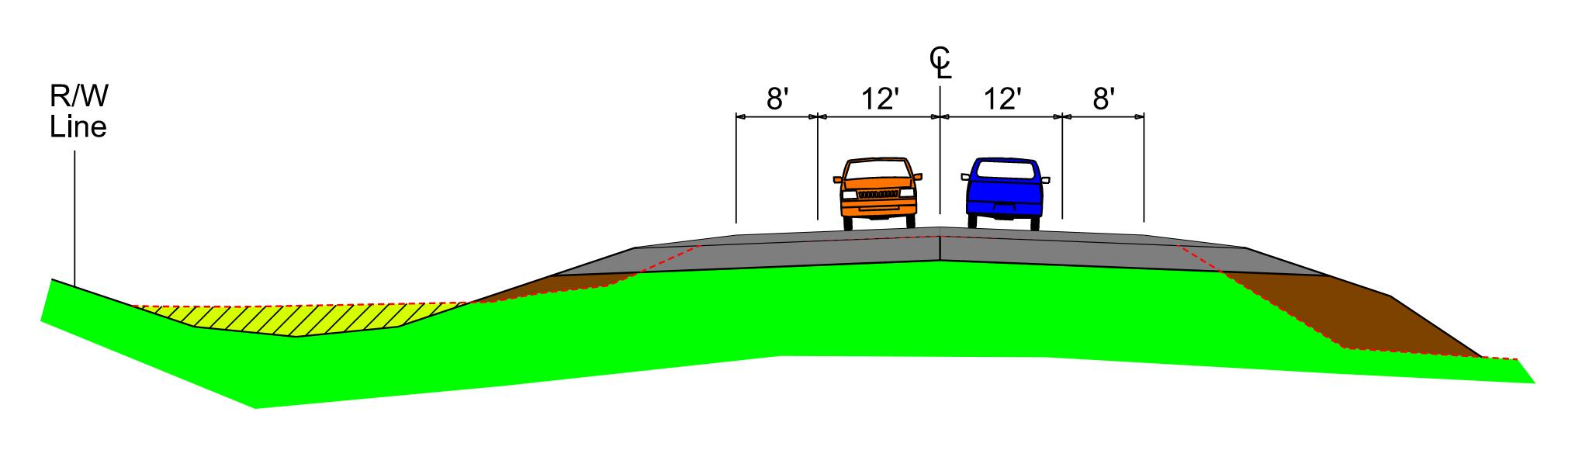
Proposed Typical Section
Notes:
Existing Rural Section
Roadway: 2 – 12 Ft Asphalt Lanes
Narrow Existing Shoulders: 2 Ft Asphalt, 4’ Aggregate
200 Ft ROW width
Proposed Rural Reconstruction
Roadway: 2-12 Ft
Shoulders: 8 Ft (Gravel Shoulders)
150 ft ROW width in Rural Section
100 Ft ROW width through Turkey Ridge
<150 Ft ROW width near buildings

Slide 10
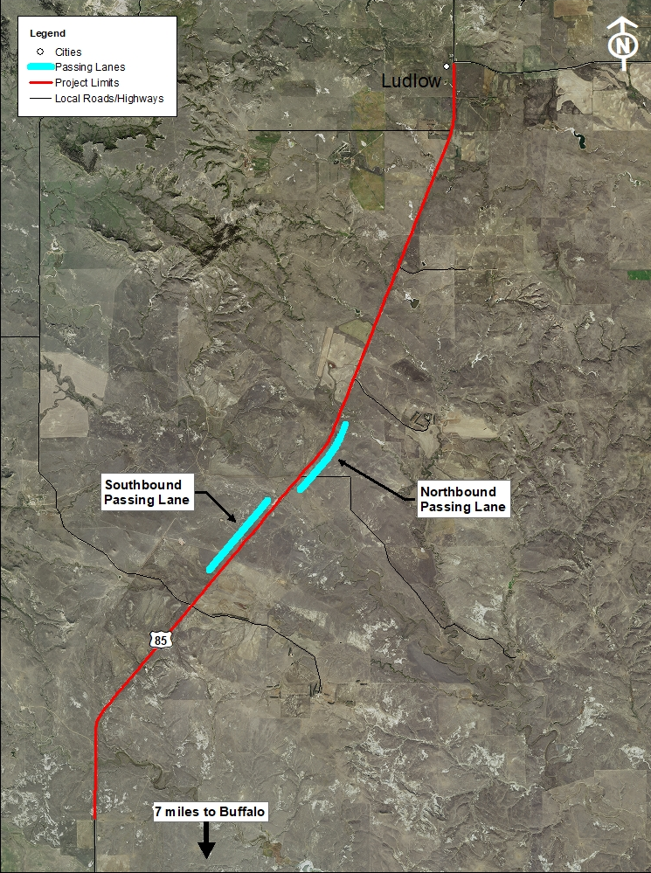
Proposed Passing Lanes
Notes:
Proposed passing lane locations – mitigate public concerns about traffic backing up behind slow moving vehicles

Slide 11
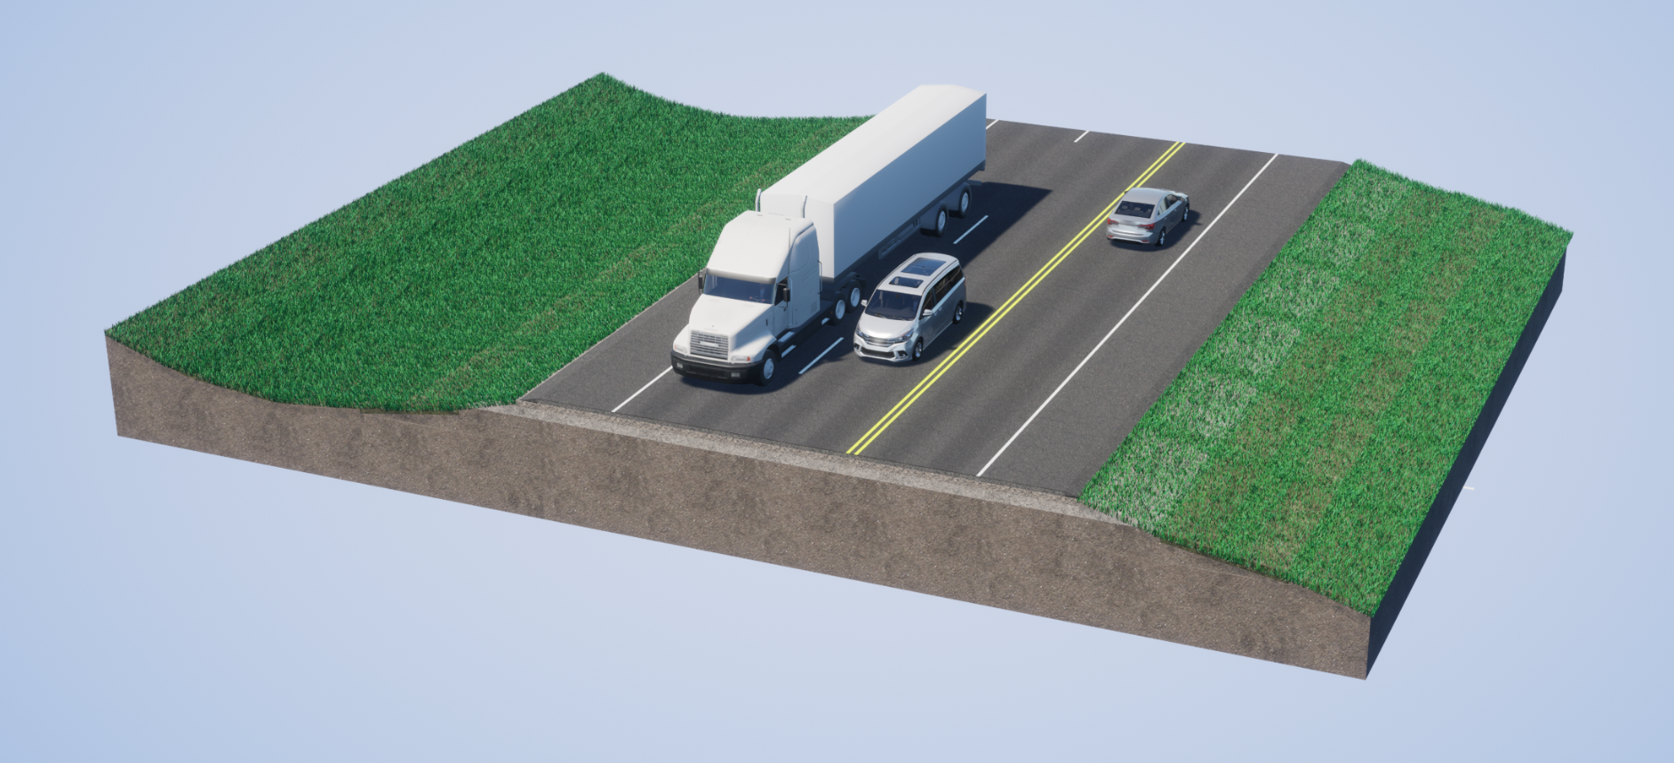
Passing Lane
Notes:
Southbound Passing Lane

Slide 12
Access Management
To provide safe, efficient access to streets and highways
Limit number of direct accesses to major roadways
Provide safe, efficient access to streets and highways
By limiting the number of direct accesses to major roadways
See Handout
Notes:
Any time SDDOT reconstructs a roadway, we evaluate Access Management. The purpose of access management is to ensure there is safe, efficient ways to access highways not only now but in the future as traffic volumes grow and developments get more dense. Studies have shown that by controlling the access of vehicles to highways, accident rates are decreased. Existing approaches will generally be left in place except where they can be combined with another approach or eliminated if they are not being used. An approach is a hazard itself. Crashes including some fatal crashes can involve vehicles launched by an approach, the elimination or minimizing approaches removes the hazard from the ROW.
The goal is to reduce the number of access points along the route, thereby making the route safer.
If there are proposed changes to accesses, this will be discussed during the landowner meetings. While always a difficult subject, design will work with the property owners as best we can to come up with solutions.
More information on access management is available in the handout.

Slide 13
Right of Way (ROW)
Existing Width = 200 feet
Purchase additional ROW as needed
Temporary Easements as needed
See Handout
Notes:
The existing ROW is 200 ft (100’ from centerline).
Temporary easements are necessary whenever the construction work limits are outside of the right of way. Temporary easement allows construction to occur on your property during construction of the highway. The red dashed line represents the limits of work and when this line is near or outside the ROW line temporary easements will need to be obtained by the State.
ROW and Temporary Easements will be discussed in more detail during Individual Landowner Meetings, and more information on the right of way process is available in the handout.

Slide 14
Encroachments
Private property in public ROW
Examples
Signs
Private Use (Parking)
Landscaping Items
Notification
Federal Highway Regulations for Safety
Owners of encroachments will be notified by the Belle Fourche Area Office
See Handout

Slide 15
Utility Coordination
Consolidated Telecom
West River Cooperative Telecom
Grand Electric
Midcontinent Communications
Some utilities may need to be relocated
Utility companies negotiate easements with landowners
See Handout

Slide 16
Utility Coordination
Water lines
Drain fields
Septic tanks
Underground storage tanks
Underground power lines
Any known private utilities?
Contact SDDOT
See Handout

Slide 17
Environmental, Social and Economic Concerns
A cultural resources survey will be completed.
The project is being reviewed to determine extent of wetland impacts.
Endangered and Threatened Species:
  Birds: Whooping Crane, Red Knot
  Mammals: Northern Long-Eared Bat
  Insects: Monarch Butterfly
See Handout
Notes:
Section 106
As stated in slide, this is specific to the protection of historic properties. Which will include: districts, sites, structures, and objects of historic & archaeological significance. This will also include tribes that may attach religious or cultural importance to them. Invite the public to provide information on any culturally or archaeologically known site(s).
Contaminated Materials
Request public’s input to any known AST or UST tanks within vicinity of project.

Slide 18
Environmental, Social and Economic Concerns
This project is being developed in accordance with applicable State and Federal environmental regulations.
National Environmental Policy Act of 1969 (NEPA), as amended. Coordination has been initiated with State & Federal resource agencies.
See Handout
Notes:
Section 106
As stated in slide, this is specific to the protection of historic properties. Which will include: districts, sites, structures, and objects of historic & archaeological significance. This will also include tribes that may attach religious or cultural importance to them. Invite the public to provide information on any culturally or archaeologically known site(s).
Contaminated Materials
Request public’s input to any known AST or UST tanks within vicinity of project.

Slide 19
Construction Traffic Control
Road will be open to traffic during construction. Flagging operations will be in place.
Local traffic and emergency vehicle access will be maintained at all times.

Slide 20
Landowner Meetings
Winter 2023
Landowners adjacent to the project will be contacted individually by SDDOT to schedule a meeting.
Discussion Items
Driveway locations/widths
Fences
Drainage
Trees
Temporary Easements or ROW acquisition
See Handout

Slide 21
Tentative Project Schedule
Dependent on Federal Funding
Winter 2023
Landowner Meetings
2023
Final Design
2024-
2025
ROW Acquisition
2027
Construction
Estimated Cost: $7.8 million
Final Surfacing is planned for 2019
Notes:
The tentative project schedule is shown here.
Dates where there will be additional involvement between SDDOT and adjacent property owners are:
Landowner Meetings to be held in the Summer of this year
ROW Acquisition Process will begin in 2024.
The construction is scheduled for the 2027 construction season.
Final surfacing is scheduled to be done in 2028

Slide 22
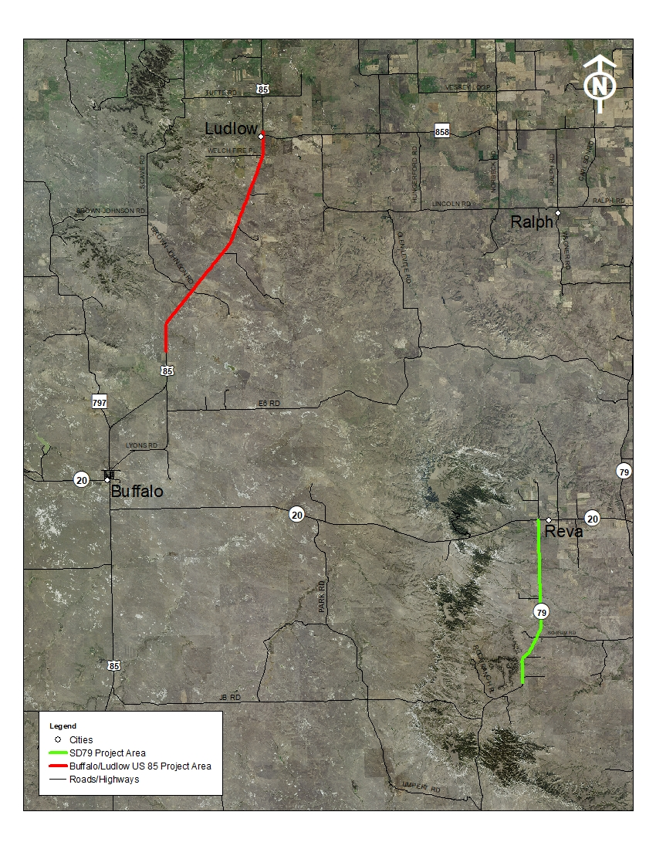
Projects in the Area
U.S. Highway 85 Future Grading and Asphalt
Concrete Surfacing
S.D. Highway 79 Grading and Interim
Surfacing in 2028

Slide 23

Questions or Comments
by: March 3, 2023
submit to: Jeff Lansink
Houston Engineering, Inc.
1401 21st Ave N
Fargo, ND 58102
jlansink@houstoneng.com
website:
https://dot.sd.gov/projects-studies/projects/public-meetings#listItemLink_1874
Notes:
At this time I will take any general comments or question you may have on this project. If you have any specific questions or comments regarding how the projects may impact your property we will take the remaining time to visit with you one-on-one at one of the aerial layouts.
You are also asked to submit your questions or comments in writing on the form provided in the handout or via email address to Jeff Lansink by March 3, 2023 (2 weeks) .
In the next few days the power point presentation, handout and design layouts will be added to the web site address noted. Go to the section under Rapid City Region and click on the link to the project.

