Slide 1
Notes:
Hold/Waiting to Begin Slide. And the Aviation Group Text & Airplane Icon can be deleted.

Slide 2
South Dakota Airport Conference Design Standard Update AC 150/5300-13B
Rod Senn & Travis Hirschey— April 2022
Notes:
Aviation Group & the Airplane Icon can be deleted.

Slide 3
Key Discussion Points
What is AC 150/5300-13 & Why It Matters
Design Principles
Changes to Runways
Changes to Taxiways/Taxilanes
Changes to Aprons
Rod Senn, PE
Travis Hirschey, PE

Slide 4
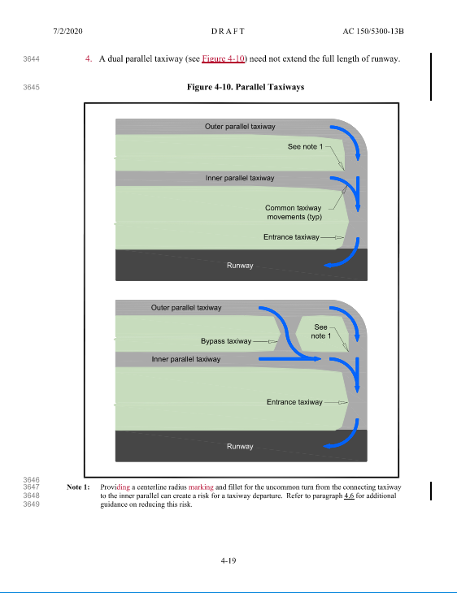
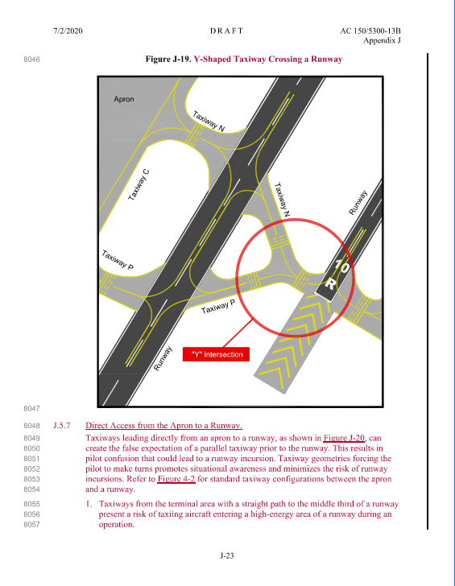
What is AC 150/5300-13 & Why it Matters
New Color Exhibits
New Guidance on Runways, Taxiways, Aprons, and Much More
Notes:
Purpose of Airport Design AC
- Acts as one of the most important guides to airport design
- Guidelines for establishing level of safety, efficiency and capacity for civil airports
- Describes design principles, Runways, Taxiways, Aprons, and Miscellaneous Airfield Systems & Facilities
Overall changes & why it matters
- Its getting thicker (322 to 411 pages)
- Cosmetic improvement, more color
- Changes will impact how we design airports in various aspects.
-

Slide 5
Timeline Highlights
Issued for Use March 31, 2022
1989 First Issue of Airport Design
September 2012 First Major Rewrite 150/5300-13A
February 2014 Change 1 to 13A
July 2020 Draft 13B for Comment
September 2020 Deadline for Industry Comments
Engineering Briefs
18 Changes
Notes:
Original issue 1989. This version received many (18) changes issued before the rewrite of 13A was issued. 12A only received one revision which was to revisit the TESM design.

Slide 6
Major Items Not Changed
Runway Protection Areas Unchanged

Slide 7
Design Principles
Standard
A physical characteristic, quality, configuration, function, operation or procedure established by the FAA as a benchmark for uniformity, safety, capacity, performance, economy and environmental quality.
Recommended Practice
Guidelines beneficial towards enhancing safety, capacity or efficiency. Recommended practices imply discretionary application to address a site-specific condition.
Requirement
Mandatory language such as “must”, “shall”, “required” or “requirements” used to describe obligations that originate in either federal statutes or regulations.
Design Consideration
Additional factors to consider during airport design that may influence application of a standard or recommended practice.
Notes:
Section 1.2.1 Defines the meaning of four terms used throughout the AC and, in our opinion, these clear
definitions are a welcome addition. The four terms defined here: Standard, Recommended Practice,
Requirement, and Design Consideration. These terms represent different levels of the applicability of
design guidance. Requirements are obligations found in federal statutes or regulations. Standards are
set in order to fulfill the FAA’s statutory responsibilities. Recommended Practices are practices that
further enhance safety, capacity, or efficiency but can be applied with discretion. Design Considerations
are other elements to consider in the design.
Provide examples of each
- Requirement -> Size/type a ARFF truck /Rules for funding
- Standard ->RSA/TOFA
- Recommended Practice -> Taxiway offset, TESM pavement, Site specific
- Design Consideration -> Details of when you use recommended practice/ basis of design

Slide 8
Instrument Departure Surfaces
Less Restrictive For Obstructions!
13B Departure Surface (Green)
13A Departure Surface (Blue)
150'
1000'
Common Obstructions Include:
Trees, Fences, Roads,
Aprons & Many More
Notes:
A significant (and welcome) change to the instrument departure surface was released in Engineering
Brief 99A and is included in this change. Under 13A, the departure surface made for some very
challenging planning, due to its width and relatively flat slope, especially at smaller GA airports. The
surface was 1,000 feet wide at the end of the runway or clearway and went out at 15-degree angles for
10,200 feet from the runway end. The surface started at the runway end elevation and went up at a
40:1 slope.
In 13B, the departure surface is divided into two sections. Section 1 starts at the runway end and goes
up at a 40:1 slope. The surface is the width of the runway at the end and goes out at 15-degree angles
for 12,152 feet from the runway end. Section 2 consists of two “wings” on either side of Section 1. These
wings are wide but start at an elevation 150 feet above the runway end and go up at the same 40:1
slope for 6,152 feet. The result is obstructions close to the runway end will have a lower impact on
planning. This is difficult to describe in words, so Figures 3-8 and 3-10 from 13B are included here

Slide 9
Parachute Operations
Notes:
Parachute operations represent an allowable aeronautical activity at federally obligated airports subject to compliance with reasonable terms and regulatory requirements.

Slide 10
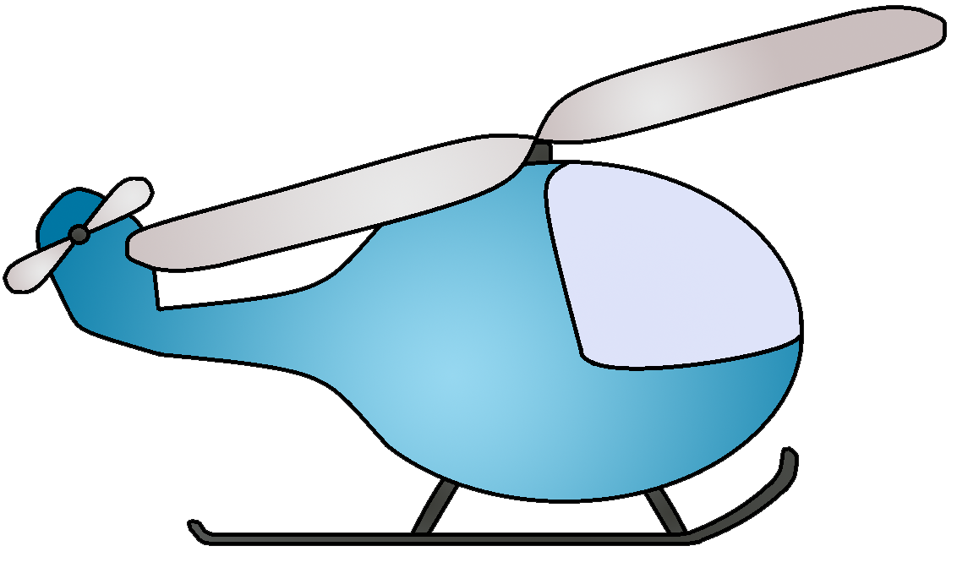
Operations in Unpaved RSA
Notes:
Pilots of certain aircraft (such as ultralights, powered parachutes, helicopters, gliders, agricultural aircraft, etc.) occasionally use the unpaved portion of the RSA adjacent to a runway for takeoffs, landings or other operations (e.g. banner towing). While aircraft operations from the unpaved portion of an RSA are not inherently unsafe, such operations have potential to introduce various hazards and risks to the pilot as well as other aircraft, vehicles, individuals and facilities on the airport.

Slide 11
Runway Design Standard Tables
13A
13B
New Online Design Tool

Slide 12
Runway Design Criteria – C/D/E - III
AC 150/5300-13A
Runway Width
150 Feet
Blast Pad Width
200 Feet
Draft AC 150/5300-13B
Runway Width
100 Feet
Shoulder Width
25 Feet
Shoulder Width
20 Feet
Blast Pad Width
140 Feet
Notes:
Different approach with putting 100' first

Slide 13
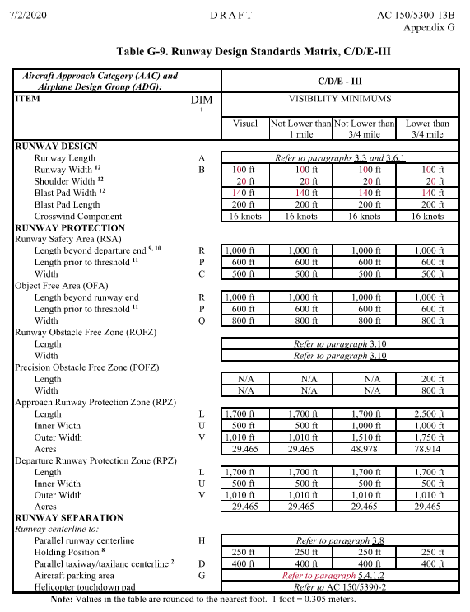
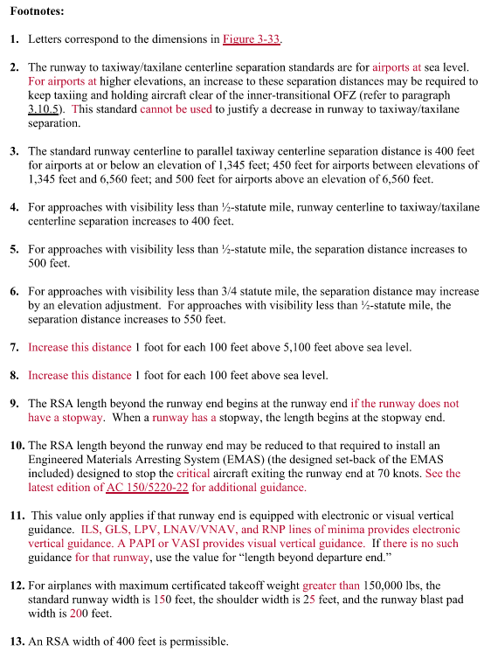
Runway Design Criteria – C/D/E - III
Changes to C/D/E - III
Notes:
Different approach with putting 100' first

Slide 14
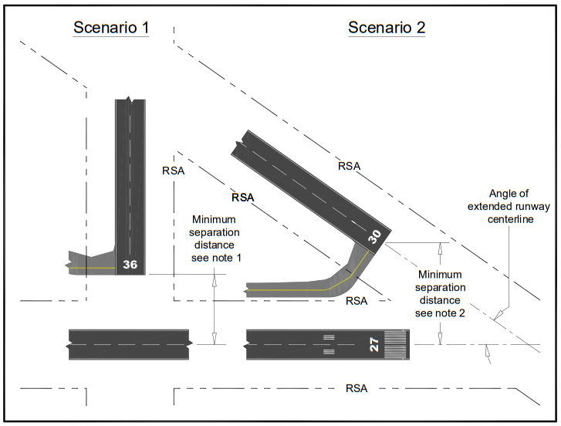
Overlapping Runway Safety Areas
Ensure Aircraft on Taxiway are Outside RSA
Standard Taxiway to Runway Separation Requirement
Notes:
A significant (and welcome) change to the instrument departure surface was released in Engineering
Brief 99A and is included in this change. Under 13A, the departure surface made for some very
challenging planning, due to its width and relatively flat slope, especially at smaller GA airports. The
surface was 1,000 feet wide at the end of the runway or clearway and went out at 15-degree angles for
10,200 feet from the runway end. The surface started at the runway end elevation and went up at a
40:1 slope.
In 13B, the departure surface is divided into two sections. Section 1 starts at the runway end and goes
up at a 40:1 slope. The surface is the width of the runway at the end and goes out at 15-degree angles
for 12,152 feet from the runway end. Section 2 consists of two “wings” on either side of Section 1. These
wings are wide but start at an elevation 150 feet above the runway end and go up at the same 40:1
slope for 6,152 feet. The result is obstructions close to the runway end will have a lower impact on
planning. This is difficult to describe in words, so Figures 3-8 and 3-10 from 13B are included here

Slide 15
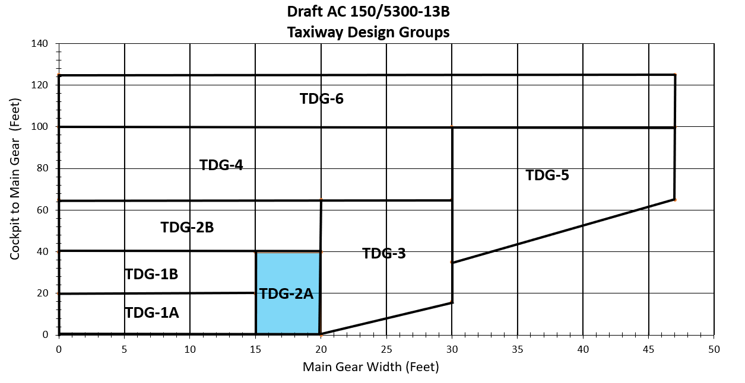
Taxiway & Taxilane Design Standards
Removed TDG-7
TDG-2 is Separated into Two Categories
Notes:
Only TDG 7 was A380

Slide 16
Common Aircraft’s Taxiway Design Group
TDG 2A
King Air 200 & 300
Citation CJ2 & V
TDG 2B
Gulfstream IV
CRJ 700 & 900
Embraer EMB 145
Piper PA-42
Boeing 717-200
TDG 1B
TDG 3
Air Tractor AT-802
Citation III
Airbus A320
Boeing 737-800
TDG 1A
Beechcraft Baron 55
King Air A90
Cessna 172
CRJ 200
Embraer EMB 175
Notes:
Only TDG 7 was A380

Slide 17
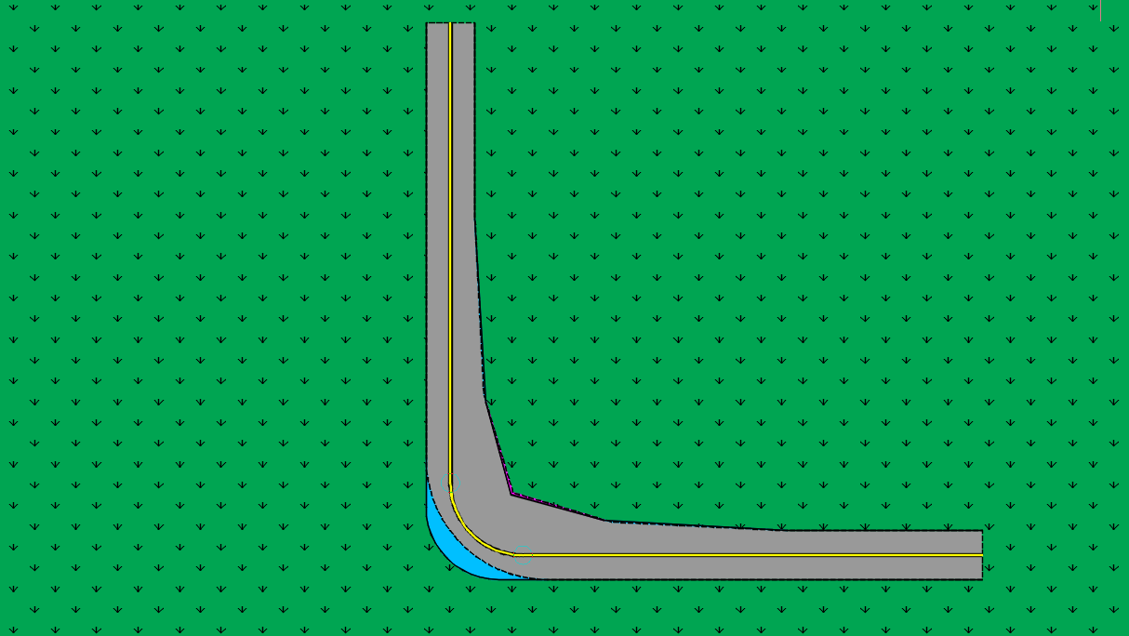
Changes to TDG 1B Fillets
Changes to TDG 1B Fillets
5.5% Increase in Pavement Areas
Slightly Less Inner Pavement
Added Pavement on Outer Radius
Notes:
Only TDG 7 was A380

Slide 18
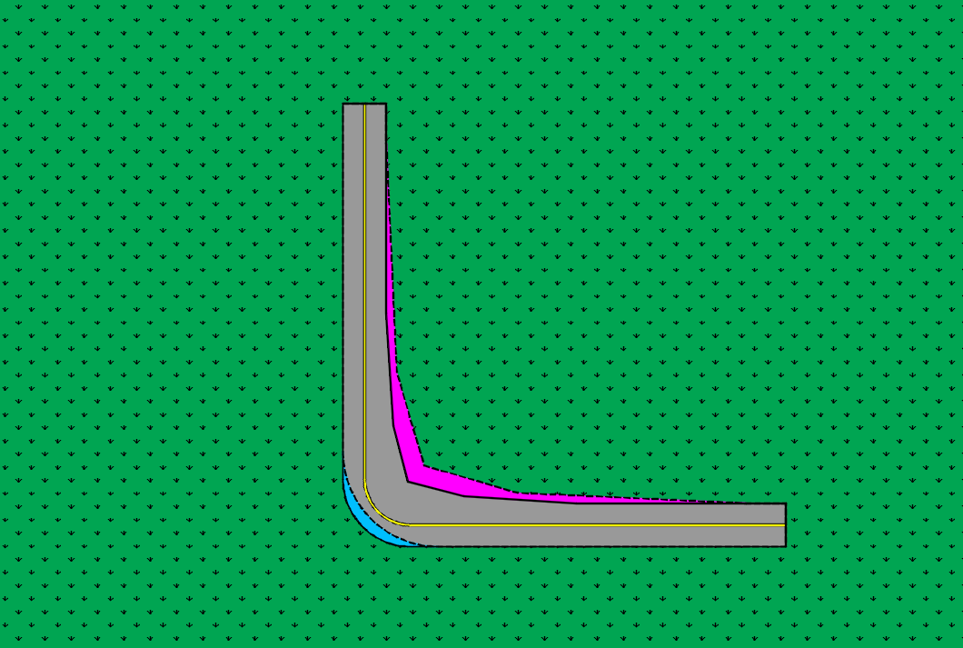
Changes to TDG 2A Fillets
11.5% Decrease in Pavement Areas
Significantly Less Inner Pavement
Added Pavement on Outer Radius
Notes:
Only TDG 7 was A380

Slide 19
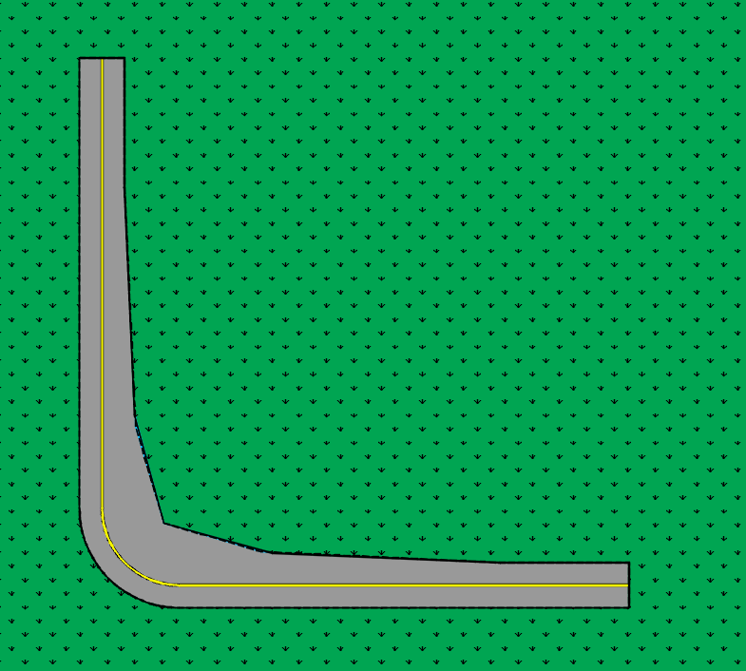
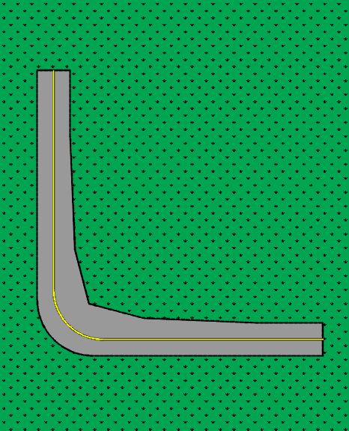
Changes to TDG 2B & 3 Fillets
TDG 2B
Essentially No Change in Pavement Areas
TDG 3
Essentially No Change in Pavement Areas
Very Minor Adjustments
Notes:
Only TDG 7 was A380

Slide 20
Changes to Taxiway & Taxilane Design Standards
 | Airport Design Group
 | I | II | III | IV | V | VI
TSA | 0 | 0 | 0 | 0 | 0 | 0
Taxiway OFA | 0 | -7 | -15 | -16 | -35 | -51
Taxilane OFA | 0 | -5 | -4 | -1 | -6 | -12
 | 0 | 0 | 0 | 0 | 0 | 0
Taxiway Centerline to Parallel Taxiway/Taxilane Centerline | 0 | 0 | -8 | -8 | -18 | -26
Taxiway Centerline to Fixed or Movable Object | 0.5 | -3.5 | -7 | -8.5 | -18 | -25
Taxilane Centerline to Parallel Taxilane Centerline | 0 | -3 | -2 | 0 | -3 | -6
Taxilane Centerline to Fixed or Movable Object | 0.5 | -2.5 | -2 | -0.5 | -3 | -6
Notes:
This table is changed significantly, in nearly all cases with the standard dimensions smaller in 13B than
they were in 13A. In some cases, the differences are striking. For example, the taxiway wingtip clearance
for ADG V is reduced from 53 feet to 36 feet. The standards that changed are highlighted below (green
means the standard is lower; cyan, higher).
13A included guidance for turnarounds at the ends of runways without parallel taxiways. This
configuration was rounded (see Figure 4-29 in 13A). The resulting taxiways are affectionately called
“teacups” because they look like the handle of a teacup. In 13B, the teacups are gone, replaced with a
short portion of parallel taxiway configured for a future holding bay and parallel taxiway (Figure 4-26).
There is no word on what nickname we will use for this configuration, at this time.

Slide 21
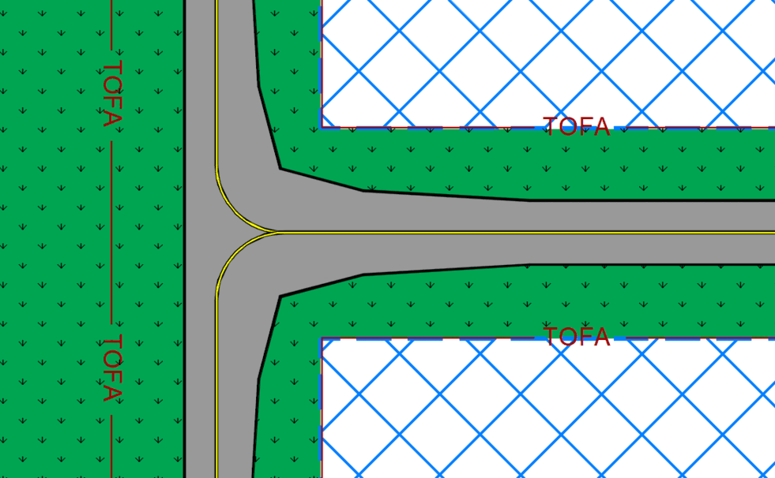
Impact of Less Restrictive TOFA
Reduced TOFA
Hangar or Object
Reduced TOFA
Hangar or Object
Notes:
TDG II with both 12A & 12B Shown
Benefits to smaller hangar potentially includes:
- Larger Hangars
- Less hangar access pavement
- Less restrictive for designs while meeting safety requirements
- Less land required

Slide 22
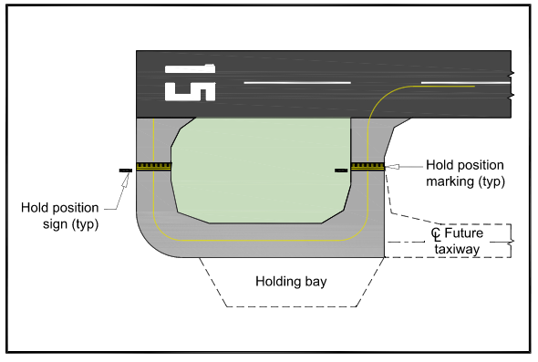
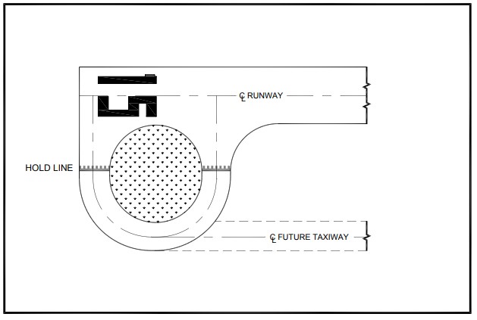
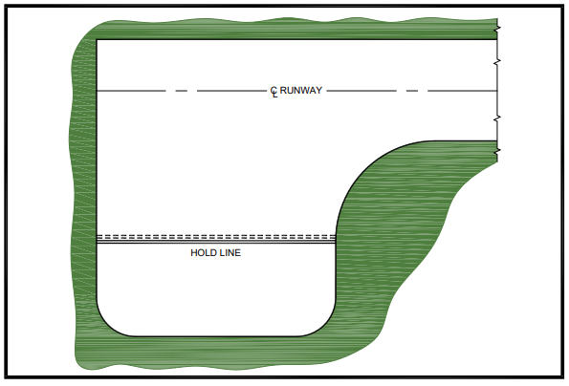
Changes to Turnarounds
Turf Interior Introduced with 13A
Original Turnaround Design
Turn Arounds Based on Parallel Taxiways with 13B
Notes:
This table is changed significantly, in nearly all cases with the standard dimensions smaller in 13B than
they were in 13A. In some cases, the differences are striking. For example, the taxiway wingtip clearance
for ADG V is reduced from 53 feet to 36 feet. The standards that changed are highlighted below (green
means the standard is lower; cyan, higher).
13A included guidance for turnarounds at the ends of runways without parallel taxiways. This
configuration was rounded (see Figure 4-29 in 13A). The resulting taxiways are affectionately called
“teacups” because they look like the handle of a teacup. In 13B, the teacups are gone, replaced with a
short portion of parallel taxiway configured for a future holding bay and parallel taxiway (Figure 4-26).
There is no word on what nickname we will use for this configuration, at this time.

Slide 23
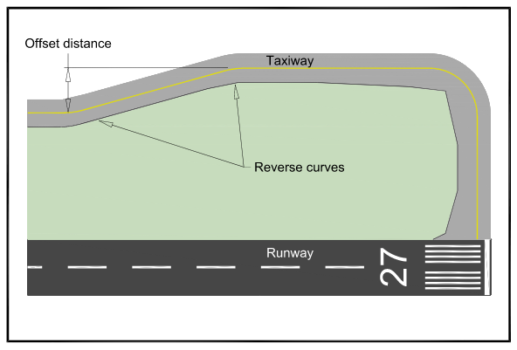
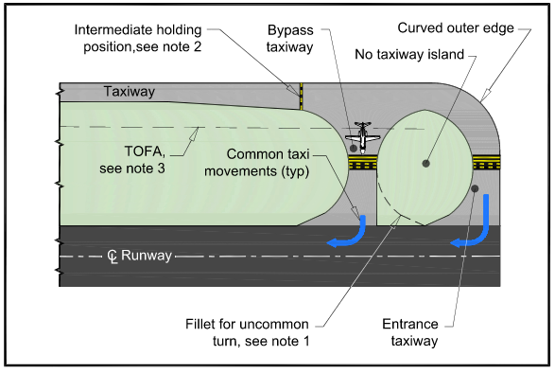
Parallel Taxiways
Recommended to Add Offset to Parallel Taxiway
Recommended to
Remove Uncommon Turn
Notes:
There is additional information in this section intended to prevent wrong surface events. This includes
eliminating radii for uncommon turns (see Figure 4.10) and offsetting a portion of the parallel taxiway
toward the end, so that it does not look like a runway on approach.

Slide 24
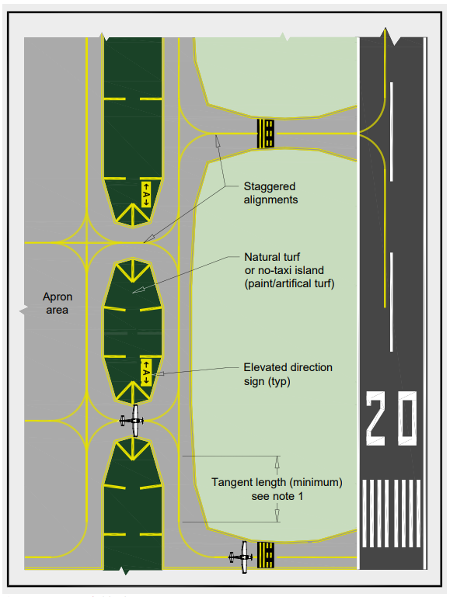
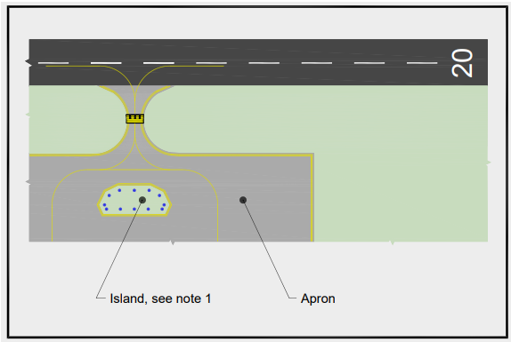
Tangent Length on Parallel Taxiway
Provide a No-Taxi Island or at Least One Turn Between 75 & 90 Degrees
New Recommended Practice for Separation to Align Aircraft Fuselage with Parallel Taxiway
Notes:
The goal is to maintain situational awareness. Parallel taxiways need tangent lengths adequate to align fuelage. If no parallel taxiway exists, the pilot needs to make at least a 75 to 90 degree.
To be realigned when the taxiway is reconstructed.

Slide 25
Aprons
Defines Varies Types of Aprons
Added Guidance for Apron Sizing, Fuel Facilities, Vehicle Access, Wash Racks, Fencing, Hangar and More

Slide 26
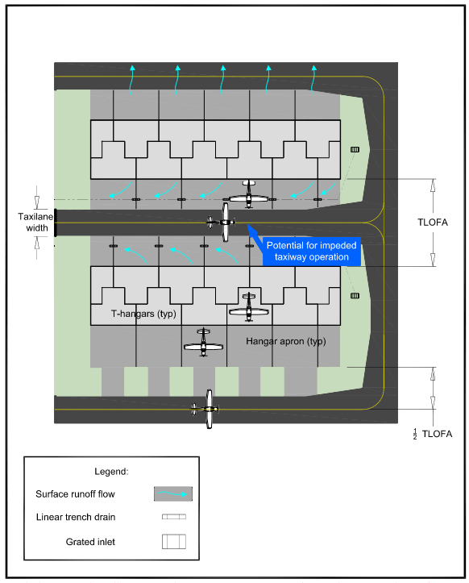
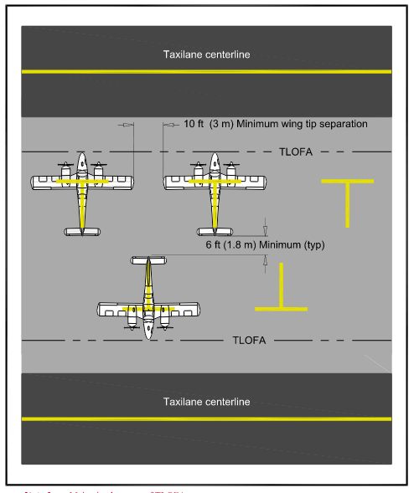
Hangars & Tiedowns
Added Design Considerations for Tiedowns
Added Design Considerations for Hangar Complexes

Slide 27
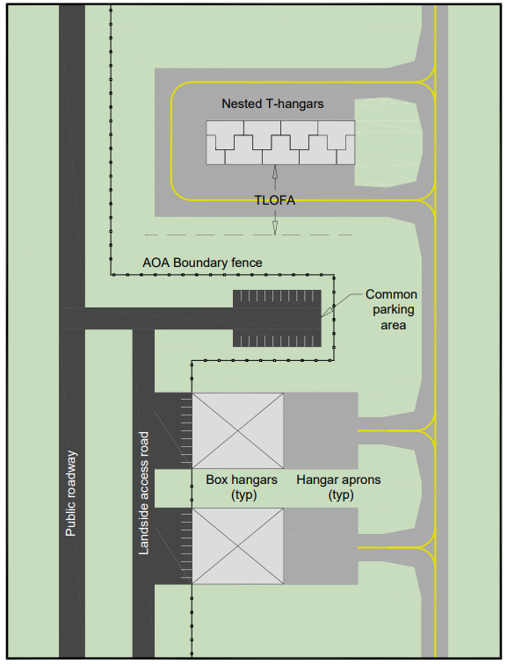
Separation Between Land and Airside
Focus on Interaction of Vehicles and Aircraft
Further Guidance on Fencing

Slide 28
Thank You!
Notes:
Thank You Slide. And the Aviation Group Text & Airplane Icon can be deleted.

