Slide 1

Scholarships for Pilots and Mechanics
Steve Hamilton
South Dakota Pilots Association
April 7, 2022

Slide 2
Need for Pilots & Mechanics
Boeing’s annual “Pilot and Technician Outlook” predicts 612,000 new pilots,
626,000 new maintenance technicians, and
886,000 new cabin crew members
will be needed to fly and maintain the global commercial fleet over the next 20 years
(2021-2040).

Slide 3

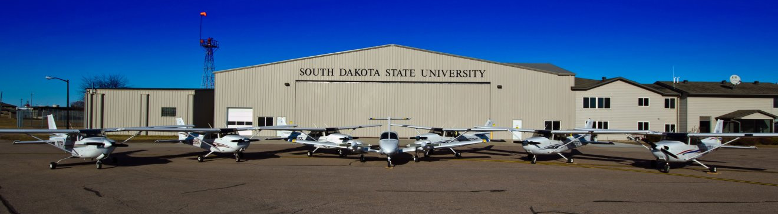
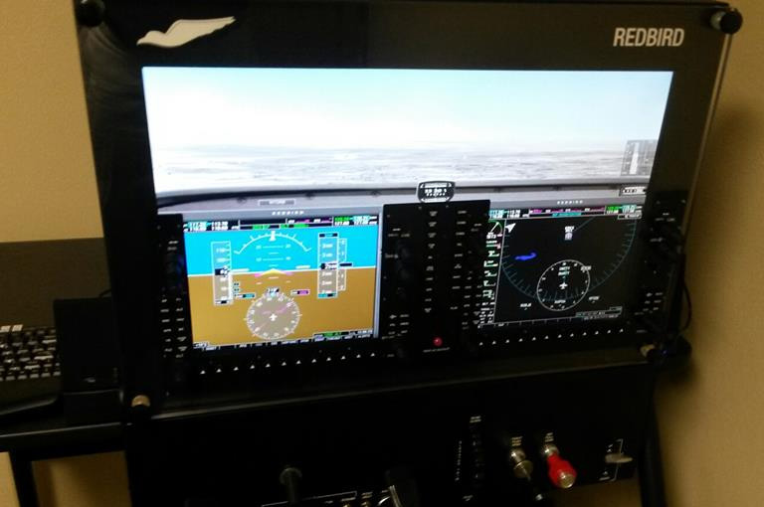
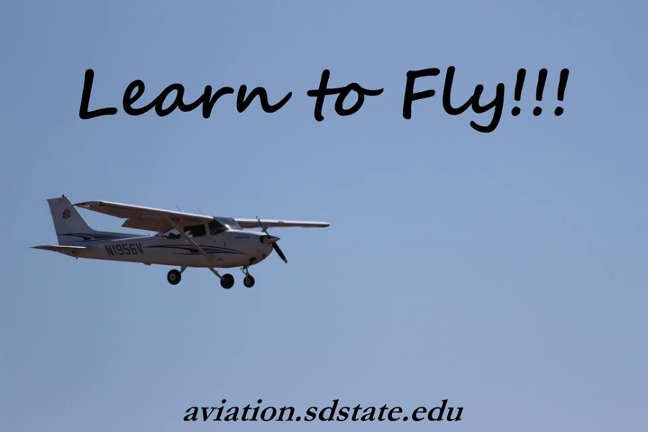
SDSU Aviation Program

Slide 4
SDSU Aviation Program
Estimated Costs
Cessna 172 Skyhawk $200/hour
Cessna 172 Instruction $75/hour
Advanced Aircraft Training Device $70/hour
AATD Instruction $75/hour
Ground Instruction $75/hour
- - - - - - - - - - - - - - - - - - - - - - - - - - - - - - - - - - - - -
Full and part time flight instructors: 33 CFIs
17 aircraft
Eleven Cessna 172 Skyhawk aircraft (primary training with G500 or G1000
avionics)
One Piper Arrow aircraft (optional complex training)
Four Piper Seminole aircraft (multiengine training, G1000 avionics)
One American Champion Citabria (optional tailwheel training)
One Basic Aviation Training Device (Redbird TD)
One Advanced Aviation Training Device (Frasca RTD)

Slide 5
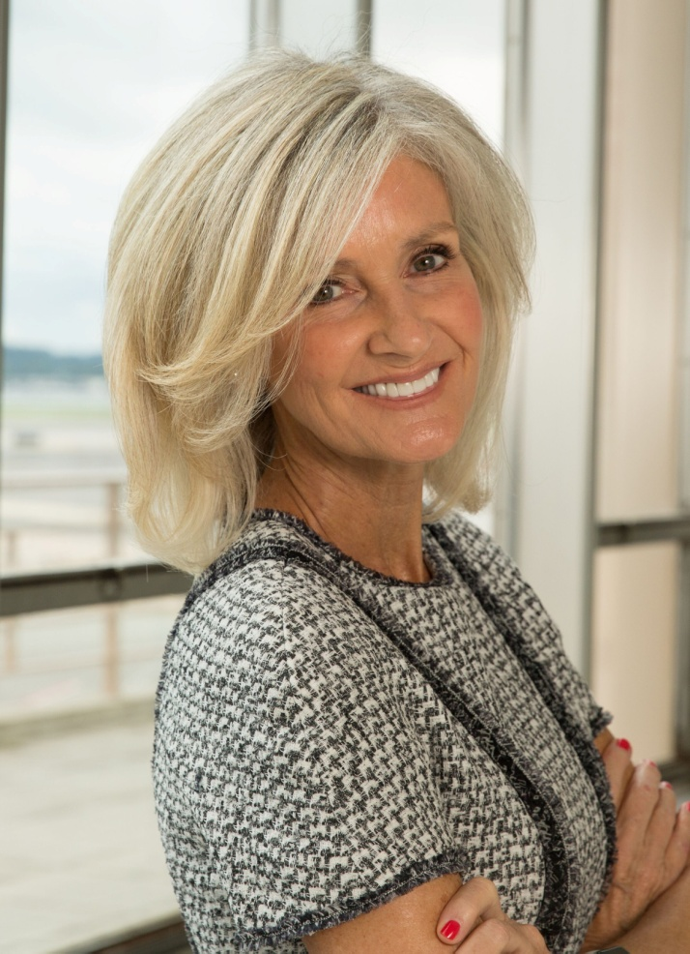
SDSU Av. Scholarships
Linda Hall Daschle Scholarship
for Aviation Excellence
Second woman to be deputy
administrator of the FAA (1993-1996).
First woman to serve as FAA acting
administrator (1996-1997).
2003 Amelia Earhart Pioneering
Achievement Award.
Scholarship established in 2005.

Slide 6
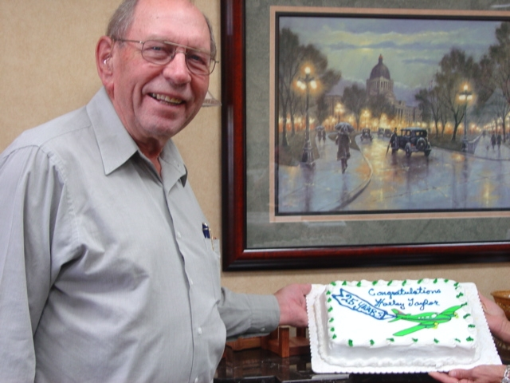
SDSU Av. Scholarships
Harley F. and Adele M. Taylor
Scholarship in Aviation Education
Pilot certificate in 1958.
Aberdeen Regional Airport
Board for 10 years.
SD Aeronautics Commission for
25 years (retired in July 2004).
FAA Wright Brothers Master
Pilot Award (September 2009).
Scholarship established in 2006.

Slide 7
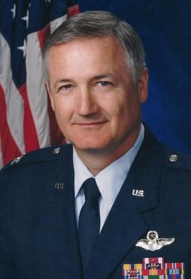
SDSU Av. Scholarships
Jeffery Boulware Memorial
Scholarship
Joined U.S. Air Force in 1975 and
served 26 years as a B-52 bomber
pilot (retired in 2001 as a colonel).
Professor of Aviation Education at
SDSU (retired 2014).
Jeff, age 63, passed away on
May 22, 2015.
Scholarship established in 2016.

Slide 8

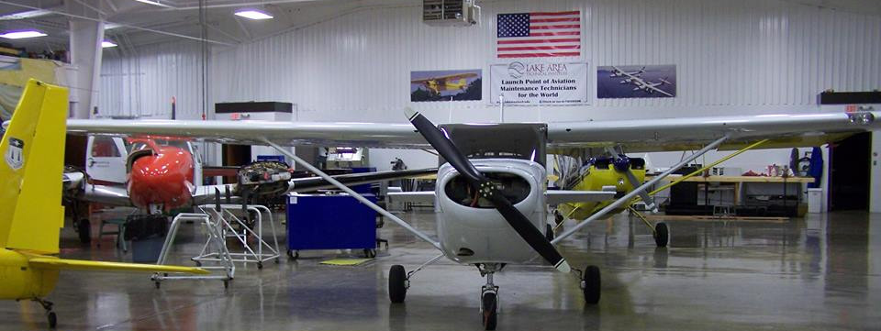
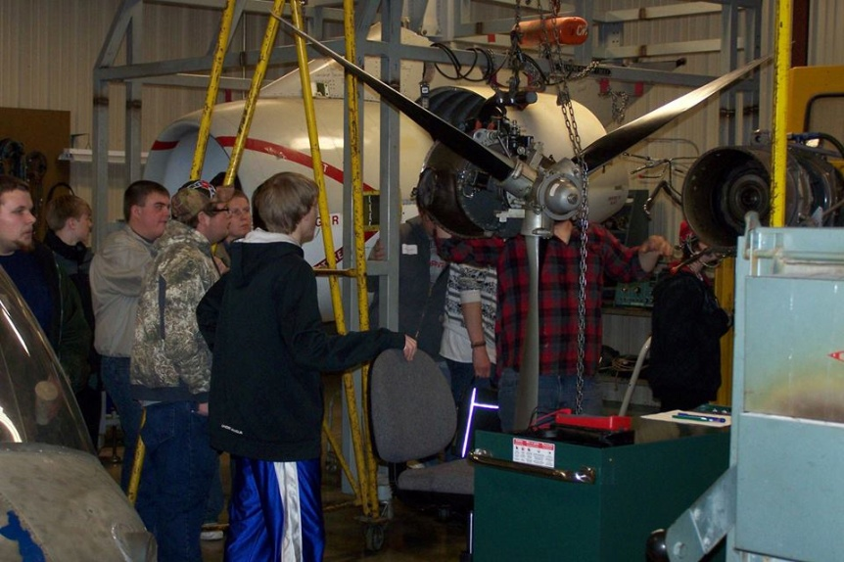
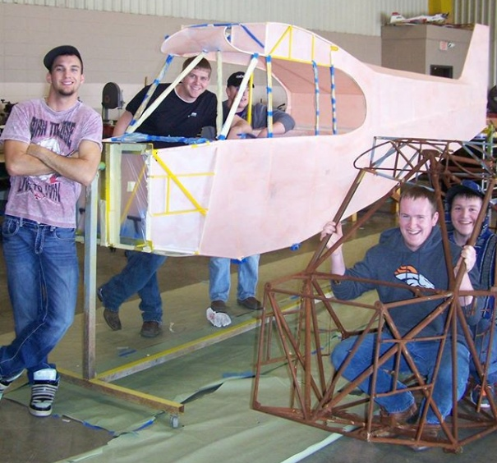
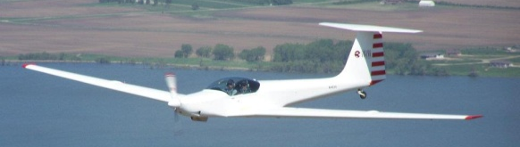
LATC Aviation Maintenance Technology Program

Slide 9
LATC – AMT Program
Estimated Costs for 2021-2022
First Year Second Year
Fall Spring Summer Fall Spring
Credits 20 23 1.5 6.5 13
Tuition $2480 $2852 $186 $2046 $1612
State Fees $860 $989 $65 $710 $559
~Departmental Fee $1030 $1030 $53 $1030 $1030
Campus Support Fee $300 $345 $15 $248 $195
Uniform Cleaning Fee $29 $29 $0 $29 $29
Total $4699 $5245 $318 $4062 $3425
*Tools $4000 – $6000
Books $760 $350
^Laptop $915
FAA Test Fee $200 $100
Grand Total $26,074

Slide 10

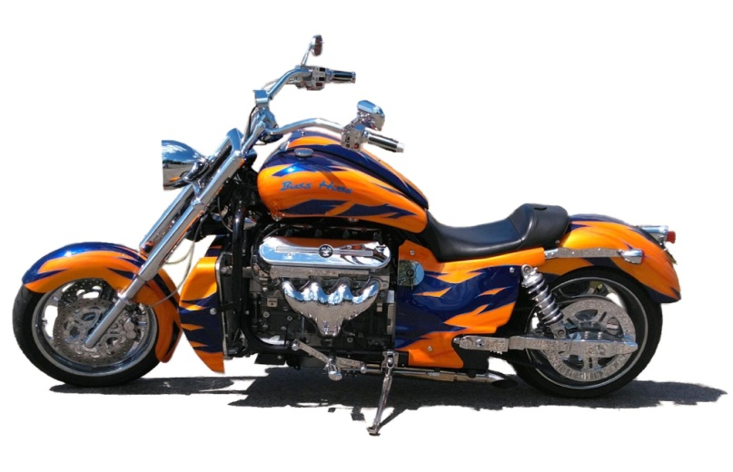
AMT Scholarships
Boss Hoss, Inc Scholarship
Monte Warne graduated from AMT program in 1975.
Boss Hoss motorcycle ($40,000) raffled off to fund
scholarship.
Scholarship established in 2008.

Slide 11
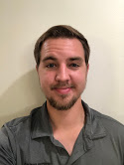

AMT Scholarships
SDPA Aviation Maintenance Technology Scholarship
Scholarship established 2009.
$ 500: 2009-2010.
$ 750: 2011-2013.
$1,000: 2014-2015.
$1,500: 2016.
$2,000: 2017-2021.
$2,500: 2022.
12 scholarships (total $17,800).
2021: Ian Radach (Watertown)

Slide 12
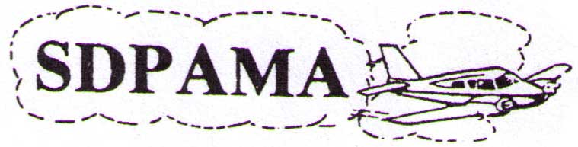
AMT Scholarships
SD PAMA (Professional Aviation Maintenance Association) Scholarship
Organization no longer active.
Scholarship established in 2012.
Gave their treasury to LATC Foundation to continue
scholarship in 2015.

Slide 13

AMT Scholarships
Christopher J. Gustad Memorial Scholarship
Graduated from the AMT Program in 2002.
7 years at Business Aviation / Landmark in
Sioux Falls.
May 2011 diagnosed with kidney cancer.
Sanford aircraft mechanic in March 2012.
Chris, age 30, passed away on August 1,
2012.
Scholarship established in 2013.

Slide 14
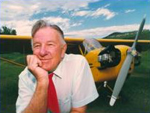
AMT Scholarships
Luverne Kraemer Aviation Maintenance Scholarship
First licensed experimental
airplane in SD in 1952.
SD Aviation Hall of Fame in 1994.
Charles Taylor Master Mechanic
Award in 1996.
Wright Brothers Master Pilot
Award in 2007.
Congressional Gold Medal for his service
in Civil Air Patrol during WWII in 2014.
Scholarship established in 2013.

Slide 15
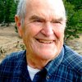
AMT Scholarships
R.P. “Pete” Kliegle Aviation Scholarship
Bomber pilot in the U.S. Air Force.
Recruited by Eastern Air Lines
(retired 1992).
Founder of Priority Air FBO.
Passion for vintage airplanes.
Died of cancer on December 23, 2016.
Scholarship established in 2019
by Watertown Area Community
Foundation.

Slide 16
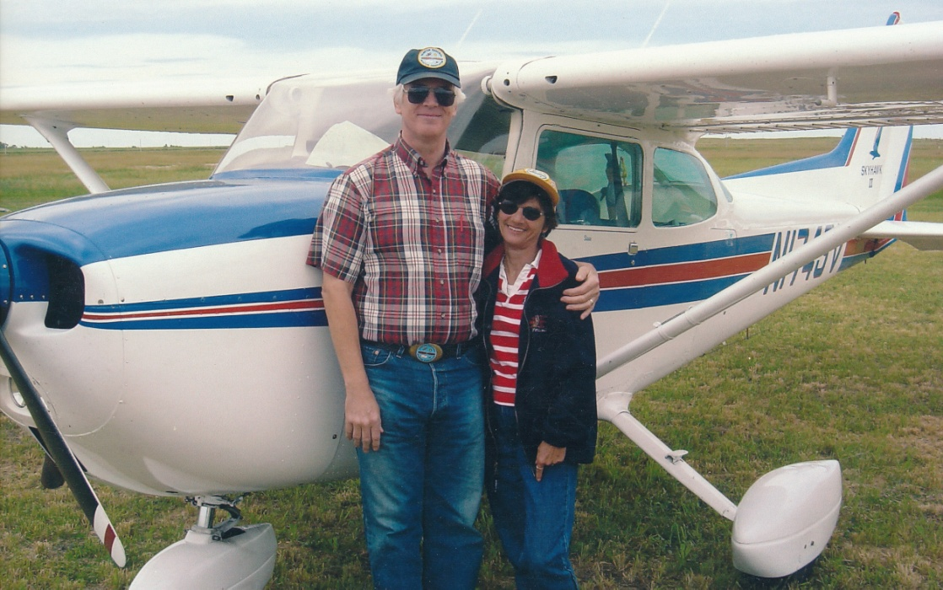
AMT Scholarships
Steven J. & Pamela J. Hamilton Scholarship
Mechanic in the USAF.
Pilot certificate in 1991.
Mr. Skyhawk (N1743V)
“Thank you” in honor of
mechanics who
maintained 4-3-Victor.
Scholarship established
in 2020.

Slide 17
Pilot Training
Professional Fixed Wing Pilot Program
Started in 2019.
Private pilot certificate commercial, instrument, CFI and CFII.
1988 Beech C23 Sundowner
1967 Cessna 172E (T-41)
1955 Cessna 172
1988 Schweizer SGM2-37 Motorglider
2003 Aeromot AMT-200S Motorglider
1967 Lake LA-4
1968 Piper PA-30 Twin Comanche
Piper J3C-65 Cub

Slide 18
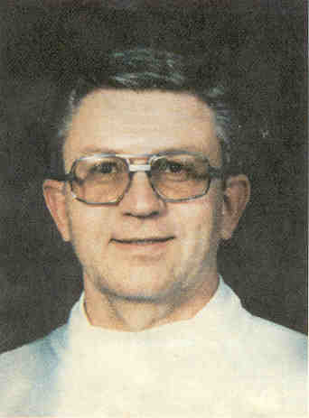
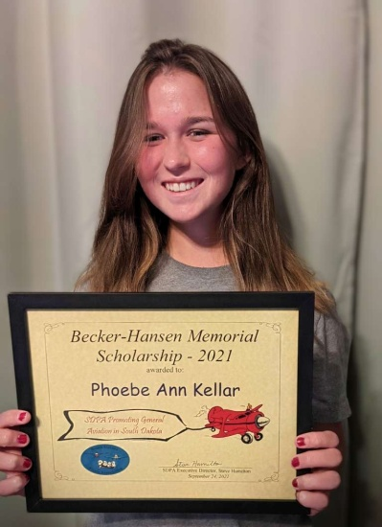
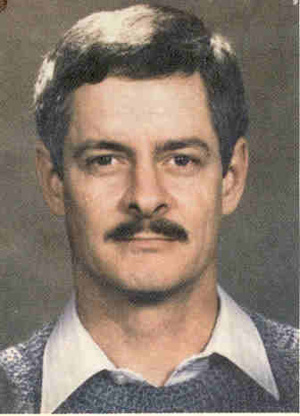
Pilot Training
Becker-Hansen Memorial Scholarship
Scholarship established in 1998 by SDPA.
In memory of state pilots Ron Becker and
Dave Hansen (died April 19, 1993).
$ 500: 1998-2004.
$ 800: 2005-2008.
$1,000: 2009-2010.
$1,250: 2011-2014.
$1,500: 2015-2016.
$2,000: 2017-2021.
$2,500: 2022.
24 scholarships ($19,536.34).
Ron Becker
2021:
Phoebe Kellar
(Rapid City)
Dave Hansen

Slide 19

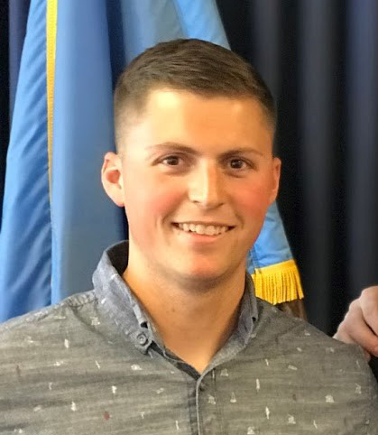
Pilot Training
YRAA Flight Training Scholarship
Scholarship established 2006 by the
Yankton Regional Aviation Association.
Awarded to candidate in Yankton
Regional Area (southeastern SD,
northeastern NE, west central IA).
$500: 2006-2010.
$750: 2011-2022.
13 Scholarships (total $5,650).
2020: Matt LaFave
(Mission Hill)

Slide 20
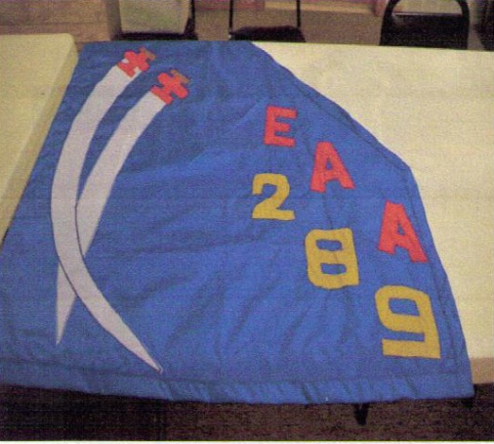
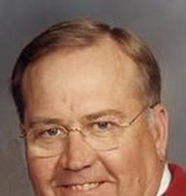
Pilot Training
Curl Memorial Fund Aviation
Scholarship
In memory of David Curl of
Sioux Falls (died July 13, 2010).
Pilot certificate January 11, 2000.
Limited to EAA Chapter 289 members.
Awarded to actively participating
members of Chapter 289 for at
least one year.
Scholarship established 2010.

Slide 21
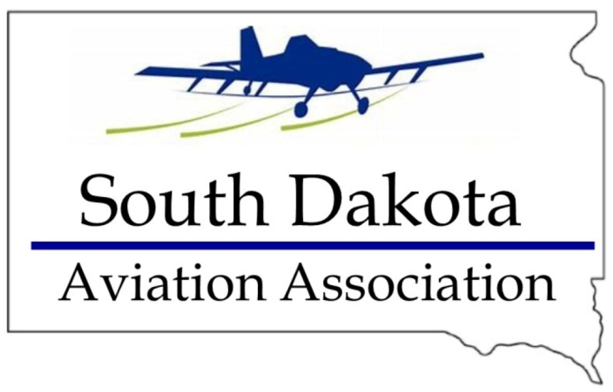
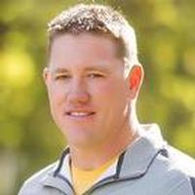
Pilot Training
SD Aviation Association &
DJ Fischer Foundation
Scholarship
Joint scholarship: SDAA ($3,000) &
DJ Fischer Foundation ($1,000).
In memory of DJ Fischer of
Gettysburg (died April 27, 2014).
Training program for a future career
that is related to or will benefit
the Aerial Application Industry.
Scholarship established 2014.

Slide 22

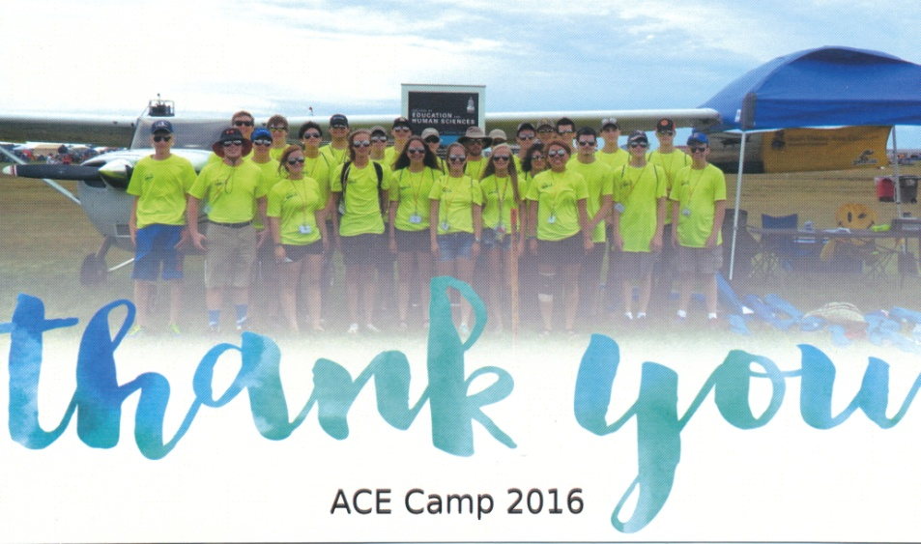
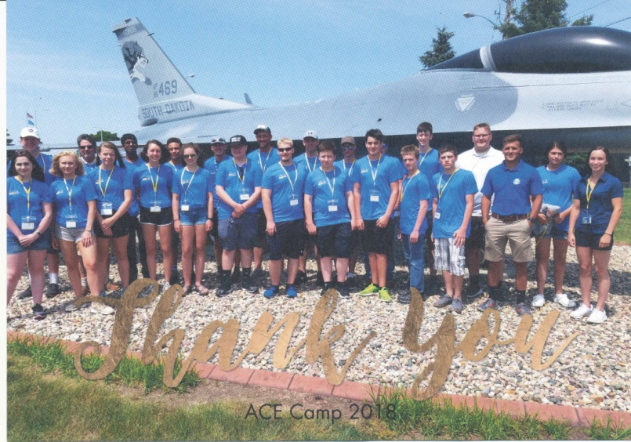
Promoting Aviation
SDSU ACE Camp
YRAA scholarship established 1992.
53 students ($9,585). $600/year.
SDPA scholarship established 1995.
59 students ($9,190). $1500/year.
2016
2018

Slide 23

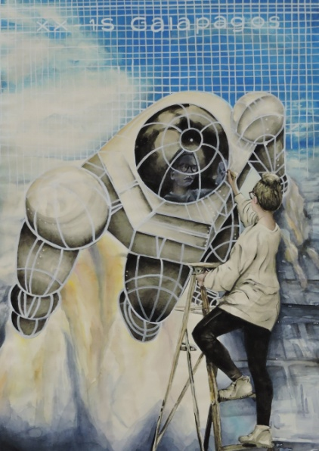
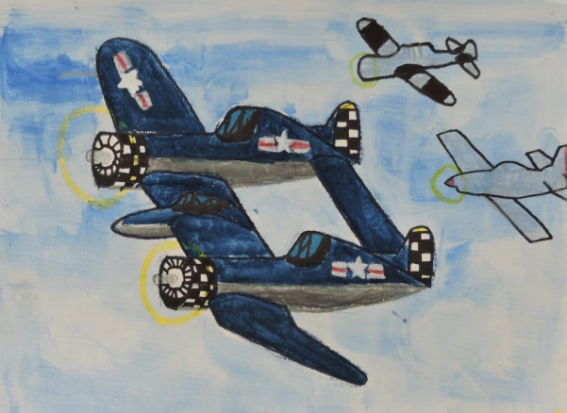
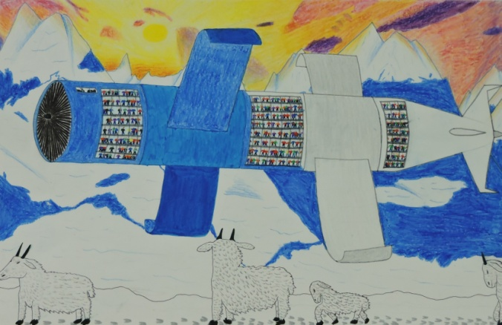
Promoting Aviation
SD Aviation Art Contest
Sponsored by the SD Office of Air, Rail & Transit.
Co-sponsored by the SDPA since 2005.
SDPA contributed $2,300. $300/year.
2022: “Design Your Perfect Aircraft”
1st Place 6-9 year old Josiah Grossman (Eureka)
1st Place 10-13 year old
Jesse Schoon (White River)
1st Place 14-17 year old Ella Ratliff (Sioux Falls)

Slide 24
Scholarships
for Pilots and Mechanics
ACE Camp
Aviation Art Contest
https://sdpilots.com

Slide 25
Help the next generation of Pilots and Mechanics
get their training and promote General Aviation !!
Pay It Forward
Give Generously

