Slide 1
Avera Careflight at the SD Airport Conference
Presented by Brandon Bell, Director of Operations

Slide 2
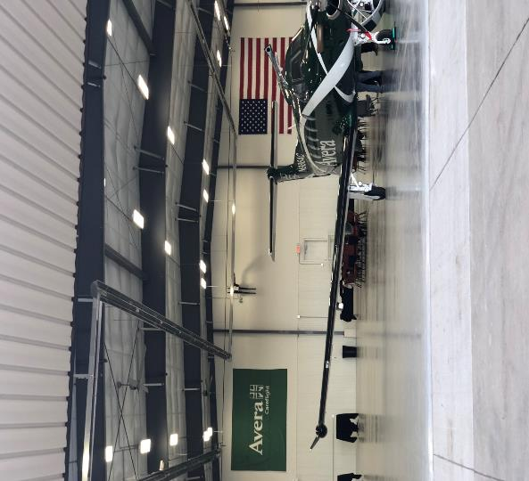
Who are we?
Hospital owned part 135 air carrier
Six aircraft and four bases in South Dakota
Provide timely and efficient medical evacuation to the five state region and beyond
“Firehouse” mentality to preserve health
12 minute liftoff RW
15 minute liftoff FW
Majority of transports are facility to facility to achieve a higher level of care

Slide 3
Avera Careflight in South Dakota

Slide 4
Mission Mindset
Historically common in air ambulance
Clouded judgement due to the nature of the call
Increase stress
Reduce situational awareness
Reduce risk comprehension
Deter communication abilities

Slide 5
Working Together with YOU
Defeat the MISSION MINDSET for successful transports
Not the military
Dispatch information
Utilize great AMRM both internally with program and externally
Accuracy and reliability of information
NOTAMs, runway conditions, weather reporting
SAFE and LEGAL
Notes:
It takes all of us to defeat the mission mindset and have successful outcomes on every single flight.
We are not the military risking our lives to save our freedoms. We are medevac serving our communities by transporting patients. We don’t fly “missions” we fly transports. We will not risk 3 to save 1.
Accrediting bodies require us to withhold patient information until the flight is accepted. Reduce the induced stress and clouding of judgement knowing patient info.
Must communicate effectively inside our own team and use the experience and resources that the team can provide. Externally resources include all of you, the airport managers/employees that we rely on for critical information.
Accuracy and reliability of information is vital to our decision making process. We ask that NOTAMs are updated in a timely fashion and accurate. If we call for runway conditions, please be as accurate as possible and discuss a plan. Legally, FAA weather reporting is the most beneficial to our programs.
SAFE is not always legal, and legal is not always safe. We need both.

Slide 6
Case Studies
Midnight blizzard
Accurate reliable airport conditions
Exceptional communication
“You didn’t have to go”
Aircraft immobilized
Fantastic assistance
Multiple airports involved
Successful outcome
Notes:
A few years back got the 0 dark thirty call during a South Dakota blizzard. During the weather check process a call was made to the airport manager to check on runway conditions. Great communication and a plan was made that the blade was going to stick around until we arrived and left. Runways/taxiways were kept clean and communication with blade was constant upon arrival and departure. A few days later a work acquaintance asked about the flight. He stated that was his nephew involved in the MVA that we flew out and he knew the weather was bad. He was very thankful as his nephew was recovering quite nicely. He stated “you didn’t have to go”, my response was “your right I didn’t have to go but I was ABLE to go” thanks to the airport crew and great CRM.
We had an aircraft become immobile on the runway due to a nose tire. Airport employee went above and beyond in helping this crew get to a warm hangar. Several hours of assistance on the airport, we flew crews to a neighboring airport, sheriff gave our staff rides, mechanics transported to on site aircraft, patient was transported to the neighboring airport and successful completion of the flight. Timely NOTAMs on closing runway, neighboring airport was responsive to make sure conditions were safe and legal. A great example of multiple airports, crews, aircraft, all coming together to have a successful outcome.

Slide 7
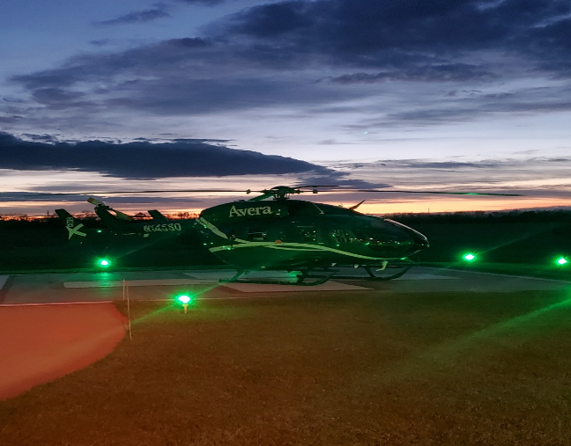
THANK YOU for all your support of rural healthcare and helping us serve South Dakota communities!!

