Slide 1
PUBLIC MEETING
Project Location: U.S. Highway 16 in Rapid City
Project Number: NH 0016(94)65 PCN 078D
Date: Thursday, April 4, 2024, 5:30 p.m.
Stacia Slowey, PE
Design Project Manager
Notes:
Good evening and welcome to the Public Meeting to discuss planned improvements to US Highway 16.
My name is Stacia Slowey. I’m with HDR Engineering, based out of our Rapid City office.
SDDOT representatives here with me this evening are:
Mike Carlson, Rapid City Area Engineer
Tom Horan, Region Operations Engineer
Steve Palmer, Engineering Supervisor
Sam Gilkerson, Consultant Management Engineer
Jacob Rosecky, Consultant Management Supervisor
….
Hopefully everyone had a chance to sign in and picked up a handout. Included in the handout is the power point of which you may follow along.

Slide 2
MISSION
To efficiently provide a safe and effective public transportation system.
https://dot.sd.gov/

Slide 3
PURPOSE OF THE MEETING
Involve the public in the planning and design process.
Provide a project overview.
Gather input and comments.
Background information
Proposed project
Project schedule
Notes:
We are here tonight to involve the public in the design process. We would also like to share with you the project scope, what the current design layout is, and the schedule. After the presentation we want to gather public input in the form of exchange of ideas and/or discuss any concerns you may have.

Slide 4
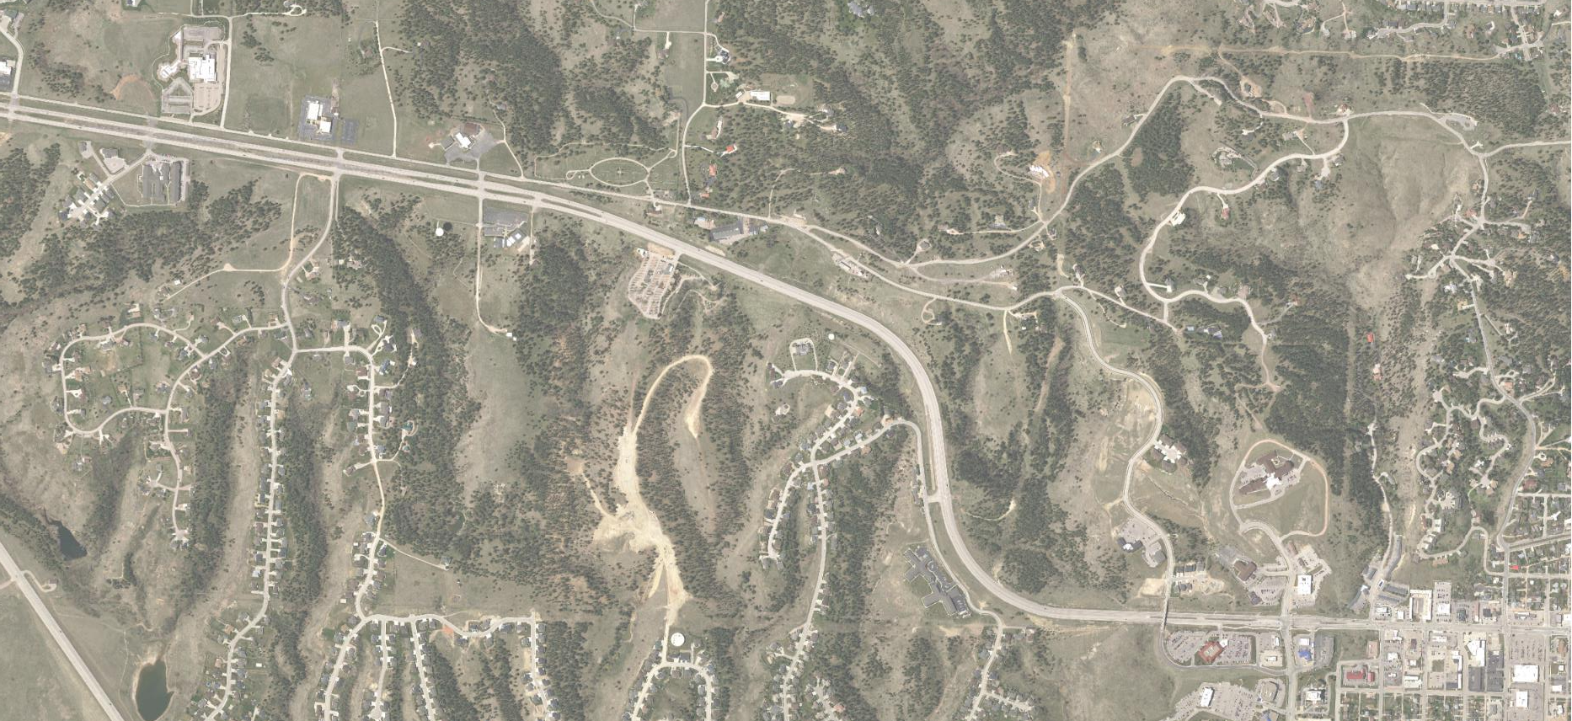
PROJECT LIMITS
F
Fox Rd.
Highwood Rd.
Skyline Ranch Rd.
Skyline Dr.
Begin project
U.S. Highway 16
Tower Rd.
End project
Enchantment Rd.
Fox Run Dr.
Cathedral Dr.
City of Rapid City
Notes:
The proposed reconstruction along US16 is approximately 2 miles in length. Grading will begin at the Fox Road/Tablerock Road intersection and continue north through the Tower Road overpass bridge.

Slide 5
NEARBY PROJECTS
PCN 09NU
Promise Road Relocation & Highway 16 Service Road
2024-2025
F
Catron Blvd.
PCN 078D
Highway 16 Reconstruction
2028-2029
Moon Meadows Dr.
Promise Rd.
Highwood Rd.
Tower Rd.
U.S. Highway 16
U.S. Highway 16
PCN 6874
Catron Boulevard Interchange
2026-2027
Tower Rd.
Enchantment Rd.
U.S. Highway 16B
Cathedral Dr.

Slide 6
BACKGROUND INFORMATION
Grading and structures in 1964.
Last surface improvements in 2010.
Notes:
This segment of US16 was first constructed in 1964. The last surface improvements on US16 occurred in 2010.

Slide 7
TRAFFIC
2019 Average Daily Traffic (ADT): 14,500
2044 Projected ADT: 22,800
4.3% Average Truck Traffic
Notes:
The Average Daily Traffic is 14,500 vehicles per day for US Highway 16. The 20-year projected ADT is 22,800. The average Truck Traffic is 4.3%.
Traffic Volumes and Vehicle Types are used to establish a base line for what type of facility is needed to safely handle traffic now and into the future. For example, the number of lanes, width of lanes, width of shoulders, and surfacing types and thicknesses are all determined by the projected traffic volume and truck percentages.
With the current and projected traffic volumes a 4-lane divided facility (with 8-foot shoulders) in combination with intersection improvements will safely handle the traffic at an acceptable level of service.

Slide 8
CRASH HISTORY
53 Reported crashes
(Five-year period from 2018-2022)
Twelve (12) run off road crashes
Ten (10) angle intersection crashes
Two (2) side-swipe crashes
One (1) rear end crashes
Fourteen (14) injury
Zero (0) fatalities
Urban principal arterial
Reported crash rate = 1.78
Statewide weighted crash rate = 1.99 (crashes per million vehicle miles of travel)
Notes:
Crash data is important to identify potential safety hazards.

Slide 9
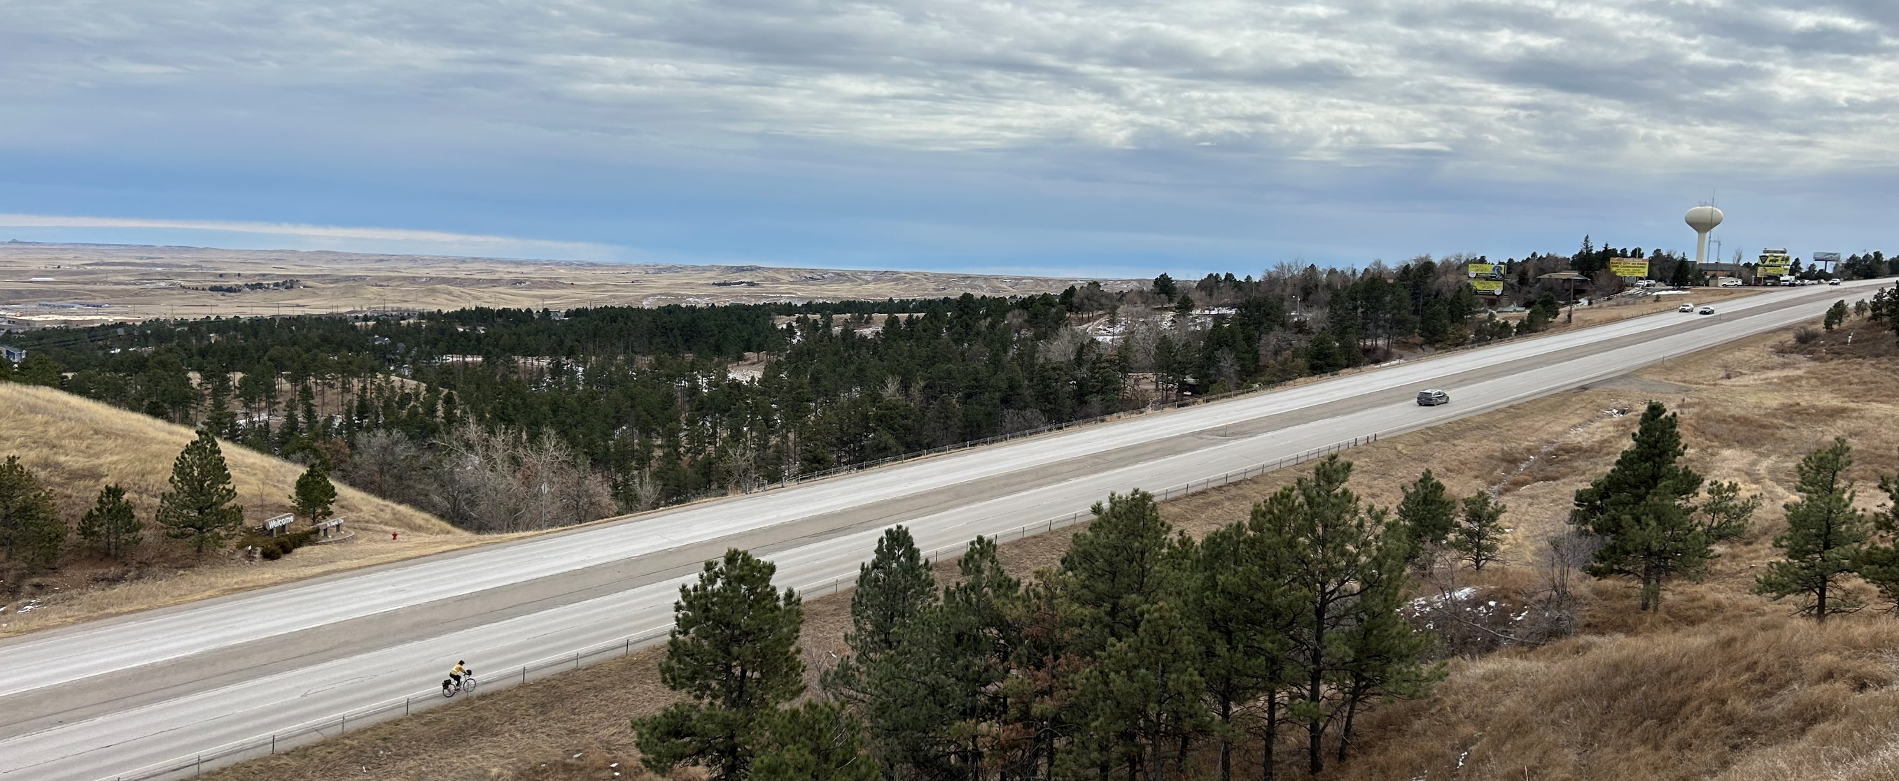
WHY WE ARE RECONSTRUCTING
Future traffic operations
Pavement condition
Lack of pedestrian facilities
Bridge near End of Service Life
Rapidly urbanizing land use
Improved safety

Slide 10
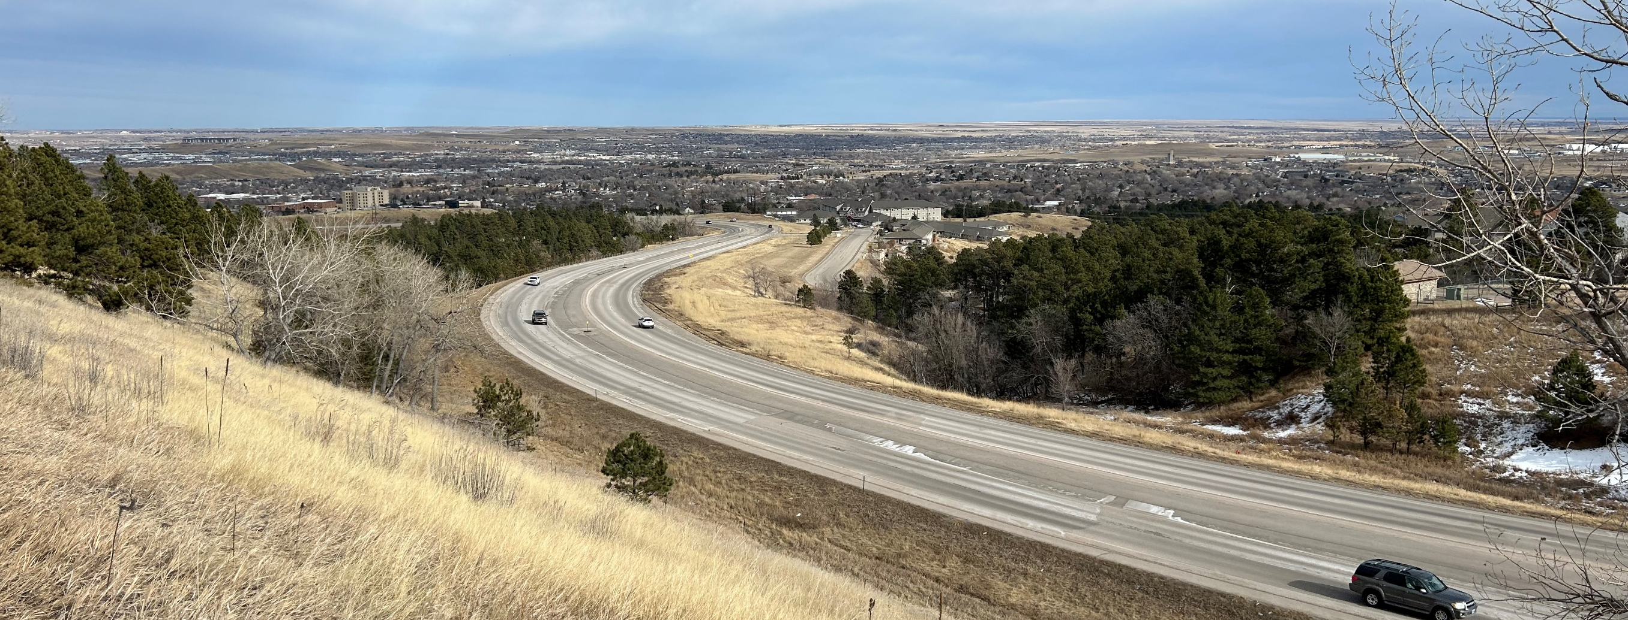
PROPOSED IMPROVEMENTS
Consolidating access
Storm sewer
Curb and gutter
Raised median
Add sidewalks and shared use path
Intersection & roadway lighting

Slide 11
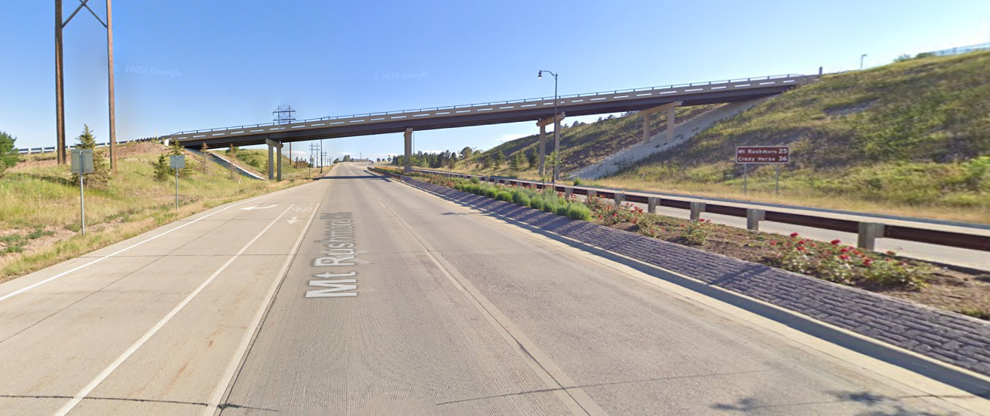
PROPOSED IMPROVEMENTS
Replace Tower Road Overpass
Notes:
Replace Tower Road structure over US16. It was built in 1964. It will be 64 years old at the time of replacement.

Slide 12
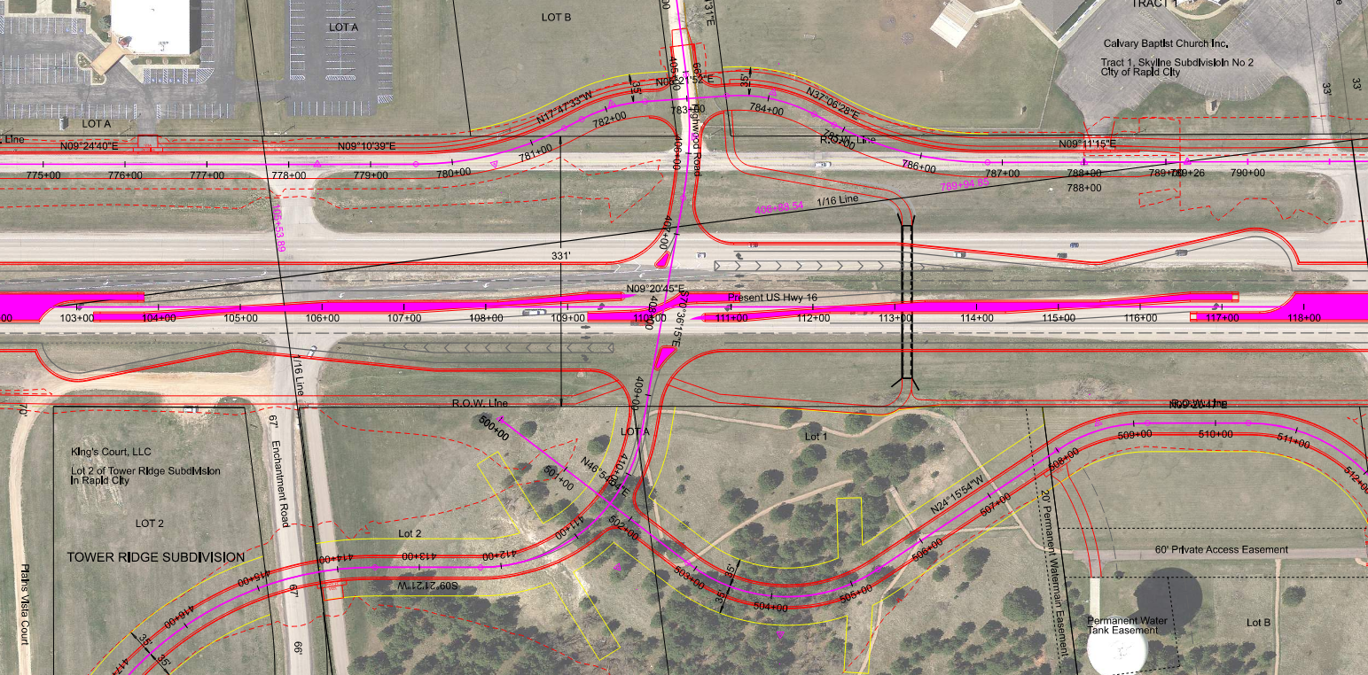
PROPOSED IMPROVEMENTS
Reduced conflict intersection at Enchantment Road/Highwood Road
Consolidating access & realigning Enchantment Road to Highwood Road

Slide 13
REDUCED CONFLICT INTERSECTION
From the U.S. Highway 16 Corridor Study:
82% predicted reduction in fatal & injury crashes
Best overall intersection traffic operations
Zero Highway 16 mainline delay due to unsignalized free movements
Convert to signalized RCI when warranted
Highest benefit-cost ratio (compared to other intersection alternatives)
Notes:
Replace Tower Road structure over US16. It was built in 1964. It will be 64 years old at the time of replacement.

Slide 14
REDUCED CONFLICT INTERSECTIONS
https://youtu.be/Op22DR2ah-8?si=TdOEGawn5nT9hDDR

Slide 15
REDUCED CONFLICT INTERSECTION KEY TAKE-AWAYS
Less conflict points = safer for drivers
Notes:
Replace Tower Road structure over US16. It was built in 1964. It will be 64 years old at the time of replacement.

Slide 16
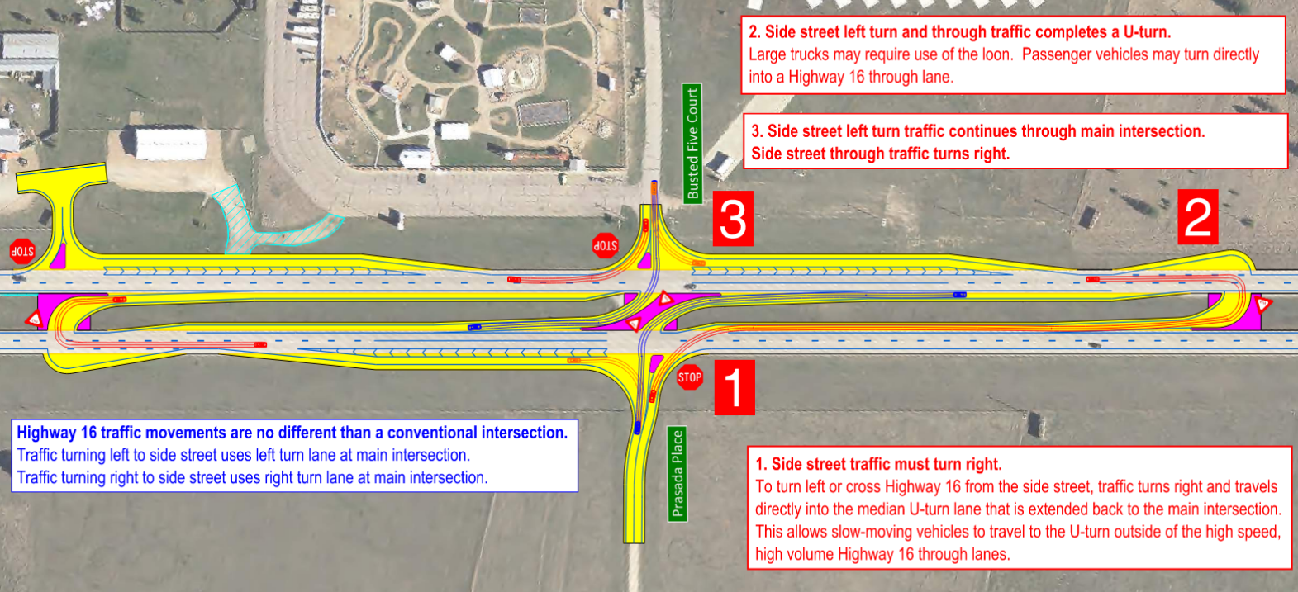
REDUCED CONFLICT INTERSECTIONS
Passenger cars

Slide 17
REDUCED CONFLICT INTERSECTIONS
Heavy trucks

Slide 18
PROPOSED TYPICAL SECTIONS

Slide 19
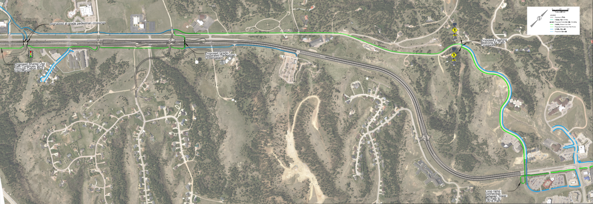
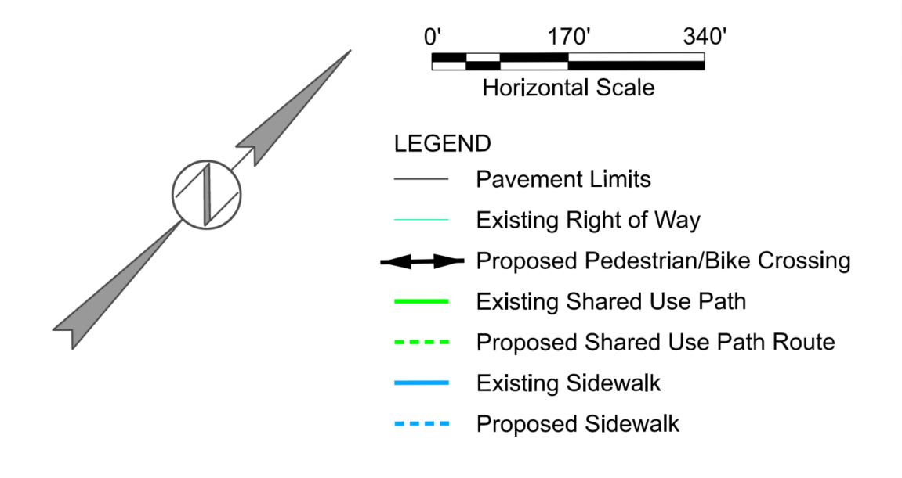
PROPOSED PEDESTRIAN FACILITIES
Signalized crossings
Highwood Rd.
F
Promise Rd.
Skyline Ranch Rd.
Skyline Dr.
Tower Rd.
Sandstone Ln.
U.S. Highway 16
Flashing beacon for pedestrian crossing
Tower Rd.
Continues south through Catron Boulevard Interchange
Enchantment Rd.
Section of path previously built on Tower Road
Pedestrian underpass
Fox Run Dr.
City of Rapid City
Cathedral Dr.
Loop ramp connection between Tower Road path and Highway 16 path

Slide 20
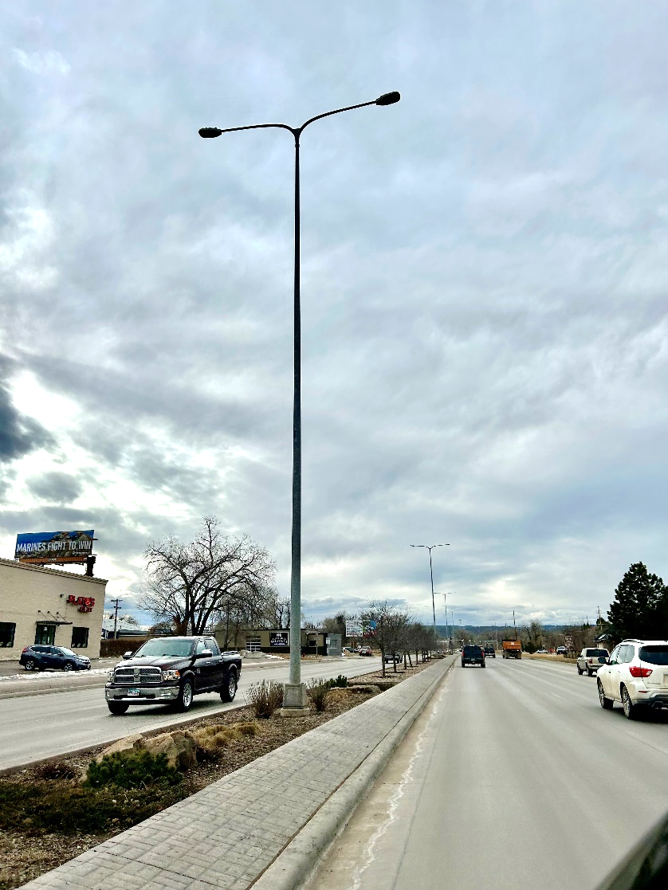
ROADWAY LIGHTING
Install intersection and median roadway lighting:
LED

Slide 21
ACCESS MANAGEMENT
Manage location and number of access points.
Provide safe, efficient access to streets and highways by relocating, combining, and eliminating access points.
See handout
Notes:
Any time SDDOT reconstructs a roadway, we evaluate Access Management. The purpose of access management is to ensure there is safe, efficient ways to access highways not only now but in the future as traffic volumes grow and developments get more dense. Studies have shown that by controlling the access of vehicles to highways, accident rates are decreased. Existing approaches will generally be left in place except where they can be combined with another approach or eliminated if they are not being used. An approach is a hazard itself. Crashes including some fatal crashes can involve vehicles launched by an approach, the elimination or minimizing approaches removes the hazard from the ROW.
The goal is to reduce the number of access points along the route, thereby making the route safer.
If there are proposed changes to accesses, this will be discussed during the landowner meetings. While always a difficult subject, design will work with the property owners as best we can to come up with solutions.
More information on access management is available in the handout.

Slide 22
RIGHT OF WAY (ROW)
Existing width varies 300-400 feet.
Purchase additional ROW as needed.
Temporary easements as needed.
See handout
Notes:
The existing ROW ranges from 300 to 400 ft (or 150’ to 200’ from the median centerline).
Temporary easements are necessary whenever the construction work limits are outside of the right of way. Temporary easement allows construction to occur on your property during construction of the highway. The red dashed line represents the limits of work and when this line is near or outside the ROW line temporary easements will need to be obtained by the State.
ROW and Temporary Easements will be discussed in more detail during Individual Landowner Meetings, and more information on the right of way process is available in the handout.

Slide 23
ENCROACHMENTS
Private property in public ROW
Examples
Notification
Federal highway regulations for safety
Signs
Private use (parking)
Landscaping
Owners of encroachments will be notified by the
Rapid City Area Office.
See handout

Slide 24
UTILITY COORDINATION
Some utilities may need
to be relocated.
BHE
Lumen
Midco
SDN
Bluepeak
Golden West
MDU
City of Rapid City
Utility companies negotiate easements
with landowners.
See handout

Slide 25
UTILITY COORDINATION
Any known private utilities?
Water lines
Drain fields
Septic tanks
Underground storage tanks
Underground power lines
Contact HDR Engineering.
See handout

Slide 26
ENVIRONMENTAL, SOCIAL, AND ECONOMIC CONCERNS
This project is being developed in accordance with applicable State and Federal environmental regulations.
National Environmental Policy Act of 1969 (NEPA), as amended
Section 106 of the National Historic Preservation Act
Section 404 of the Clean Water Act
Section 4(f) of the USDOT Transportation Act of 1966
See handout
Notes:
Section 106
As stated in slide, this is specific to the protection of historic properties. Which will include: districts, sites, structures, and objects of historic & archaeological significance. This will also include tribes that may attach religious or cultural importance to them. Invite the public to provide information on any culturally or archaeologically known site(s).
Contaminated Materials
Request public’s input to any known AST or UST tanks within vicinity of project.

Slide 27
ENVIRONMENTAL, SOCIAL, AND ECONOMIC CONCERNS
Section 7 of the Endangered Species Act
The U.S. Fish and Wildlife Service will review the project to determine if it will impact the following species that are known to occur in Pennington County:
Birds: Red Knot (threatened)
Mammals: Northern Long-Eared Bat (endangered), Tricolored Bat (proposed)
Insects: Monarch Butterfly (candidate)
See handout
Notes:
We are just starting the CE process and we are reviewing the resources and proposed design to determine the impacts within the CE process

Slide 28
CONSTRUCTION TRAFFIC CONTROL
Two-year plan
2028-2029
Construct one half at a time.
Maintain head-to-head traffic.
Open to traffic during phased construction

Slide 29
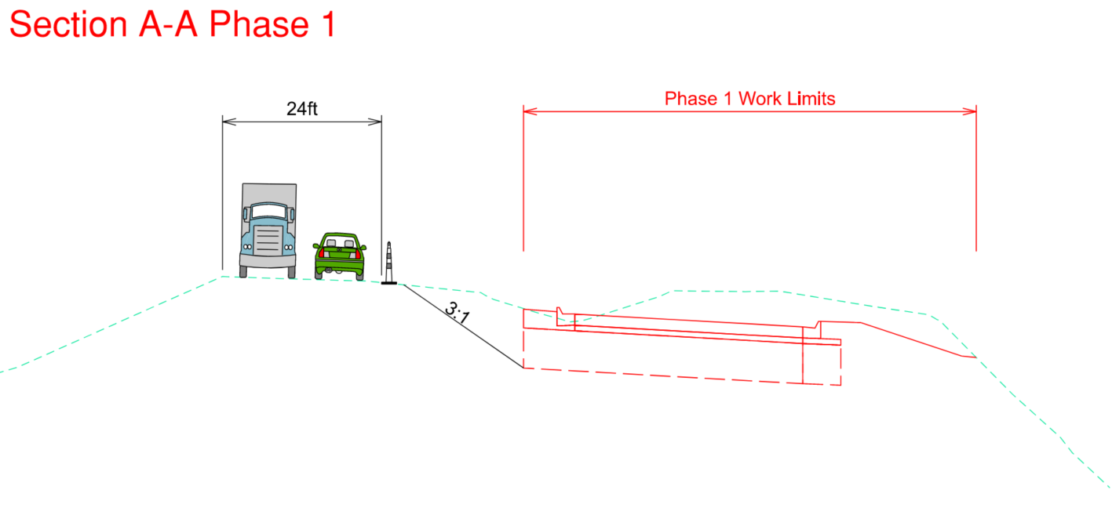
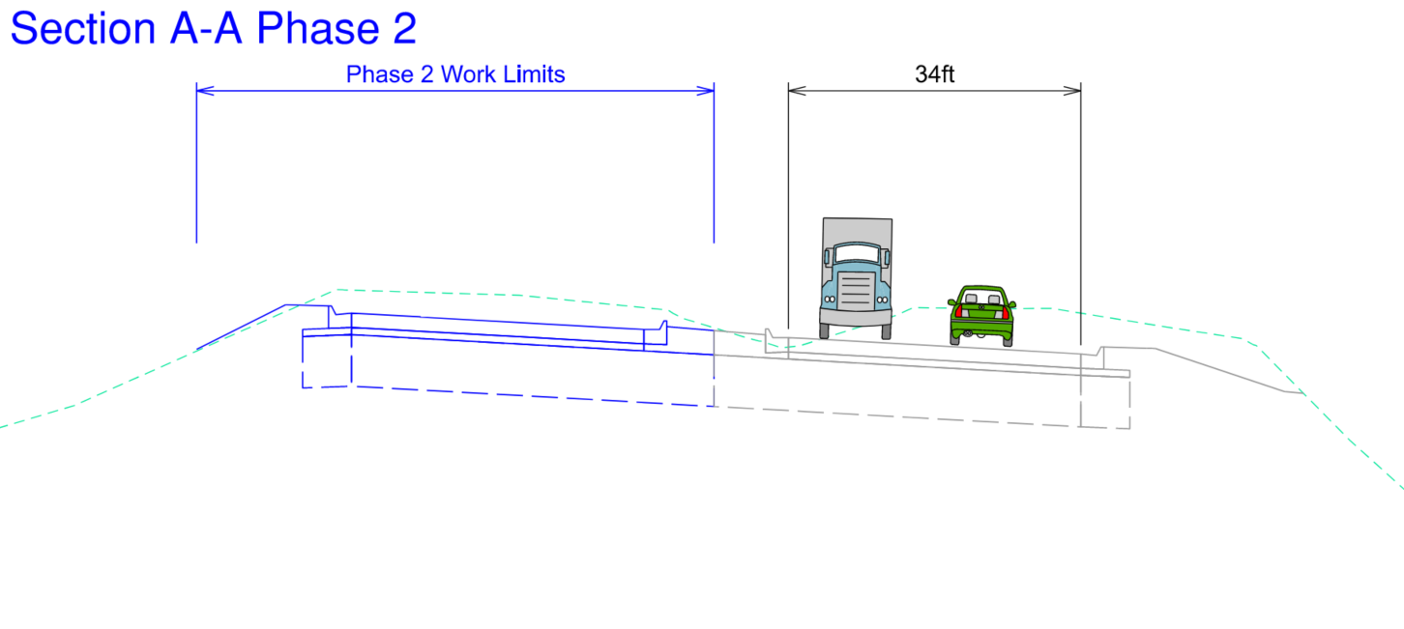
CONSTRUCTION TRAFFIC CONTROL
Construct northbound lanes first. Maintain head-to-head traffic on southbound lanes.
Construct southbound lanes second. Maintain head-to-head traffic on newly constructed northbound lanes.

Slide 30
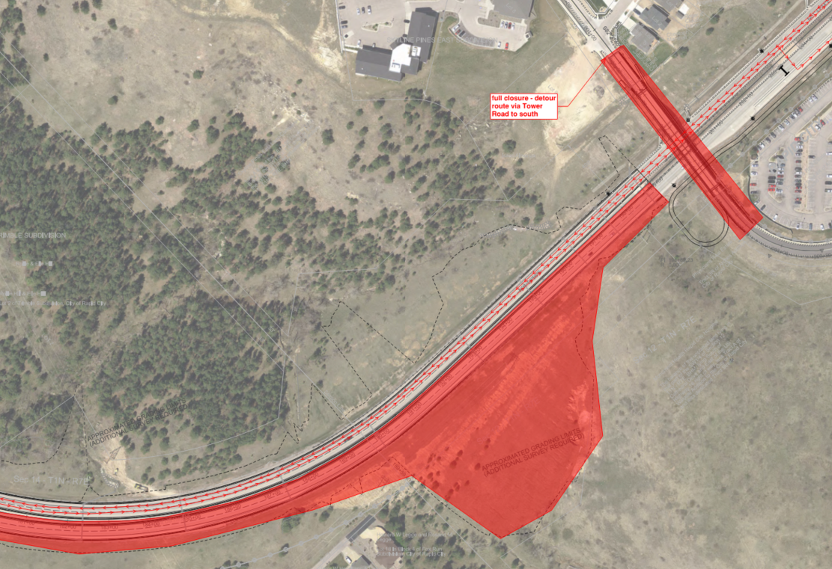
CONSTRUCTION TRAFFIC CONTROL
Full closure of Tower Road Overpass
Traffic detoured via Tower Road to the south and onto Highway 16
Tower Rd.
U.S. Highway 16

Slide 31
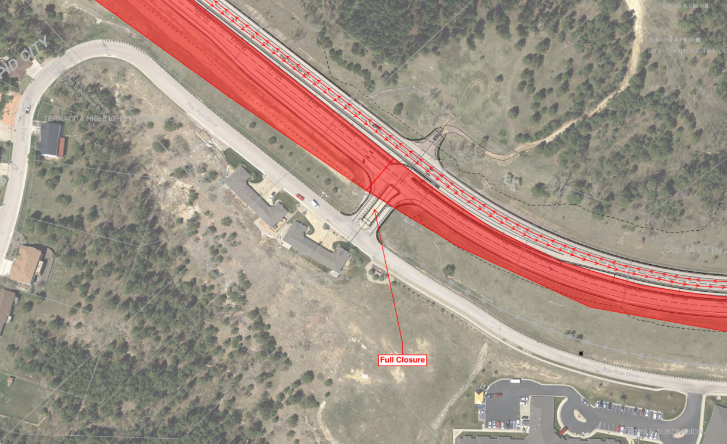
CONSTRUCTION TRAFFIC CONTROL
Full closure of Echo Ridge Road while southbound lanes are reconstructed.
Traffic detoured to 5th Street.
City View Dr.
U.S. Highway 16
Echo Ridge Dr.
Fox Run Dr.

Slide 32
LANDOWNER MEETINGS
Summer 2024
Landowners adjacent to the project will be contacted individually by SDDOT to schedule a meeting.
Discussion Items
Driveway locations/widths
Sidewalk and curb ramps
Fences
Drainage
Trees
Temporary easements or ROW acquisition
See handout

Slide 33
TENTATIVE PROJECT SCHEDULE
Dependent on federal funding
Estimated cost: $44.7 million
Landowner
meetings
ROW
acquisition
Summer 2024 | December 2024 | 2025-2026 | 2028/2029
Final
design
Construction
Notes:
The tentative project schedule is shown here.
Dates where there will be additional involvement between SDDOT and adjacent property owners are:
Landowner Meetings to be held in the Summer of this year
ROW Acquisition Process will begin in 2025.
The construction is scheduled for the 2028/29 construction season.

Slide 34
QUESTIONS OR COMMENTS
DEADLINE:
Thursday, April 18, 2024
SUBMIT TO:
Stacia Slowey
HDR Engineering
703 Main St. Ste. 200
Rapid City, SD 57701
stacia.slowey@hdrinc.com
WEBSITE:
https://dot.sd.gov/projects-studies/projects/public-meetings#listItemLink_1975
THANK YOU
SCAN ME
Notes:
At this time, I will take any general comments or question you may have on this project. If you have any specific questions or comments regarding how the projects may impact your property, we will take the remaining time to visit with you one on one at either one of the aerial layouts.
You are also asked to submit your questions or comments in writing on the form provided in the handout or via email address to Stacia Slowey by April 18th (2 weeks).
The power point presentation, handout and design layouts have been added to the web site address noted. Go to the section under Rapid City Region and click on the link to the project.

