Slide 1

PUBLIC MEETING
Project Location: S.D. Highway 63 from the West Junction of U.S. Highway 20 South 13.1 miles - Dewey County
Project Number: P 0063(55)190 DEWY06CX; P 0020(243)152) DEWY09J9
Date: Thursday, Jan. 11, 2023, 5:30 p.m. MST
Mark Malone, PE
SDDOT Road Design Consultant Manager
Notes:
Good evening and welcome to the Public Meeting to discuss planned improvements to S.D. Highway 63.
My name is Mark Malone with the SDDOT Road Design Office in Pierre.
Other SDDOT representatives here with me this evening are:
Hopefully everyone had a chance to sign in and picked up a handout. Included in the handout is the power point of which you may follow along.

Slide 2

MISSION
We provide a safe and efficient public transportation system.
https://dot.sd.gov/
Notes:
The SDDOT’s mission is to provide a safe and efficient public transportation system

Slide 3
PURPOSE OF THE MEETING
Involve the public in the planning and design process
Provide a project overview
Gather input and comments
Background information
Proposed project
Project schedule
Notes:
We are here tonight to involve the public in the design process. We would also like to share with you the project scope, what the current design layout is, and the schedule. After the presentation we want to gather public input in the form of exchange of ideas and/or discuss any concerns you may have.

Slide 4
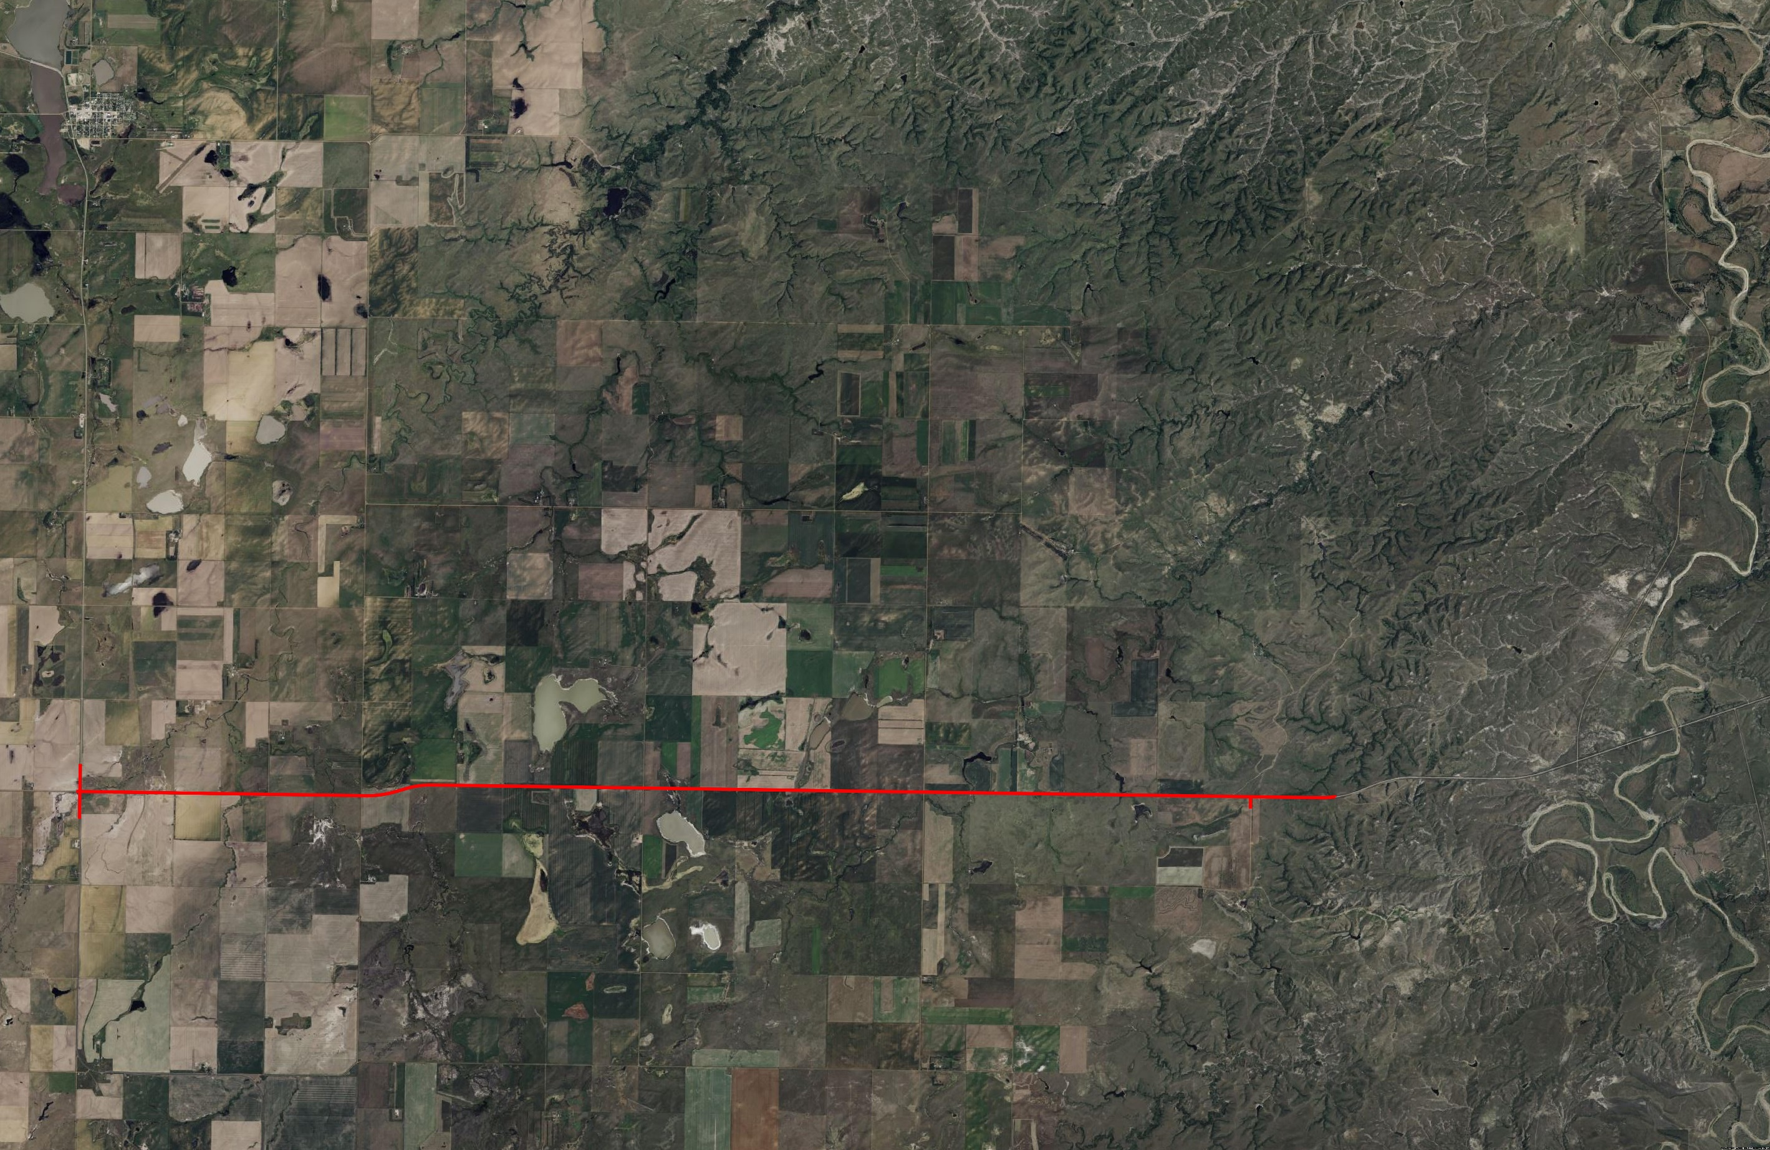
PROJECT LIMITS
Firesteel
End Project
Begin Project
County Road 3F
County Road 3E
County Road 5H
County Road 5G
County Road 3I
County Road 5
Livermant Lake
Moreau River
S.D. 63
S.D. Highway 20
North
Horseshoe Lake
On the Tree Road
Notes:
The proposed project is 13 miles in length. Grading begins at the intersection of SD63 with US20 and goes south 13.1 miles.

Slide 5
BACKGROUND INFORMATION
Grading and structures in 1948
Most Recent Surfacing Project- 2010
Notes:
There was grading and structure work done in 1948, and the most recent surfacing was done in 2010

Slide 6
TRAFFIC
2021 Average daily traffic (ADT): 502
2041 Projected ADT: 790
Notes:
The average daily traffic in 2021 was 502 vehicles, and it is projected to go up to 790 vehicles in 2041.

Slide 7
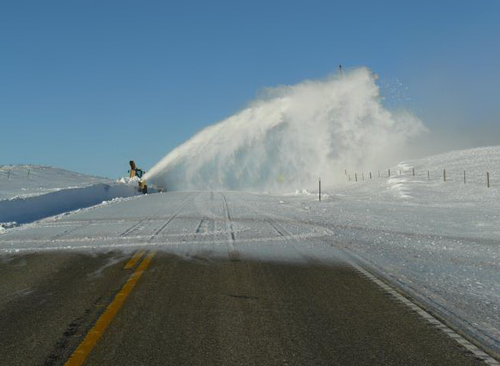
CRASH HISTORY
Reported crashes
(Five-year period from 2017-2021)
Two (2) Injury
Twelve (12) Property Damage
One (1) Fatality
Accident Rate
Weighted Accident Rate: 2.23
Statewide Average: 1.73
Notes:
Here are the crashes reported from 2017 to 2021.
It is believed that the crash numbers do not account for all the crashes and that numerous crashes go unreported. Part of the purpose and need of the project is to enhance safety.
Sites with an excess crash frequency greater than zero experience more crashes than expected, while sites with a value less than zero experience fewer crashes than expected.
These accident rates mean that this area experience more accidents than the state does on average.

Slide 8
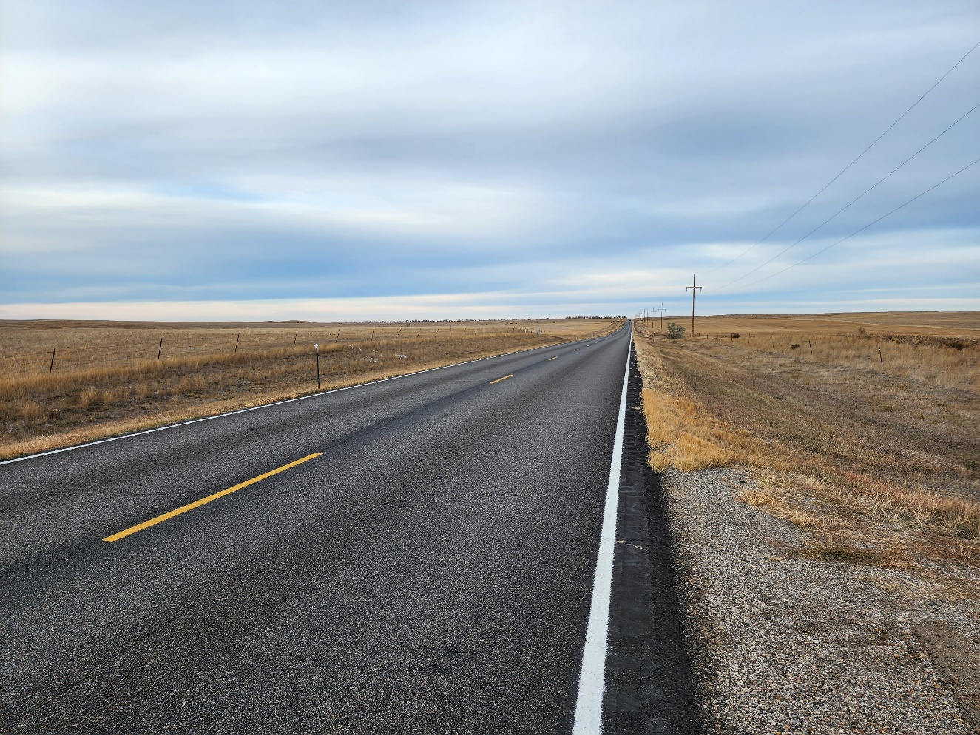
HIGHWAY CONCERNS
Surfacing and Structures
Sub-Standard Vertical Curves
Sight Distance Problems
Narrow Shoulders
Snow Drifting Issues
Notes:
35 vertical curves at a 60-mph design speed or under. 4 of them (sags) only meet 50 mph design speed
Narrow shoulders (about 1’)
Surfacing and drainage Structures will be updated.
There are a couple of intersections with sight distance issues due to vertical curves.
Snow drifting is also a concern on the project.

Slide 9
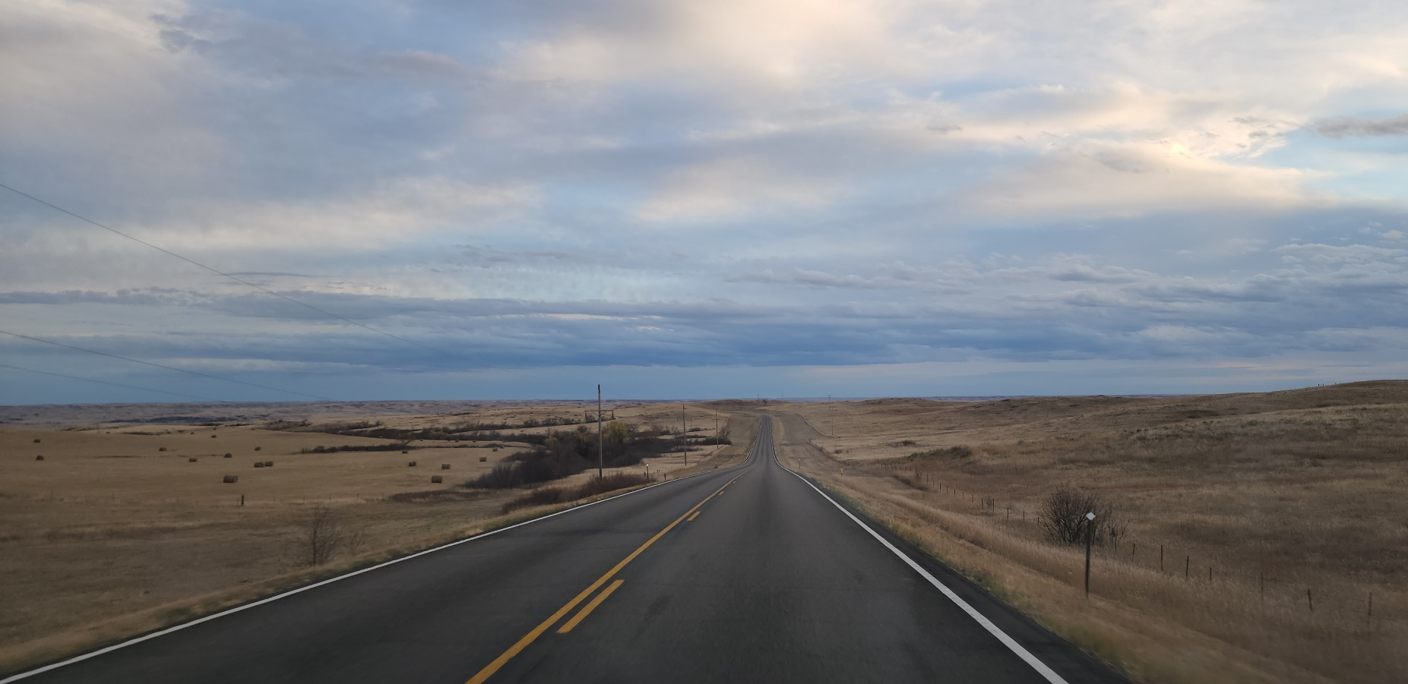
PROPOSED IMPROVEMENTS
Addition of Turn Lanes on
S.D. Highway 20
Improve drainage
Reduce vertical curves to improve sight distance
Replace fence and culverts
Improve side slopes for snow drifting
Widen roadway: six-foot shoulders
Notes:
Turn lanes will be added on the intersection of SD 20 and SD 63
Vertical curves will be reduced to improve sight distance
Shoulders will be widened to 6 feet.
Fences and culverts will be replaced, and drainage will be improved.
Ditch will be widened and slopes reduced to prevent snow drifting.

Slide 10
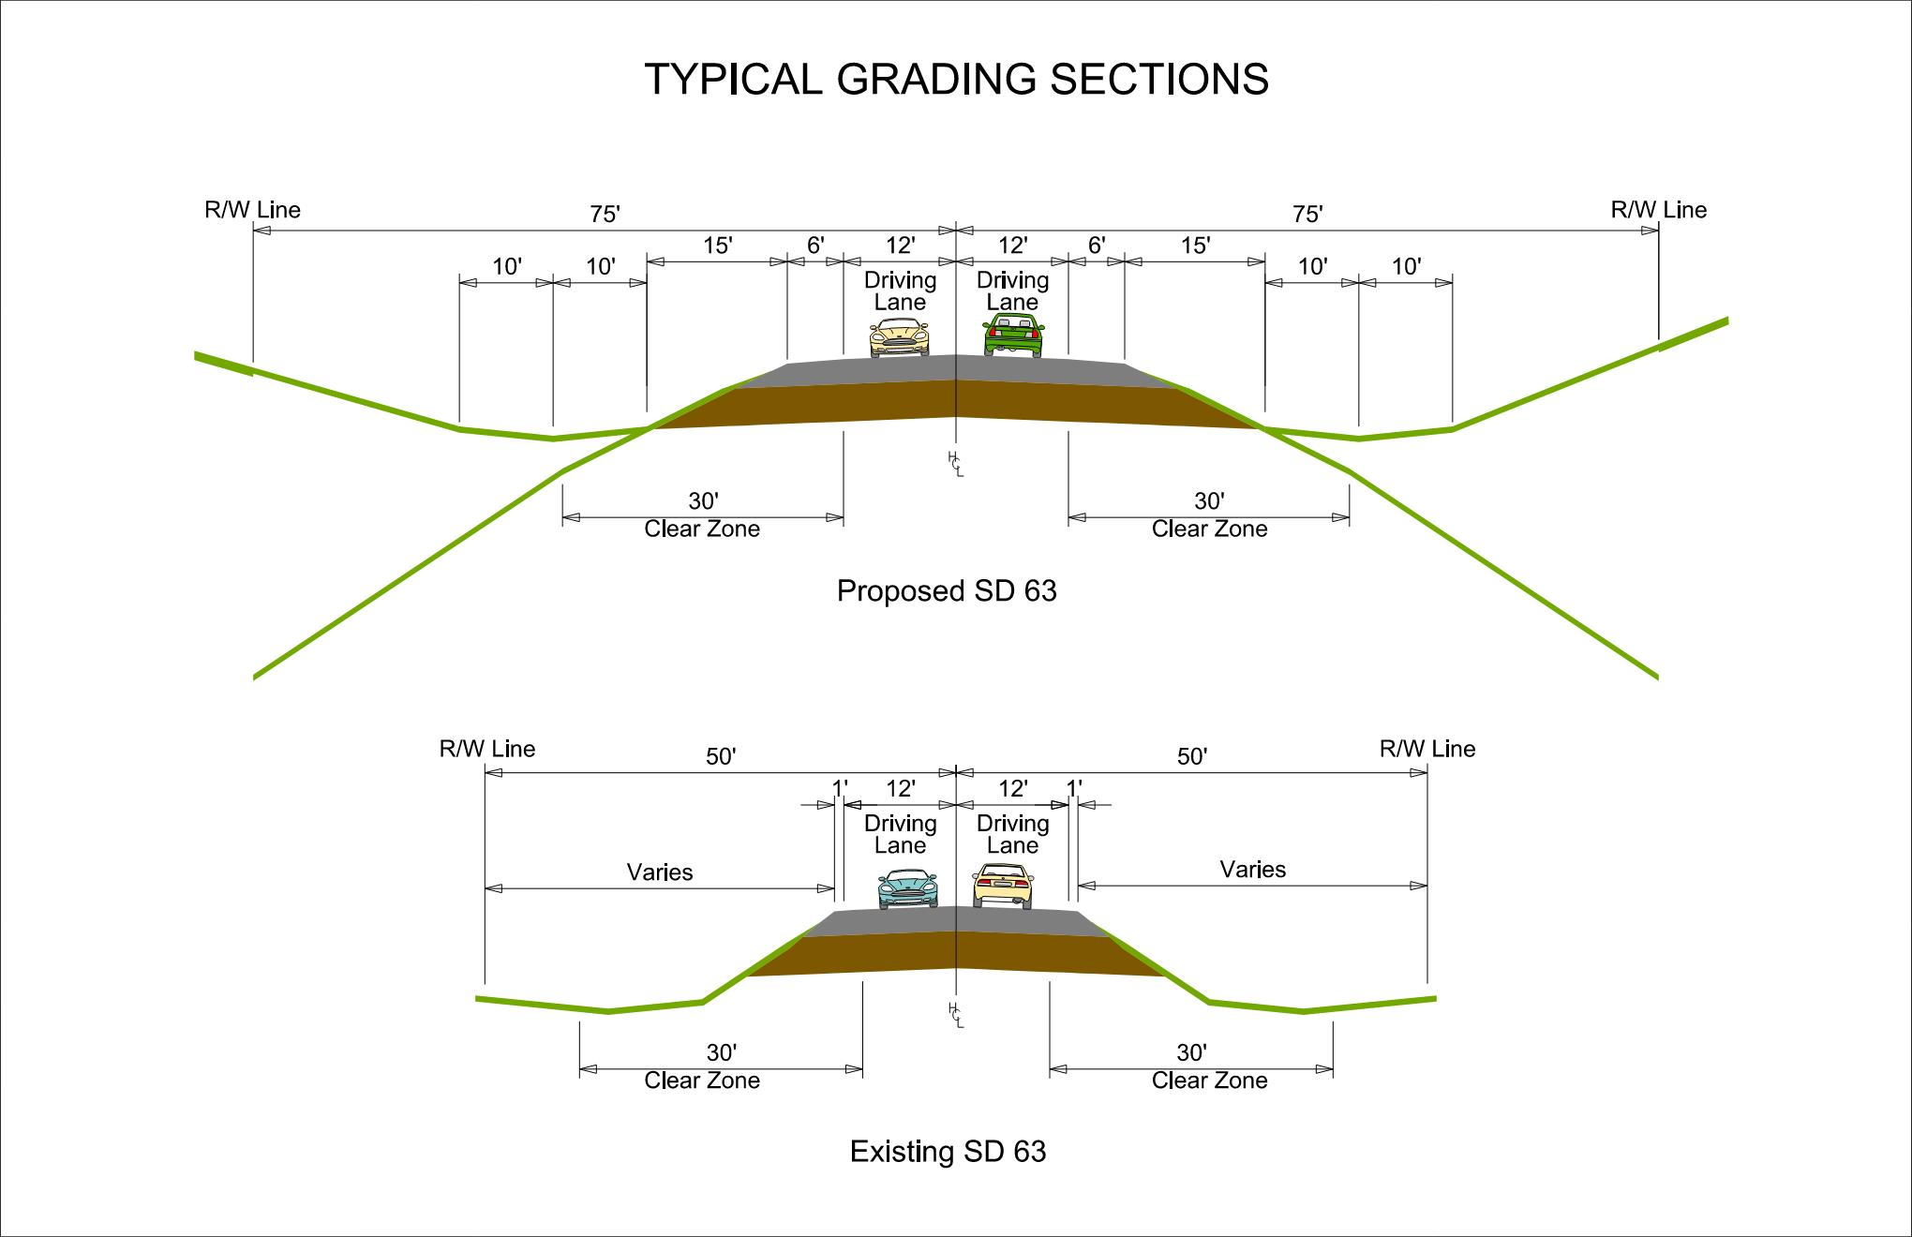
PROPOSED TYPICAL SECTION
Notes:
Existing Rural Section
Roadway: 2 – 12 Ft Lanes
Narrow Existing Shoulders: 1 Ft
100 Ft ROW width
Deficient Vertical curves
Proposed Rural Reconstruction
Roadway: 2-12 Ft lanes
Shoulders: 6 Ft
150 Ft ROW width

Slide 11
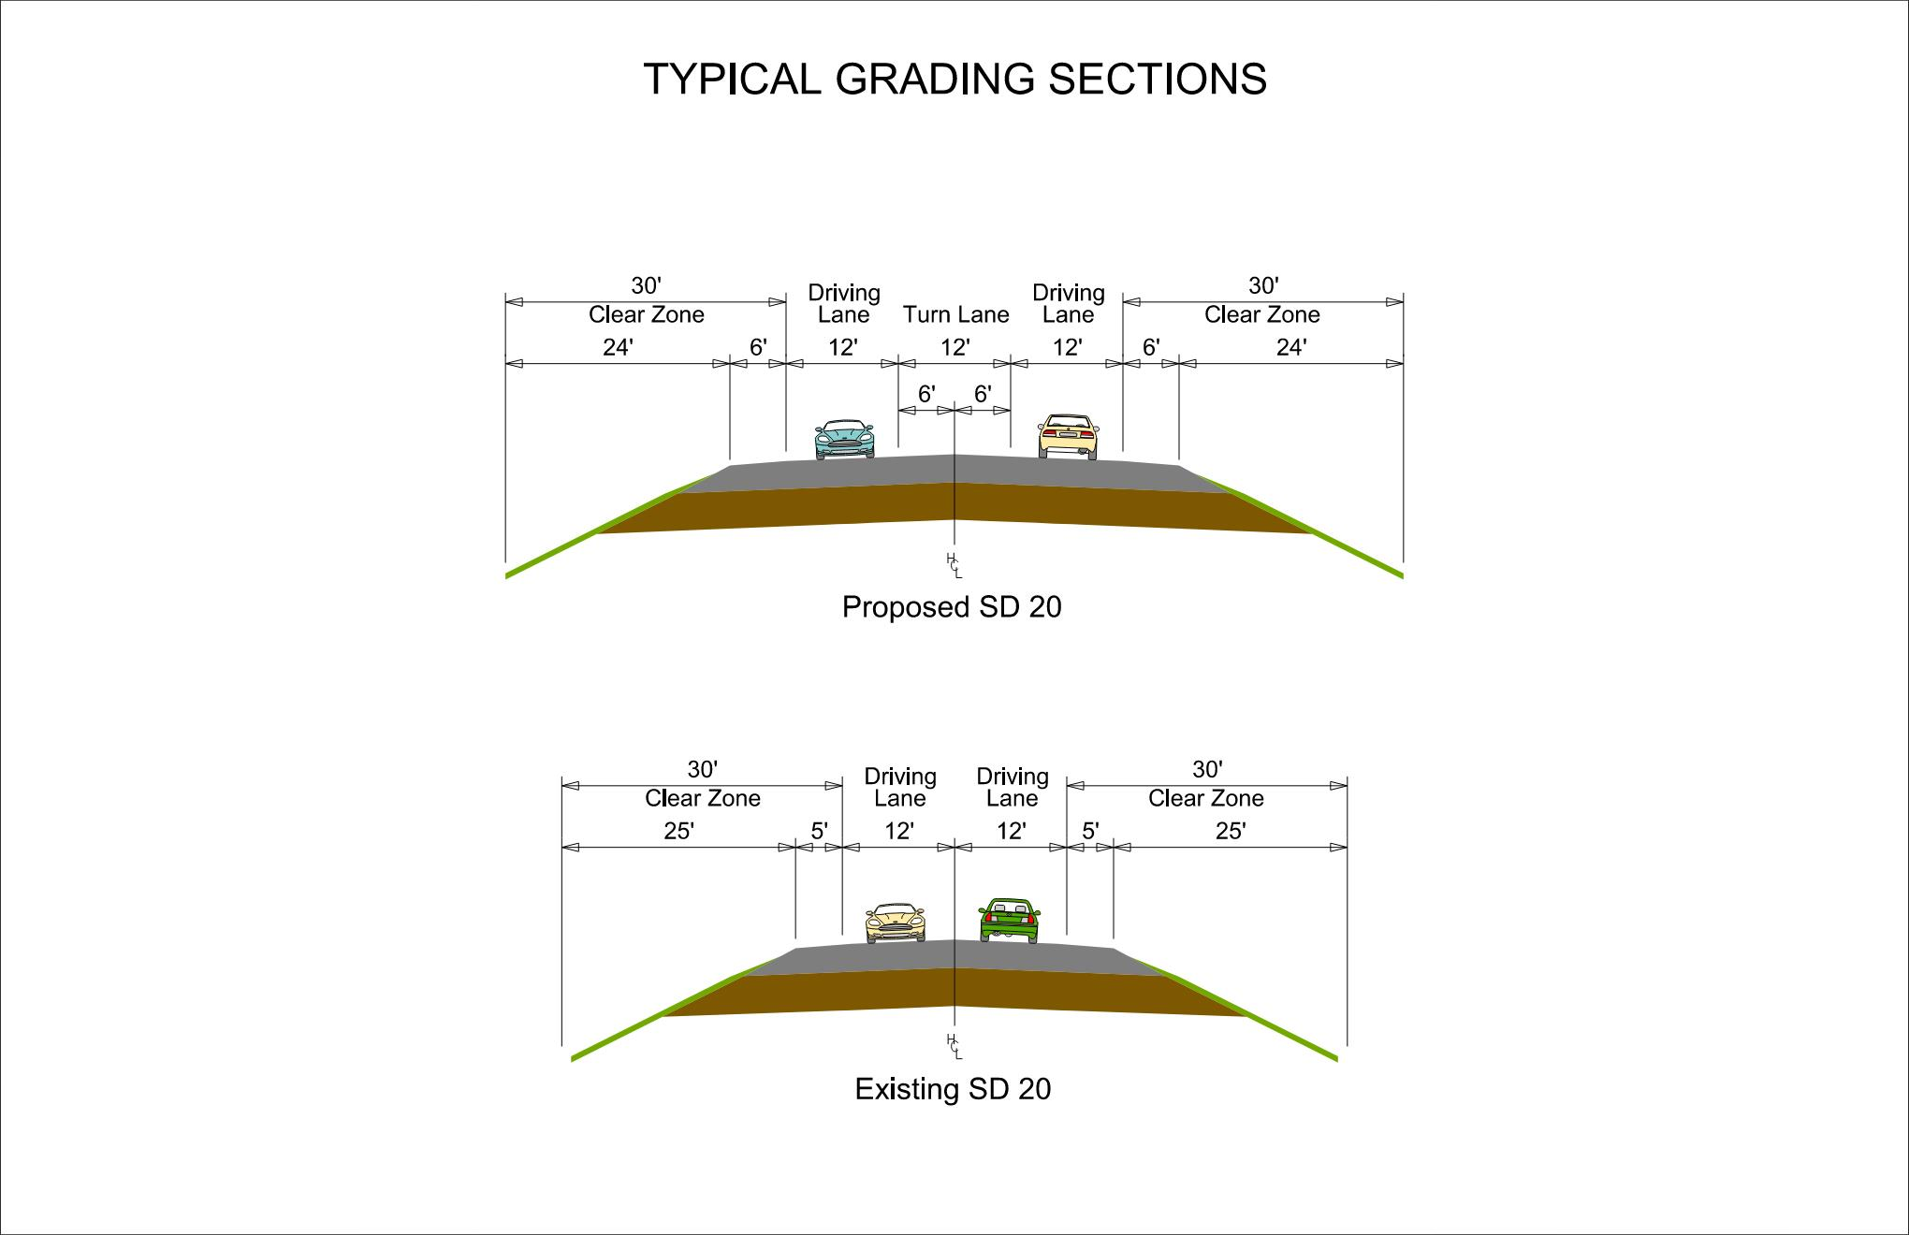
PROPOSED TYPICAL SECTION
Notes:
Existing Rural Section
Roadway: 2 – 10 Ft Lanes
Narrow Existing Shoulders: 5 Ft
Proposed Rural Reconstruction
Roadway: 3-12 Ft lanes
Shoulders: 6 Ft

Slide 12
ACCESS MANAGEMENT
Provide safe, efficient access to streets and highways by limiting the number of direct accesses to major roadways.
See handout
Notes:
Any time SDDOT reconstructs a roadway, we evaluate Access Management. The purpose of access management is to ensure there is safe, efficient ways to access highways not only now but in the future as traffic volumes grow and developments get more dense. Studies have shown that by controlling the access of vehicles to highways, accident rates are decreased. Existing approaches will generally be left in place except where they can be combined with another approach or eliminated if they are not being used. An approach is a hazard itself. Crashes including some fatal crashes can involve vehicles launched by an approach, the elimination or minimizing approaches removes the hazard from the ROW.
The goal is to reduce the number of access points along the route, thereby making the route safer.
If there are proposed changes to accesses, this will be discussed during the landowner meetings. While always a difficult subject, design will work with the property owners as best we can to come up with solutions.
More information on access management is available in the handout.

Slide 13
RIGHT OF WAY (ROW)
Existing width = 100 feet
Acquisition of additional ROW for 150 feet
Temporary easements as needed
See handout
Notes:
The existing ROW is 100 ft (50’ from centerline). Additional ROW will be acquisitioned for 150’
Temporary easements are necessary whenever the construction work limits are outside of the right of way. Temporary easement allows construction to occur on your property during construction of the highway. The red dashed line represents the limits of work and when this line is near or outside the ROW line temporary easements will need to be obtained by the State.
ROW and Temporary Easements will be discussed in more detail during Individual Landowner Meetings, and more information on the right of way process is available in the handout.

Slide 14
ENCROACHMENTS
Private property in public ROW
Examples
Notification
Federal highway regulations for safety
Signs
Private use (parking)
Landscaping items
Owners of encroachments will be notified by the Mobridge Area Office.
See handout
Notes:
Encroachments on the project area will need be removed. Owners of any encroachments will be notified by the Mobridge Area Office.

Slide 15
UTILITY COORDINATION
Some utilities may need
to be relocated.
CRST Telephone Authority
Moreau Grand Electric Co-op
Tri County Water
Lumen
Utility companies negotiate easements
with landowners.
See handout
Notes:
Some existing utilities within the project area will need to be relocated. Any easement needed by the utility companies will be negotiated with landowners. Known utilities in the area are CRST Telephone Authority, Moreau Grand Electric Co-op, Tri County Water, and Lumen

Slide 16
UTILITY COORDINATION
Any known private utilities?
Water Lines
Drain fields
Septic tanks
Underground storage tanks
Underground power lines
Contact SDDOT
See handout
Notes:
If you know of any private utilities, like water lines, drain fields, septic tanks, underground storage tanks, or underground power lines for example, please contact the SDDOT

Slide 17
ENVIRONMENTAL, SOCIAL,
AND ECONOMIC CONCERNS
This project is being developed in accordance with applicable State and Federal environmental regulations including:
National Environmental Policy Act (NEPA)
Section 106 of the Historic Preservation Act
Coordination has been initiated with State & Federal resource agencies and the Cheyenne River Sioux Tribe
The project would seek to protect items of cultural significance identified by the tribe, including the collection of vegetation prior to construction
See handout
Notes:
This federally-funded project is being developed in accordance with applicable state and federal environmental regulations and will comply with the National Environmental Policy Act and Section 106 of the historic preservation act.
Coordination has been initiated with state and federal resource agencies and the Cheyenne River Sioux Tribe to gather input on the project.

Slide 18
ENVIRONMENTAL, SOCIAL,
AND ECONOMIC CONCERNS
A cultural resources survey will be completed.
A wetland delineation has been conducted and is being reviewed to determine the extent of wetland impacts.
Endangered and threatened species w/ potential habitat:
  Birds: Whooping Crane, Rufa Red Knot
  Mammals: Northern Long-Eared Bat
See handout
Notes:
Cultural Resources
Examples of resources being evaluated include cultural resources, which may include districts, sites, structures, and objects of historic & archaeological significance. This will also include input from tribes that may attach religious or cultural importance to historic sites. Invite the public to provide information on any culturally or archaeologically known site(s).
Wetlands
A wetland delineation has been conducted to identify the boundaries of wetlands and stream channels in the project area. Impacts to these resources will be avoided or minimized where possible. Any necessary impacts will be permitted through the Army Corps of Engineers.
T&E
Endangered and threatened species that have the potential to be in the project area include whooping crane, Rufa red knot, and northern long-eared bat. Coordination will be conducted the U.S. Fish & Wildlife Service and South Dakota Game Fish & Parks to avoid or minimize potential impacts to these species.

Slide 19
Construction Traffic Control
Traffic will be maintained during construction, and the roadway will be gravel. Temporary wet weather detours are possible.
Pilot cars will be utilized in the moving work zone.
There will be diversions to allow for constructing drainage structures.
See handout
Notes:
Traffic will be maintained during the construction period, and the surface will be gravel. Because of this, the construction area may close during wet weather conditions, which will require temporary detours.
Movement through the construction zone will be controlled by a pilot car.
Diversions will be used to go around where drainage structures are being built

Slide 20
LANDOWNER MEETINGS
Spring 2024
Landowners adjacent to the project will be contacted individually by SDDOT to schedule a meeting.
Discussion Items
Driveway locations/widths
Fences
Drainage
Trees
Private utility locations
Temporary easements or ROW acquisition
Notes:
Landowner meetings will be held in the spring of 2024. Landowners adjacent to the project will be contacted by SDDOT to schedule an individual meeting.
At these meetings, we will discuss driveway locations and widths, fences, drainage, trees, the location of any private utilities, and temporary easements or ROW acquisition.

Slide 21
TENTATIVE PROJECT SCHEDULE
Dependent on federal funding
Public
meetings
Final
design
2026
Construction
2024 | Spring 2024 | Fall 2024 | 2025 | 2028
Landowner​
meetings
ROW
acquisition
Notes:
The tentative project schedule is shown here.
Dates where there will be additional involvement between SDDOT and adjacent property owners are:
Landowner Meetings to be held in the Spring of this year
ROW Acquisition Process will begin in 2025
The construction is scheduled for the 2028 construction season.

Slide 22
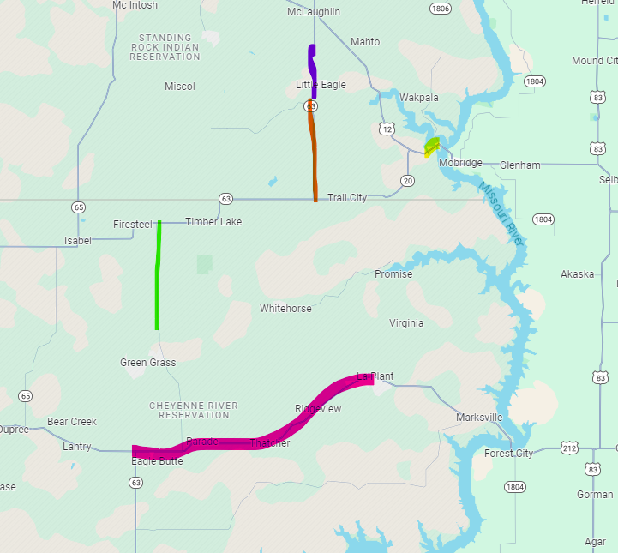
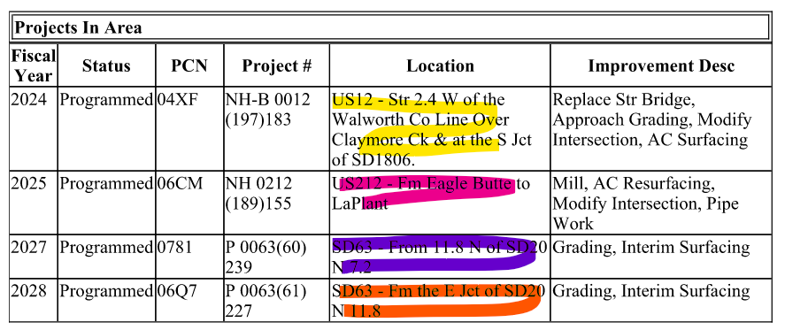
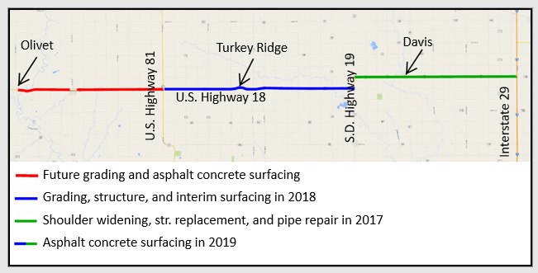
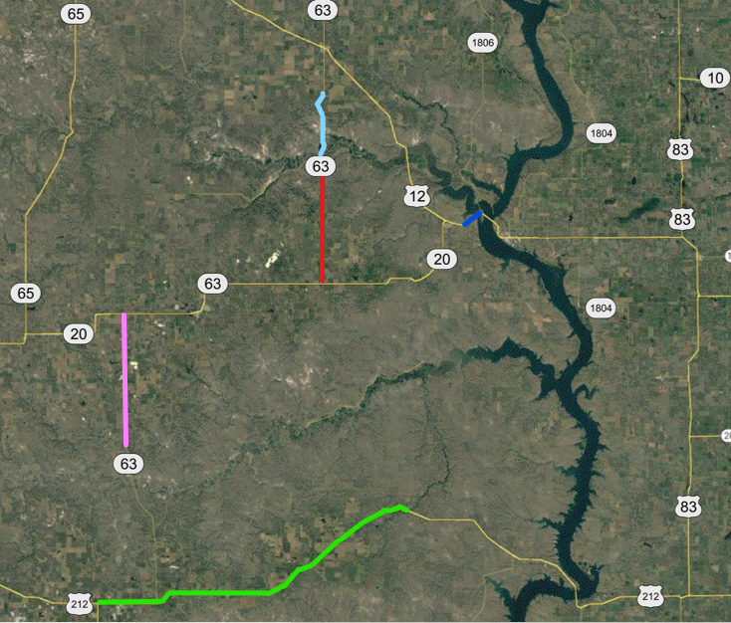
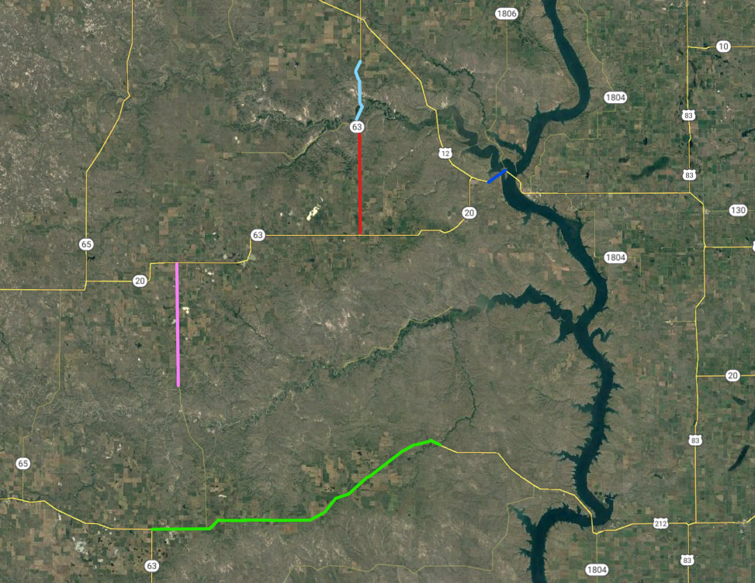

PROJECTS IN THE AREA
1806
10
Grading, Interim Surfacing (2028)
1804
63
Mill, AC Resurfacing, Modify Intersection, Pipe Work (2025)
Mobridge
20
65
63
1804
Grading, Interim Surfacing (2028)
20
Timber Lake
Grading, Interim Surfacing (2027)
20
63
Missouri River
Replace Bridge, Approach Grading, Modify Intersection, AC Surfacing (2024)
65
Moreau River
63
1804
Eagle Butte
Notes:
Here is a rundown of other projects happening in the area, and the fiscal year they are programmed for.

Slide 23
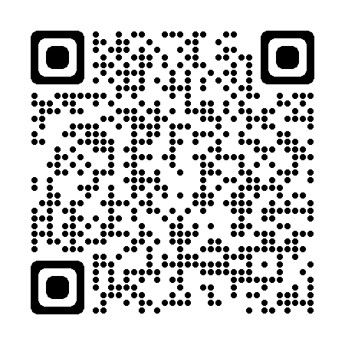
QUESTIONS OR COMMENTS
DEADLINE:
Friday, Jan. 26, 2024
SUBMIT TO:
Jennica Wilcox
Senior Transportation Engineer
Felsburg Holt & Ullevig
600 E 7th St, Sioux Falls, SD 57103
Jennica.Wilcox@fhueng.com
WEBSITE:
https://dot.sd.gov/projects-studies/projects/public-meetings#listItemLink_1949
THANK YOU
SCAN ME
Notes:
At this time, I will take any general comments or question you may have on this project. If you have any specific questions or comments regarding how the projects may impact your property, we will take the remaining time to visit with you one on one at either one of the aerial layouts.
You are also asked to submit your questions or comments in writing on the form provided in the handout or via email address to Jennica Wilcox by February 1, 2024
In the next few days, the power point presentation, handout and design layouts will be added to the web site address noted. Go to the section under Pierre Region and click on the link to the project.

