Slide 1


FAASTeam
SOUTH DAKOTA
South Dakota Airport Manager’s Conference
Steven R. Hoogerhyde
FAASTeam Program Manager
Rapid City FSDO (GL-27)
Jay M. Flowers

Slide 2

Steven R. Hoogerhyde
FAASTeam Program Manager
“ Operations “
South Dakota

Slide 3
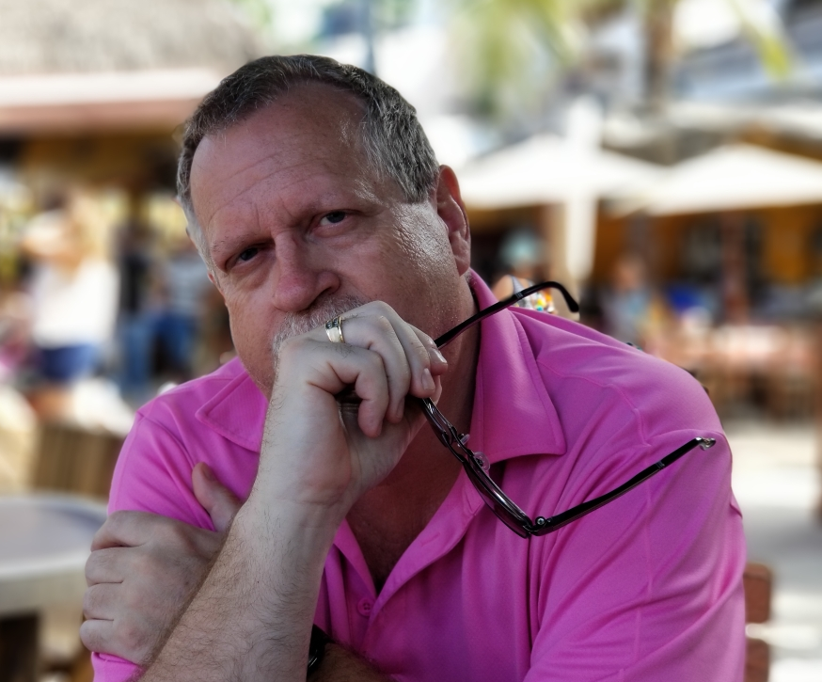
About your presenter:
Steven R. Hoogerhyde (Grand Rapids, Michigan)
44 years in General Aviation (1979-2023)
FAASTeam Program Manager / 27 Years with FAA
5 Years Experience as Principle Operations Inspector
Regional Pilot Safety Award (Six Consecutive Years)
National Flight Safety Officer
Airline Transport Pilot Certificate
11,850 Hours Total Flight Time
5,700 Hours Flight Instruction Given
Chief Flight Instructor (AMR Combs)
Director of Training (Part 141 Flight School)
Chief Pilot & Check Airman (Part 135 Operator)
Designated Pilot Examiner (7 Years in West Michigan)

Slide 4
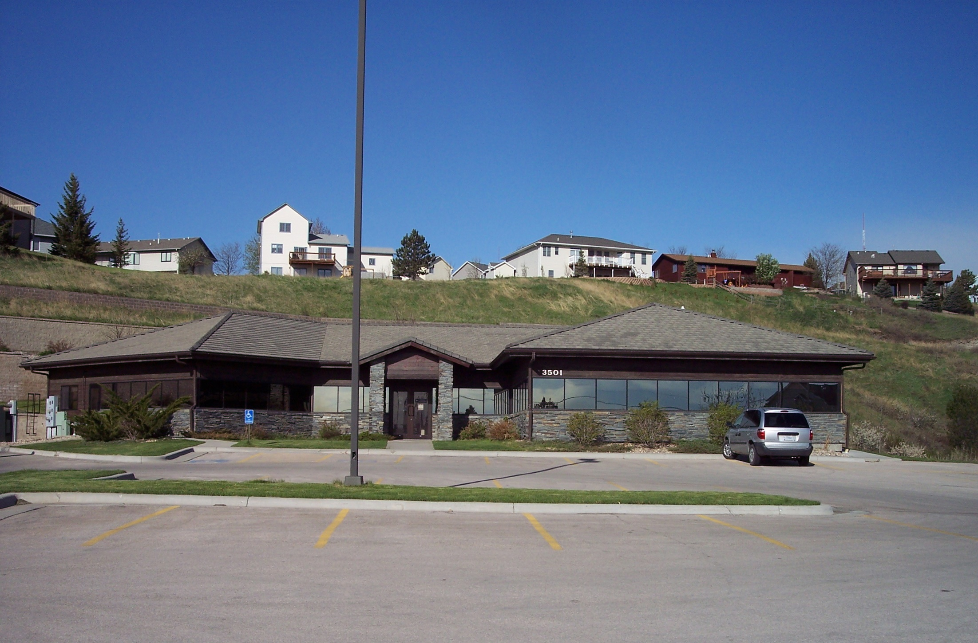

Slide 5
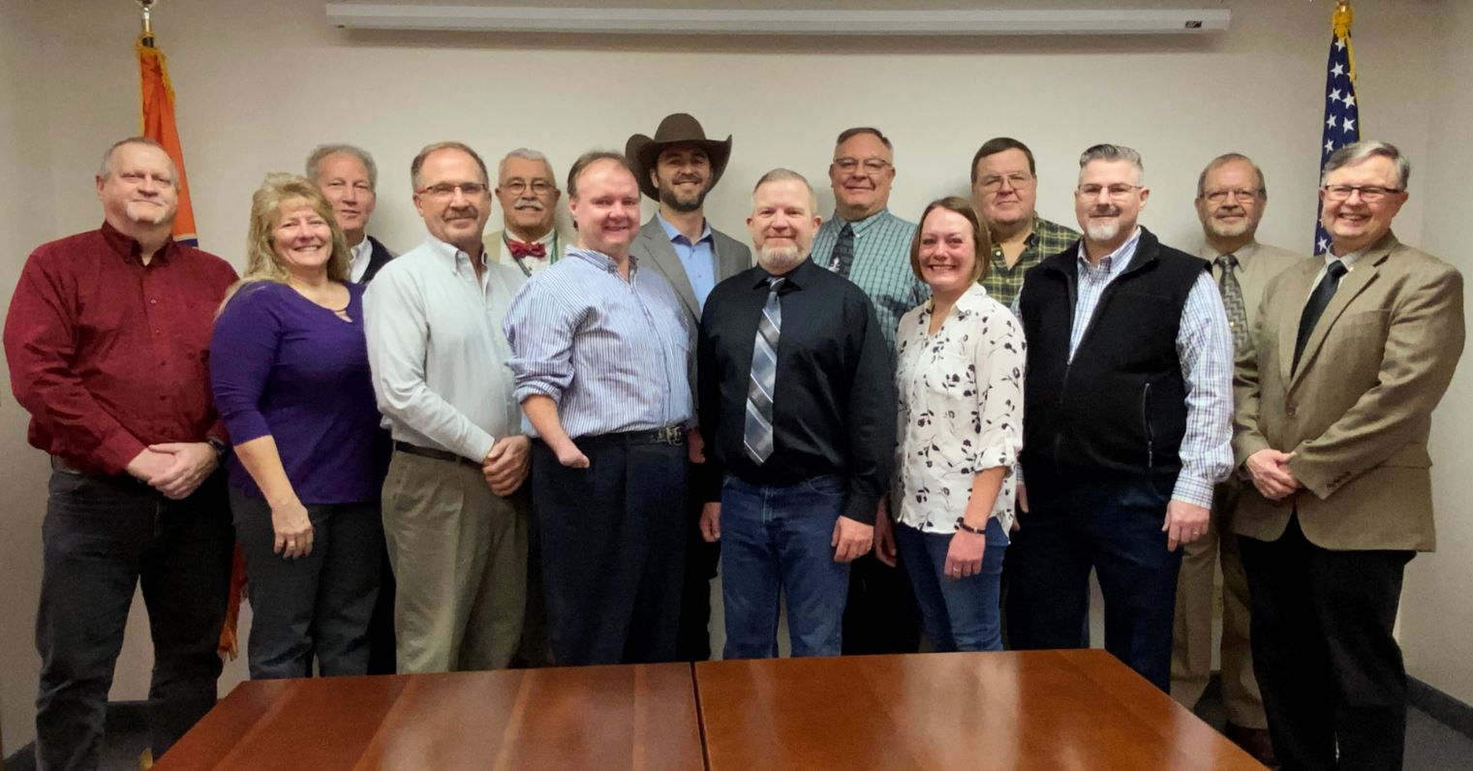
Rapid City Flight Standards District Office

Slide 6
Rapid City Flight Standards District Office
Wayne Jensen (Manager)
Alan Christianson (Assistant Manager)
Thia French (AST) / Tammera Geske (ASA)
Dwight Pladsen (PMI) / Bill Howell (PMI)
Todd Obritsch (PAI) / Brandon Caneva (PMI)
Ryan Friedrichsen (ASI-AW) / Chris Lang (POI)
Barry Dunmire (POI) / Drew Smith (POI)
Randy Green (ASI-OPS)

Slide 7

When it comes to reporting accidents, incidents,
low-flying aircraft, getting permits, certifications, airman oversight, regulatory guidance,
safety seminars, maintenance issues,
your local Flight Standards District Office (FSDO)
is the place to start.

Slide 8


Contact Us:
Rapid City
Flight Standards District Office
3501 5th Street
Rapid City, SD 57701-6000
605-737-3050
7-AGL-RAP-FSDO@FAA.GOV

Slide 9
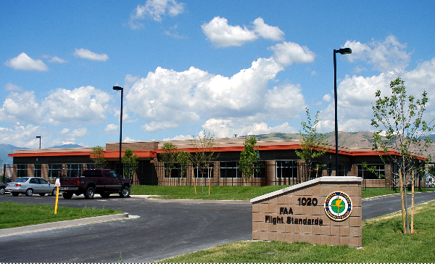
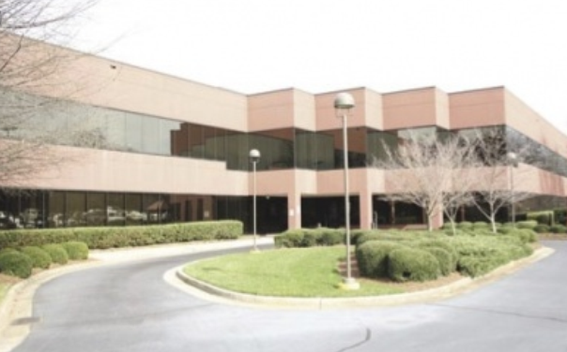
There are 80 FSDOs covering 77 geographical areas of responsibility in the United States.
Some districts overlap into multiple states.

Slide 11
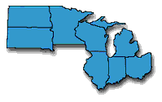
Great Lakes Regional District
ND
MN
SD
WI
MI
IL
IN
OH

Slide 12
Great Lakes Regional District
ND
MN
SD
WI
MI
IL
IN
OH

Slide 13
FAASTeam Program Managers
FPMs are assigned Areas of Responsibility –
  Steven R. Hoogerhyde (Operations – SD)
  Troy D. Siekas (Operations – MN)
  Jeffery R. Boe (Airworthiness – SD, ND, MN)
FPMs are responsible for recruiting, training, and encouraging FAASTeam Representatives to assist in meeting the mission of our National FAASTeam Performance Plan

Slide 14
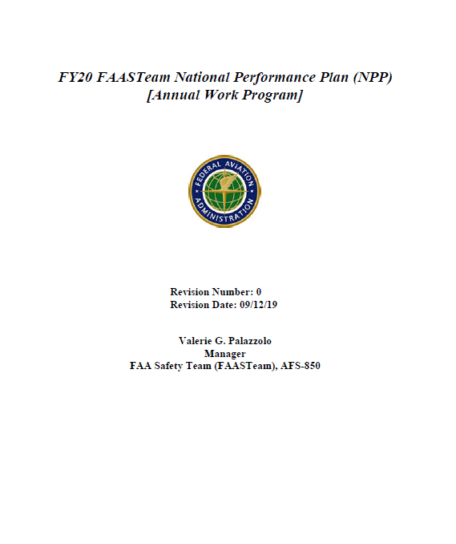
FAA Safety Team (FAASTeam)
Review & Analyze Accidents
Safety Seminars
Review & Analyze Incidents
Air Tours
Review & Analyze Pilot Deviations
Remedial Training
Quarterly FSDO Data Analysis & Briefings
Webinars
FSDO Aviation Activity Reports
Runway Safety
GAJSC Topic of the Month
Career Fairs
Wright Brothers Master Pilot Awards
WINGS / AMT
Charles Taylor Master Mechanic Awards
Representatives
General Aviation Awards
Flight Schools
Safety Officer Meetings
Helicopter Operations
Light Sport / Experimental Groups
UAS
Inspection Authorization (IA) Renewal Events
CFI & DPE Meetings
State Aeronautical Agencies
Symposiums
Loss of Control Outreach
First Responders

Slide 15
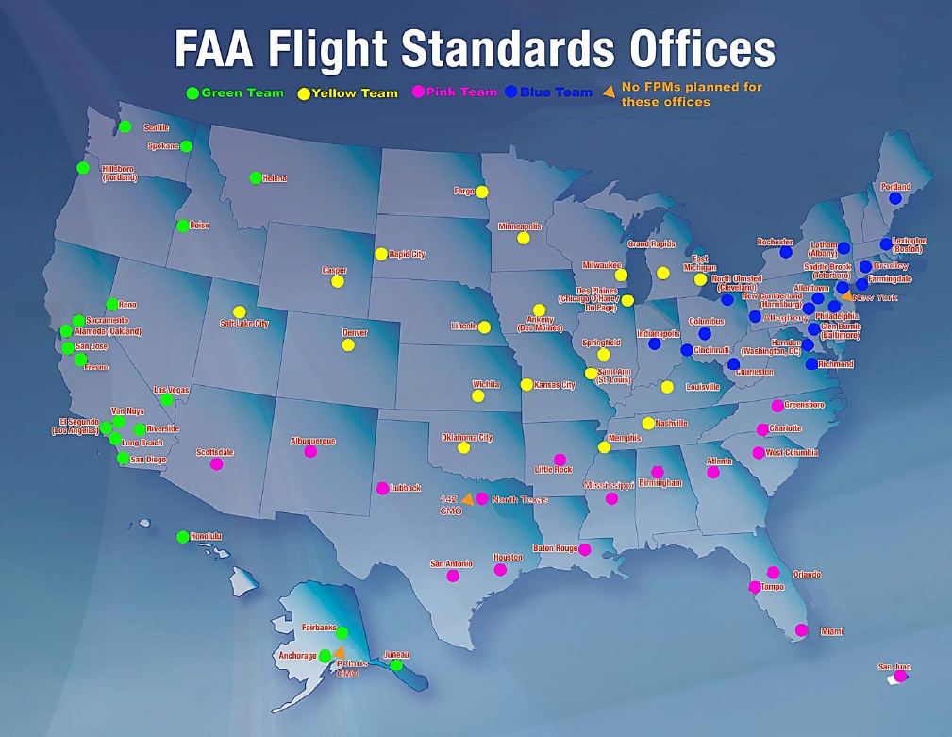


Slide 16
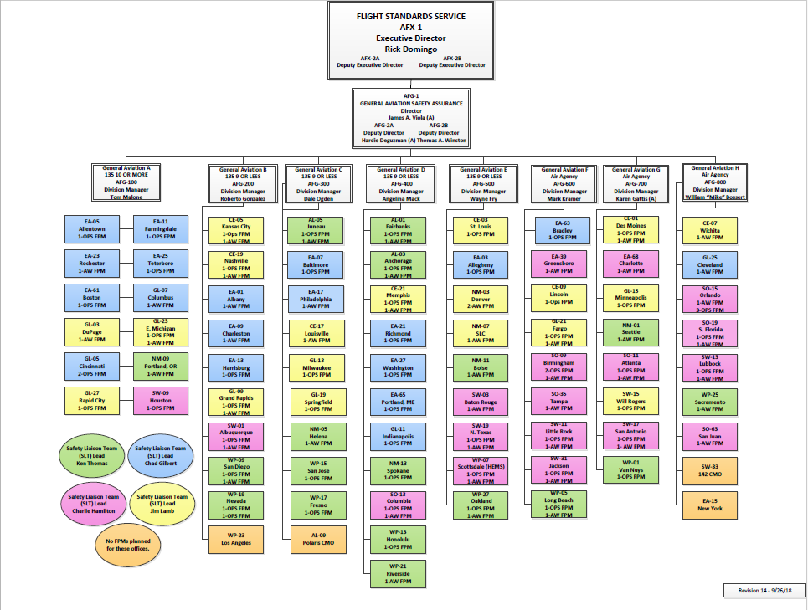

Slide 17
FAASTeam Representatives Are Volunteer Supporters
They play a vital role in accomplishing the
FAASTeam mission.
They serve the aviation community by sharing their time, knowledge, and professional experience in order to create a positive safety culture.
They organize and participate in FAASTeam events, initiate action to correct conditions that may be hazardous to persons or aircraft in flight or on the ground.
They counsel airmen.

Slide 18
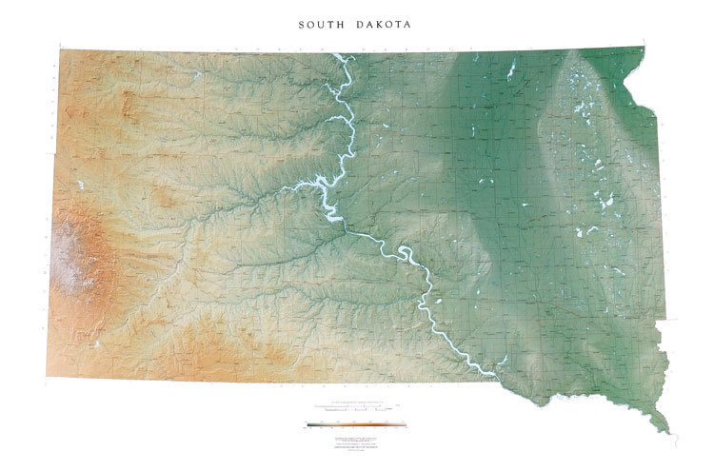

34 (5 DronePros)
Gregory L. Klein Watertown
Tony L. Wiegman Watertown
Ron A. Hauck Pierre
Paul A. Soulek Spearfish
Forrest D. Wixon Pierre
Daniel J. Moerke Brookings
Warren G. Hovland Brookings
David L. Timmons Pierre
Wayne N. Kelm Brookings
Cody J. Christensen Brookings
Martin B. Larson Rapid City
Mike Hickman Rapid City
Chris H. Funk Brookings
Craig Bair Grenville
Sarah Schumacher Pierre
Peter J. Jensen Rapid City
Jerry L. Densmore Rapid City
Jon R. Becker Pierre
Josh W. Weiland Sioux Falls
Mike Klarenbeek Sioux Falls
Chris M. Thompson
Sioux Falls
Marc E. Boddicker Rapid City
Gary W. Hewett Rapid City
Jon D. Christensen Sioux Falls
Eric J. Steen Sioux Falls
John M. Parezo
Sioux Falls
Caleb Ziolkowski Crazy Horse
Robert F. Huggins Sioux Falls
Richard Larson
Sioux Falls
Paul Rooks Crazy Horse
Petra Wilson Hot Springs
Jordan Hall
Tea
John C. Lillevold Yankton
Mark T. Isackson Tea
Denny D. Martens Vermillion

Slide 19
South Dakota Part 137 Air Operators (54)
Current VIS Data: 02/2023

Slide 20
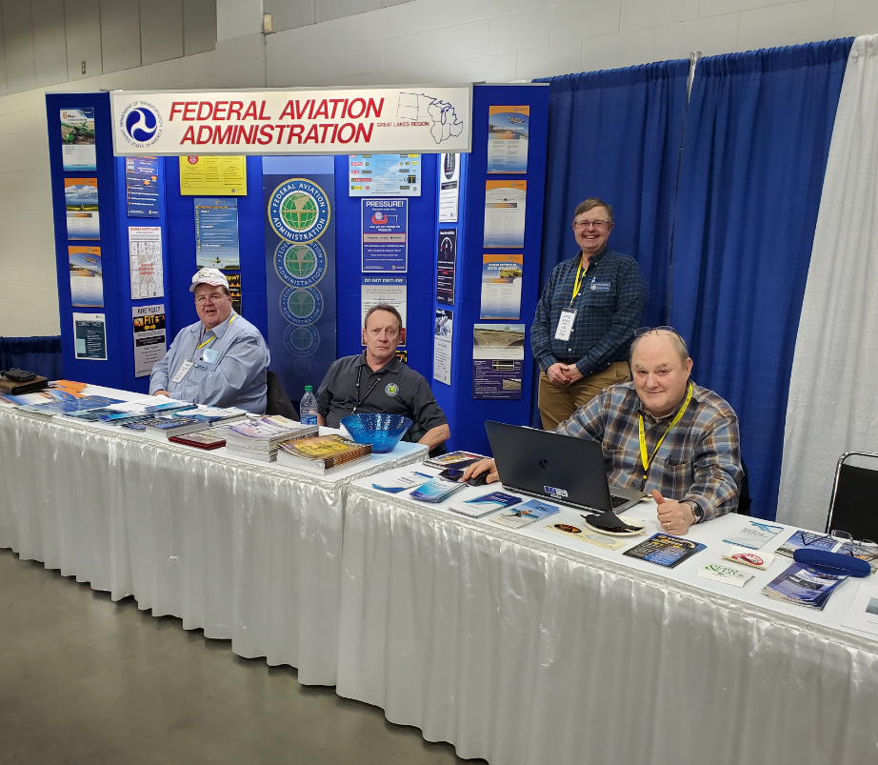

Slide 21
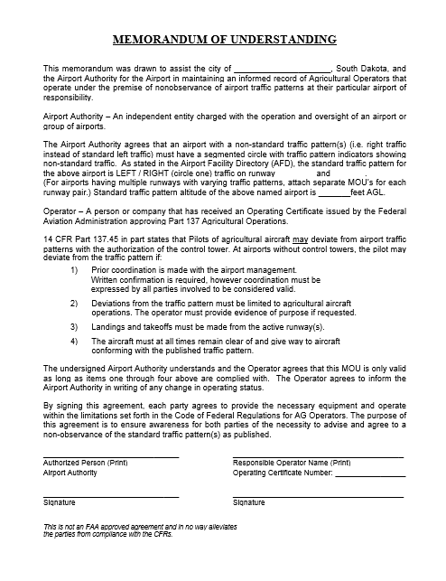


Traffic Pattern MOU

Slide 22
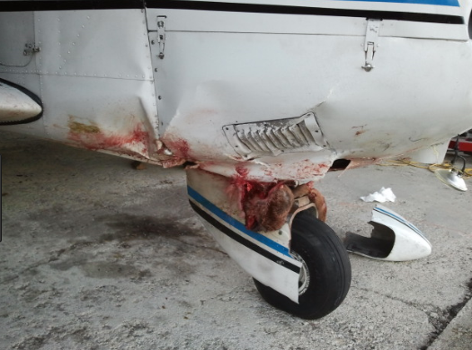
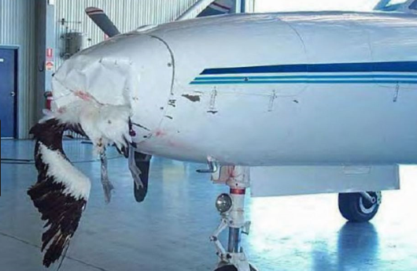
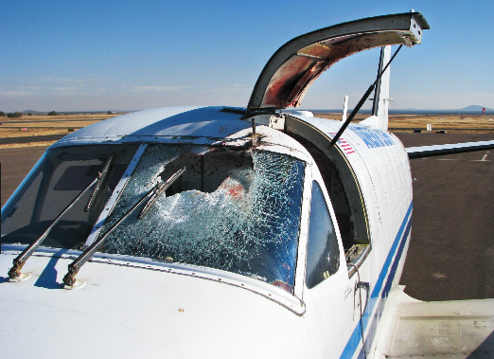
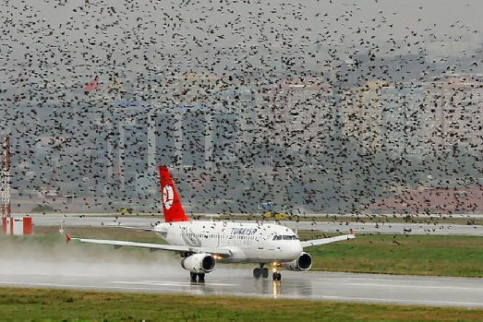
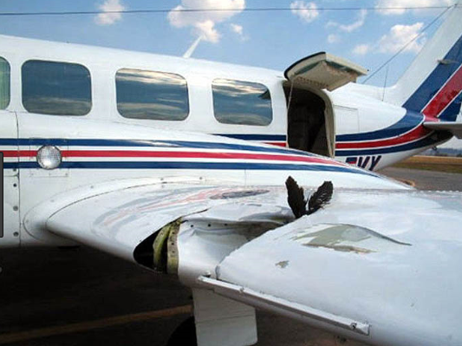
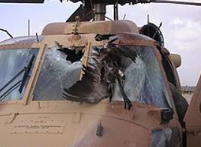
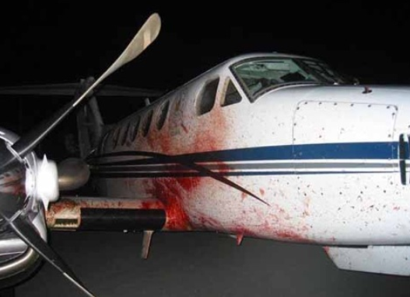
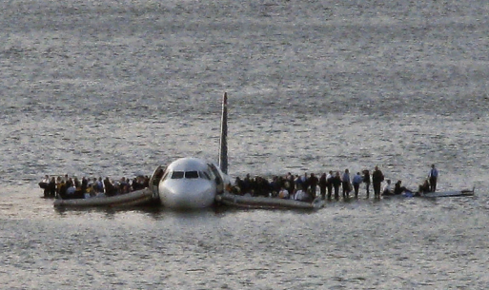
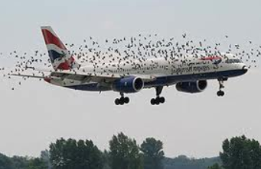
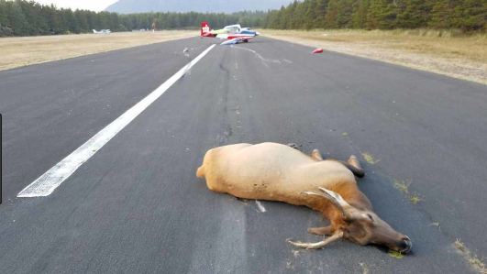

Slide 23
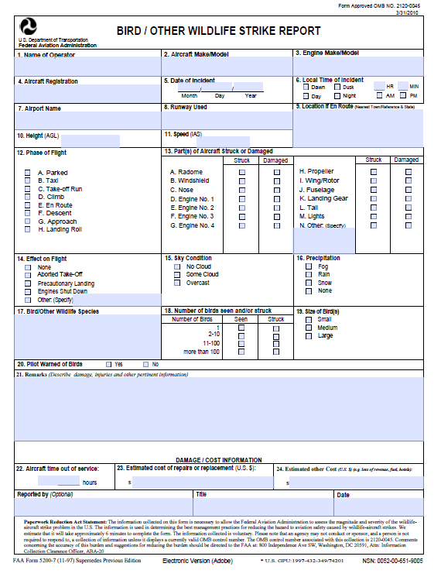
FAA Form 2500-7
Bird / Other Wildlife Strike Report.
Searchable Database.
https://wildlife.faa.gov/

Slide 24
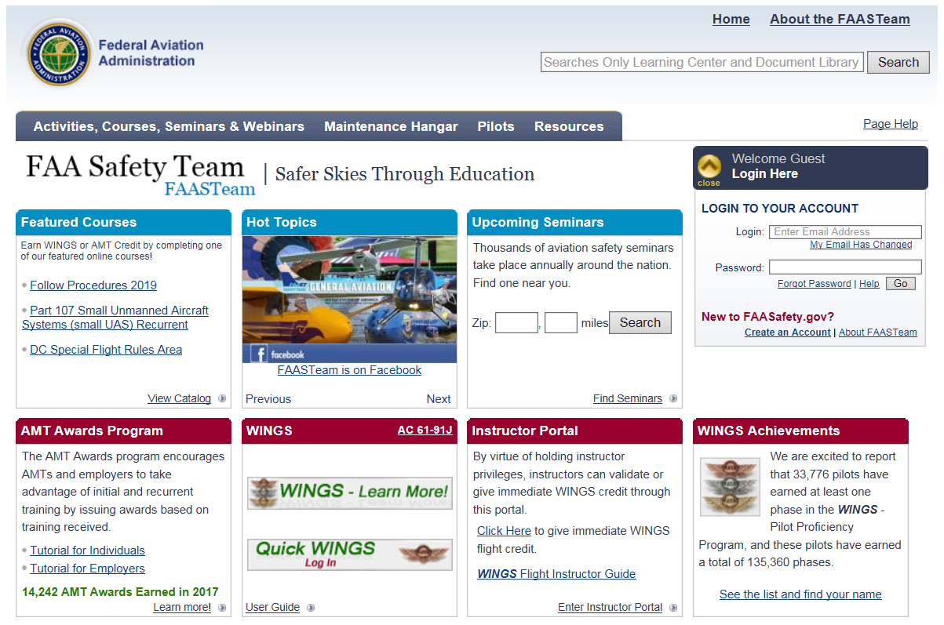
FAA Safety Team (FAASTeam)
www.FAASafety.gov

Slide 25

South Dakota Pilot’s Association
www.sdpilots.com

Slide 26
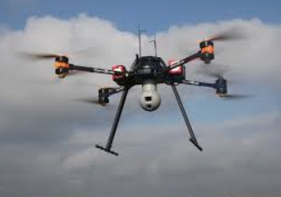
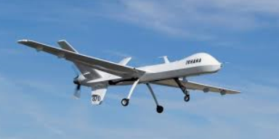
Unmanned Aircraft Systems
https://www.faa.gov/uas

Slide 27

NTSB Database
https://www.ntsb.gov/_layouts/ntsb.aviation/index.aspx
The NTSB aviation accident database contains information from 1962 and later about civil aviation accidents and selected incidents within the United States, its territories and possessions, and in international waters.

Slide 28
NTSB Part 830.5
The operator of any civil aircraft shall immediately, and by the most expeditious means available, notify the nearest National Transportation Safety Board (NTSB) field office when an aircraft accident occurs.

Slide 29
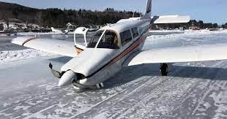
Airport Managers have the responsibility to report any known accident or incident.
Please contact the
Great Lakes Regional Operations Center (ROC)
(817) 222-5006

Slide 30
14 CFR Part 1
AIRCRAFT
means a device that is used or intended to be used for flight in the air.
Unmanned Aerial Vehicle ?

Slide 31
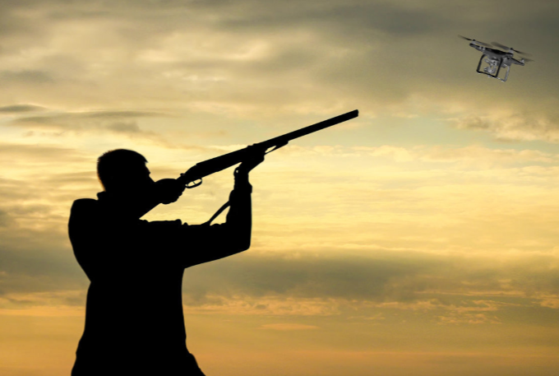
It is a Federal Crime to Shoot at Aircraft.
18 USC 32
Our federal statue makes it a felony to damage or destroy an aircraft.

Slide 32
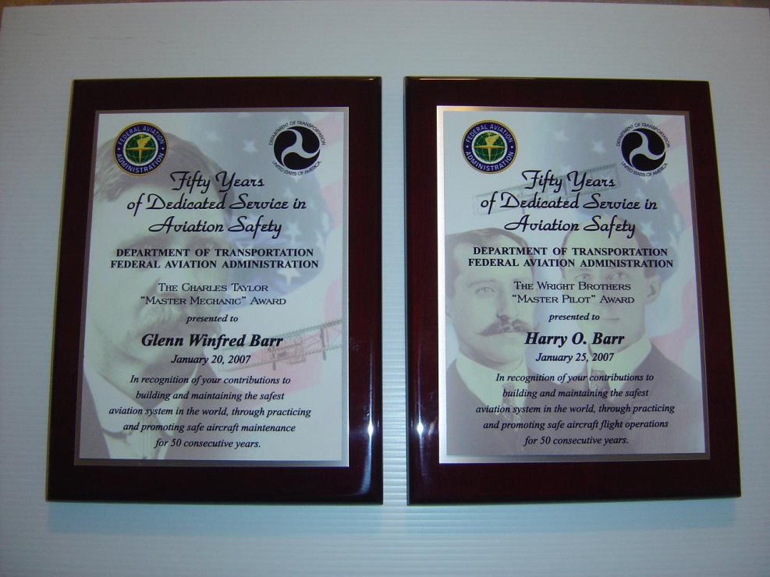
Wright Brothers Master Pilot Award &
Charles Taylor Master Mechanic Award
Applicant FAA Recognition Letter
Spouse FAA Recognition Letter
Applicant Lapel Pin
Spouse Lapel Pin

Slide 33

Wright Brothers Master Pilot Award:
Held a US Civil Aviation Authority or FAA Pilot Certificate
Fifty or more years of civil flying experience
  Up to twenty years may be US military experience
Been a US citizen or permanent resident
No revocation of certificate
No enforcement actions
  May be reviewed on case-by-case basis
No revocation of certificate
May be presented up to two years posthumously
Three letters of recommendation from other airmen
Photo copies of documentation
Personal resume with completed application
Medical certificate or current flight review is not required at the time of nomination

Slide 34

Wright Brothers Master Pilot Awards
Cecil Ice (Pierre) – March 2002
Robert Balentine (Yankton) – July 2005
Roy Crisman Jr. (Wagner) – July 2005
William Ferwerda (Springfield) – July 2005
Grove Rathbun (Rapid City) – July 2005
James Bartels (Pierre) – September 2006
Charles Summers (Rapid City) – September 2006
Laverne Kraemer (Deadwood) – June 2007
Dennis Martens (Vermillion) – August 2007
Kenneth Merrill (Black Hawk) – August 2008
Mark Breuer (Howard) – September 2009
Richard Grorud (Grenville) – September 2009
James Nelson (Spearfish) – September 2009
Larry Nelson (Rapid City) – September 2009
Harley Taylor (Aberdeen) – September 2009
Laverne Tech (Rapid City) – September 2009
Colman Wagner (Clark) – September 2009
Charles Meyer (McCook Lake) – April 2010
Ladell Swiden (Madison) – October 2010
Clifford Adkins (Parkston) – November 2010
Earle Geide (Hartford) – August 2011
55
Jerome F. Mitchell (Rapid City) – September 2016
Irvin D. Lewis (Hot Springs) – September 2016
Lynn R. Riedesel (Brookings) – September 2016
Jerry E. Ellingson (Lake Preston) – September 2016
Roger A. Huntley (Yankton) – July 2017
Roger R. Hutchison (Sioux Falls) – October 2017
James J. Huls (Madison) – September 2018
Billy E. Davis (Castlewood) – September 2018
Thomas R. Kitterman (Sioux Falls) – March 2019
Vernon C. VanDerhule (Yankton) – September 2019
James G. Cox (Yankton) – September 2019
Kenneth K. Thomson (Sioux Falls) – September 2019
Robert J. McLaughlin (Brookings) – September 2019
Jess T. Bauer (Revillo) – September 2021
Raymond N. Thomas (Springfield) – September 2021
Christopher A. Lang (Rapid City) – November 2021
John E. Bucher (Castlewood) – December 2022
Gerald A. Kasuske (Watertown) – December 2022
Gene L. Ebneter ( Yankton) – December 2022
Harrison C. Thompson (Brookings) – December 2022
James C. Christophersen (Brookings) – December 2022
Harold G. Schramm (Utica) – December 2022
Lawrence Pravecek (Winner) – September 2012
Boyd Porch (Kadoka) – September 2012
James Eisenmenger (Yankton) – September 2012
Peter Hegg (Sioux Falls) – September 2012
Forrest Wixon (Pierre) – September 2012
James Ketchen (Rapid City) – September 2013
Bert Corwin (Rapid City) – September 2013
John A. Barney (Brookings) – September 2014
Bernard W. Christenson (Pierre) – November 2014
Richard E. Bown (Black Hawk) – November 2014
Allen B. Neal (Rapid City) – September 2015
Donald D. Blumenberg (Fulton) – September 2015

Slide 35
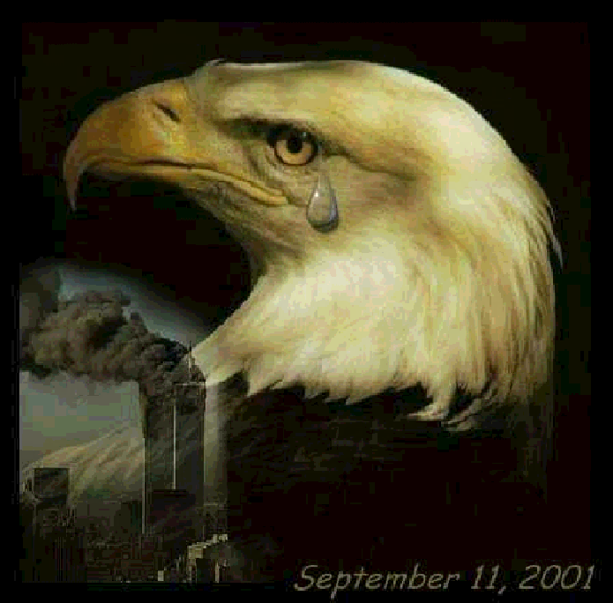
The Day We Lost More Freedom

Slide 36


