Slide 1
An ADO Perspective
General Aviation Airport Safety
2023 South Dakota Airports Conference
Notes:
During today’s FAA presentations, we would like to talk about General Aviation Airport Safety. We plan to focus on three areas today. These are safety issues with which you are probably familiar. Today we would like to stress the importance of: Runway Safety Areas surrounding your runways, Wildlife Hazard Mitigation, and Snow and Ice Control during the Winter months.

Slide 2
What is a Runway Safety Area?
Runway safety area: Protective area surrounding runways that is suitable for reducing the risk of damage to aircraft in the event of an undershoot, overshoot or excursion from the runway.
Notes:
Runway safety areas are the protective area surrounding runways that is suitable for reducing the risk of damage to aircraft in the event of an undershoot, overshoot or excursion from the runway. Safety areas save lives, injuries and damage to aircraft. The size of the runway safety area is defined by the critical aircraft using the airport. For the most part, the ground that is in the runway safety area should be graded so that there are not objects or ruts in that area. Also, where there is a requirement for equipment to be located in the runway safety area it should be frangible.

Slide 3
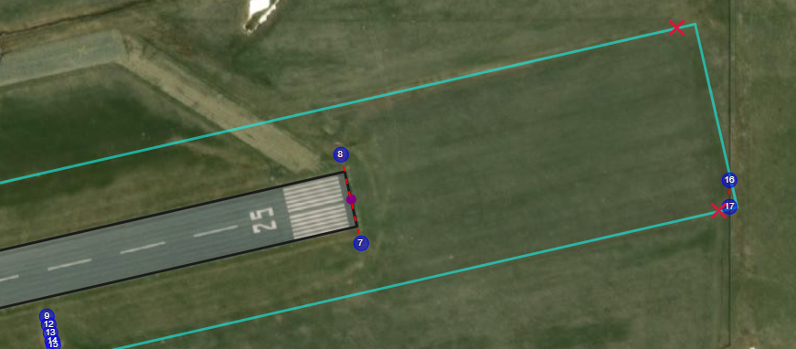
GA Runway Safety Area (RSA) Initiative
Most RSA Determinations are done at Master Plan stage, to plan any needed improvements, however RSAD must be completed prior to major runway grant
RSA improvements (from RSAD) required as part of any major (restore useful life) RW project
RSA Program details found in FAA Order 5200.8
ADO lead for non-Part 139 RWs
Notes:
The focus for safety area improvements was initially on those accomplished at our commercial service airports. It is just as important for airport sponsors at General Aviation airports to be familiar with the runway safety area dimensions and state of affairs. Where safety area enhancements are needed to meet the runway safety area standards, this should be a high priority improvement.
If your airport doesn’t have a RSA Determination that is current, you should identify the path toward getting a determination in place. The RSAD must be completed prior to any major runway grant, but more importantly, it is an important step toward full understanding improvements that are beneficial at your airport.
While this slide presentation has been prepared by the Safety and Standards Branch for the Great Lakes Region, the lead POC for working with the general aviation airports to track the completion of Runway Safety Area Determinations and to plan for and track the completion of enhancements is the POC in the Airports District Office that serves your airport.
Besides the Runway Safety Area, the next safety topic we are going to discuss is best practices for mitigation of wildlife hazards at airports.

Slide 4
Where do GA airport operators learn about wildlife hazard mitigation?
Wildlife presents challenges for airport operators
Understand the differences between a Wildlife Hazard Site Visit and Wildlife Hazard Assessment
Make use of training resources and work with a professional to learn about best practices for mitigation of wildlife hazards
Notes:
During the next several slides we are going to talk about the challenges that wildlife present to airport operators. In addition, we want to talk about what tools have become the best practices for understanding the specific wildlife hazards and mitigation recommendations for your airport. We will also identify the training resources that the FAA offers to stakeholders.

Slide 5
Notes:
Wildlife presents a challenge for all airport operators – both large airports and smaller or regional airports have seen increasing challenges.
Increasing human population and also wildlife population.
Unfortunately, wildlife become accustomed to harassment and frightening techniques, so it is important not to become complacent once mitigation steps are taken.
Dynamic with different nesting, roosting and feeding sites.
Airport operators have limited funding – the airport activity drive the revenue streams and there is always a challenge when it comes to incoming revenues versus the needs for its use. It is important to prioritize wildlife mitigation and communicate about the importance of taking actions
Another reality and consideration when identifying the best mitigation tactics is to recognize that there is a sensitivity to killing of wildlife.
Airports may represent an attractive island habitat, but wildlife and aviation activities don’t mix.
Understanding the challenges at your airport…by conducting a Wildlife Hazard Assessment or Site Visit…let’s discuss the difference.

Slide 6
WILDLIFE HAZARD SITE VISIT (WHSV)
VS
WILDLIFE HAZARD ASSESSMENT (WHA)
WHSV
Duration = 1-3 Days
Recommend Qualified Airport Wildlife Biologist conduct WHSV
Data Collection = Dawn / dusk avian surveys and nocturnal mammalian observations completed during 1-3 full days
Wildlife Hazard Site Visit Report = Accepted
GA airports – may use WHSVs as basis for Wildlife Hazard Mitigation Plans
WHA
Duration = 12 Months
Required Qualified Airport Wildlife Biologist conduct WHA
Data collection = Monthly dawn / dusk and nocturnal surveys at pre-determined stations and routes for future repeatability
Wildlife Hazard Report = Approved
Part 139 airports – may use WHSVs to investigate triggering events, land use changes, etc…
Notes:
Let’s talk about the tools that are available and used to receive information from professionals when it comes to understanding the wildlife hazards and mitigation options for your specific airport location.
The charts on this slide compare at a high level the differences between a Wildlife Hazard Site Visit versus a Wildlife Hazard Assessment. The duration, the qualifications, data collection and findings differ. There are similarities (in green box at bottom) between the Site Visit and Assessment, but the Assessment is a bigger undertaking. The need for one versus the other is driven by the complexity and seriousness of the situation at the Airport.
In general, Site Visits are typically used at GA airports, while Part 139 certificated airports will most likely require full WHAs.

Slide 7
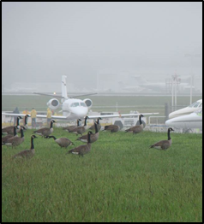
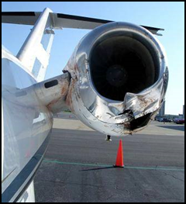
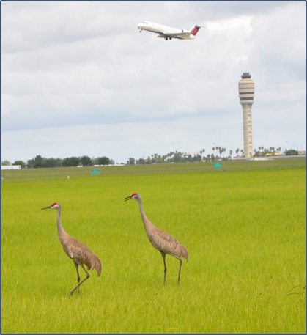
Wildlife Hazard Site Visits
The FAA has no requirement for GA* or Part 139 airports to conduct WHSVs. We do however want to encourage airport sponsors to work with your FAA POC to make sure you have received the information needed to identify a mitigation plan.
FAA will review and accept the WHSV reports and GA Wildlife Hazard Mitigation Plan. (As identified in the last slide, the FAA does not “approve” these documents.
As a note, NEPA does not apply to GA Mitigation Plans because there is no Federal Action.
*GA is used in this presentation to refer to non-certificated airports.
Notes:
While the FAA doesn’t conduct the Site Visits or the Assessments, the FAA is the POC and will work closely with the airport sponsors to identify the review process and timing for acceptance of the Wildlife Hazard Site Visits.
An important point: the GA Wildlife Hazard Site Visit can and should be used as the basis for a Wildlife Hazard Mitigation Plan and projects listed in the plan can qualify for AIP funding if necessary.

Slide 8
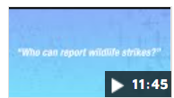
Wildlife Training Resource
Wildlife Hazards Video – Released October 2022
https://www.youtube.com/watch?v=f2nuO4PZKF0
Notes:
A Wildlife Hazard Video was released October 2022. The link on this slide is a live link or you can copy it into your browser to view the slides. Take 12 minutes to view it. There are other safety related videos released by the FAA that pop up when you visit this site.
The video provides an overview of how successful wildlife strike reporting and the National Wildlife Strike Database (jointly administered by USDA and FAA) is reducing the impact of wildlife strikes on both commercial and general aviation.
During the video it provided an interesting stat: 97% of the wildlife strikes reported are birds (mainly in the daytime) and only 2% are mammals (mainly deer) and 1% other (such as bats). The bird strikes occur primarily from July to October and the deer strikes occur mainly at night and during Oct-Nov. While these strikes are fewer in percentage than bird strikes they can cause greater damage. These stats are at a high level. If you haven’t participated in a site visit for your airport or haven’t read the report, take the time to look at the specific findings at your facility and compare the stats and recommendations at your airport with the national data and information.
Next we are going to talk about challenges that come with the winter months.

Slide 9
How can I learn about snow and ice control at a general aviation airport?
Work with other airports in your area to form groups that can work together to learn more about best practices for snow and ice control
Consider attendance at the AAAE Snow Symposium
Review FAA guidance and training resources
Notes:
It would be short-sighted if we were highlighting key areas on general aviation airport safety without talking about winter months and snow and ice control at a general aviation airport.
It is important to not go it alone when it comes to planning and preparing for the snow season. The needs of the users of your airport facility will probably drive the critical nature of responding to snow and ice control at your airport facility. Working with stakeholders as you prepare and plan for the winter months and establishing communication among a group of airport peers are important steps toward preparing for the winter.
We would be remiss if we didn’t recognize a long-standing larger group of airports sharing techniques and best practices on snow and ice control at the annual Aviation Snow Symposium held in April of each year (since 1967) in Allentown. The purpose of the symposium, then and now, is to provide a forum for dialogue on the numerous aspects of winter operations at airports. Early discussions focused on equipment, technique and shared experiences. Today, over 40 years later, topics include the use of chemicals, advanced communications and weather reporting systems as well as environmental, security, legal and financial considerations.
All sizes of airports participate in the snow symposium so it can be beneficial for an general aviation airport operator and field crew to attend.

Slide 10
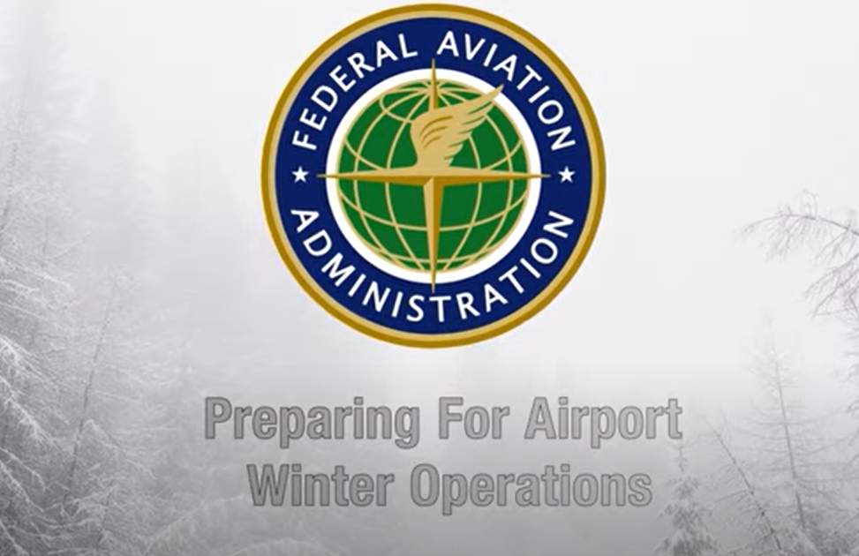
Winter Operations
Training Resources
New FAA Video
“Preparing for Winter Operations”
https://youtu.be/FNgAN1tHJUE
Notes:
Two resources for winter operations training worth mentioning
New FAA video to supplement winter ops – Key word search FAA Winter Operations will help you easily find it. This video, however, is geared primarily for larger airports with ATCTs. But when I viewed it I thought about how important the items that addressed uncontrolled airports were in the overall scheme of things during runway closures or when reporting on evolving airfield conditions.
NBAA (Nat’l Business Aviation Association) has several good TALPA (Takeoff and Landing Performance Assessment) (RwyCC [Runway Condition Codes – RCC]) training videos worth viewing to supplement TALPA training.
(Key word NBAA TALPA on youtube to find the resource)

Slide 11
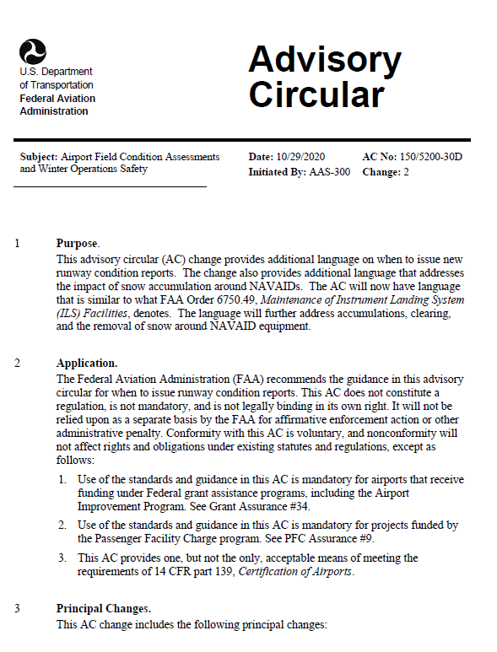
Airport Field Condition and Winter Ops AC 150/5200-30D
Using descriptor “patchy” on TWYs and ramps and how defined.
Monitoring more than 1 runway for conditions.
Snow depth in localizer critical areas and access to NavAid equipment
Access to EMAS
RwyCC reporting language clarity
Updating conditions – agreements, LOAs, procedures to ensure timely reporting
Use of Snow Logs and documentation
Some changes in various areas of AC from “must” to “should”
RwyCC language clarity on reporting
Guidance on updating conditions long and short term
Notes:
150/5200-30D - Airport Field Condition Assessments and Winter Operations Safety
This AC provides guidance to assist airport operators in developing a snow and ice control plan, assessing and reporting airport conditions through the utilization of the Runway Condition Assessment Matrix (RCAM), and establishing snow removal and control procedures. Consolidated version includes Changes 1 and 2.
If you have navaids on your airport, it is important to have a conversation with the FAA Technical Operations staff that serve your navaids to be sure that you have an understanding about the snow depth limitations in localizer (or other navaids) critical areas). This was prompted by a crash on the East coast in March 4, 2019. NTSB has recently published a final report on that crash that speaks to deviations of LOC signals and snow depth in front of the LOC antenna.

Slide 12
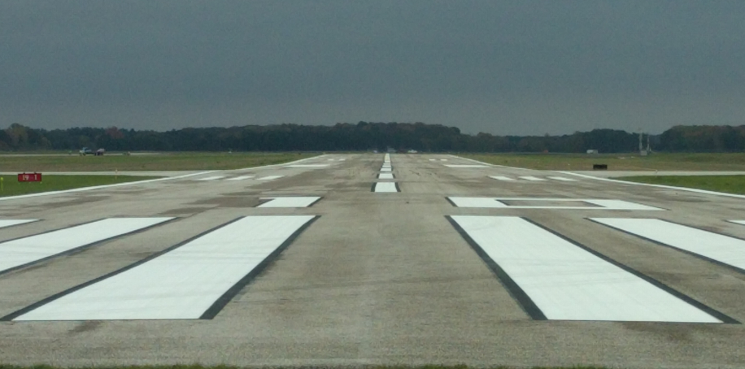
Winter Operations Airport Condition Reporting
Avoid EXPIRED FICONs and Expired Closure NOTAMS
=
Expired NOTAMs are the same as an OPEN bare and dry surface.
Notes:
Common issues are NOTAMs (Notice to Air Missions) that are left to expire instead of actively canceled.
FICONs are issued no longer than 24 hrs. and can be forgotten if the airport has not established good habits in monitoring published conditions.
Establish best practices by updating conditions at the start of each shift even if conditions haven’t changed as this will refresh the NOTAM timestamp.
Note: Expired NOTAMS (surfaces or aerodrome) imply the surface or aerodrome is OPEN and no hazard exists.

Slide 13
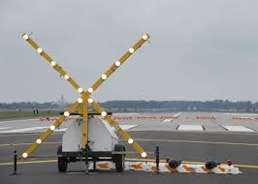
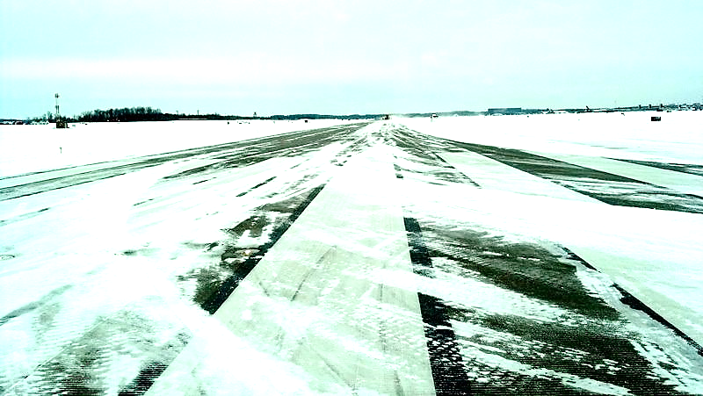
Notices to Air Missions
Changes to AC 150/5200-28G
Section 3.2.5
RwyConditions Codes (RCCs) no longer accepted on closed runways.
Notes:
NOTAM policy no longer allowing Rwy Condition Codes (RCCs) on closed runways will alleviate confusion as conditions on a closed surface were confusing.
Flight crews unclear, due to conflicting information, if the runway should be closed or open with what appeared to be an active condition on a closed surface.
The change will enhance safety by reducing confusions and assumptions.
Operators will have to cancel closure NOTAMs to issue FICONs and vice versa.

Slide 14
Questions?

Slide 15
Airport Design Technical Video Series
Currently Available
Taxiway Design Groups
Basic Taxiway Design
Taxiway Lighting for Fillets
End-Around Taxiways
Runway Incursion Mitigation and Prevention
Coming Soon
High Speed Exit Taxiways
Obstacle Limitation Surfaces
https://www.faa.gov/airports/engineering/airport_design/airport_design_technical_videos
Notes:
This slide saved for Consultants Symposium: One final resource I would like to share with you today. The Airport Design Technical Video Services is available and provides an overview on basic concepts in Airport Design from AC 150/5300-13B.
Currently the series has five videos available and two addition videos are coming soon.

