Slide 1
Public Meeting
S.D. Highway 37
From S.D. Highway 28, south 12 miles
Beadle & Spink County
P-PH 0037(161)133 PCN 06VV
Waylon Blasius, PE
Design Engineer
Tuesday, Oct. 4, 2022
Notes:
Good evening and welcome to the Public Meeting to discuss planned improvements to SD Hwy 37.
My name is Waylon Blasius with Banner Associates, the design consultant for the SDDOT.
Other SDDOT representatives here with me this evening are:
……………..
……………..
……………..
Hopefully everyone had a chance to sign in and picked up a handout. Included in the handout is the power point of which you may follow along.

Slide 2
Purpose of the Meeting
Involve the public in the planning and design process
Provide a Project Overview
Background Information
Proposed Project
Project Schedule
Gather Input and Comments
Notes:
We are here tonight to involve the public in the design process. We would also like to share with you the project scope, what the current design layout is, and the schedule. After the presentation we want to gather public input in the form of exchange of ideas and/or discuss any concerns you may have.

Slide 3
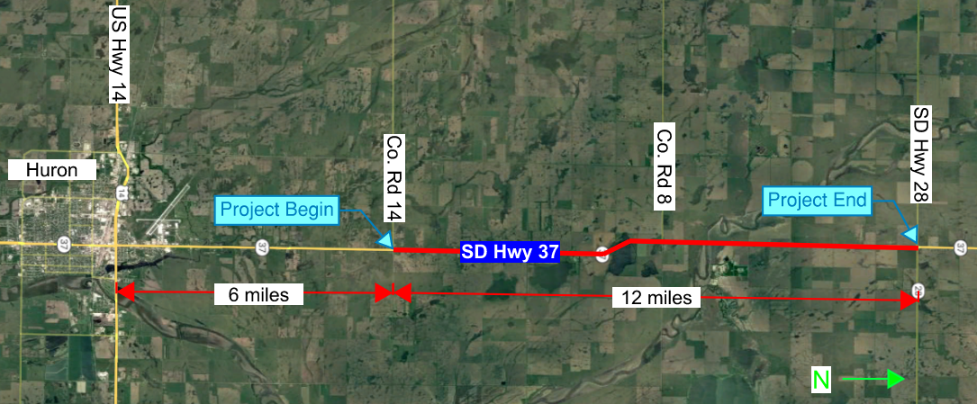
Project Limits
Notes:
The proposed project is approximately 12 miles in length. Grading will begin at Co. Rd 14 (202nd St) and continue east to SD Hwy 28.

Slide 4
Background Information
Grading & Pipe Replacement in 1952
Resurfaced in 1977
Resurfaced in 2001
Resurfaced & Pipe Work in 2018

Slide 5
Traffic
2021 Average Daily Traffic (ADT) = 1722
2041 Projected ADT = 2574
5.9% Average Truck Traffic
Notes:
The Average Daily Traffic is 1722 vehicles per day for SD Highway 37. The 20 year projected ADT is 2574. The average Truck Traffic is 5.9%.
Traffic Volumes and Vehicle Types are used to establish a base line for what type of facility is needed to safely handle traffic now and into the future. For example the number of lanes, width of lanes, width of shoulders, and surfacing types and thicknesses are all determined by the projected traffic volume and truck percentages.
With the current and projected traffic volumes a 2 lane facility (with 8 foot shoulders) will safely handle the traffic at an acceptable level of service.

Slide 6
Crash History
5 Year Period from 2017 to 2021
7 Reported Crashes
5 Animal Hit
1 Head-on (Injury)
1 Fixed Object Off Road (Injury)
Rural Minor Arterial
Reported Crash Rate for this segment of S.D. Highway 37 = 0.282
Statewide Weighted Crash Rate = 1.73 (crashes per million vehicle miles of travel)
5 Property Damage Only (PDO)
0 Fatalities
Notes:
- Update based on more recent crash information

Slide 7
Highway Deficiencies
Vertical Curves
Narrow Shoulders – Four feet
Surfacing
Structures
Notes:
4 vertical curves at a 60 mph design speed or under. 1 of them (crest) only meet 45 mph design speed
Narrow shoulders (4’ to 8’).
Surfacing and Structures will be updated.

Slide 8
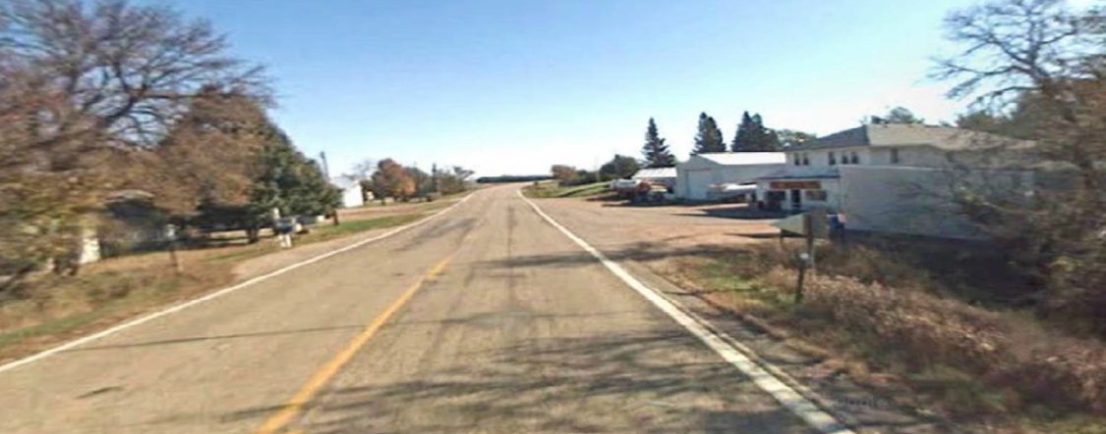
Proposed Improvements
Widen Roadway – Eight feet Shoulders
Replace Fence and Culverts
Adding left & right northbound and southbound turn lanes onto Highway 28
Adding left and right northbound turn lanes, left southbound turn lane onto 196th Street
Notes:
196th St leads to Lake Byron

Slide 9


Proposed Typical Section
ROW = Right of Way
S.D. HIGHWAY 37
TYPICAL GRADING SECTION
Existing & Proposed ROW
75’
Existing & Proposed ROW
75’

Slide 10
Access Management
To provide safe, efficient access to streets and highways
Limit number of direct accesses to major roadways
Provide safe, efficient access to streets and highways
By limiting the number of direct accesses to major roadways
See Handout
Notes:
Any time SDDOT reconstructs a roadway, we evaluate Access Management. The purpose of access management is to ensure there is safe, efficient ways to access highways not only now but in the future as traffic volumes grow and developments get more dense. Studies have shown that by controlling the access of vehicles to highways, accident rates are decreased. Existing approaches will generally be left in place except where they can be combined with another approach or eliminated if they are not being used. An approach is a hazard itself. Crashes including some fatal crashes can involve vehicles launched by an approach, the elimination or minimizing approaches removes the hazard from the ROW.
The goal is to reduce the number of access points along the route, thereby making the route safer.
If there are proposed changes to accesses, this will be discussed during the landowner meetings. While always a difficult subject, design will work with the property owners as best we can to come up with solutions.
More information on access management is available in the handout.

Slide 11
Right of Way (ROW)
Existing Width = 150 feet
Proposed Width = 150 feet
Temporary Easements as needed
See Handout
Notes:
The existing and proposed ROW width are 150’ (75’ from centerline)
Temporary easements are necessary whenever the construction work limits are outside of the right of way. Temporary easement allows construction to occur on your property during construction of the highway. The red dashed line represents the limits of work and when this line is near or outside the ROW line temporary easements will need to be obtained by the State.
ROW and Temporary Easements will be discussed in more detail during Individual Landowner Meetings, and more information on the right of way process is available in the handout.
- Potential for blockouts or PE around pipe ends and erosion protection

Slide 12
Encroachments
Private Property in Public ROW
Examples
Signs
Private Use (Parking)
Landscaping Items
Notification
Federal Highway Regulations for Safety
Owners of encroachments will be notified by the Huron Area Office
See Handout

Slide 13
Utility Coordination
Dakota Energy Cooperative
Dakota Access Pipeline LLC
Mid-Dakota Rural Water Systems Inc
Midcontinent Communications
Lumen
Venture Communications Cooperative
Santel Communications
Northern Electric Cooperative
Some utilities may need to be relocated.
Utility companies negotiate easements with landowners.
See Handout

Slide 14
Utility Coordination
Water Lines
Drain Fields
Septic Tanks
Underground Storage Tanks
Underground Power Lines
Any Known Private Utilities?
Contact SDDOT
See Handout

Slide 15
Environmental, Social and Economic Concerns
A cultural resources survey will be completed.
The project is being reviewed to determine extent of wetland impacts.
Endangered and Threatened Species:
  Birds: Whooping Crane, Red Knot
  Mammals: Northern Long-Eared Bat
  Fish: Topeka Shiner
  Plants: Western Prairie Fringed Orchid
See Handout
Notes:
Section 106
As stated in slide, this is specific to the protection of historic properties. Which will include: districts, sites, structures, and objects of historic & archaeological significance. This will also include tribes that may attach religious or cultural importance to them. Invite the public to provide information on any culturally or archaeologically known site(s).
Contaminated Materials
Request public’s input to any known AST or UST tanks within vicinity of project.

Slide 16
Environmental, Social and Economic Concerns
This project is being developed in accordance with applicable State and Federal environmental regulations.
National Environmental Policy Act of 1969 (NEPA), as amended. Coordination has been initiated with State and Federal resource agencies.
See Handout

Slide 17
Construction Traffic Control
Road will be closed to through traffic during construction.
Local traffic and emergency vehicle access will be maintained at all times.

Slide 18
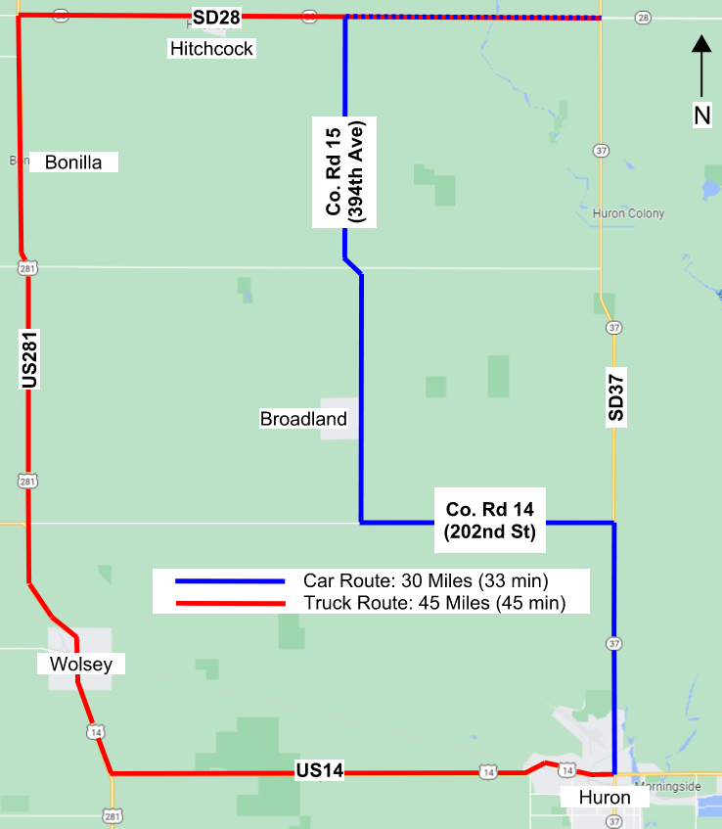
Construction Traffic Control
Detour routes for
S.D. Highway 37
traffic during construction:
Notes:
- County Road 14 is a gravel road

Slide 19
Landowner Meetings
Spring 2023
Landowners adjacent to the project will be contacted individually by SDDOT to schedule a meeting.
Discussion Items
Driveway locations/widths
Fences
Drainage
Trees
Temporary Easements or ROW acquisition
See Handout

Slide 20
Tentative Project Schedule
Dependent on Federal Funding
Spring
2023
Landowner Meetings
2023
Final Design
2024-
2025
ROW Acquisition
2027
Construction
Estimated Cost: $7.8 million
Final Surfacing is planned for 2019
Notes:
The tentative project schedule is shown here.
Dates where there will be additional involvement between SDDOT and adjacent property owners are:
Landowner Meetings to be held in the Spring of next year
ROW Acquisition Process will begin in 2024.
The construction is scheduled for the 2027 construction season.

Slide 21
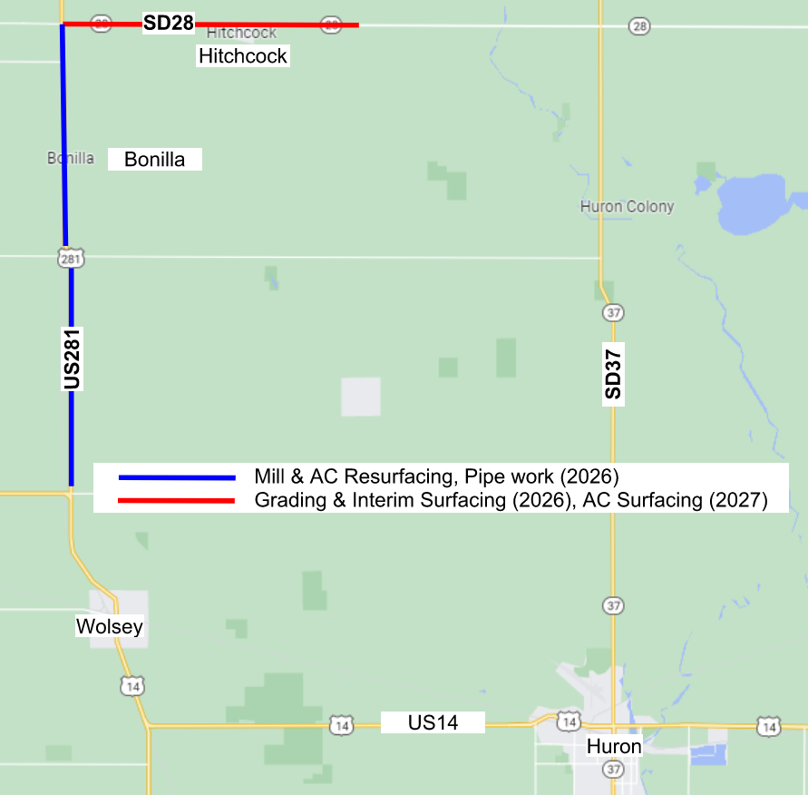

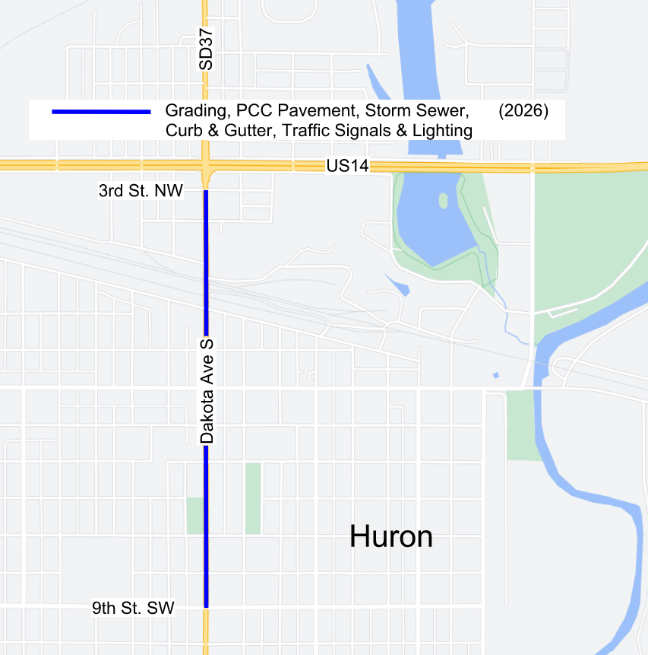
Projects in the Area

Slide 22

Questions or Comments
by: Tuesday, Oct. 18, 2022
submit to: Waylon Blasius
Design Engineer
Banner Associates, Inc.
409 22nd Ave S
Brookings, South Dakota 57006
waylonb@bannerassociates.com
website:
https://dot.sd.gov/projects-studies/projects/public-meetings#listItemLink_1806
Notes:
At this time I will take any general comments or question you may have on this project. If you have any specific questions or comments regarding how the projects may impact your property we will take the remaining time to visit with you one on one at either one of the aerial layouts.
You are also asked to submit your questions or comments in writing on the form provided in the handout or via email address to Waylon Blasius by October 18, 2022 (2 weeks) .
In the next few days the power point presentation, handout and design layouts will be added to the web site address noted. Go to the section under Huron Region and click on the link to the project.

