Slide 1



FAA NOTAM Briefing
Katie Ludwig
FAA NOTAM Governance
South Dakota DOT Airports Conference
April 2022

Slide 2

Agenda
NOTAM Governance Background
Current NOTAM Systems
Future NOTAM Systems Updates
NOTAM Modernization
Airport NOTAMs

Slide 3

Introduction
Who is US NOTAM Governance?
  FAA’s authoritative source for US NOTAM Policy
  Responsible for the maintenance, update, and publication of FAA Order 7930.2, NOTAMs, which establishes national policy for the National Airspace System (NAS) NOTAM operations.
    FAA Order 7930.2 is supportive of FAA Advisory Circular (AC) 150/5200-28, NOTAMs for Airport Operators.
NOTAM Governance collaborates with other LOBs to establish policies
Flight Standards
ATO
Others
NWS
International Organizations
Office of Airports

Slide 4
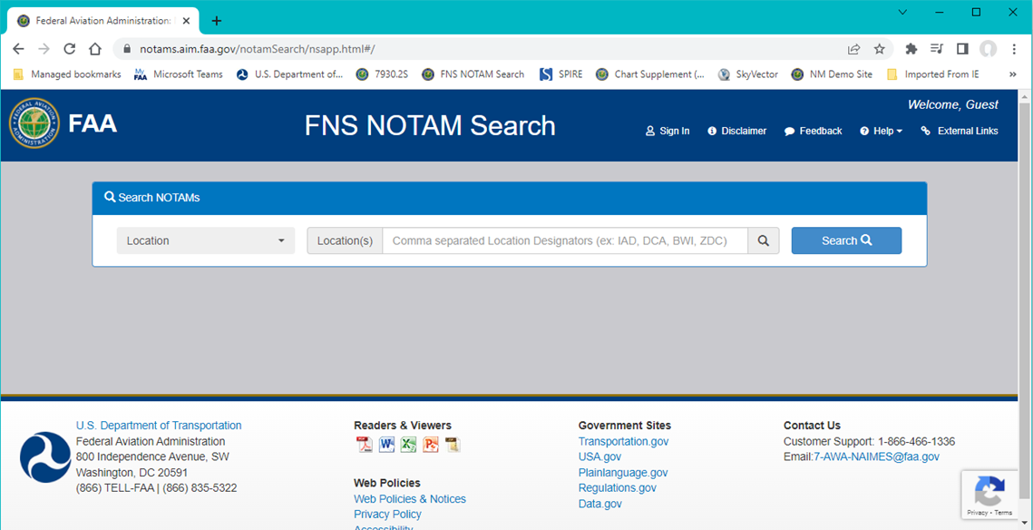
Current NOTAM System: Federal NOTAM System (FNS) NOTAM Search
FNS NOTAM Search
Domestic, ICAO and Plain Language NOTAMs
Letters to Airmen (LTAs)
Closure/Restriction Notice Diagram Automation (CNDA) at select airports
External Links (TFR website, Domestic/International Notices (formerly NTAP), etc.)

Slide 5
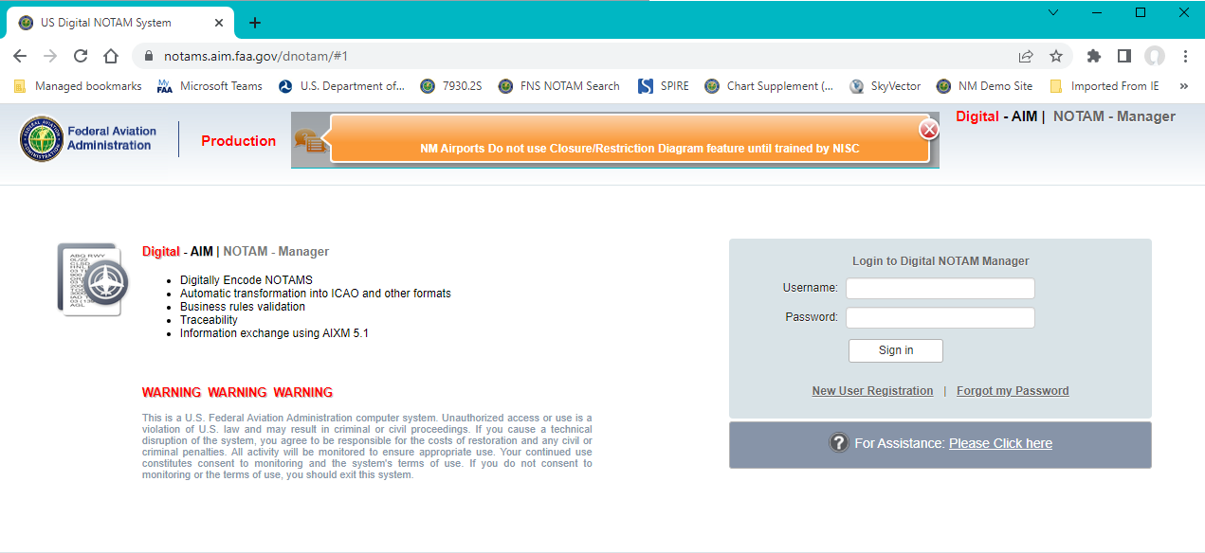
Current NOTAM System: NOTAM Manager
Submitting NOTAMS through NOTAM Manager:
Supports Digital NOTAM Availability
Reinforces Accuracy

Slide 6
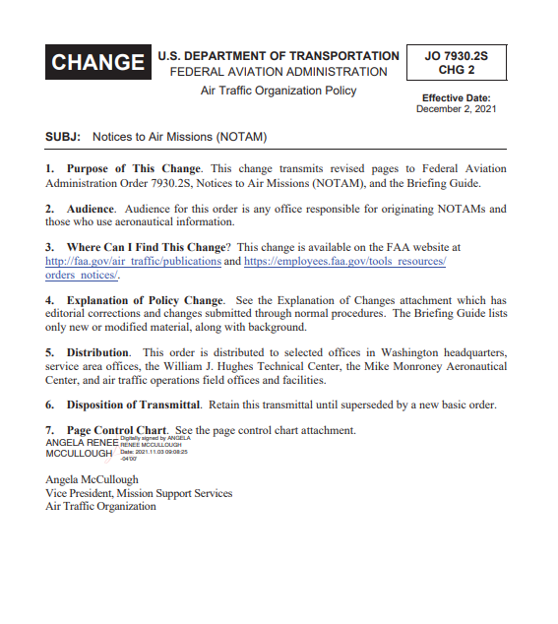
Current NOTAM System: FAA Order 7930.2S, NOTAMs
FAA NOTAM Policy
(Updated December 2021)
TALPA Enhancements for Runway Field Condition (FICON) NOTAMs
Removed standalone dropdown option “GOOD” for braking action NOTAMs
Same NOTAM requirements for ASOS and AWOS outages
NOTAM acronym change
Permanent (PERM) NOTAM updates
AC 150/5200-28, NOTAMs for Airport Operators to be updated with similar requirements

Slide 7
Current NOTAM System: FAA Order 7930.2S, NOTAMs (cont’d)
PERM NOTAM Process
Prior to issuance of a PERM NOTAM, the accountable organization must demonstrate that the publication process has been initiated.
Wildlife and Obstacle NOTAMs

Slide 8
Current NOTAM System: FAA Order 7930.2S, NOTAMs (cont’d)
ASOS and AWOS NOTAM Requirements:
Per NTSB recommendation
Incorporate consistent NOTAM standards for Automated Weather Observing Systems (AWOS) and ASOS, including individual elements as NOTAM criteria
NOTAM Acronym Change:
Changed to the more applicable term Notice to Air Missions
Inclusive of all aviatiors and missions
Seamless change, as continue prevailing use of the term NOTAM

Slide 9
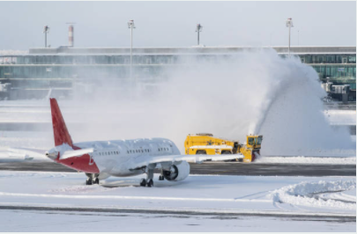
Future NOTAM System: NOTAM Manager TALPA Enhancements
NOTAM Manager to be updated with latest change of FAA Order 7930.2S Takeoff And Landing Performance Assessment (TALPA) Enhancements
Supports the NOTAM reduction effort
No field condition (FICON) NOTAMs will be allowed for closed runway
Only one FICON NOTAM per runway surface, e.g., 04/22

Slide 10
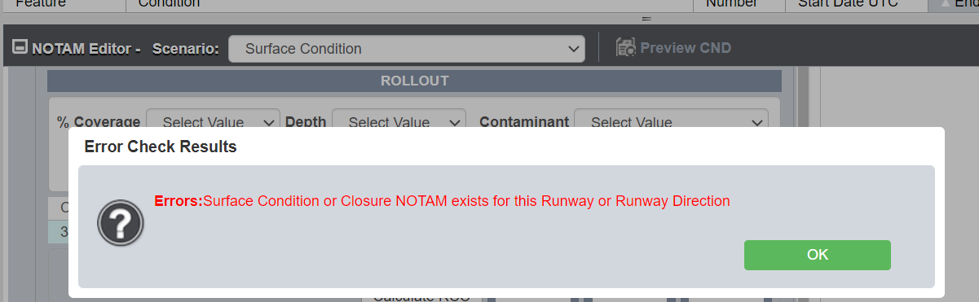
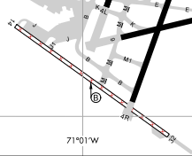
Future NOTAM System: NOTAM Manager TALPA Enhancements (cont’d)
Preventing Runway Surface Condition (FICON) NOTAMs on a runway with an active closure NOTAM
Users will no longer be able to issue surface condition NOTAMs on a runway or runway end that is closed.
  This includes CLSD, CLSD EXC TAX, CLSD EXC XNG
  For example:
    If you have the following active NOTAM:
      RWY 14/32 CLSD EXC TAX
    You cannot issue a surface condition NOTAM for RWY 14 or 32.

Slide 11
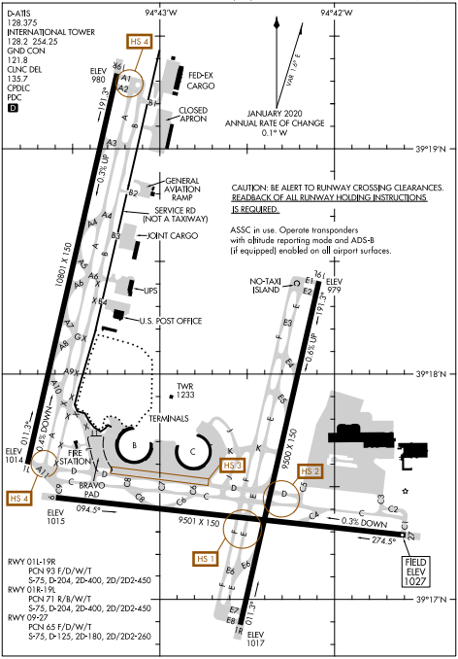
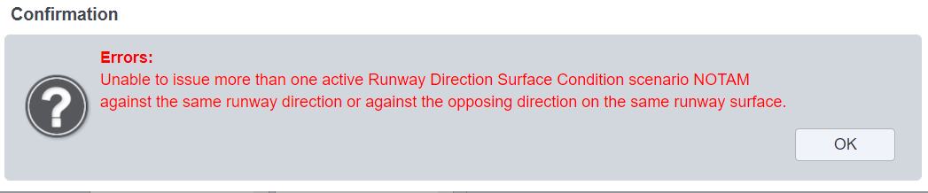
Future NOTAM System: NOTAM Manager TALPA Enhancements (cont’d)
Preventing the issuance of multiple Runway Surface Condition (FICON) NOTAMs against the same runway surface
Users will no longer be able to submit multiple surface condition NOTAMs on the same runway or against the opposing direction of the same runway surface.
  For example:
    If you have the following active NOTAM:
      RWY 09 FICON 3/3/3 100 PCT 4IN DRY SN…
    You will not be able to also issue:
      RWY 27 FICON 3/3/3 100 PCT 4IN DRY SN…

Slide 12
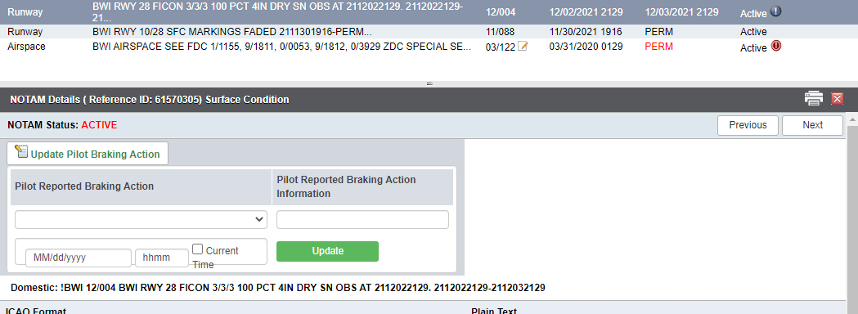
Future NOTAM System: NOTAM Manager Pilot Reported Braking Action
Pilot Reported Braking Action Notes Updates
When reporting pilot reported braking action data, users will be able to include date/time information.
Edit/add pilot reported braking action information in an already issued NOTAM.
The time must be within 1 hour of the NOTAM’s observation time.

Slide 13
Future NOTAM System: FNS NOTAM Search
ICAO Phase 1 (Mid-2022)
FNS software update
Improves automatic translation digital NOTAMs
ICAO-formatted NOTAMs will be available in the NOTAM Search website and the NOTAM Distribution Service (NDS).
ICAO Phase 2 (unknown future date)
The FAA will adopt ICAO requirements for all NOTAMs and implement these requirements via policy and enhancements to the Federal NOTAM System.
This implementation will include NOTAM formatting, numbering, series, and NOTAM codes.
FNS NOTAM Search
The FAA’s ultimate goal is to align with international standards by changing the domestic NOTAM format to ICAO. Done in two phases
Additional airport training and implementation of CNDA
Digital NOTAMs: Increase machine interpretability of NOTAMs to improve graphical display, plain language, filtering, etc.

Slide 14
Future NOTAM System: Why ICAO?
Benefits
All users: Provides NOTAM consumers with one consistent format for domestic and international operations
Pilots: Ability to access the right NOTAMs at the right time
Flight Planning Service Providers: Enhanced capabilities for sorting and filtering of NOTAM data
Global Harmonization: Promotes further global harmonization among neighboring Air Navigation Service Providers (ANSPs)
Supports the NOTAM Modernization effort because…
Domestic NOTAMs: Very limited potential for filtering through automation
ICAO NOTAMs: Help reduce information overload by increasing the amount of digital NOTAMs which supports automation and filtering of NOTAMs

Slide 15
NOTAM Modernization
The FAA is modernizing the NOTAM system
Improve the delivery of safety critical information to aviation stakeholders
FAA’s goal: Provide users of the NAS with NOTAMs that are relevant, timely and accurate
Working in coordination with the Aeronautical Information Services Reform Coalition

Slide 16
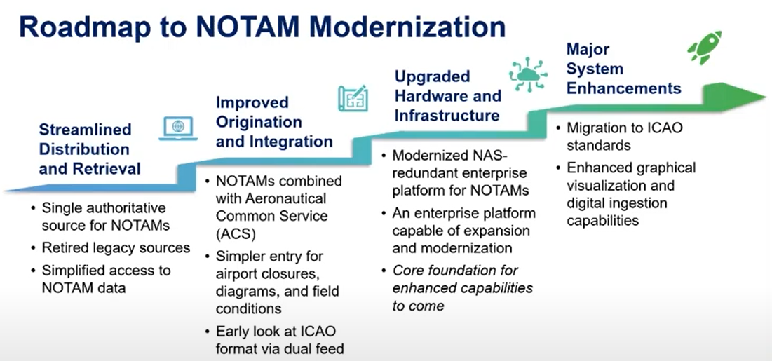
NOTAM Modernization

Slide 17
NOTAM Modernization Initiative
Ensure U.S. NOTAMs are compliant with SARPs set by the International Civil Aviation Organization (ICAO)
Reduce number of NOTAMs
Address FAA Reauthorization Act of 2018 and Pilot’s Bill of Rights
Designed To
Updates to NOTAM Policy Driven by NOTAM Modernization Initiative

Slide 18
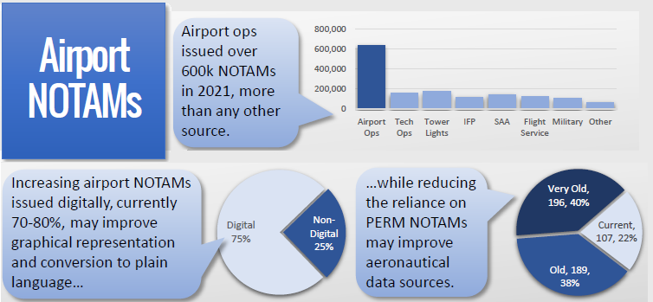
Airport NOTAMs

Slide 19
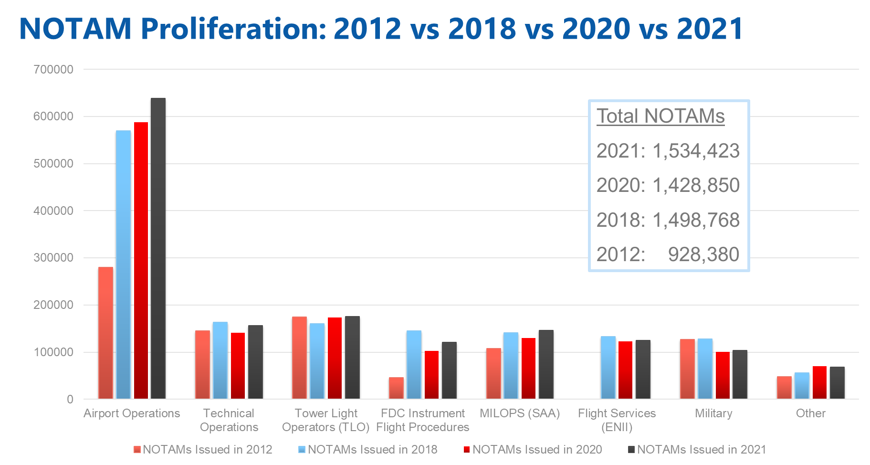
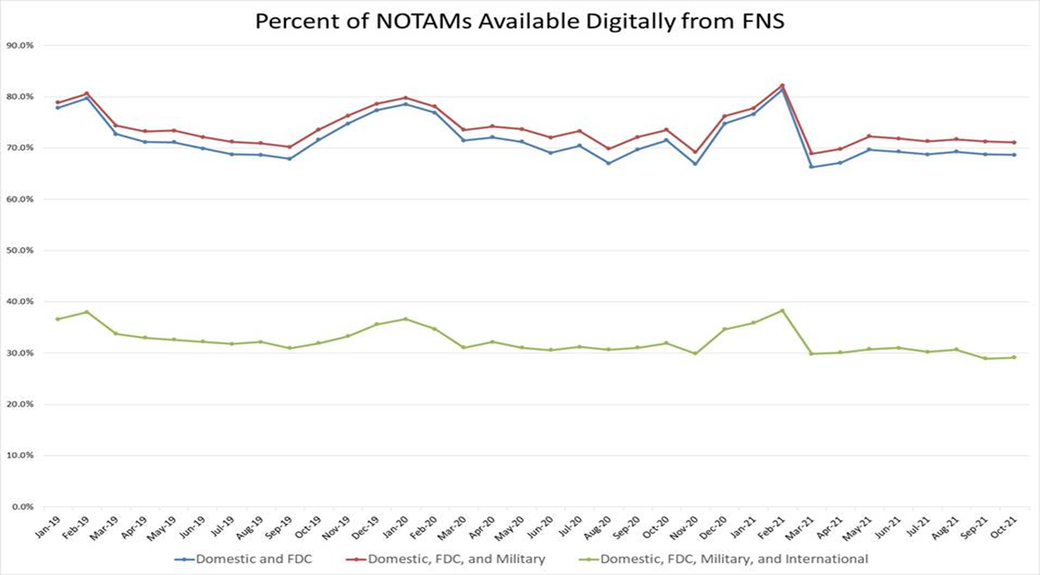
Airport NOTAMs
Airport Operations = single largest NOTAM contributor by volume
Airport Operations = single largest contributor of PERM NOTAMs
Majority of airport PERMs are over 3 months old
1,666 of ~5,000 public use airports use NOTAM Manager to issue digital NOTAMs
Between 70-80% of NOTAMs are available in “digital” format – gap of 20-30%
Notes:
Data Needs:
Complete list of airport NOTAMs currently active (for analysis)
Descriptive data on each NOTAM (issuer, location, class, keyword, digital/non-digital, etc. for metrics)
Longer time period (for metrics baseline and setting performance targets)
Entire NAS, including Alaska
FICON NOTAMs – measure effect of TALPA enhancement to FNS
Ability to repeatedly sample for updating metrics and tracking progress

Slide 20
Goals, Challenges, and Constraints of Airport NOTAMs
Goals:
Reduce the number of NOTAMs a pilot needs to review before flight
Increase confidence in airport-related aeronautical information
Improve how NOTAMs can be converted to plain language and displayed graphically
Challenges and Constraints:
Scale – large volume of NOTAMs, large number of airports
Availability of baseline airport layout data
Resource availability to implement solutions

Slide 21
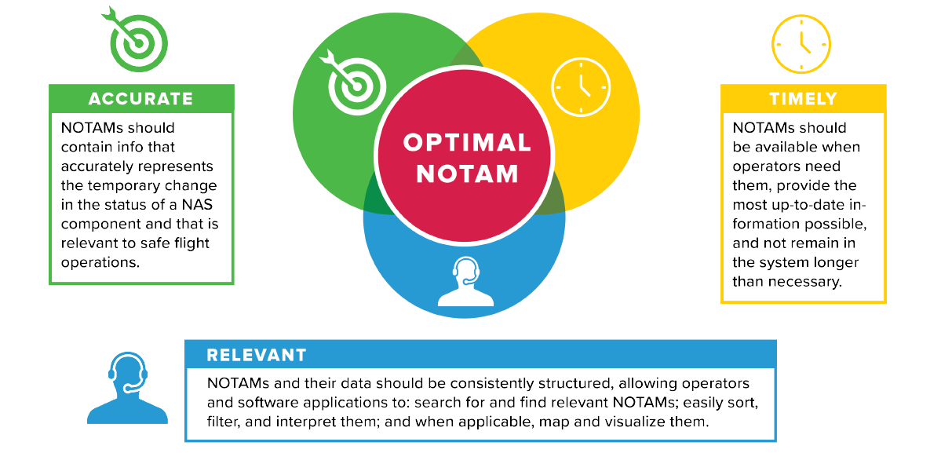
Airport NOTAMs

Slide 22
Airport NOTAMs Best Practices
When originating a NOTAM ask yourself the following questions:
Does this action require a NOTAM and/or meet NOTAM Criteria?
Is the NOTAM being issued with enough time to be distributed to the end user?
Are the proper contractions being used for the NOTAM?
Does the NOTAM clearly define the affected attribute, location and condition?

Slide 23
Airport NOTAMs: Field Condition (FICON) Metrics

Slide 24
Airport NOTAMs: Field Condition (FICON) Metrics

Slide 25
Airport NOTAMs: Surface Condition Reminders
WID FIELD Requirements
If the contaminant is full width of the surface do not include a width
If the contaminant is not full width of the surface include a width of the contaminant and…
  YOU MUST add a remainder with a contaminant type and depth if necessary
  Or…
  If there are ridges (BERMS/SNOWBANKS/WINDROWS/DRIFTS) at the edge of the reported contaminant add them
    If ridges are reported a remainder is not necessary

Slide 26
Airport NOTAMs: Surface Condition Reminders
WID FIELD Requirements Cont.
If the surface is plowed or swept full width DO NOT include plowed or swept or a width
If the surface is plowed or swept but not full width of the SFC include a width and…
  YOU MUST Include a remainder with a contaminant type and depth if necessary
  OR…
  If there are ridges (BERMS/SNOWBANKS/WINDROWS/DRIFTS) at the edge of the plowed surface add them
    If ridges are reported a remainder is not necessary
If the surface is SANDED/DEICED/SCARIFIED full width do not include a width.
If the surface is SANDED/DEICED/SCARIFIED but not full width include the width

Slide 27
Airport NOTAMs: PERM NOTAM
PERM NOTAM Purpose: Ultimately have NOTAM data published
Reminder: Prior to issuance of a PERM NOTAM, publication process must be initiated

Slide 28


Questions?

