Slide 1
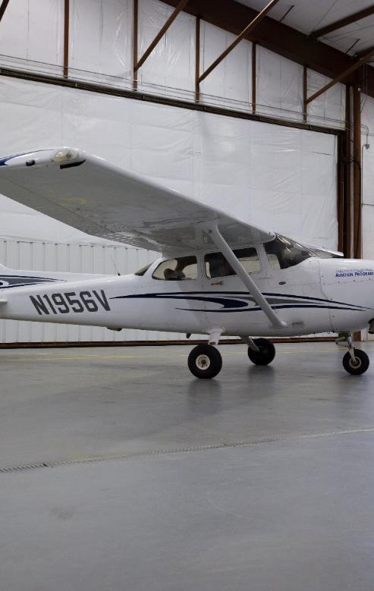
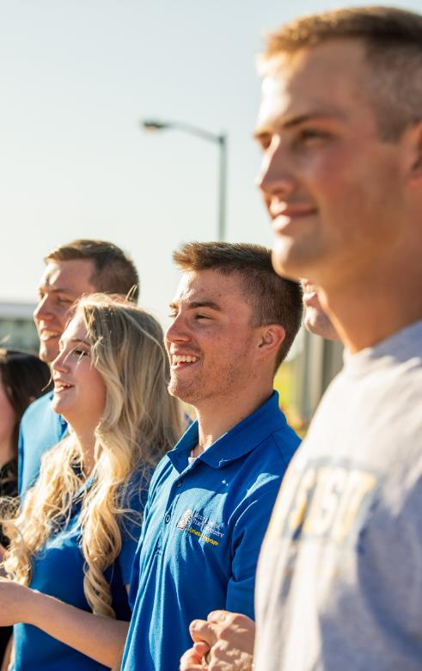
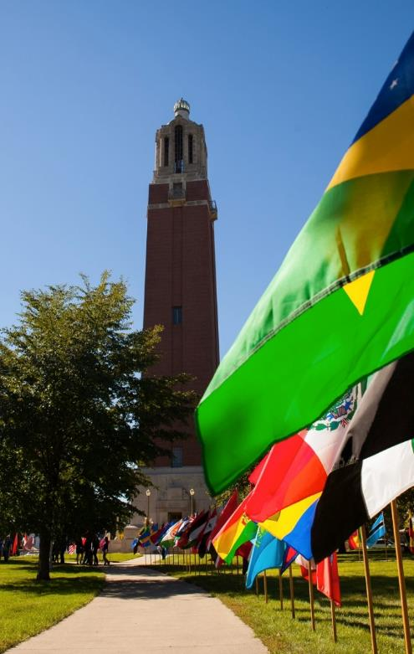
SDSU Flight Training update
Dr. Cody Christensen
Associate Professor Aviation

Slide 2
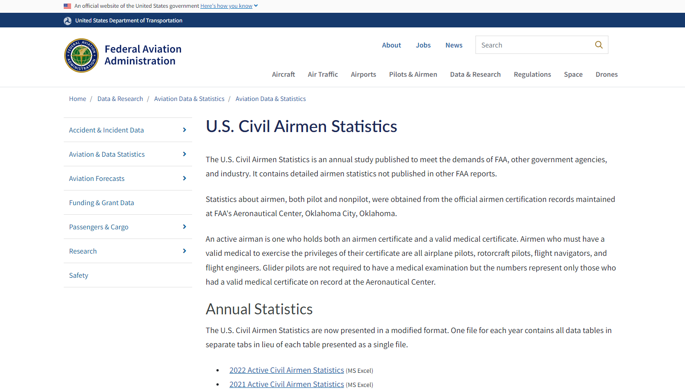

Slide 3
Source: https://www.faa.gov/
Notes:
https://www.faa.gov/data_research/aviation_data_statistics/civil_airmen_statistics

Slide 4
Source: https://www.faa.gov/
Notes:
https://www.faa.gov/data_research/aviation_data_statistics/civil_airmen_statistics

Slide 5
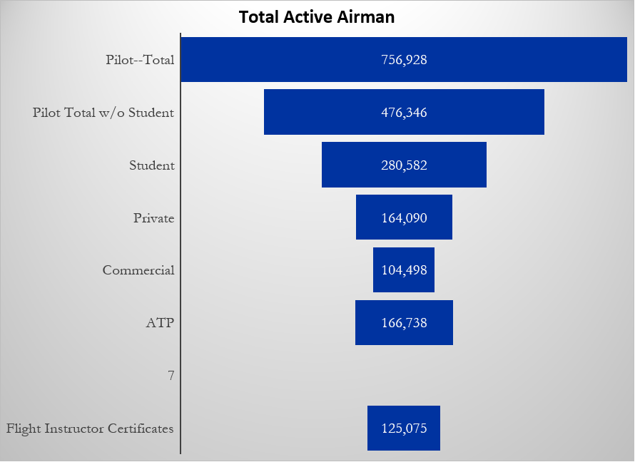
Source: https://www.faa.gov/
Notes:
https://www.faa.gov/data_research/aviation_data_statistics/civil_airmen_statistics

Slide 6
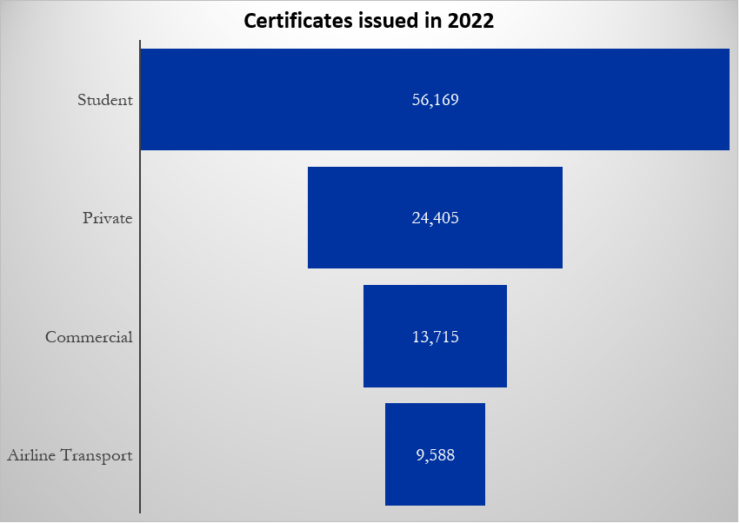
Source: https://www.faa.gov/

Slide 7
Age 21 to 65
Boeing 128,000 new pilots next 20 years
Source: FAA & Boeing.com 2022-Pilot-Technician-Outlook
Notes:
https://www.faa.gov/data_research/aviation_data_statistics/civil_airmen_statistics
https://www.boeing.com/resources/boeingdotcom/market/assets/downloads/2022-Pilot-Technician-Outlook.pdf
69,649 retirements (40%)

Slide 8
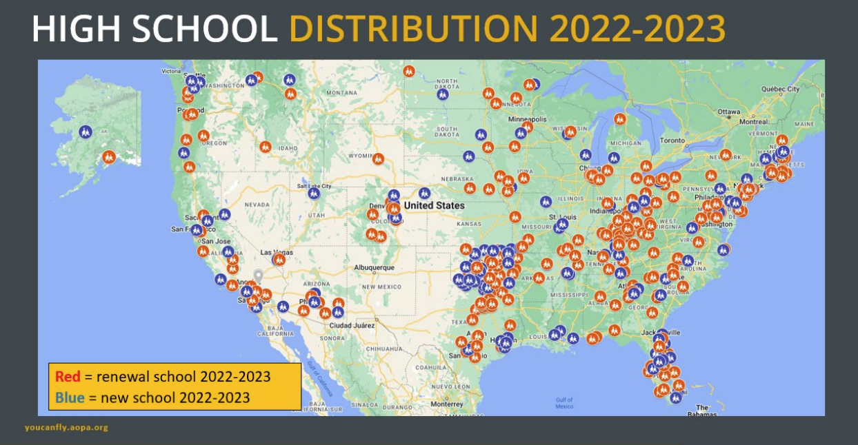
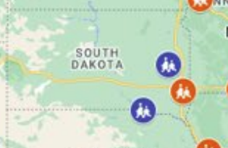

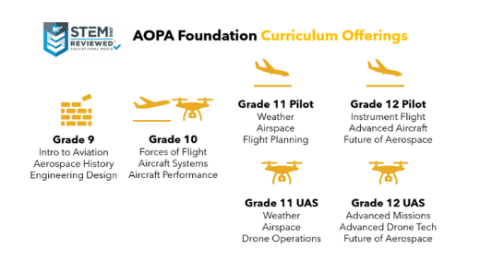
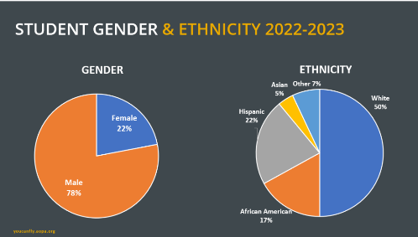
Source: www.youcanfly.aopa.org
Notes:
www.youcanfly.aopa.org
Kimball High School
Lake Preston School
CTE Academy Sioux Falls School District
Marty Indian High School

Slide 9


Slide 10
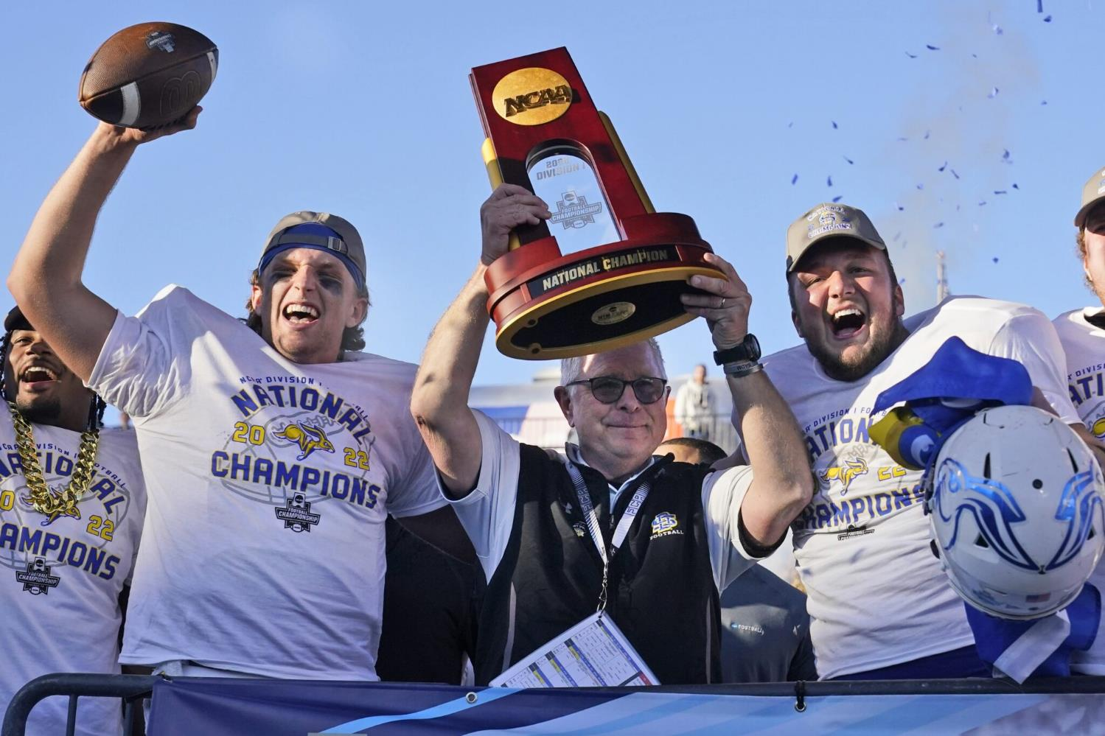

Slide 11
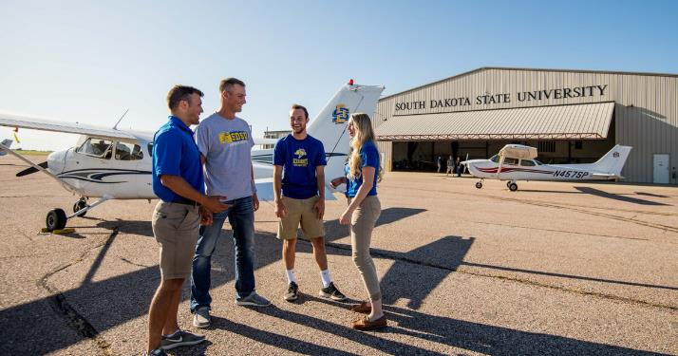
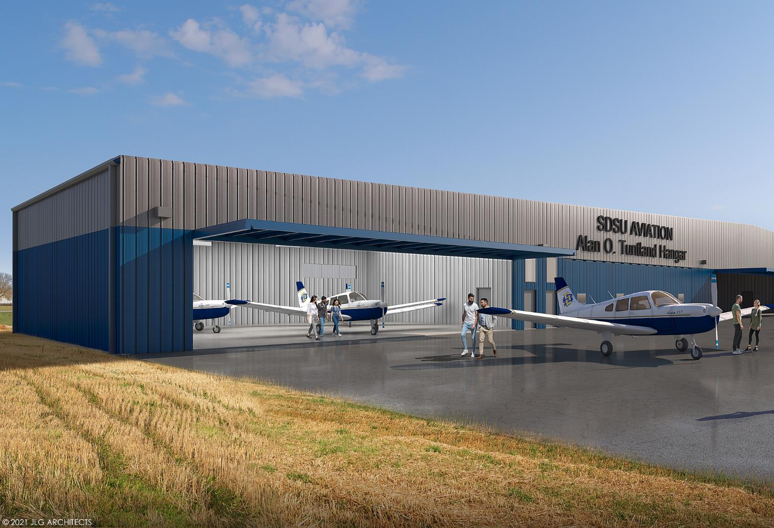

Slide 12
Student/enrollment updates
13 Skyhawks
2 Seminole
1 Citabria
3 Sims
4 Skyhawks
1 Arrow
1 Seminole
1 Sim

Slide 14
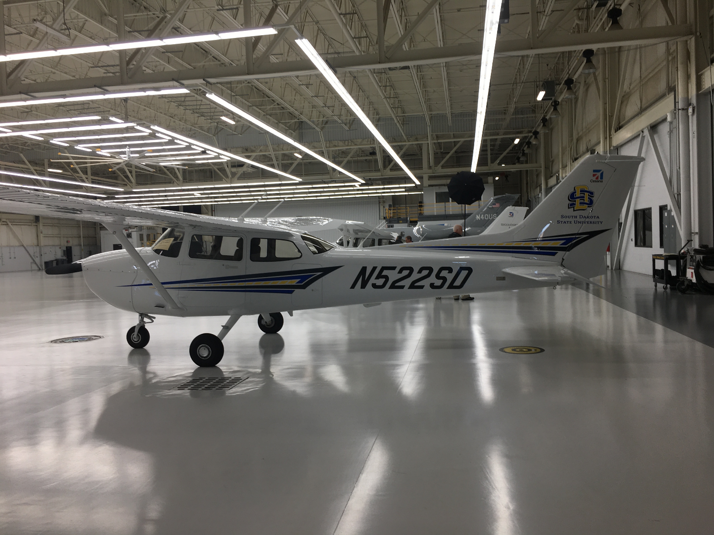
Cessna Skyhawk 172

Slide 15
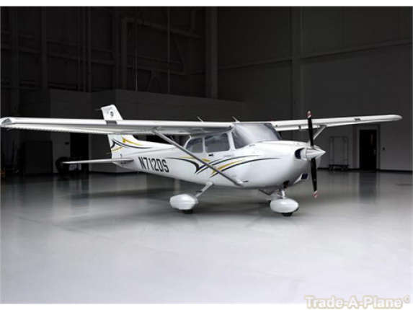
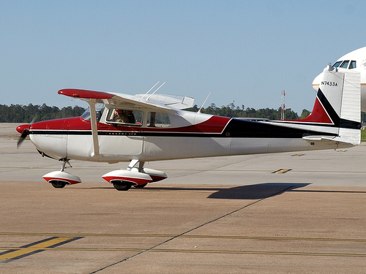
Cost increase
New 1956: $ 8,700
Today's dollars $ 96,000
2014 C172SP $292,000
2016 C172SP $395,000
2022 C172SP $492,000
2025 C172SP $525,000
Notes:
Source: trade-a-plane.com
www.controller.com

Slide 16
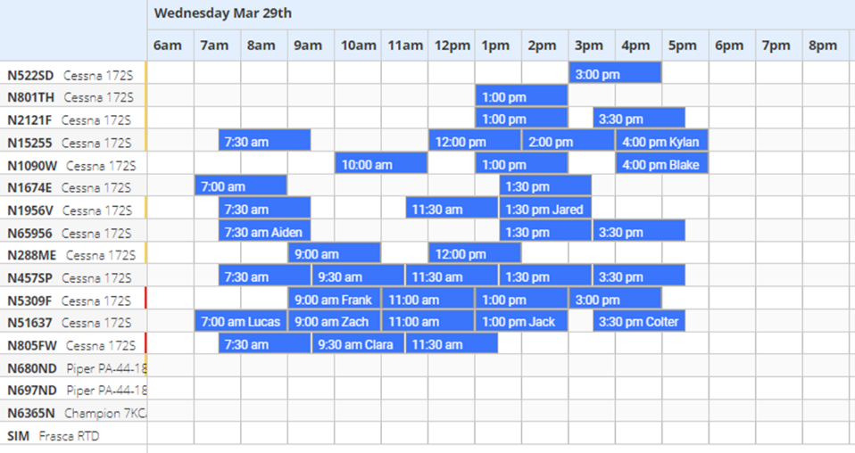
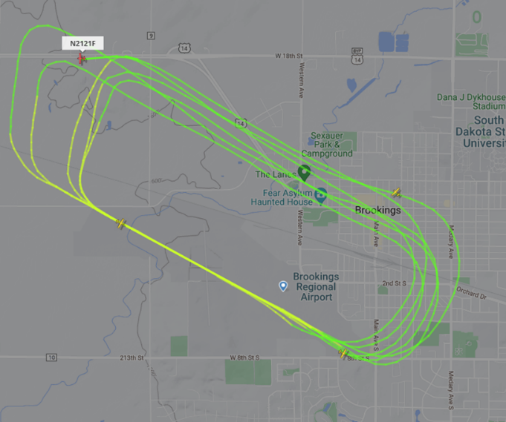
SDSU operations
Do right by our students/ constituents/ stakeholders
Excel in our focused area
  Aviation educators
Growing pains
Skilled employees
Size/growth
Environment
Costs
Notes:
3,857 ops in Feb
137 ops/day
10 bad weather days

Slide 17
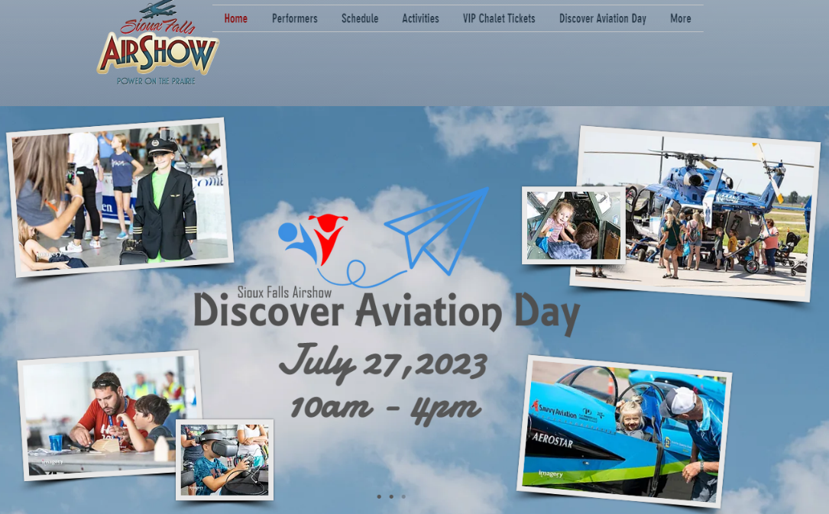
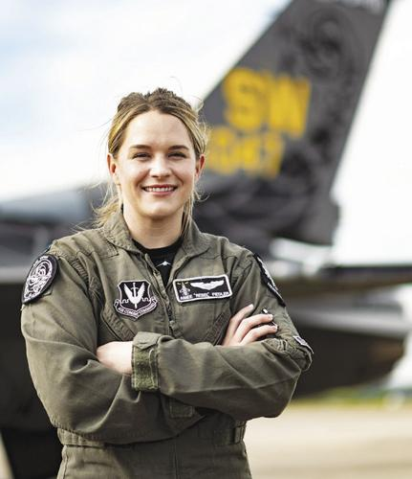
Questions?
Cody.Christensen@sdstate.edu
Notes:
https://www.shaw.af.mil/Portals/98/Viperdemo/Capt%20Fiedler%202022.pdf

