Slide 1
Airfield Asphalt Preservation & Maintenance
Shane Steiner, KLJ
Joe LaRusso, Asphalt Systems Inc.
Greg Cline P.E., Consultant

Slide 2
Pavement preservation to slow deterioration
Applying the right treatment, to the right pavement, at the right time
NOTE: As much as 60 percent of the life of asphalt pavement is lost in the first two years through oxidation. [from The Foundation For Pavement Preservation]
Asphalt Pavement consists of aggregate and asphalt binder
Aggregates are usually not significant factors in pavement deterioration
Asphalt Binder (the “glue” that binds the aggregate together) breaks down by oxidation from the weather, resulting in pavement deterioration
The aggregate literally comes “unglued”. Therefore, the answer to asphalt pavement maintenance and preservation is, in basic terms, very simply ~
SAVE THE BINDER AND YOU SAVE YOUR PAVEMENT

Slide 3
THE RIGHT TIME
Early Treatment
Simplified
Natural
Intermediate Treatment
Aging
Curve
Curve shape determined by materials, construction quality, climate, timing of maintenance
Early treatments typically perform longer than late treatments
Pavement Condition
Late Treatment
Timing for Preservation Matters
Pavement Age Increasing
Notes:
The earlier you start the more economical treatments Fog seal-Emulsions-Slurry Seal – Microsurfacing – thin overlay – thicker overlay - reconstruction

Slide 4
Pavement Preservation Techniques
Pavement Preservation Techniques
Surface Treatments for Airport Pavements
Crack Sealing of Airport Asphalt Pavements
Full Depth Asphalt Patching
~
Seal Coats
Notes:
Others will be covering surface treatments, crack sealing and full depth patching….since seal coats new to 10G I will go over a litt

Slide 5
Asphalt Surface Treatments
Terminology for materials and processes used in Preventative Maintenance differs throughout the US.
Asphalt Surface Treatment is any application of asphalt materials to roadway with a thickness <1”, including Fog Seal, Slurry Seal, and Micro-Surfacing [National Center for Pavement Preservation].
Fog Seal is a light application of diluted asphalt emulsion (normally 1:1) to enrich the pavement surface, seal small cracks & surface voids, and hinder oxidation.
Slurry Seal is a mixture of ~ 10% emulsified asphalt, and 90% fine aggregate and additives applied in a very thin wearing-layer to protect against moisture and air intrusion.
Micro-Surfacing is like Slurry Seal but “better”, using polymer-modified asphalt emulsion, high quality fine aggregate, and other additives; in addition to being a wearing-surface to protect the pavement from surface wear, it also fills cracks or rutting and may increase friction.
Notes:
Chip seals not recommend on movement area not sure why listed.

Slide 6
Effectiveness of Treatments
Estimated Life Extension (years)
Treatment | Good PCI > 80 | Fair PCI > 60 | Poor PCI >40
Fog Seal: Rejuvenator | < 1 | - | -
Fog Seal: Spray Applied Seal | 3-5 | 1-3 | 1-2
Slurry Seal | 5-7 | 3-5 | 1-3
Micro-surface | 8-12 | 5-7 | 2-4
Thin HMA | 10-12 | 5-7 | 2-4
Table is based on AAPTP Report 05-07 Table 4-1
For PCI < 60 : surface treatment typically not recommend ~ unless rehabilitation/reconstruction not practical – it will buy a little time
Notes:
6
Table 3.1 gives expected life extensions of various treatments, showing that treatment application at the right time (PCI level) results in a longer lasting pavement.
The major cause of asphalt age hardening in HMA pavements is oxidation. Therefore, one goal of pavement preservation is to delay aging by restricting the supply of oxygen to the pavement by reducing the surface permeability. Another important goal of preservation is to protect the pavement from moisture damage, which can also be delayed by reducing surface permeability. This can be done with varying degrees of success by applying spray applied seals, chip seals, micro surfacing or slurry seals, or other applications that apply asphalt emulsion to the surface in sufficient quantities to prevent intrusion of air and water. Heavier emulsion applications may be needed when surface permeability is high. Unsealed cracks serve as pathways for moving air and water into underlying layers, so cracked, permeable pavements may not be candidates for preventive seals, unless they are crack-sealed before treatment. Since some oxygen will always be available to the asphalt, sealing strategies are most effective if applied early before binder properties age to critical cracking conditions. The objective is to apply the surface seal prior to the point where the curve begins to bend downward.
**DBJ Comment this shows putting on surface treatments on pavements with PCI < 70, not sure we would promote surface treatments on a pavement with a PCI of 40.

Slide 7
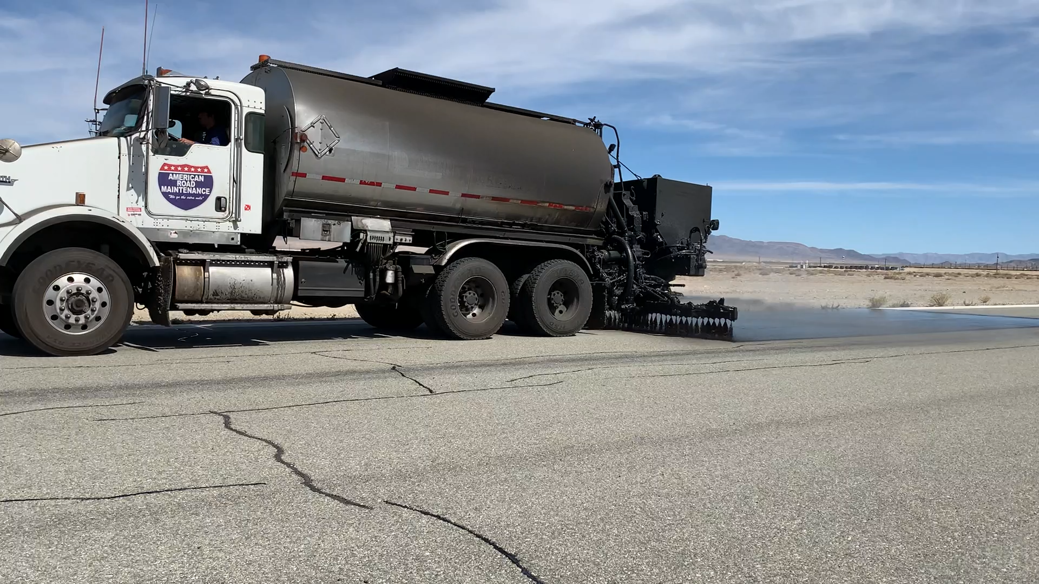
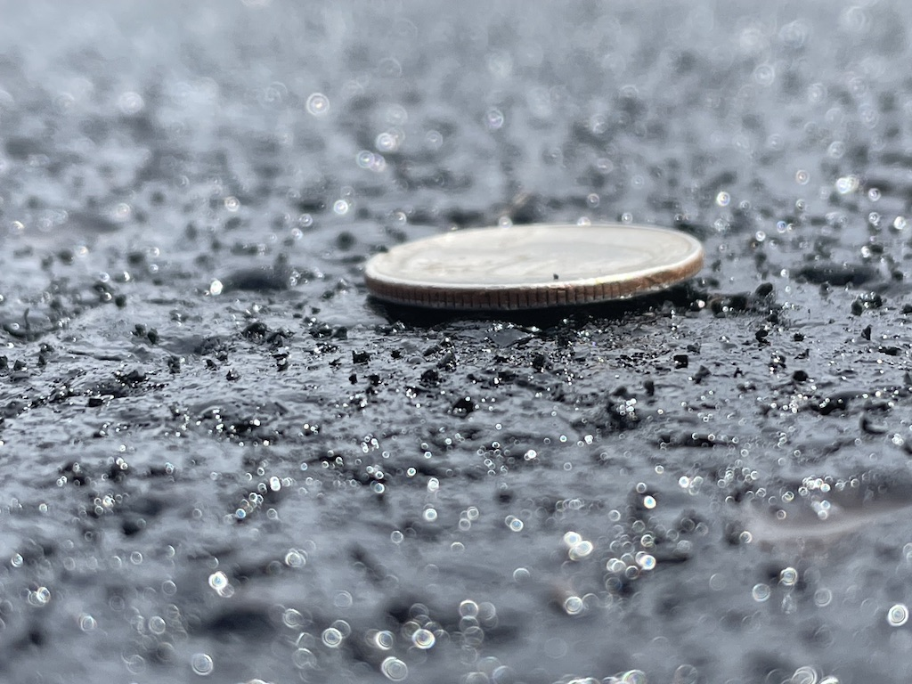
Estimated Pricing
P-101 Crackfill: $1.50 - $2.00 LF
P-608: $1.50 - $2.00 SY
P608H: $3.50 - $4.50 SY
P-626: $4.00 - $5.00 SY
P-629: $5.00 - $6.00 SY

Slide 8
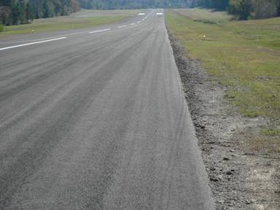
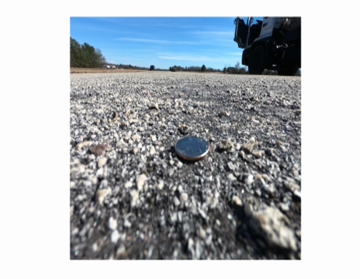
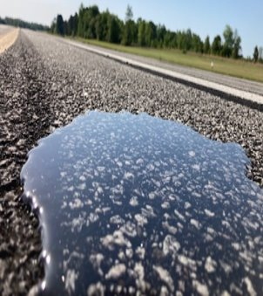
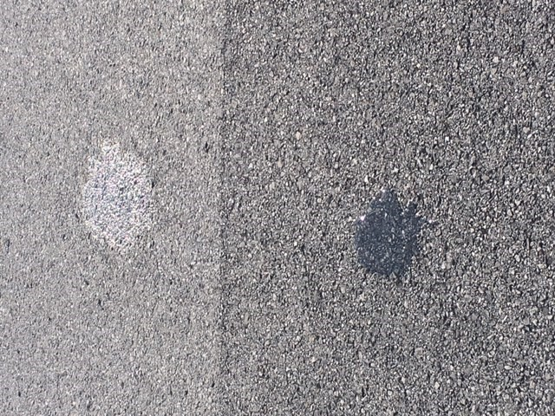
Are My Airport Asphalt Pavements Sealed?
What does “sealed” look like?
Before: PCI of 30
2.5 yrs after GSB-88® application.
10 mins after water applied.
Unsealed Pavement sealcoat
3 yrs old
6 mins after water applied
2 minutes after
water applied
© Copyright 2022 Asphalt Systems Inc. All rights reserved.

Slide 9
Airport Use/Application of Surface Treatments
Notes:
9
Table 3.1 gives expected life extensions of various treatments, showing that treatment application at the right time (PCI level) results in a longer lasting pavement.
The major cause of asphalt age hardening in HMA pavements is oxidation. Therefore, one goal of pavement preservation is to delay aging by restricting the supply of oxygen to the pavement by reducing the surface permeability. Another important goal of preservation is to protect the pavement from moisture damage, which can also be delayed by reducing surface permeability. This can be done with varying degrees of success by applying spray applied seals, chip seals, micro surfacing or slurry seals, or other applications that apply asphalt emulsion to the surface in sufficient quantities to prevent intrusion of air and water. Heavier emulsion applications may be needed when surface permeability is high. Unsealed cracks serve as pathways for moving air and water into underlying layers, so cracked, permeable pavements may not be candidates for preventive seals, unless they are crack-sealed before treatment. Since some oxygen will always be available to the asphalt, sealing strategies are most effective if applied early before binder properties age to critical cracking conditions. The objective is to apply the surface seal prior to the point where the curve begins to bend downward.
**DBJ Comment this shows putting on surface treatments on pavements with PCI < 70, not sure we would promote surface treatments on a pavement with a PCI of 40.

Slide 10
Airport Use/Application of Surface Treatments
Notes:
10
Table 3.1 gives expected life extensions of various treatments, showing that treatment application at the right time (PCI level) results in a longer lasting pavement.
The major cause of asphalt age hardening in HMA pavements is oxidation. Therefore, one goal of pavement preservation is to delay aging by restricting the supply of oxygen to the pavement by reducing the surface permeability. Another important goal of preservation is to protect the pavement from moisture damage, which can also be delayed by reducing surface permeability. This can be done with varying degrees of success by applying spray applied seals, chip seals, micro surfacing or slurry seals, or other applications that apply asphalt emulsion to the surface in sufficient quantities to prevent intrusion of air and water. Heavier emulsion applications may be needed when surface permeability is high. Unsealed cracks serve as pathways for moving air and water into underlying layers, so cracked, permeable pavements may not be candidates for preventive seals, unless they are crack-sealed before treatment. Since some oxygen will always be available to the asphalt, sealing strategies are most effective if applied early before binder properties age to critical cracking conditions. The objective is to apply the surface seal prior to the point where the curve begins to bend downward.
**DBJ Comment this shows putting on surface treatments on pavements with PCI < 70, not sure we would promote surface treatments on a pavement with a PCI of 40.

Slide 11
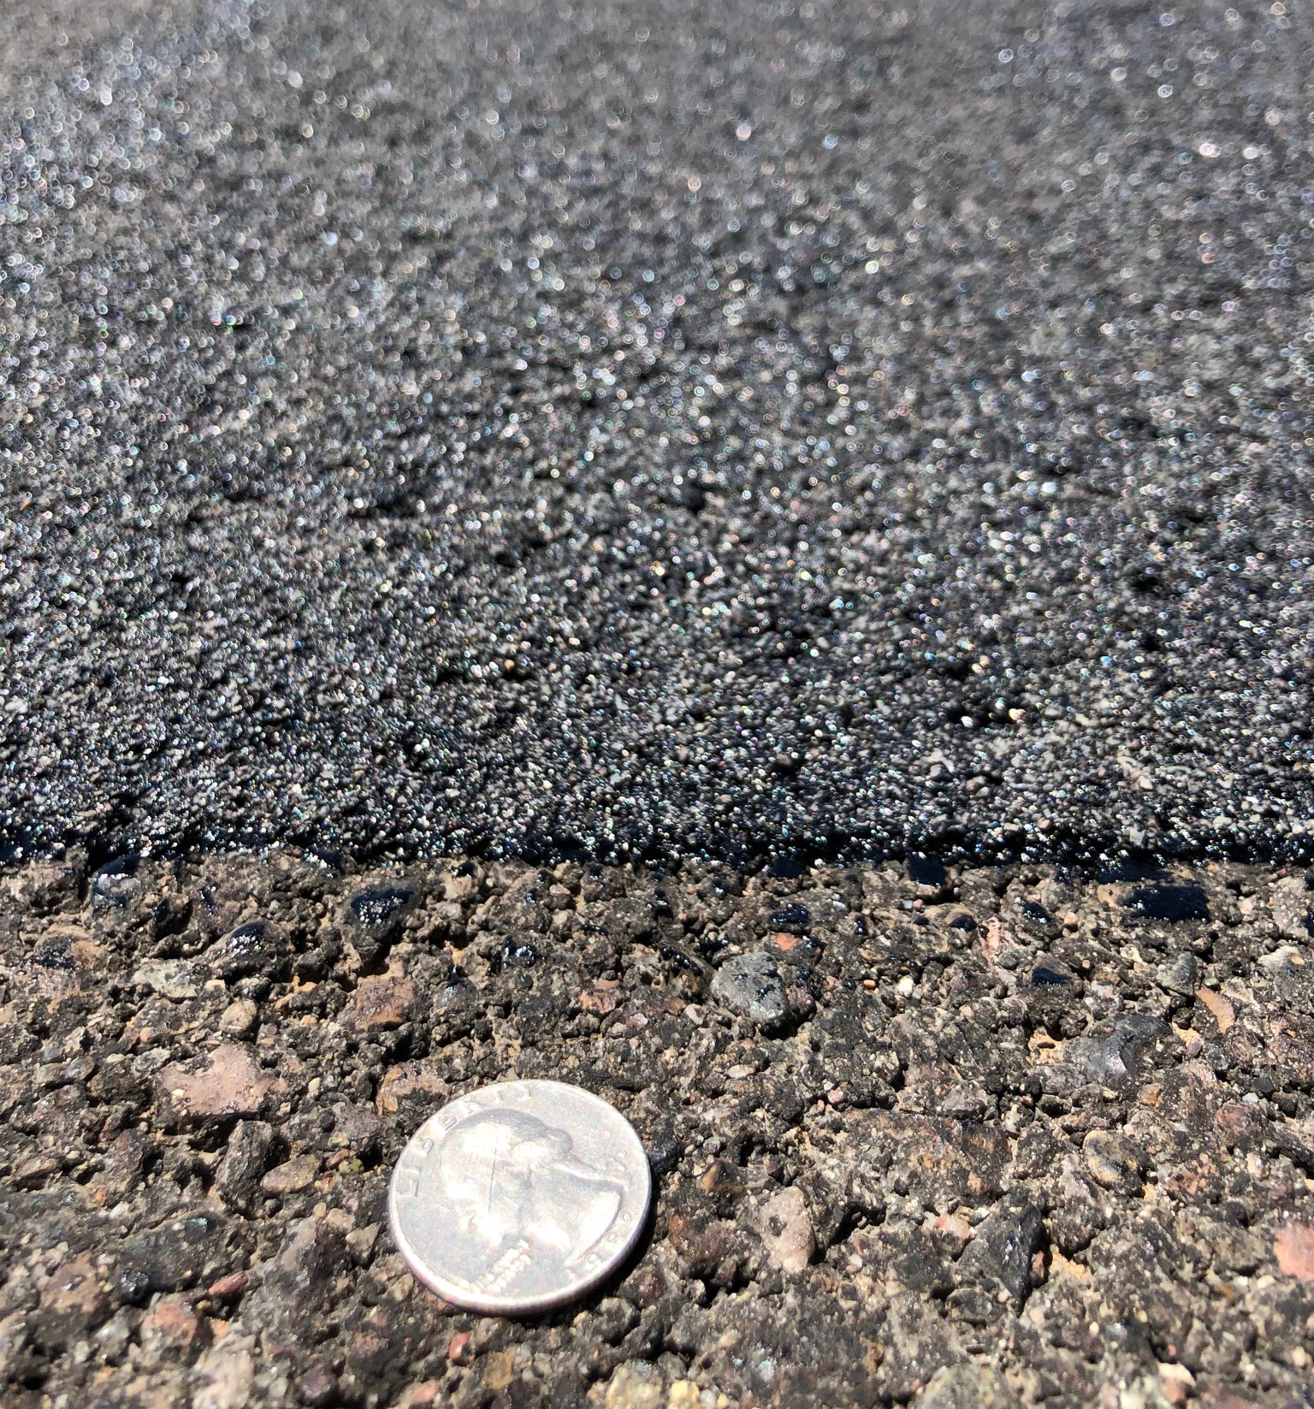
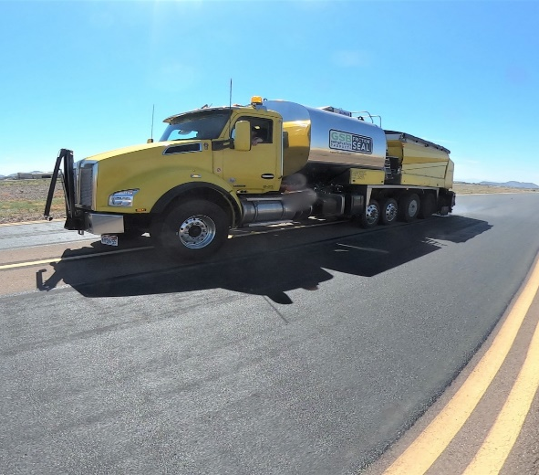
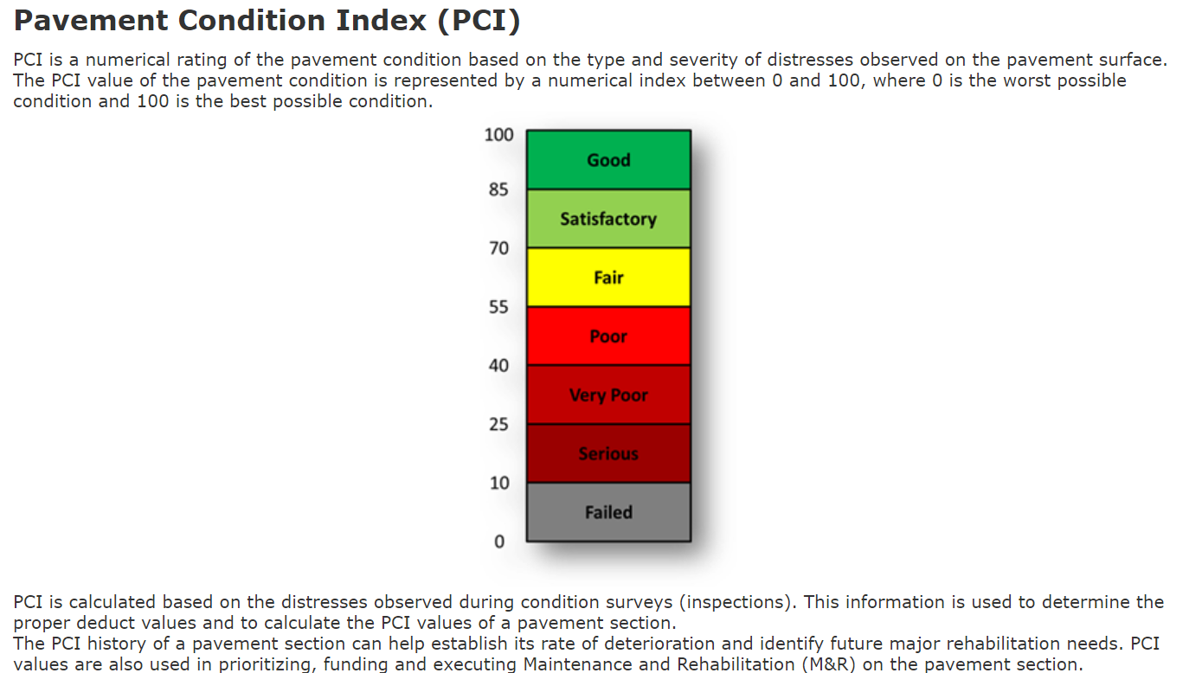
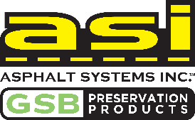
P608H – The Treatment
2- to 4-times the residual asphalt of standard P-608
High polymer loading
ESL to pavement 7-10 years.
$3.50 - $4.50 sy VS $20+ sy new HMA
© Copyright 2022 Asphalt Systems Inc. All rights reserved.

Slide 12
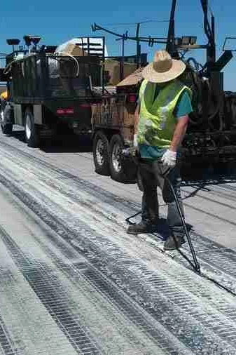
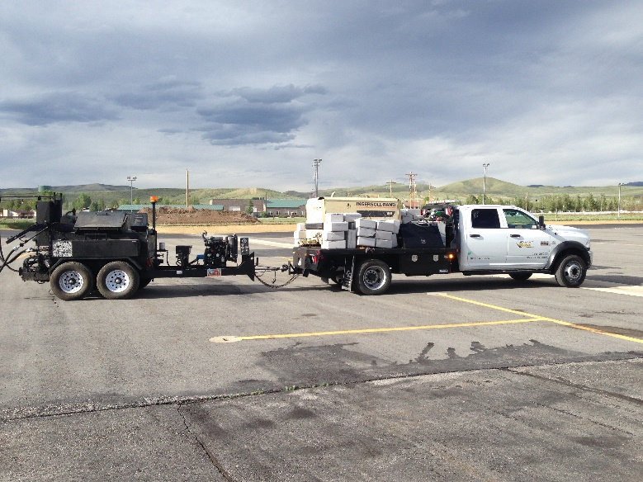
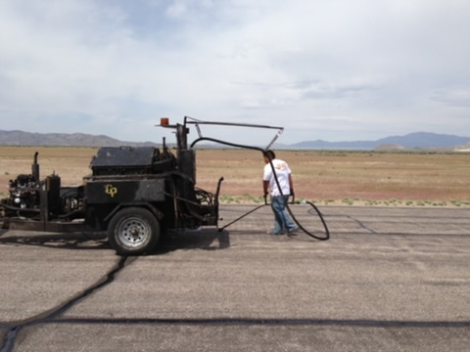
Project Sequence
Pavement Marking Obliteration
Clean Pavement
Crackfill
Sealcoat
Pavement Markings
© Copyright 2022 Asphalt Systems Inc. All rights reserved.

Slide 13

Best Practices

Slide 14

Questions
© Copyright 2022 Asphalt Systems Inc. All rights reserved.

