Slide 1
Environmental Updates
SD Conference 2023
Dakota-Minnesota Airports District Office
Sheri G. Lares, Regional Tribal Consultation Official/Environmental Protection Specialist

Slide 2
Points of Interest
2023 Preapp Recap
Phase Transition Review
Commitment Compliance
Tribal Consultation
Endangered Species Act Update
Floodplain Update – EO 13690
Waters of the US Rule Update
Section 4(f)

Slide 3
2023 Recap of Preapplications
FAA uses preapp to process environmental approval (SWR).
Ensure that the preapp project work description and sketch match and is most current info.
Any changes to the project description and/or sketch could affect the environmental approval and/or consultation that has been completed
Do not want to do things twice!

Slide 4
Phase Transition Reviews
Please review your environmental approval during Design Phase to ensure that it remains valid, and any commitments have been addressed in Design plans and/or special provisions.
Be aware of any change to footprint or additional items not previously covered (scope creep).
During Construction Phase – any change orders should be considered for any applicable environmental impacts or implications to environmental approval.

Slide 5
Commitment Compliance
Communicate environmental commitments to the engineer to incorporate into the design plans and specifications.
Include inadvertent discovery plan into the contract documents
Discuss the plan during the preconstruction meeting and provide project communication plan contacts

Slide 6
Oversight/Quality Control
If commitments are not documented or monitored to ensure that the commitments were implemented or effective, it may result in:
Failure to advance NEPA’s purpose of ensuring informed and transparent environmental decision-making
Undermine the integrity of the NEPA review
Issues with the ability to close out the project
Could jeopardize Federal funding with related compliance issues

Slide 7
Tribal Consultation
FAA serves as the lead Federal agency and consults with up to 26 tribes affiliated with the great plains on transportation projects.
Early coordination
Field surveys during planning
Consultation during NEPA
Commitment for construction monitoring will need to be included in scope/fee for construction
Coordinate with DMA ADO EPS to initiate coordination for surveys/monitoring.
Consultant provides APE or survey boundary map for FAA to coordinate with Tribe(s) affiliated with the area.
Consultant handles the daily logistics and costs.
Scope/Fee needs to include costs associated with survey/monitoring.

Slide 8
Endangered Species Act Update
11/29/22 USFWS published final rule to reclassify the NLEB from threatened to endangered, nullifying existing 4d rule.
Effective date delayed to 3/31/2023 to develop guidance and tools to help transition to reclassification.
Interim Section 7 Framework*
Determination Key
Interim Guidance for forest habitat modification*
Interim Guidance for wind energy ops.*
After 3/31/2023 Use NLEB range wide D Key (4d rule no longer valid)
*In place to 4/1/2024

Slide 9
Floodplain Update - EO 11988 Amended by EO 13690/EO 14030
Presidents Climate Action Plan directed Fed agencies to update flood-risk reduction standards to improve resilience to flooding and to better prepare the US for impacts of climate change.
EO 13690 requires Federal agencies to incorporate Federal Flood Risk Management Standards (FFRMS) into the implementation of EO 11988.
FFRMS improves implementation of EO 11988
Encourages use of natural features and nature-based approaches in the development of alternatives to increase resiliency against flooding.
The FFRMS flood hazard elevation establishes the level to which a structure or facility must be resilient.
Provides approaches to establishing a higher vertical elevation and corresponding floodplain that MUST be applied to Fed projects to address current and future flood risks to ensure that projects federally funded with taxpayer dollars last as long as intended.

Slide 10
FFRMS Approaches to Identification of Floodplains
Climate Informed Science Approach (Preferred)– use of best available, actionable hydrologic and hydraulic data and methods that integrate current and future changes in flooding based on climate science
Freeboard Value Approach – based flood elevation of 1% annual flood [(BFE) + X] (X = 2 feet for non-critical action or 3 feet for critical action)
500 year Floodplain Approach – area subject to flooding by the 0.2% annual chance flood

Slide 11
Effects of EO on FAA Floodplain Analysis
1050 Desk Reference instructs practitioners to identify if floodplain is in study area:
FIRM maps
FEMA flood hazard boundary map or Flood Insurance Study
Contact with FEMA or state/local fp agency
Desk Reference under revisions/updates.
Practitioners should now use the FFRMS establishing approaches for identification of floodplains for federally funded projects.
Until further guidance issued continue to follow the Desk Reference for all aspects of floodplain analysis.
Critical action is defined as any activity for which even a slight chance of flooding is too great. This includes damage or disruption to infrastructure. Described further in the 2015 Guidelines for Implementing EO 11988 and EO 13690

Slide 12
Wetland Update – WOUS Final Rule
Revised definition of WOUS in Federal Register 1/18/23 and became effective 3/20/23.
Rule considered:
Relevant provisions of the CWA and statute as a whole;
Relevant case law;
Agencies (EPA/USACE) technical expertise (over 45 years) implementing the pre2015 WOUS framework;
Best available science; and
Extensive public comment to establish definition of WOUS that supports public health, environmental protection, ag activity and economic growth.

Slide 13
WOUS Final Rule
Agencies are interpreting “WOUS” to mean the waters defined by the familiar pre-2015 regulations, with amendments, to reflect agencies determination of the statutory limits on the scope of WOUS.
Rule is organized into 3 parts:
Jurisdictional waters;
Exclusions; and
Definitions.

Slide 14
Organized Areas of Rule (Parts 1&2) *Excluded pre2015, now modified in final rule ** Generally nonJD pre2015, now exclusions in final rule
Jurisdictional Waters
Exclusions
(a)(1)(i) Traditional Navigable Waters
(a)(1)(ii) Territorial Seas
(a)(1)(iii) Interstate Waters
(a)(2) Impoundments of JD Waters
(a)(3) Tributaries
(a)(4) Adjacent Wetlands
(a)(5) Intrastate lakes, ponds, streams, and wetlands that do not fall into (a)(1) – (a)(4)
(b)(1) Waste Treatment Systems*
(b)(2) Prior Converted Cropland*
(b)(3) Certain Ditches**
Excavated wholly in upland and draining only upland and that do not carry a relatively permanent flow of water
(b)(4) Artificially Irrigated Areas that would not revert to dryland without irrigation**
(b)(5) Certain artificial lakes and ponds**
(b)(6) Artificial reflecting or swimming pools or other ornamental bodies of waters**
(b)(7) Certain water filled depressions**
(b)(8) Swales and erosional features**

Slide 15
WOUS Key Concepts
Relatively permanent standard – i.e. waters are relatively permanent, standing or continuously flowing body of water with a continuous surface connection to an (a)(1) water or relatively permanent tributary.
Agencies expect that there will be a slight increase in waters being found JD; related to the implementation of the relatively permanent and significant nexus standards.
In summary – in comparison to the regulatory regime of the past 15 years, it was estimated that the final rule will have a de minimis impact.

Slide 16
DOT Act Section 4(f) of 1966
Publicly owned parks and recreation areas
Wildlife and waterfowl refuges
Historic properties on or eligible for listing on NRHP
Archaeological sites including traditional cultural properties that are NRHP eligible and important for preservation rather than for data recovery
Historic districts

Slide 17
Types of Historic Sites on Airports
Buildings/Districts
Transportation facilities (radar stations, beacon towers, runways)
Historic trails and ditches
Archaeological sites (additional criteria)
Traditional cultural properties

Slide 18
Determining Section 4(f) Use
Three conditions under which use occurs:
Permanent Incorporation – resource is acquired for the project
Temporary Occupancy – temporary use that is adverse to the purpose of the resource
Constructive Use – proximity impacts that are so great that the activities, features and attributes are substantially impaired.
FAA may not approve the use of a Section 4(f) property unless:
There is no feasible or prudent avoidance alternative to use of the land
The action includes all possible planning to minimize harm to the property

Slide 19
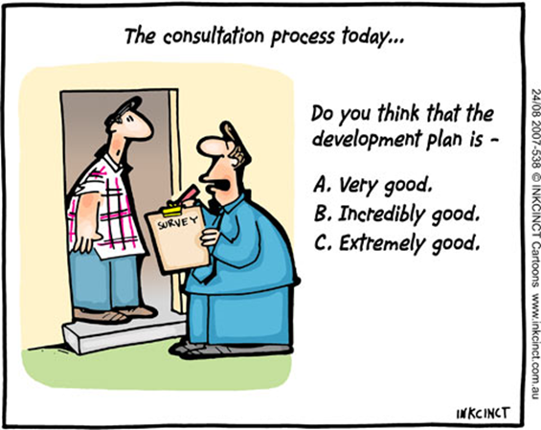
Keys to Success The Project Team
Use of an interdisciplinary team – depth of knowledge to develop a strong project purpose and need, reasonable range of alternatives, understanding of the environment to conduct the impact analysis, AND communicate clearly to the public
Develop comprehensive schedule, milestones, and deadlines including review and revision times
Open communication & trust amongst the project team
Be active participant in your project
Meet regularly

Slide 20
Questions?

Slide 22
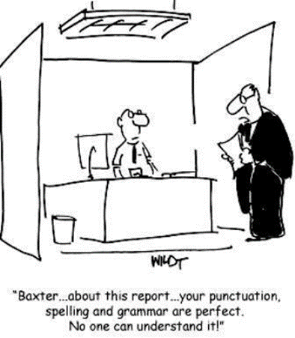
Keys to Success: Clear Writing & Readability
NEPA Documents need to be clear, consistent and concise
1970’s EIS average size >1,000 pages
1980’s CEQ issued guidance that EA/EIS should be analytic NOT encyclopedic
EIS range from 150-300 pages
EA range from 15-30 pages
Public document to be written at an 8th grade reading level for general public
Define acronyms, terminology, concepts
Use graphics, illustrations, call-out boxes to explain technical terms
Use Subject Matter Experts as part of the Interdisciplinary Team
Documents must be – clear, concise, supported, defensible, and fully coordinated
PLEASE review the document internally for grammar, clear writing, and NEPA compliance BEFORE sending to Agency for review

