Slide 1
Dakota Minnesota Airports District Office
FAA Update
SD Airports Conference
Dave Anderson
April 6, 2022

Slide 2
Presentation Topics
Staff Changes in DMA-ADO
Authorization & Appropriation
FAA Money, Money, Money
SD at a glance

Slide 3
Staff Changes at DMA ADO
Welcome
Marinda Guagenti – Program Analyst in Minneapolis
Mark Schrader – Program Manager Bismarck
Michelle Basquin - Program Analyst in Bismarck
Farewell
Andy Peek (moved to Tech Ops)
Josh Fitzpatrick (MN - Moved to HQ)
Sandy DePottey (enjoy your retirement!)
AJ Ornelas (left the FAA)
Nick Pratt (MN - leaving the FAA)
Changes
Lindsay Butler – ADO Manager
Brian Schuck – Replaced Sandy as Planner for ND / SD

Slide 4
FAA’s Current Status
Authorization
We are operating under Public Law 115-254 (FAA Reauthorization Act of 2018)
Authorizes $3,350,000 in AIP for the period beginning on October 1, 2018, ending on September 30, 2023
Appropriation
We are appropriated for the rest of the fiscal year (September 30, 2022)

Slide 5
FAA MONEY
FY2022 Programs
Airport Improvement Program (AIP) Grants
Supplemental Appropriations (FY18-19-20-21-22)
CARES Act Grants
CRRSA/ACRGP Grants
ARPA Grants
BIL (AIG and ATP)

Slide 6
FY2022 AIP Grants
Entitlement only grants
  NOFO – FRN issued December 21, 2021
    https://www.govinfo.gov/content/pkg/FR-2021-12-21/pdf/2021-27533.pdf
  FRN says sponsor must notify FAA by February 15 for intent to use (pre-application or transfer documents)
  Grant Application deadline: April 11 (entitlement grant)
    BASED ON BIDS – NOT ESTIMATES
  Carryover/Transfer deadline: June 1
Notes:
An airport sponsor intending to apply for any of its available entitlement funds, including those unused, but still available in accordance with 49 U.S.C. 47117 from prior years, must notify the FAA of its intent to submit a grant application by 12 p.m. prevailing local time on Tuesday, February 15, 2022.
This notice must be in writing and stipulate the total amount the sponsor intends to use for eligible and justified projects during FY 2022, including those entitlement funds not obligated from prior years that remain available in accordance with 49 U.S.C. 47117 (also known as protected carryover). These notifications are critical to ensure efficient planning and administration of the AIP.
The final grant application deadline for entitlement funds only is Monday, April 11, 2022. The final grant application funding requests should be based on bids, not estimates.
As prescribed under 49 U.S.C. 47117, the FAA will carryover the remainder of available entitlement funds after June 1, 2022. These funds will not be available again to the airport sponsor until the beginning of FY 2023.

Slide 7
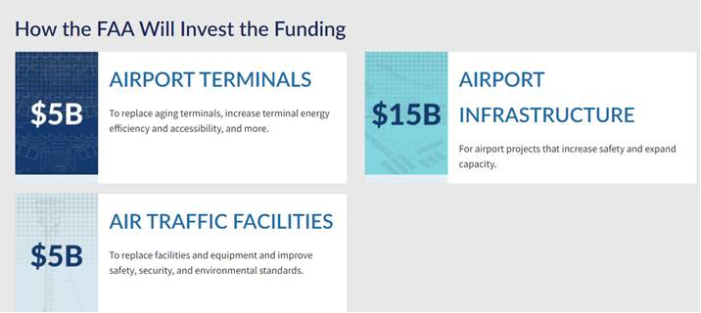
Bipartisan Infrastructure Law
https://www.faa.gov/bil
Under the Bipartisan Infrastructure Law, airports in North Dakota could receive approximately $95 million for infrastructure development over five years
Notes:
https://www.faa.gov/bil
For Airports, the attached documents are entitled “The BIL WILL DELIVER FOR MN” as approximate estimates for the state for the various transportation sectors. The report has a paragraph estimating the approximate dollar amount for the airports in that state over the 5 year period under FAA BIL, MN- $298M!
Precise airport allocations could change each year because the formulas use current passenger boarding and cargo data, and these estimates are based on 2019 data.

Slide 8
Welcome to 2022!
Tentative transition to the office April 18, 2022
ADO’s still on maximum telework
Communicating in Teams and Zoom
Checking the mail every couple weeks, please email / FTP documents
Electronic grants continue

Slide 9
Program Management Changes
Kyle |  |  | Jeremy |  |  | Jason |  |  | Mark H. |  |  | Mark S. |  | Sheri
ND |  |  | SD |  |  | ND |  |  | ND |  |  | ND |  | Environmental
Bismarck | BIS |  | Belle Fourche | EFC |  | Bottineau | D09 |  | Ashley | ASY |  | Casselton | 5N8
Grand Forks | GFK |  | Bison | 6V5 |  | Cando | 9D7 |  | Beach | 20U |  | Edgeley | 51D | Brian
 |  |  | Buffalo | 9D2 |  | Carrington | 46D |  | Bowman | BWW |  | Ellendale | 4E7 | Planning / PFC
SD |  |  | Chamberlain | 9V9 |  | Cavalier | 2C8 |  | Crosby | D50 |  | Fargo | FAR
Canton | 7G9 |  | Custer | CUT |  | Cooperstown | S32 |  | Dickinson | DIK |  | Gwinner | GWR
DeSmet | 6E5 |  | Eagle Butte | 84D |  | Devils Lake | DVL |  | Dunsieth | S28 |  | Kindred | K74 | Unclassified
Faulkton | 3FU |  | Edgemont | 6V0 |  | Grafton | GAF |  | Fort Yates | Y27 |  | LaMoure | 4F9 | Not active
Flandreau | 4P3 |  | Faith | D07 |  | Harvey | 5H4 |  | Garrison | D05 |  | Linton | 7L2 | Primary
Highmore | 9D0 |  | Gettysburg | 0D8 |  | Hillsboro | 3H4 |  | Glen Ullin | D57 |  | Lisbon | 6L3
Howard | 8D9 |  | Gregory | 9D1 |  | Jamestown | JMS |  | Hazen | HZE |  | Valley City | BAC
Madison | MDS |  | Hot Springs | HSR |  | Langdon | D55 |  | Hettinger | HEI |  | Wahpeton | BWP
Miller | MKA |  | Kadoka | 5V8 |  | Lakota | 5L0 |  | Kenmare | 7K5
Mitchell | MHE |  | Lemmon | LEM |  | Mayville | D56 |  | Mandan | Y19 |  | SD
Onida | 98D |  | Martin | 9V6 |  | Northwood | 4V4 |  | Minot | MOT |  | Aberdeen | ABR
Parkston | 8V3 |  | McLaughlin | 5P2 |  | Oakes | 2D5 |  | Mohall | HBC |  | Britton | BTN
Sioux Falls | FSD |  | Mobridge | MBG |  | Park River | Y37 |  | Mott | 3P3 |  | Brookings | BXX
Springfield | Y03 |  | Murdo | 8F6 |  | Pembina | PMB |  | Parshall | Y74 |  | Clark | 8D7
Tea | Y14 |  | Philip | PHP |  | Rolla | 06D |  | Stanley | 08D |  | Eureka | 3W8
Vermillion | VMR |  | Pierre | PIR |  | Rugby | RUG |  | State of ND |  |  | Hoven | 9F8
Wagner | AGZ |  | Pine Ridge | IEN |  | Walhalla | 96D |  | Tioga | D60 |  | Huron | HON
Wessington Springs | 4X4 |  | Platte | 1D3 |  |  |  |  | Washburn | 5C8 |  | Milbank | 1D1
Yankton | YKN |  | Presho | 5P5 |  | Buy American |  |  | Watford City | S25 |  | Redfield | 1D8
 |  |  | Rapid City | RAP |  |  |  |  | Williston | XWA |  | Sisseton | 8D3
 |  |  | Rosebud | SUO |  |  |  |  |  |  |  | Watertown | ATY
 |  |  | Spearfish | SPF |  |  |  |  |  |  |  | Webster | 1D7
 |  |  | State of SD
 |  |  | Sturgis | 49B
 |  |  | Wall | 6V4
 |  |  | Winner | ICR

Slide 10
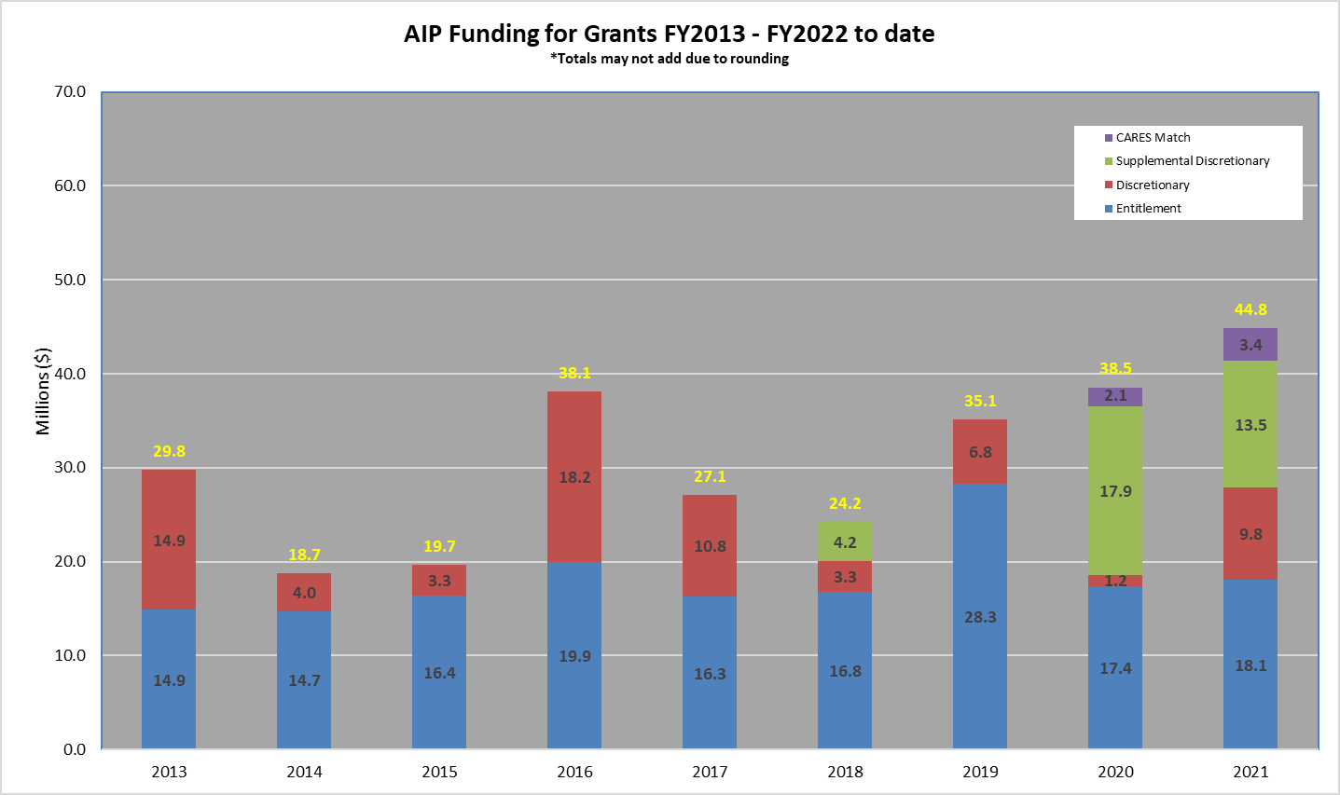
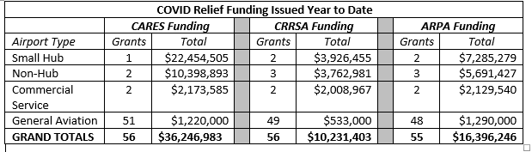
South Dakota Grant Funding 2013 – 2022 YTD; Supplemental Appropriations and CARES Act

Slide 11
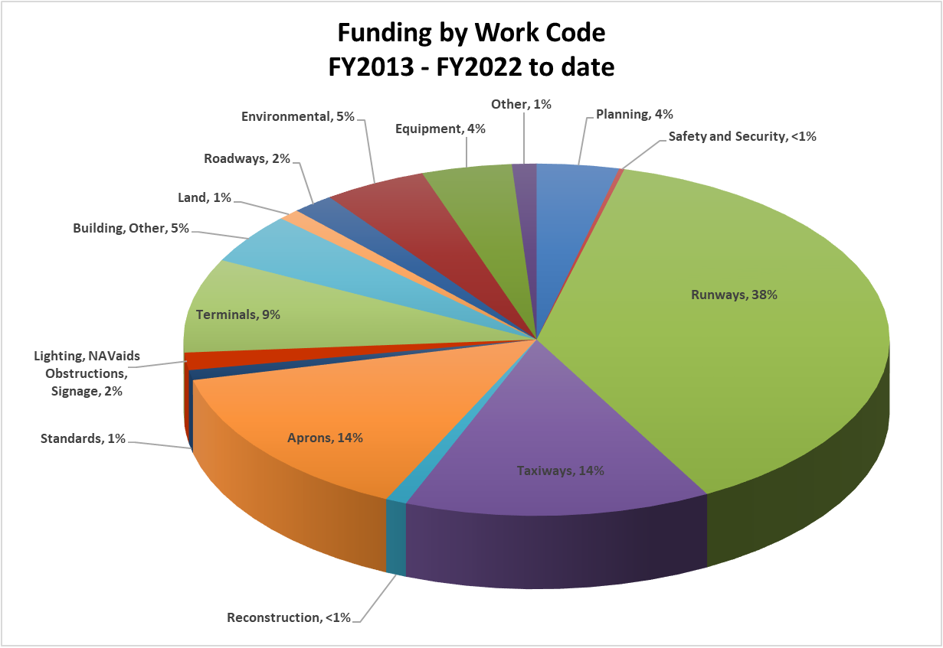

Slide 12
Grants in 2021
Funding for South Dakota
  AIP Grants
    $27,883,617 all in (Entitlement, State Apportionment, Discretionary)
    $9,797,190 in discretionary funding
    $18,086,427 in Entitlements / Apportionment

Slide 13
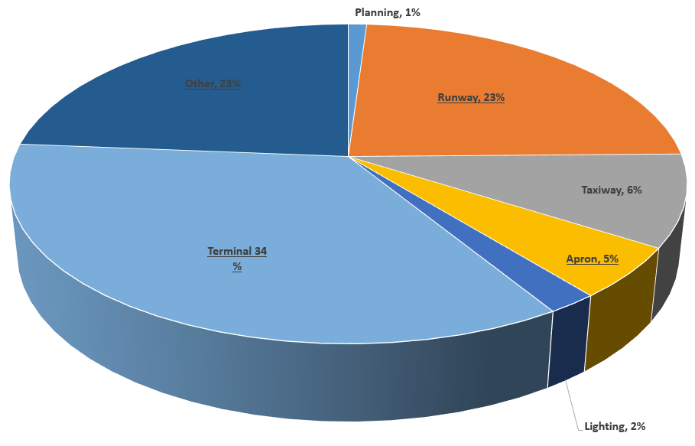
Where did the funding go?
Other include Environmental, Equipment, Land, and other small percentages

Slide 14
Grants in 2021
Funding for South Dakota
  Supplemental Grants
    $2,950,000
    Cheyenne Eagle Butte
    Application Pending

Slide 15
Grants in 2021
Funding for South Dakota
  CRRSA Grants
    $10,231,403 total
    Amounts varied on service level in our system for GA Airports
    https://www.faa.gov/airports/crrsaa/

Slide 16
Grants in 2021
Funding for South Dakota
  ARPA Grants
    $16,396,246 total
    Majority of airports sent in FY22
    https://www.faa.gov/airports/airport_rescue_grants/

Slide 17
Grants in 2022
Prepare for a fast moving process
Studies and reports still needed to be submitted!
If your project is not going to be ready, please let us know!

Slide 18

Lifecycle of a grant
Staying off the FAA’s Naughty List
Quarterly Reports – Construction Progress & Inspection Reports
Regular Drawdowns
Reaching 10%

Slide 19
Closeouts
2018 projects must be closed this fiscal year due to Period of Performance
Five 2018 open grants in South Dakota remain open. We currently have closeouts for two
Need to have these submitted before June for review / processing of final payments
Currently in “catch up” mode…

Slide 20
What’s Happening in the ADO?
Buy American
AC 150/5300-13B
Changes from the US Corp of Engineers
CARES Development Addendum
Applications Based on Bids – April 11th
SAM – Updates / Changes
https://sam.gov/content/duns-uei?utm_medium=email&utm_source=govDelivery

Slide 21

QUESTIONS

