Slide 1
South Dakota Airports Conference 2022
AWOS Siting, Crop Maintenance, and Other Factors

Slide 2
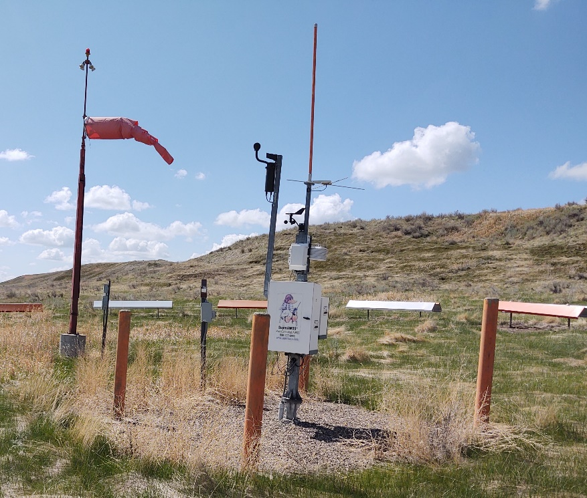
What is an AWOS?
An Automated Weather Observing System (AWOS) provides continuous and real-time weather conditions at the airport by measuring ”meteorological parameters, reduces and analyzes the data via computer, and broadcasts weather reports which can be received by aircraft operation up to 10,000’ AGL and 25 NM from the AWOS (AC 150/5220-16E Change 1)”.
Notes:
97M AWOS

Slide 3
Why get an AWOS?
Benefits from a Pilot Perspective
METAR pre-flight planning
Current METAR for enroute
Crosswind, wind shear, and METAR when landing
Benefits for the Community in General
Gateways for communities
Enables safe travel for tourism
Local products and services increase (business community)
Availability for disaster relief & medical/emergency services
Notes:
https://potomac-aviation.com/project/benefits/

Slide 4
Where does the AWOS go?
Site Selection
Cannot violate runway/taxiway safety areas, OFA, OFZ, or IFR procedure surfaces
Sensor must have minimal, or no exposure of the effects of man-made or geographical obstructions
Availability of reliable power, telecommunication line distance, and other factors should also be considered
Should be as far as practicable from cultivated land to reduce contamination by dust and dirt
Reference JO 6560.20C
Notes:
All weather inc. has a good checklist of citing criteria

Slide 5
Crop Maintenance Around the AWOS
Vegetation must be less than 10 inches tall within 100 feet.
AWOS wind sensors must remain at least 15 feet above the tops of trees within a 500 feet radius.
Man-made and naturally-occurring obstructions within 500 feet of an AWOS may interfere with its accuracy.
Avoid crops that attract wildlife to the airport.
Choose low crops such as hay, soybeans, alfalfa, peas, wheat, barley, and oats.
Notes:
All weather inc. has a good checklist of citing criteria

Slide 6
Crop Maintenance Around the AWOS
Inaccurate Measurements
Vegetation may physically block or impede airflow to sensors.
Pollen may affect airflow. (e.g., pollen may clog certain sensors, diminishing the airflow they receive. This may cause inaccurate readings for temperature, dew point, and other parameters.)
Photosynthesis causes plants to expel moisture, which may affect humidity measurements.
Fire Hazard: Dried brush or other vegetation may catch fire. Even if the fire does not destroy or damage your AWOS, the resulting smoke and heat will interfere with the system’s measurements.

Slide 7
Crop Maintenance Around the AWOS
Site Accessibility: Vegetation may create a physical impediment to maintenance technicians.
Personnel Safety (Animals & Insects): Thick vegetation may mask the presence of snakes, disease-carrying ticks, stinging insects, and burrowing mammals whose holes pose a tripping hazard.

Slide 8
AWOS Options
AWOS System | Data Provided
AWOS A | Altimeter setting
AWOS A/V | Altimeter setting, visibility
AWOS I | Wind speed, wind direction, wind gust, variable wind direction, temperature, dew point, altimeter setting, and density altitude
AWOS II | Same as AWOS I plus visibility, and variable visibility
AWOS III | Same as AWOS II plus precipitation accumulation, cloud height, and sky condition
AWOS III P | Same as AWOS III plus present weather identification (precipitation type)
AWOS III T | Same as AWOS III plus thunderstorm/lightning reporting
AWOS III P/T | Same as AWOS III plus present weather identification (precipitation type) and thunderstorm/lightning reporting
AWOS IV Z | Same as AWOS III P/T plus freezing rain detection
AWOS IV R | Same as AWOS III P/T plus runway surface condition
AWOS IV Z/R | Same as AWOS III P/T plus freezing rain detection and runway surface condition

Slide 9
Sharing AWOS Information
In accordance with the current revision of FAA Advisory Circular 150/5220-16, only non-Federal AWOS systems meeting the AWOS III (or better) criteria may be eligible for FAA long-line dissemination of certified weather information (i.e. METAR information) nationally via the FAA network.

Slide 10
What is Common?
"The majority of system airports (46) report having either AWOS or ASOS equipment at their airport. In 2010, 38 airports had weather reporting equipment... a third type of weather reporting equipment, the SuperAWOS can be found at 29 airports in the state." (SD SASP)
Commonly see AWOS III P/T
AWOS III plus present weather identification (precipitation type) and thunderstorm/lightning reporting
Notes:
Note that SuperAWOS is non-certified.

Slide 11
AWOS III
Wind speed, gust, direction, variable wind direction
Temperature
Dew Point
Altimeter Setting
Density Altitude
Data Logs (METAR & voice output)
Visibility & Variable Visibility
Precipitation
Day/Night
Cloud Height
Sky Condition

Slide 12
Cloud Height Sensor
The sensor detects the coverage and height of the clouds using an upward-pointing laser beam ceilometer
The height of the cloud base is calculated by the amount of time required for reflected light to return to the station
For rapidly changing cloud coverage, an average reading is determined toward the first 10 minutes of the 30-minute averaging period
Clouds above 12,000’ are not detected
Notes:
From MT SASP

Slide 13
Visibility Sensor
The transmitter and receiver at the top sends a cone of light twice per second
The light then scatters among the particles in the air and senses how much light has scattered which determines the visibility (based on pre-existing formulas).
Computes a one-minute visibility average
Notes:
From AOPA How it Works: Visibility Sensor A Machine that Mimics the Eyes

Slide 14
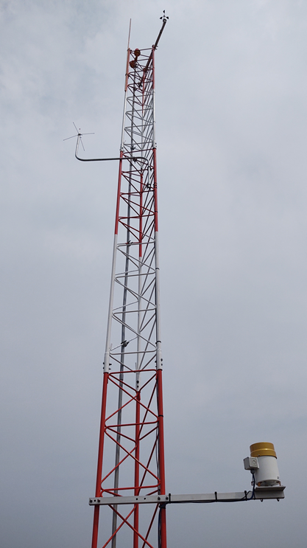
AWOS III Tower
Motor Aspirated Radiation Shield (MARS)
Temperature/Relative Humidity Sensor
Data Collection Processor
UHF Radio
Obstruction Light
Anemometer
30’ Tower
Rain Gauge

Slide 15
Monitoring Terminal
Monitoring terminal (computer) in a pilot lounge or other airport building.

Slide 16
Cost of an AWOS
Initial construction cost
FAA (90%)
SDDOT – Office of Air, Rail & Transit (5.0 % / 3.5%)
Airport Sponsor (5.0% / 6.5%)

Slide 17
Cost of an AWOS
Operating costs (Airport Sponsor for 100%)
NADIN Datalink Service
The AWOS III provides an optional system connection to the National Airspace Data Interchange Network (NADIN), and the AWOS Data Acquisition System (ADAS). These services (operated by the FAA) provide your weather data to Flight Service Stations, commercial airports, the National Weather Service (NWS), and many other internet-based weather sources.
Using NADIN service, your AWOS generates and then transmits a METAR message. The METAR message is a meteorological aviation report typically used for flight planning and input into the Automatic Terminal Information Service (ATIS), but it can also be used for local weather reporting.

Slide 18
Cost of an AWOS
Operating costs (Airport Sponsor - 100%)
Inspections
In order to maintain the FAA commissioning at an AWOS site, the system must be properly maintained. Manufacturers offer annual maintenance plans which include three annual visits by a certified technician, as well as a commissioning visit with the FAA.
Parts Replacement
Telephone service for data line to the system

Slide 19
I want one!
Get your community and the airport on board with project and costs.
Talk to SDDOT, FAA, and your engineering consultant about the next steps.

Slide 20
Questions

