Slide 1
NH 0046(69)288 PCN 05JN
SD46 through Wagner
March 24, 2020 (Virtual)
August 13, 2020 (National Guard Armory)
Public Meeting

Slide 2
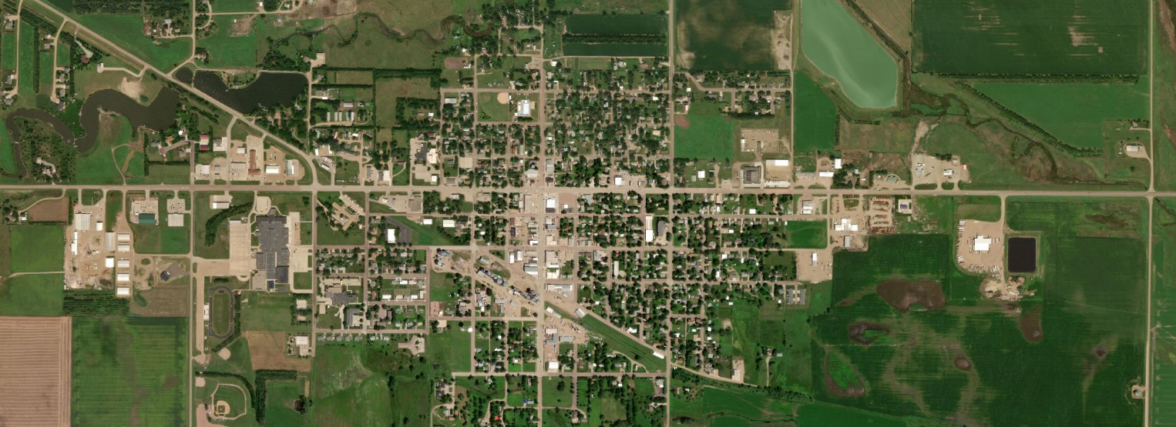
Project Limits
Front Ave
N
Main Ave
Begin Project
SD 50
High Ave
End Project
Walnut Ave
City of Wagner
394th Ave

Slide 3
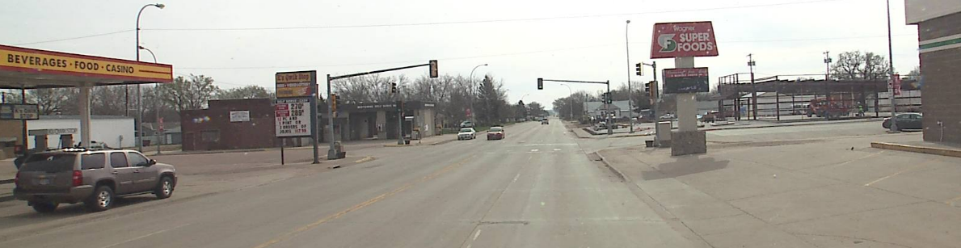
Background Information
Grading & PCC Surfacing in 1991
Signal at Main Street in 1994
Pavement Restoration in 2011

Slide 4
Traffic
    2019 ADT = 4,510
    2044 Projected ADT = 6,990
    Truck Traffic = 5.6%

Slide 5
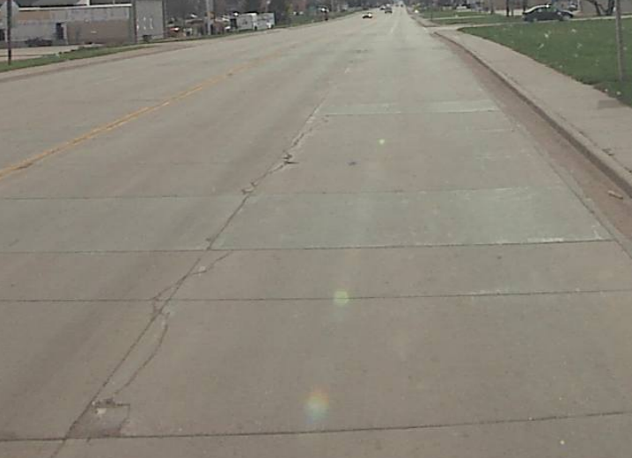
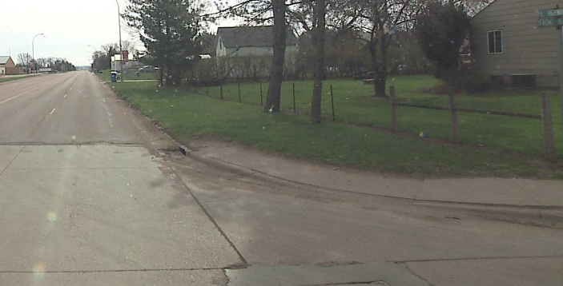
Why Are We Reconstructing
Pavement Condition
Pedestrian Facilities
Drainage
Improve Safety

Slide 6
Proposed Improvements
Modify 4 Lanes to 3 Lanes with Two Way Center Turn Lane
Add Sidewalks
New Storm Sewer
Roadway Lighting
Traffic Signals
Portland Cement Concrete Surfacing

Slide 7
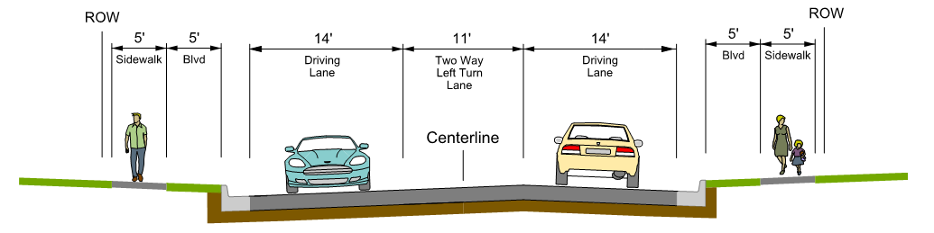
Proposed Typical Section
3 Lane Section (39’ Wide)
  2-14’ Outside Lane
  1-11’ Two Way Left Turn Lane
  Curb & Gutter
  Concrete Surfacing

Slide 8
3 Lane Roadway Advantages
Traffic analysis – Greatest benefit/cost ratio
Capable of safely and efficiently handling up to 20,000+ vehicles/day
Provides safe storage for left turning vehicles
Reduces the number of conflict points for left turning vehicles and vehicles entering the roadway
Reduces the speed differential between vehicles
Boulevard Provides Snow Storage
Reduces crossing width for
pedestrians

Slide 9
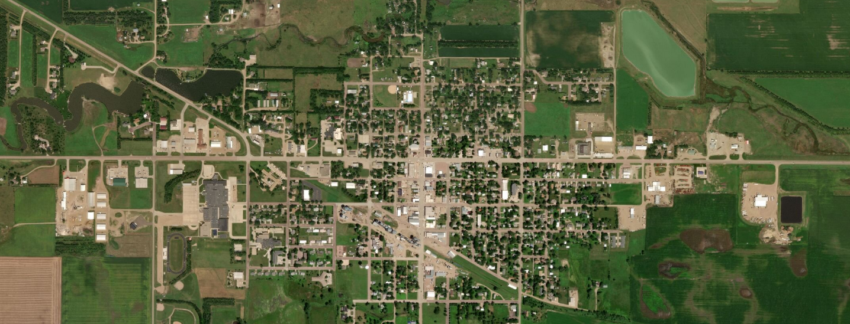
Proposed Sidewalk
SD 50
Front Ave
High Ave
Main Ave
Walnut Ave
394th Ave

Slide 10
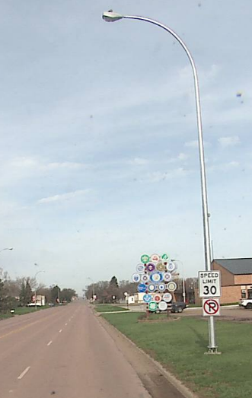
Roadway Lighting
Replace Existing Lighting
  LED

Slide 11
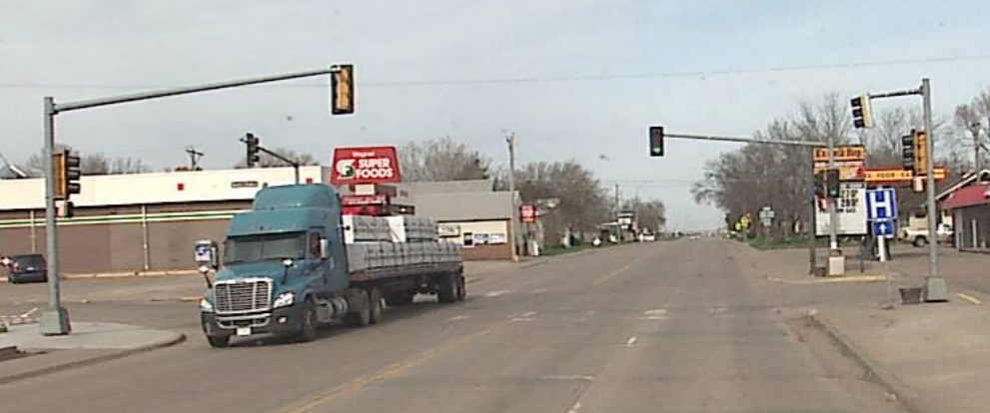
Traffic Signals
Replace Traffic Signal at SD46/Main Street

Slide 12
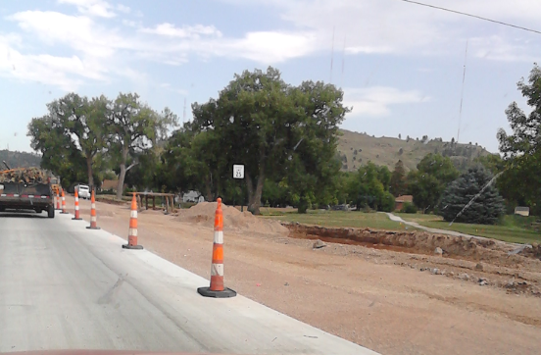
Construction Traffic Control
2 Year
  Year 1 – Main Street to East End of Project
  Year 2 – West End of Project to Main Street
Open to Traffic
Phased Construction

Slide 13
Tentative Project Schedule
Final Design | Fall 2020
ROW Acquisition Process | 2021 through 2022
Construction | 2023 & 2024
Estimated Cost: | $10.5 million

Slide 14
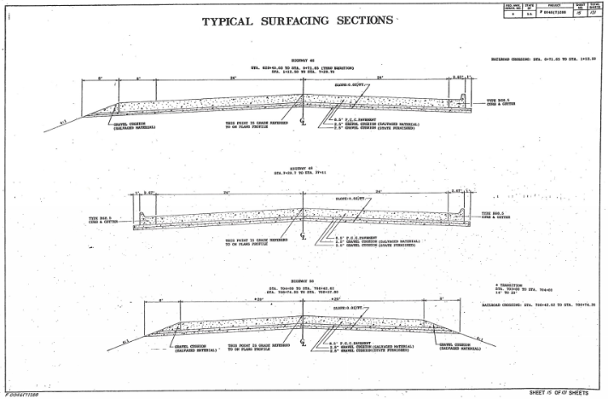

Slide 15
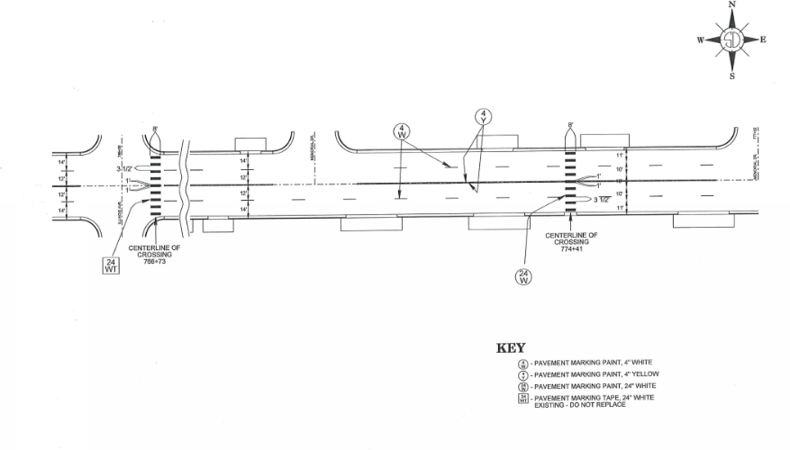

Slide 16
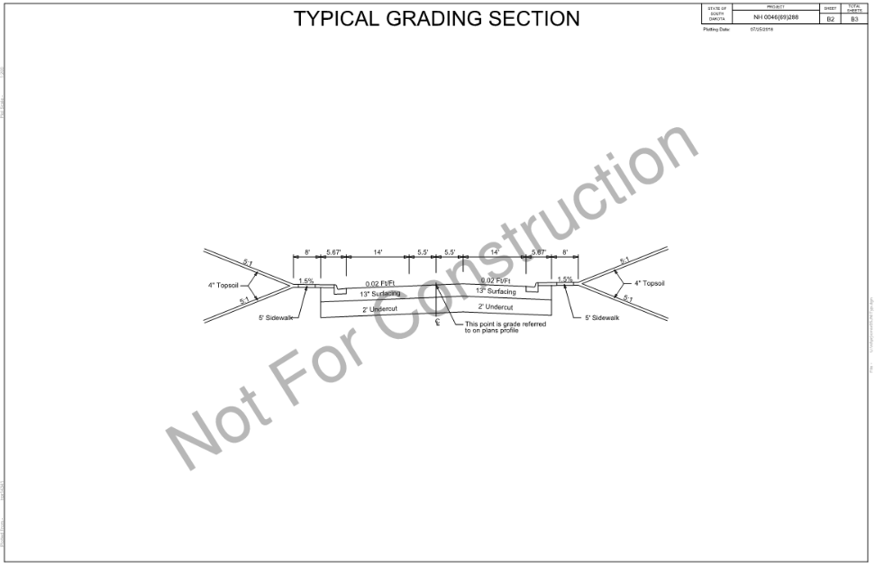

Slide 17
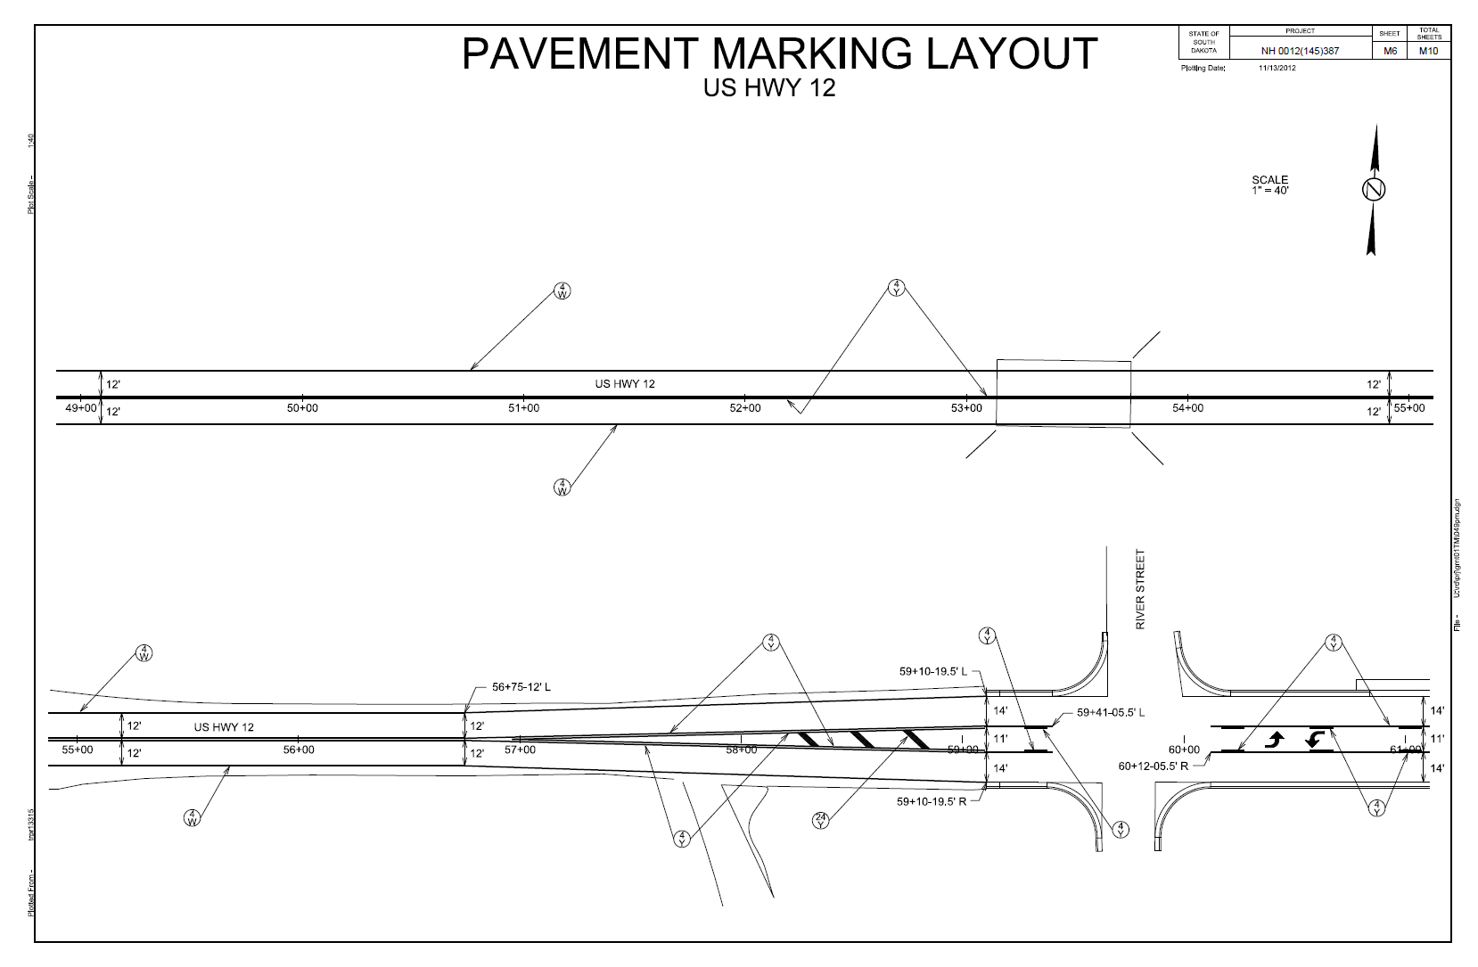
HW 12 Milbank

Slide 18
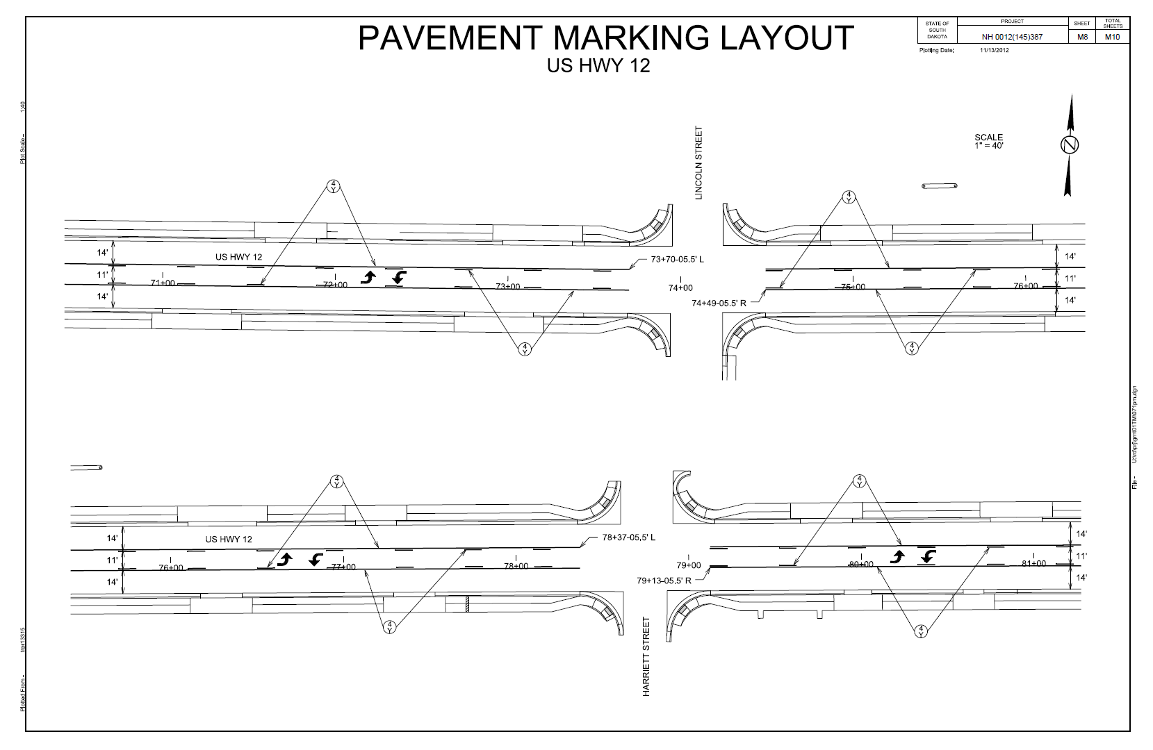
HW 12 Milbank

Slide 19
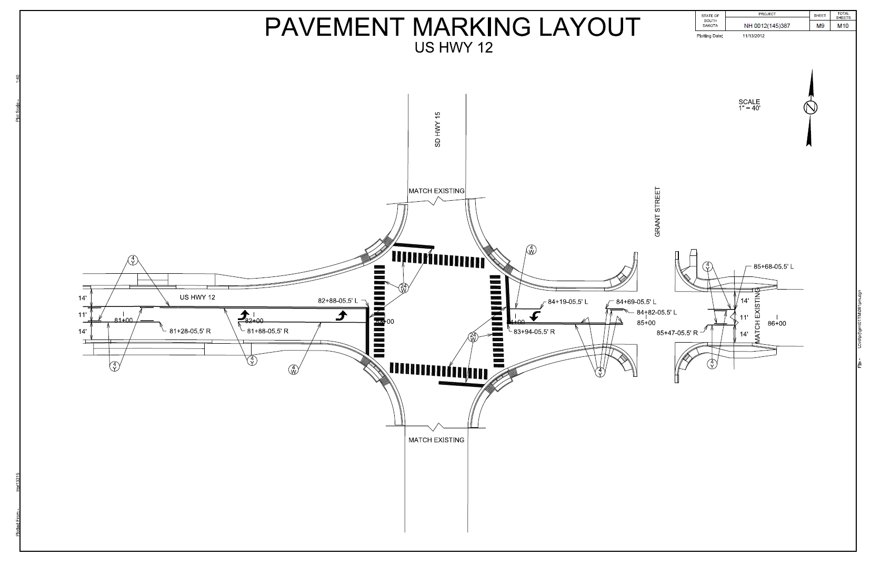
HW 12 Milbank

Slide 20
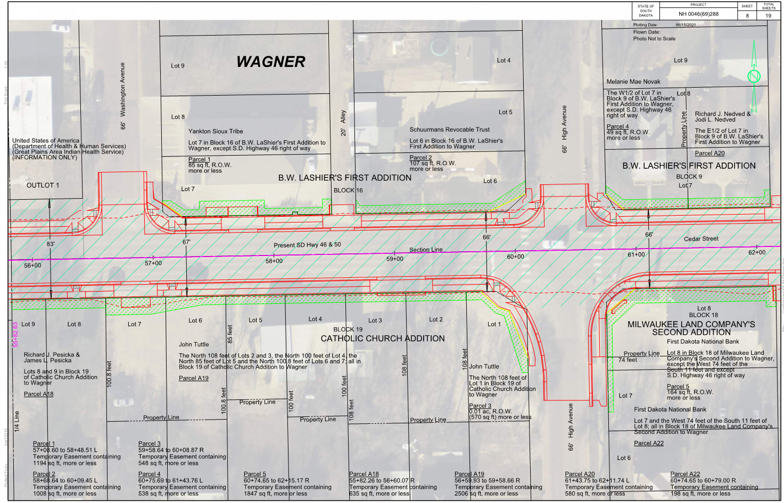
High Avenue

Slide 21
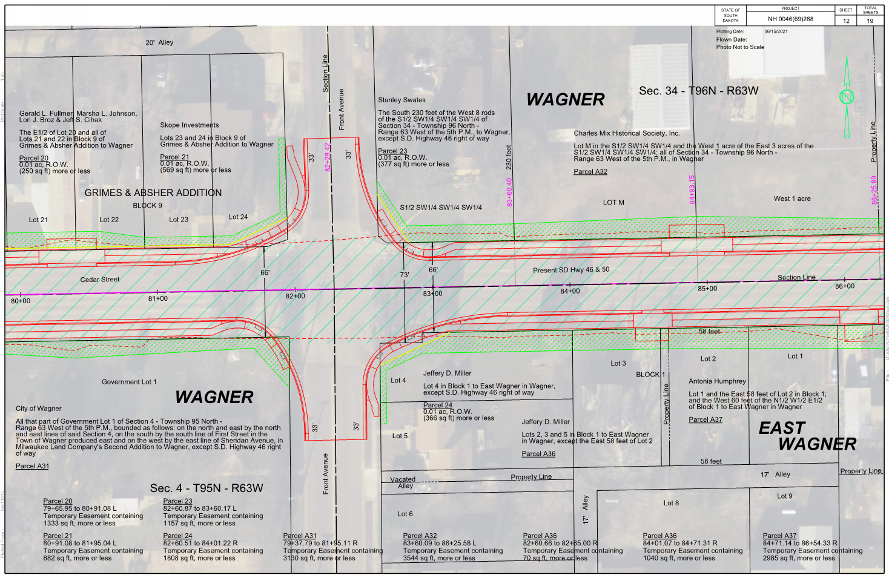
Front Avenue

Slide 22
HW 46 Thru Wagner – 2023 Construction
Typical Section / Improvements
3 Lane : 2- 14 ft Driving Lanes, 11 ft Turning Lane, 8 ft grass boulevard, 5 ft sidewalk
Project limits:
Surfacing:
West end – Wagner Building Supply East Approach
East end – S&K Truck Repair and Wash Approach
Sidewalk:
West end – Wagner Building Supply on South Side
Family Dollar on North Side
East end - Valley Pump and Casino (Both N & S Sides)
Improvements: Grading, PCC Pavement, curb and gutter, storm sewer, sidewalk & roadway lighting

Slide 23
Typical Section / Improvements
4 Lane : 4-12 ft Driving Lanes, 5 ft sidewalk – No separation between mainline and sidewalk
Project limits:
Surfacing: West end – 1000 ft West of HW 50 JCT
East end – Valley Pump and Casino
Sidewalk: West end – HW 50 JCT
East end – National Guard Armory on North Side
Front Avenue on South Side
Improvements: PCC Pavement Repair / AC Resurfacing, ADA upgrades

Slide 24
Traffic Signals
HW 46 & 50 Intersection - 3 lane – may meet warrants in 2043 under existing configuration
4 lane – Does not meet warrants
HW 46 & Main Intersection - 3 lane – Would meet warrants in 2028 – Leave existing signals in place
4 lane – Existing traffic signal should be removed
Roadway Lighting 3 lane – Install new roadway lighting for entire project
4 lane – Leave existing lighting in place
Replace when necessary?

Slide 25
Accident History – Period 2012 – 2015
1 – Driver fell asleep
2 – Rear end collisions at HW 46 & Main stoplight due to distracted driving
1 – EB Bicyclist collided with a SB 50 vehicle
** 2 – Vehicles sideswiped while making lane changes
** 1 – Vehicle turning left from side street failed to yield to HW 46 traffic
** 3 – Vehicles on side street traveling thru HW 46 failed to yield to HW 46 traffic.
** 3 – Vehicles rear ended on HW 46 trying to make a left handed turn, waiting for opposing traffic
** Notes: Accidents that would be avoided or have been proven to be greatly reduced in a 3 lane section vs a 4 lane typical section.
Accidents that occurred that could be avoided if a 3 lane was present vs a 4 lane

Slide 26
3 Lane - Advantages
Extends reconstruction project limits from current conditions
Replaces the existing concrete pavement with new concrete pavement
New curb and gutter will be installed for the entire segment
Allows sidewalks to be extended thru the entire limits of the project
Allows for the new installation and upsizing the existing storm sewer.
Allows for city utility upgrades if necessary
Provides a separation between the roadway and sidewalk for snow storage during winter and would allow city ordinance of sidewalk cleaning remain in effect all year
Provides separation between vehicles and the pedestrian traffic for increased safety.
Provides easier pedestrian crossing opportunities
Allows the current stoplight at HW 46 & Main Street to remain in place
Removes turning vehicles from the thru lanes which reduces accidents
Promotes better compliance with the existing speed limit

Slide 27
3 Lane – Disadvantages
Vehicles are not allowed to pass thru the city limits

Slide 28
4 Lane – Advantages
Vehicles are allowed to pass thru the city limits
May or may not decrease congestion

Slide 29
4 Lane – Disadvantages
Pavement would be switched to an asphalt overlay
Storm sewer will not be replaced or upgraded
Existing lighting will not be replaced at this time
Project limits will be shortened
Sidewalks will not be extended nor improved, just ADA upgrades at intersections
Signal at Main Street does not meet warrants and could be removed

Slide 30
Comparable Communities to Wagner - 4 Lane to 3 Lane Conversion
HW 12 – Milbank (2013) – Similar Traffic Volumes
HW 14 – Miller (2013) – Similar Traffic Volumes
HW 12 – Ipswitch (2012) – Similar Traffic Volumes
HW 212 – Gettysburg (2021) – Less Traffic / 2x more truck volume
HW 34 – Woonsocket (2020) – Less Traffic / 2x more truck volume
HW 44 – Platte – Less Traffic / Similar truck volume

Slide 31
Questions?

