Slide 1
FAA
BIPARTISAN INFRASTRUCTURE LAW
FUNDING OVERVIEW

Slide 2
A ONCE-IN-A GENERATION OPPORTUNITY.
The Bipartisan Infrastructure Law will modernize infrastructure, increase equity in transportation, help fight climate change, strengthen the supply chain, and create jobs.
FAA funding provided under BIL will:
  Address the physical condition of the FAA’s air traffic control facilities by reducing the sustainment backlog and accelerating the replacement of aging facilities; and
  Improve safety and efficiency at our nation’s airports.

Slide 3
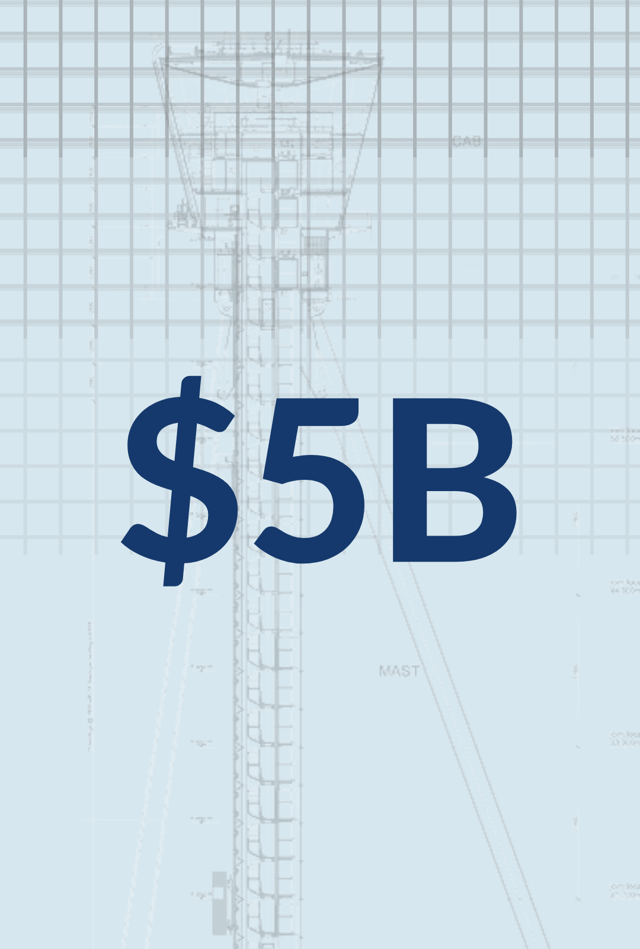
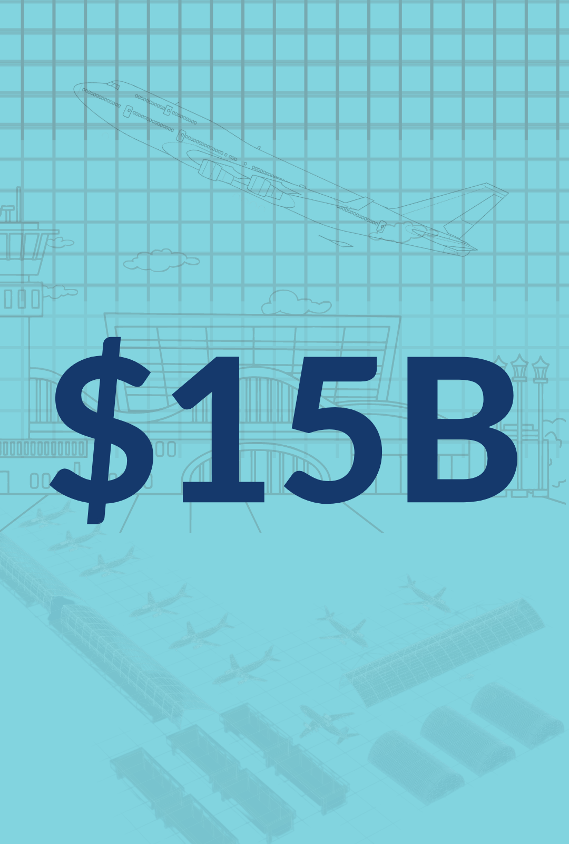
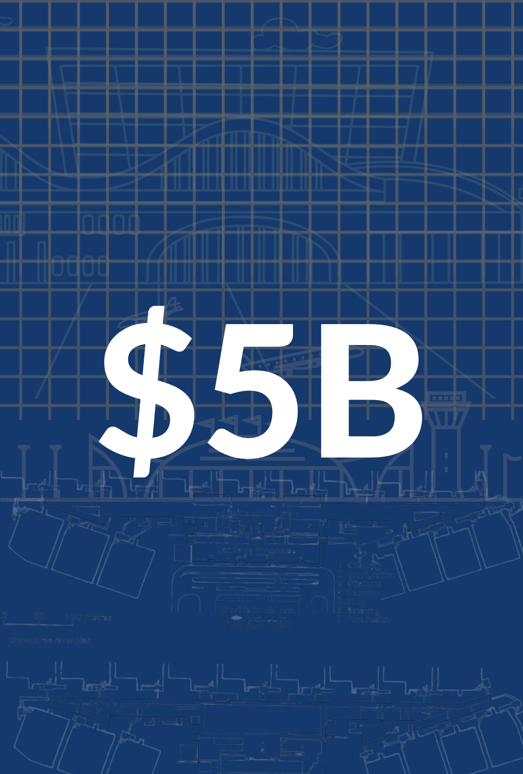
A 5-YEAR, $25 BILLION INVESTMENT IN THE NATIONS AIR TRANSPORTATION SYSTEM.
AIR TRAFFIC FACILITIES
For airport projects that increase safety and expand capacity.
AIRPORT INFRASTRUCTURE
For airport projects that increase safety and expand capacity.
AIRPORT TERMINALS
To replace aging terminals and airport-owned towers, increase terminal energy efficiency and accessibility, and more.

Slide 4
Provides $1 billion/yr over 5 years to address the physical condition of the FAA’s air traffic control facilities.
  Reduce the Sustainment Backlog
  ATC Facilities Replacement
Year 1 Funding
  Air Route Traffic Control Center (ARTCC) Facility Sustainment Study
  Long Range Radar Sustainment
  ATCT/TRACON Sustainment
  Unstaffed Infrastructure Sustainment
  Power Systems and Fuel Sustainment
Year 2-5 Funding
  Continued Sustainment
  ATC Facilities Replacement Ramps Up
AIR TRAFFIC FACILITIES

Slide 5
$15B Airport Infrastructure Program
Primary Airports
  Up to $2.39 billion/yr Primary Airports (FY2022-FY2026)
    Primary Airport allocations are based on existing apportionments formula in Airport Improvement Program (AIP) Statute (passenger traffic and cargo volume)
    FY22 and FY23 Primary airports allocation is based on Highest enplanements for CY 18, CY 19 and next full Calendar year (CY20 or CY21 respectively)
    FY24-FY26 most recent calendar year enplanements
  Non-Primary Airports
  Up to $500 million/yr Non-Primary Airports (i.e. General Aviation)
    Allocations for Non Primary Airports based on airport classification in the NPIAS and the aggregate NPIAS eligible development cost for each classification
AIRPORT INFRASTRUCTURE

Slide 6
AIRPORT INFRASTRUCTURE
$20 million/yr for competitive grants for tower construction, replacement, or refurbishment to sponsors participating in the FAA Contract Tower Program.
  There are approximately 157 airport owned contract towers.
3% available funding can be used for administrative expenses

Slide 7
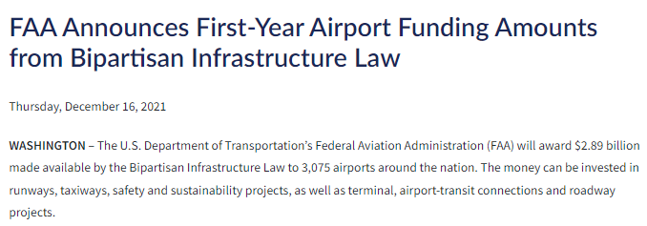
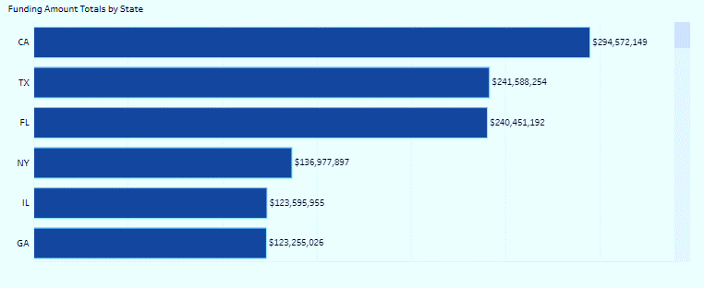
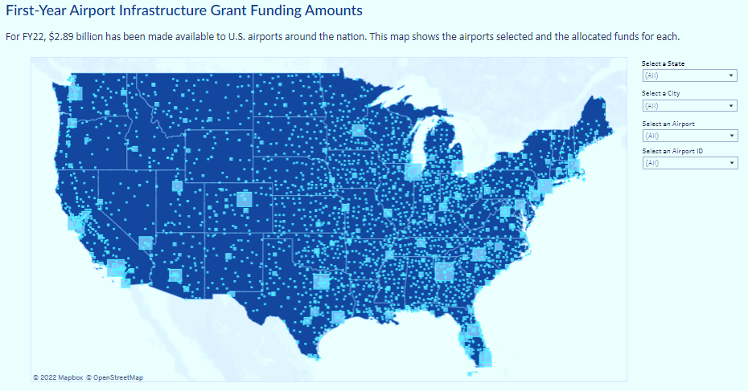

Slide 8
AIRPORT INFRASTRUCTURE
Project Eligibility
  This funding can be used to fund runways, taxiways, and aprons and other broad efforts like terminal, intermodal projects and roadway projects.
  https://www.faa.gov/bil -- then click on FAQs link under Resources

Slide 9
Discretionary Grant Program
  Funding for airport terminals and airport-owned air traffic control towers
  Approximately 210 control towers are airport-owned (157 contract tower program and 53 FAA staffed)
Competitive selection process based on Notice of Funding Opportunity (NOFO) annually – March 28
https://www.faa.gov/bil/airport-terminal-program-nofo
  Improve airfield safety through terminal relocation
  Replace aging facilities
  Increase capacity and passenger access
  Encourage competition
  Improve Energy Efficiency (incl LEED accreditation)
  Expand access for persons with disabilities
  Improve airport access for historically disadvantaged populations
AIRPORT TERMINALS

Slide 10
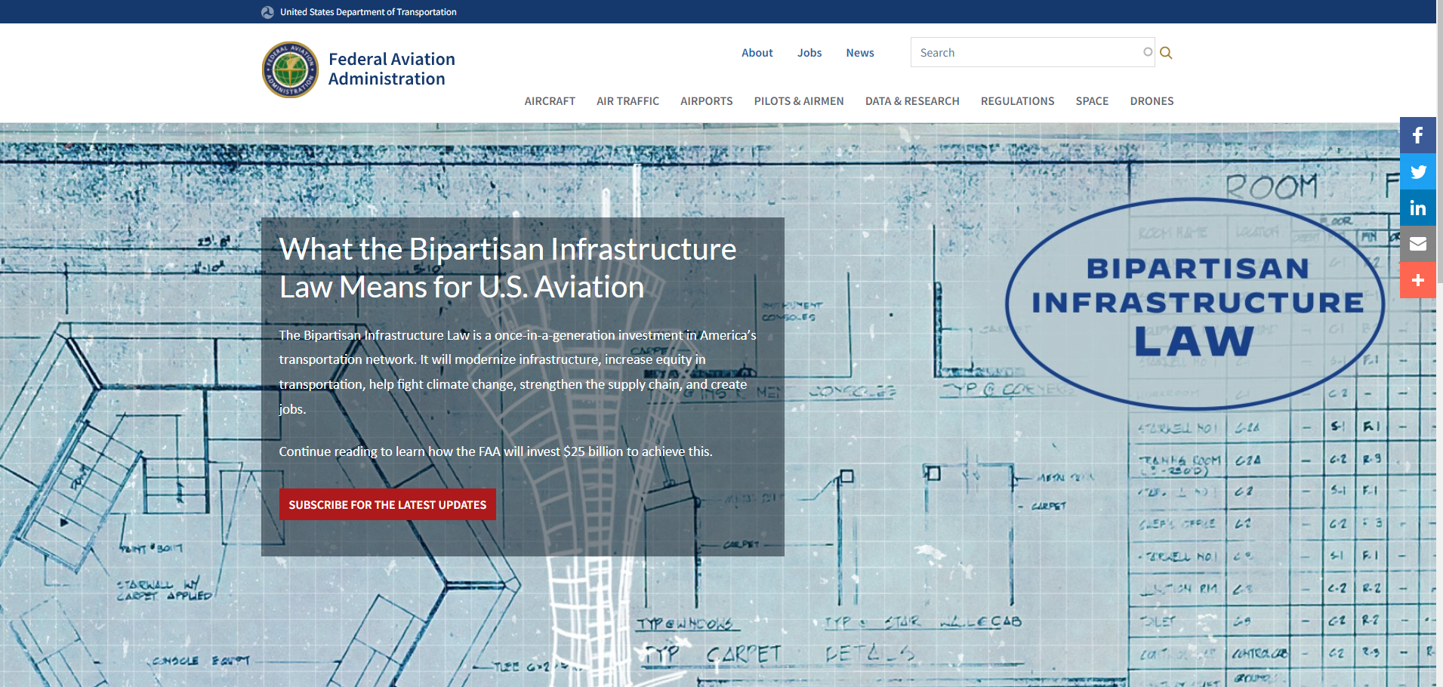
www.faa.gov/bil

Slide 11
Thank You
Questions?

