Slide 1
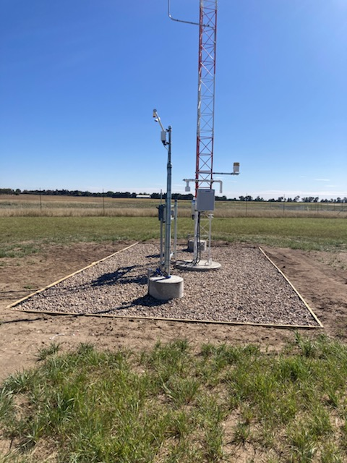
Automated Weather Observing System (AWOS)
2023 South Dakota Airports Conference
Michael Schmit, P.E (Helms & Associates)
David Feilmeier, PLS (DGR Engineering)

Slide 2
Statistics
7 Current Non-Fed AWOS in SD (Spearfish, Chamberlain, Madison, Britton, Milbank, Gettysburg, and Redfield)
3 Non-Fed AWOS to be installed in FY2023 (De Smet, Rosebud, and Sturgis)
13 Non-Fed AWOS to be installed between FY2024 and FY2028

Slide 3
Benefits
Flight Planning
Can’t fly IFR without certified weather
Less inclined to fly to that airport
NADIN (Share your weather)
Five 3rd Party Vendors (WMSCR)
Follow weather trends
Is weather following the forecast

Slide 4
Getting Started
ALP
Siting – representative of your runway conditions
FAA preferred locations (land restrictions)
Infrastructure
Conduit and Junction Boxes
Spares in the Electrical Panel
FAA/SD-DOT Program Manager
Funding Available (AIP, BIL, State, Local)

Slide 5
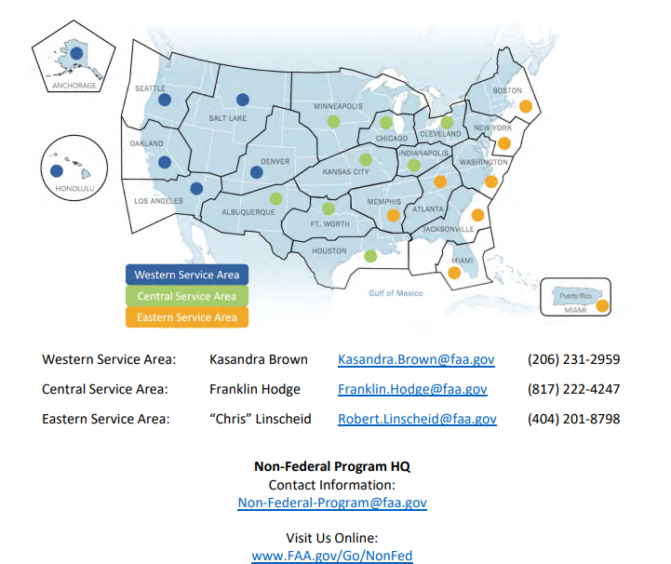
Getting Started
FAA Non-Federal Liaison

Slide 6
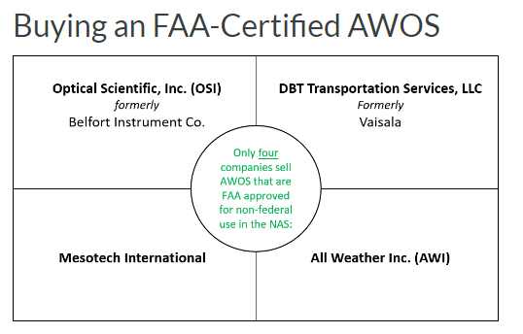
Getting Started
FAA List of Non-Federal Systems

Slide 7
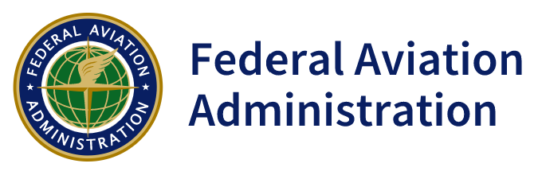
Agency Coordination
FAA Non-Federal Program Liaison
FAA Spectrum
FCC VHF License

Slide 8
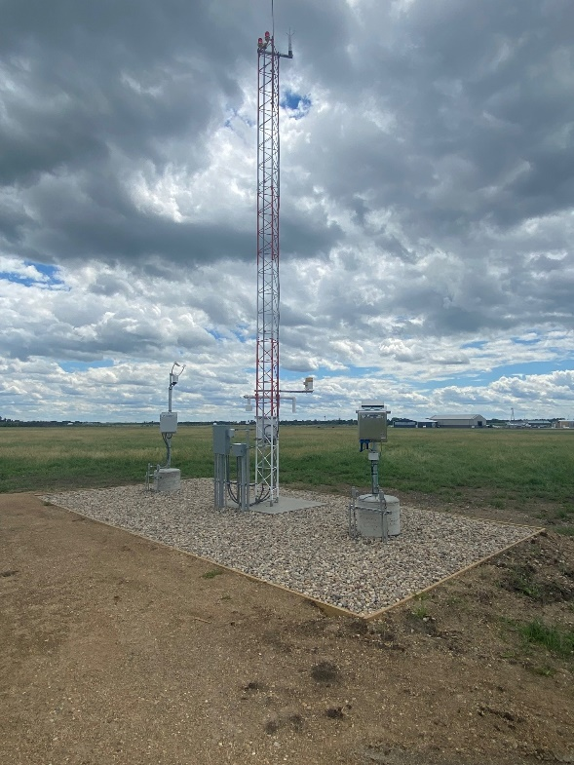
Construction Costs
2020 (BTN) - $205,000
2021 (1D1) - $204,000
2022 (1D8) - $239,000
Outlook

Slide 9
Commissioning/Maintenance
FAA’s Memorandum of Agreement
Commissioning Day
Maintenance Contracts
Site Maintenance

Slide 10
Lessons Learned
Sensors above snow line
Infrastructure
UHF vs Landline Communications
Maintenance Contracts
Site Access

Slide 11
Future Inspection Costs
Annual inspection costs will range from $3000-6000/year depending upon equipment and location.
SD-DOT is exploring options to assist Airports with future inspections.

