Slide 1
Disadvantaged Business Enterprise (DBE) Program Development & Administration
Charlie Baker / Nels Lund

Slide 2
What is a DBE?
At least 51% owned by one or more individuals who are both socially and economically disadvantaged; and
Whose management and daily business operations are controlled by one or more of the socially or economically disadvantaged individuals who own it.
Source: SDDOT website (dot.sd.gov)

Slide 3
Which groups are DBEs?
Any individual in the following groups, members of which are rebuttably presumed to be socially and economically disadvantaged:
“Black Americans,” which includes persons having origins in any of the Black racial groups of Africa;
“Hispanic Americans,” which includes persons of Mexican, Puerto Rican, Cuban, Dominican, Central or South American, or other Spanish or Portuguese culture or origin, regardless of race;
“Native Americans,” which includes persons who are enrolled members of a federally or State recognized Indian tribe, Alaska Natives, or Native Hawaiians;
“Asian-Pacific Americans,” which includes persons whose origins are from Japan, China, Taiwan, Korea, Burma (Myanmar), Vietnam, Laos, Cambodia (Kampuchea), Thailand, Malaysia, Indonesia, the Philippines, Brunei, Samoa, Guam, the U.S. Trust Territories of the Pacific Islands (Republic of Palau), Republic of the Northern Marianas Islands, Samoa, Macao, Fiji, Tonga, Kirbati, Tuvalu, Nauru, Federated States of Micronesia, or Hong Kong;
“Subcontinent Asian Americans,” which includes persons whose origins are from India, Pakistan, Bangladesh, Bhutan, the Maldives Islands, Nepal or Sri Lanka;
Women;
Any additional groups whose members are designated as socially and economically disadvantaged by the SBA, at such time as the SBA designation becomes effective.
Source: SDDOT website (dot.sd.gov)

Slide 4
DBE Plan / Goal
The Department of Transportation's (DOT) Disadvantaged Business Enterprise (DBE) program is implemented by recipients of DOT Federal Financial Assistance. Recipients are primarily state highway, transit, and airport agencies that receive funds subject to Title 49 Code of Federal Regulations part 26 (49 CFR 26).
A similar program (49 CFR 23) for airport concession DBEs (ACDBE), is mandated by 49 U.S.C. 47107(e). The ACDBE program was originally enacted in 1987 and most recently amended in 2012.
Source: FAA Civil Rights website (faa.gov)
Notes:
FAA recipients receiving grants for airport planning or development who will award prime contracts the cumulative total value of which exceeds $250,000 in FAA funds in a Federal fiscal year.
ACDBE is not typical at a general aviation airport in South Dakota and not part of this presentation.

Slide 5
DBE Plan / Goal
Creation of DBE Plan / Goal (every 3 Federal Fiscal Years)
Needed for FAA grant recipients awarding prime contracts for which the cumulative total value exceeds $250,000 in FAA Funds in a single federal fiscal year
Due August 1
Ongoing DBE (Achievement) Reporting (annual)
Due December 1 (after end of Federal Fiscal Year Oct. 1-Sept. 30)
Notes:
FAA recipients receiving grants for airport planning or development who will award prime contracts the cumulative total value of which exceeds $250,000 in FAA funds in a Federal fiscal year.

Slide 6
When to Start DBE Plan / Goal?
When updating the airport CIP (think of the next 3 years of projects)
When scoping a project (typically this service is included in engineering contract)
Prior to advertising a project for bid
Goal needs to be approved and included in the bid package

Slide 7
DBE Goals and Project Specific DBE Goals
49 CRF (Code of Federal Regulations) Part 26 – DBE Program
To ensure non-discrimination of award / administration of DOT-assisted contracts
To create a level playing field for DBE competition
Paraphrased from:
https://www.ecfr.gov/current/title-49/subtitle-A/part-26
Disadvantaged Business Enterprises. (Portion copied directly from an AIP grant agreement)
The sponsor shall not discriminate on the basis of race, color, national origin or sex in the award and performance of any DOT-assisted contract covered by 49 CFR Part 26, or in the award and performance of any concession activity contract covered by 49 CFR Part 23. In addition, the sponsor shall not discriminate on the basis of race, color, national origin or sex in the administration of its DBE and ACDBE programs or the requirements of 49 CFR Parts 23 and 26.

Slide 8
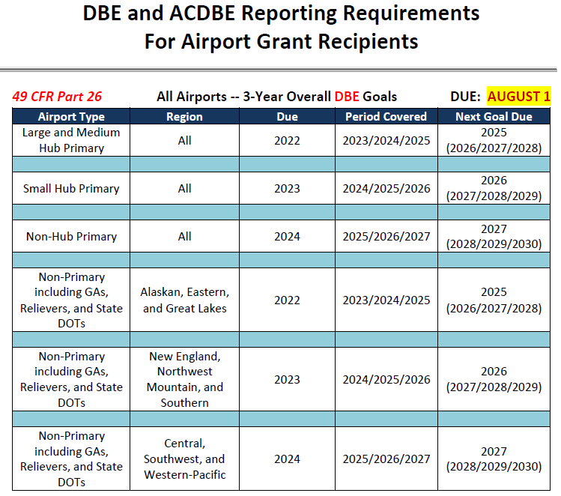
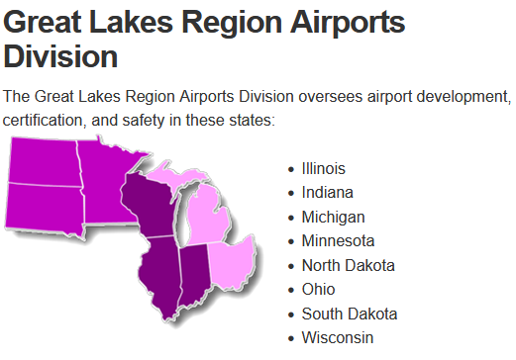
3 Year Overall DBE Goals

Slide 9
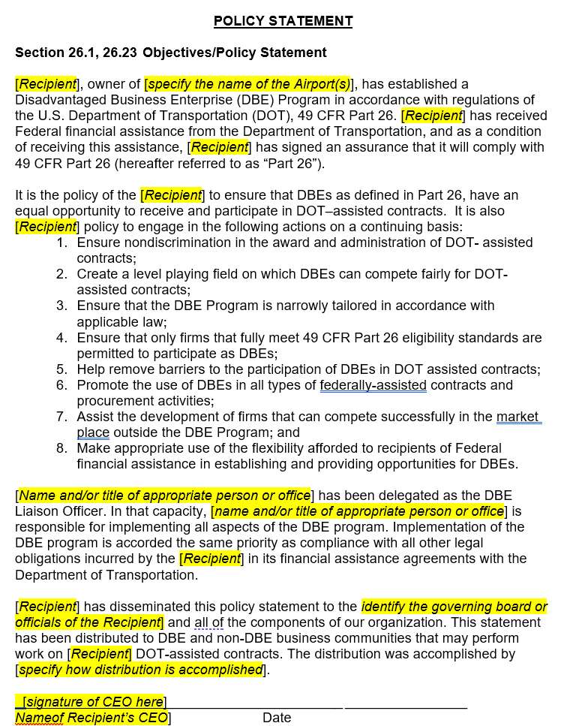
Finished Product – DBE Plan / Goal
Goal is advertised in Local Newspaper and within SDDOT DBE Newsletter
KLJ holds public comment meeting after advertising goal
Governing board votes to approve and it is signed by Sponsor
About 55-page document with airport-specific and project-specific information with Goal uploaded to FAA Civil Rights Connect
Notes:
Recommend posting an approved and signed copy on the city / airport website.

Slide 10
DBE (Achievement) Reporting - What is our goal?*
To report:
the contracts awarded to DBE’s / non-DBE’s and their DBE classification (by race/gender);
ongoing grant reimbursement amounts including how much paid to DBE’s (also ensures non-DBE’s are being paid);
final grant reimbursement amounts.
For the previous (just ended) FAA Fiscal Year (Oct. 1- Sept. 30)
*Due December 1 for all Airports
Notes:
After closeout approval, we report that final payment and that’s the last time the grant is reported (for DBE Reporting).

Slide 11
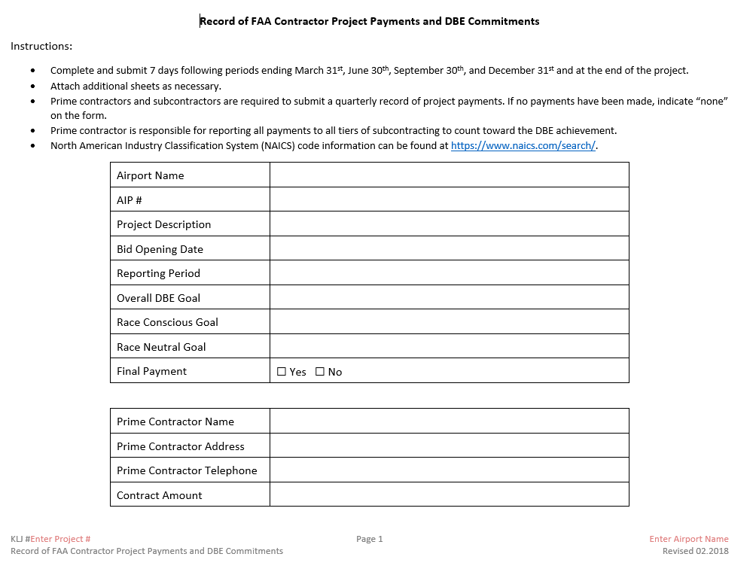
Quarterly Record of Payments Document
Notes:
Completed quarterly and at the end of the project.
This is part of the Prompt Payment requirement – Federal Contract Provisions and DBE Requirements.
Some states have differing time periods for Prompt Payment. South Dakota matches the FAA and it is 30-days.

Slide 12
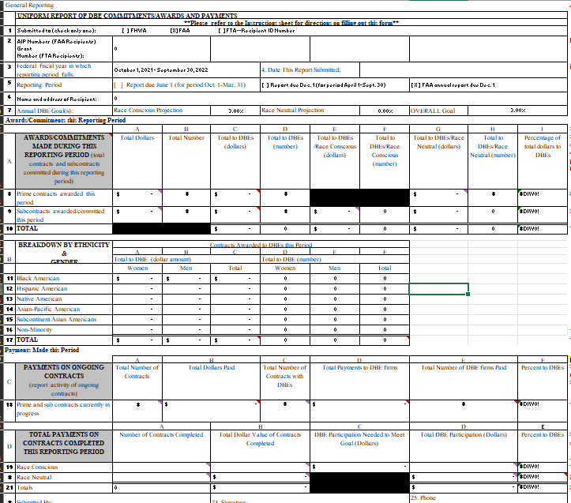
DBE Reporting
End Goal
The data from this spreadsheet entered on the Civil Rights Connect website
for the Airport

Slide 13
Other Notes
DBE Plan
Responsiveness vs. Responsibility
Responsive = turning in documents with the bid
Responsibility = turning in documents within 5 days of the bid opening
Race Conscious (RC) vs. Race Neutral (RN)
If making a “Contract Goal” it is typically Race Conscious
DBE Reporting
No reporting needed if the cumulative total of grants is under $250,000 within the fiscal year.
CARES/CRRSA/ARPA do not need to be reported unless the grant was used for a development project with established goals / contracts.
Notes:
A race-conscious program is one that focuses on, and provides benefits only for, DBEs. The use of contract goals is the primary example of a race-conscious measure in the DBE program.
A race-neutral program is one that, while benefiting DBEs, is not solely focused on DBE firms.

Slide 14
DBE Checks During Bidding
DBE Form A – DBEs Used / Not Used on Project
DBE Form B – List of ALL businesses providing quotes
DBE Form C – Confirmation DBEs Used on Form A will perform the work
DBE Utilization – DBE Utilization Calculation for Project and Percentage Achieved / Committed To
Good Faith Efforts – Used if Contractor Did Not Achieve the Project Goal
NOTE: DBEs Used must be registered as a DBE in state the work is to be performed in.

Slide 15
When do you use the DBE Program?
When things go wrong!
Did not provide adequate Good Faith Efforts with bid
Sponsor’s role
Administrative reconsideration process
Bid protest
Nonperforming subcontractors (replacement)
Prime contractor not paying subcontractors on time (prompt payment)
What do you do?
Read and follow your plan.

Slide 16
Questions?

