Slide 1


SDDOT Asphalt Specifications
Brad Remmich – SDDOT Construction Specialist

Slide 2
Overview
FAA Specification
State Specification
Benefits
What to include in Proposal and Contract
What we need to watch

Slide 3
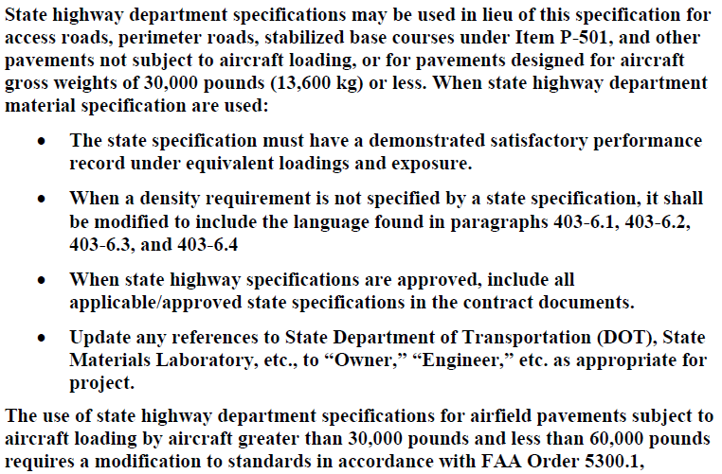
P-403 Specs

Slide 4
SDDOT Specification
Asphalt
  SD 320 and 321
  Class E Type 1
Aggregates/Binder
  SD 880 and 890
Testing
  SD 311 and 312
Price Adjustment Guidelines

Slide 5
Asphalt Binder and Aggregates
Binder SD 890
  Performance Grade Binder
Aggregates SD 880
  Use Type 1 Specifications

Slide 6
Testing
Use SDDOT Testing Specifications
Follow SD 311 and 312
92% Mat Density

Slide 7
Price Adjustments
P-403
  Any test failures causes the entire job to fail
SD 320
  Allows for Price adjustment for failed tests

Slide 8
Benefits on Using SD Specs
Price Adjustment vs All or Nothing
Material Availability (Aggregates)
Contractor Familiarity with SDDOT Specs

Slide 9
What to include in Bidding Document
Include all the SDDOT Specifications relevant to SDDOT Asphalt
  SD320 and 321
  SD311 and 312 (Found in SDDOT Materials Manual)
  SD880 and 890
  Supplementals that apply to Specifications
  Any other State specs referenced

Slide 10
What We Need to Watch
Density
  Nuclear Density Testing
  Longitudinal Joints
Performance Grade Binders
Monitor pavement performance

Slide 11
Questions?
Brad Remmich
Airport Construction Specialist
605.773-5591
Bradley.Remmich@state.sd.us

