Slide 1
OE/AAA Update
Construction Safety Phasing Plan Evaluations
Airport Layout Plan Updates
2022 South Dakota Airports Conference
Kyle Sebesta, PE
April 6, 2022

Slide 2
Outline
CSPP Evaluations
SOP 1.00, FAA Evaluation of Sponsor’s CSPPs Funded by AIP or PFC
Temporary construction points of interest
Reviewer’s view
New component types
Determination letters
ALP Updates
Pen and ink vs. ALP Update

Slide 3
CSPP Evaluation
https://www.faa.gov/airports/resources/sops/
1 case for CSPP by itself, located at ARP, elevation 1’, height 1’
Routed for review differently than PT77 points of interest
1 case for each point of interest for airspace review
Guidance in SOP 1.00
New codes in 2021, including stationary equipment and mobile equipment

Slide 4
Temporary Construction Points of Interest
Title 14 CFR Part 77 establishes notice criteria
SOP 1.00 Appendix C, Table C-1 – Guidance for Identifying Objects for Temporary Construction Activity
Construction area boundary
Staging area/stockpile areas/batch plants as logical
Haul route points near active movement areas or runway ends
Equipment that may impact line of sight
Items in/near NAVAID critical areas
Program managers are willing to review CSPPs and points of interest prior to OE/AAA submission
During review of Engineering Design Report may work best

Slide 5
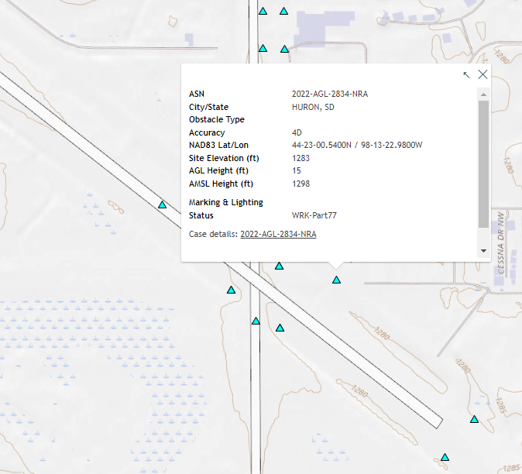
Reviewer’s View of Submitted Cases
Helpful information to provide to streamline review
Which point on the plan does the case correspond to?
Which phase is applicable?
Detailed case description
Correct component/structure type
Enough points to capture needed reviews; not so many that clutter the review process

Slide 6
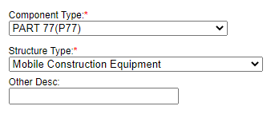
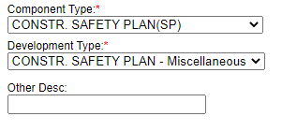
New Component Types in OE/AAA System
Structure types added for stationary and mobile equipment
Can be applicable to project areas, haul routes, stockpile areas, etc.
“Other Desc” not required, but may be helpful

Slide 7
Determination Letters
Read and review content of determination letters
FAA Action
Approval vs conditional approval
Conditions of Acceptance
Range from following AC 150/5370-2 to NOTAMs to various obstruction mitigation requirements
May include comments from several FAA divisions
Limitations of FAA Action
Required Sponsor Actions

Slide 8
ALP Updates
ALP Update should be completed for projects expected to have significant impact on aeronautical or airport operations
Submit separate OE/AAA case for ALP update to be reviewed alongside airspace cases
Pen and Ink update should be completed for projects that will not have a significant impact on aeronautical or airport operations
ADO staff will use airspace case sketch to update their copy of the ALP
Work with FAA program manager to determine appropriate course of action for each project

Slide 9
Questions?
Kyle Sebesta, PE
Kyle.E.Sebesta@faa.gov
2301 University Dr., Bldg. 23B
Bismarck, ND 58504

