Slide 1
South Dakota Aviation Trivia

Slide 2
When was the South Dakota Aeronautics Commission started?

Slide 3
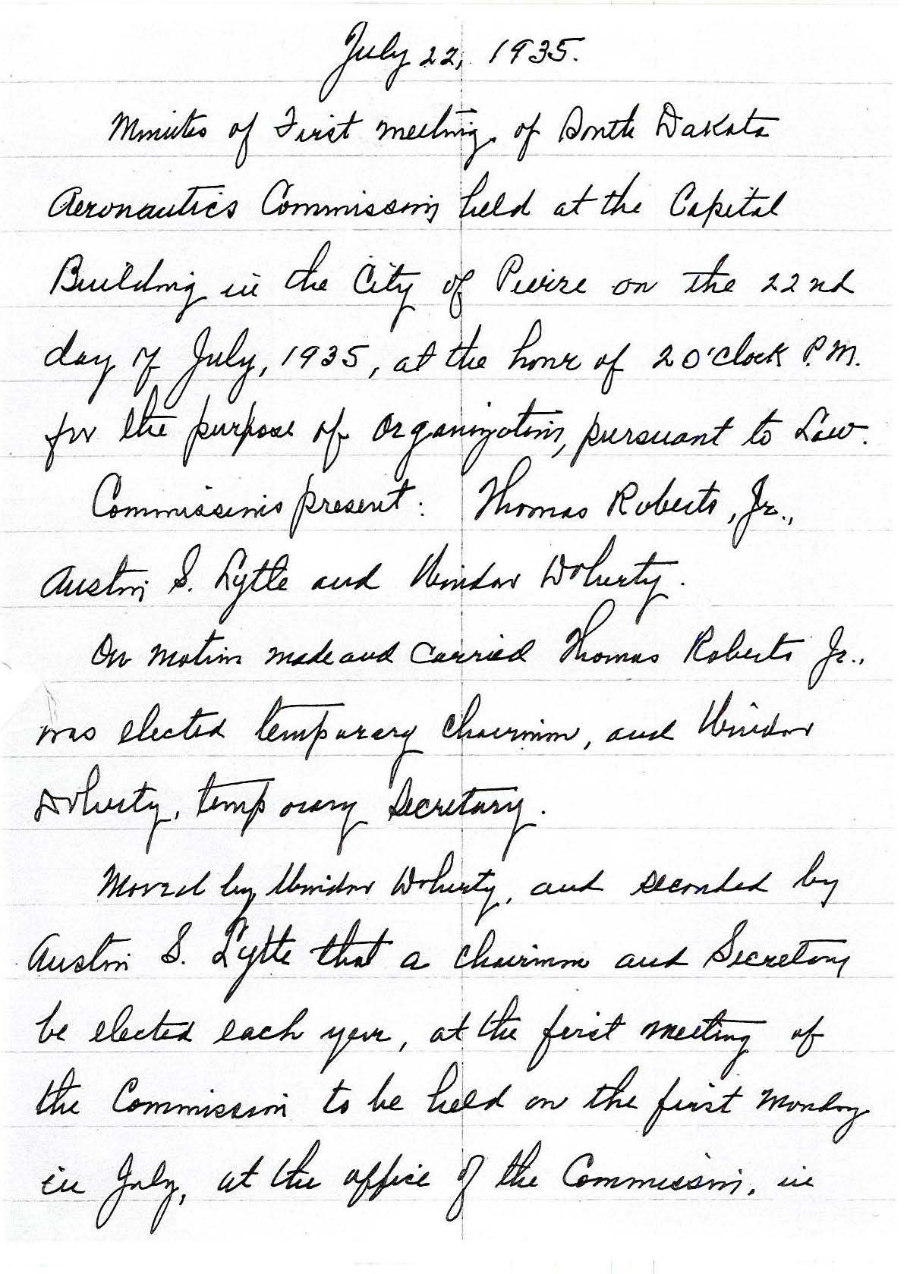
The Aeronautics Commission was formed under Governor Tom Berry in 1935. These are the first commission meeting minutes.
South Dakota State archives

Slide 4
Who was the Commission’s first chairman?

Slide 5
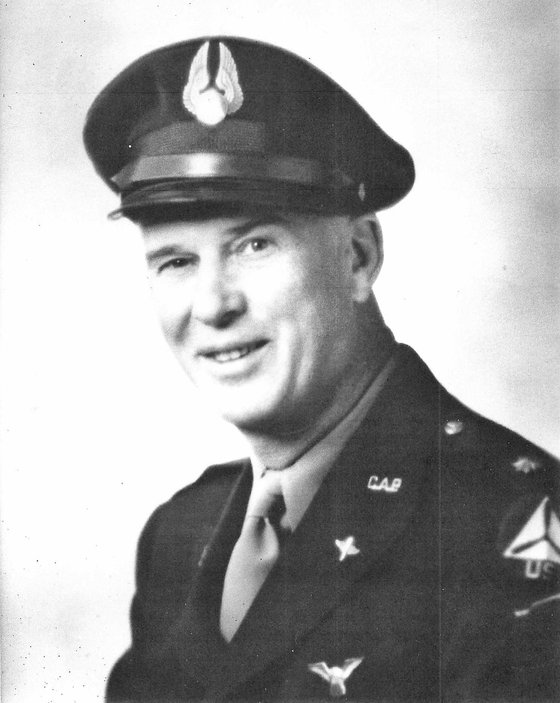
Thomas Roberts Roberts served on the Commission from 1935 to 1943. He was also the first commander of the South Dakota Wing of Civil Air Patrol. Roberts was inducted into the Aviation Hall of Fame in 2018.

Slide 6
Where and when was the first powered aircraft flight in South Dakota?

Slide 7
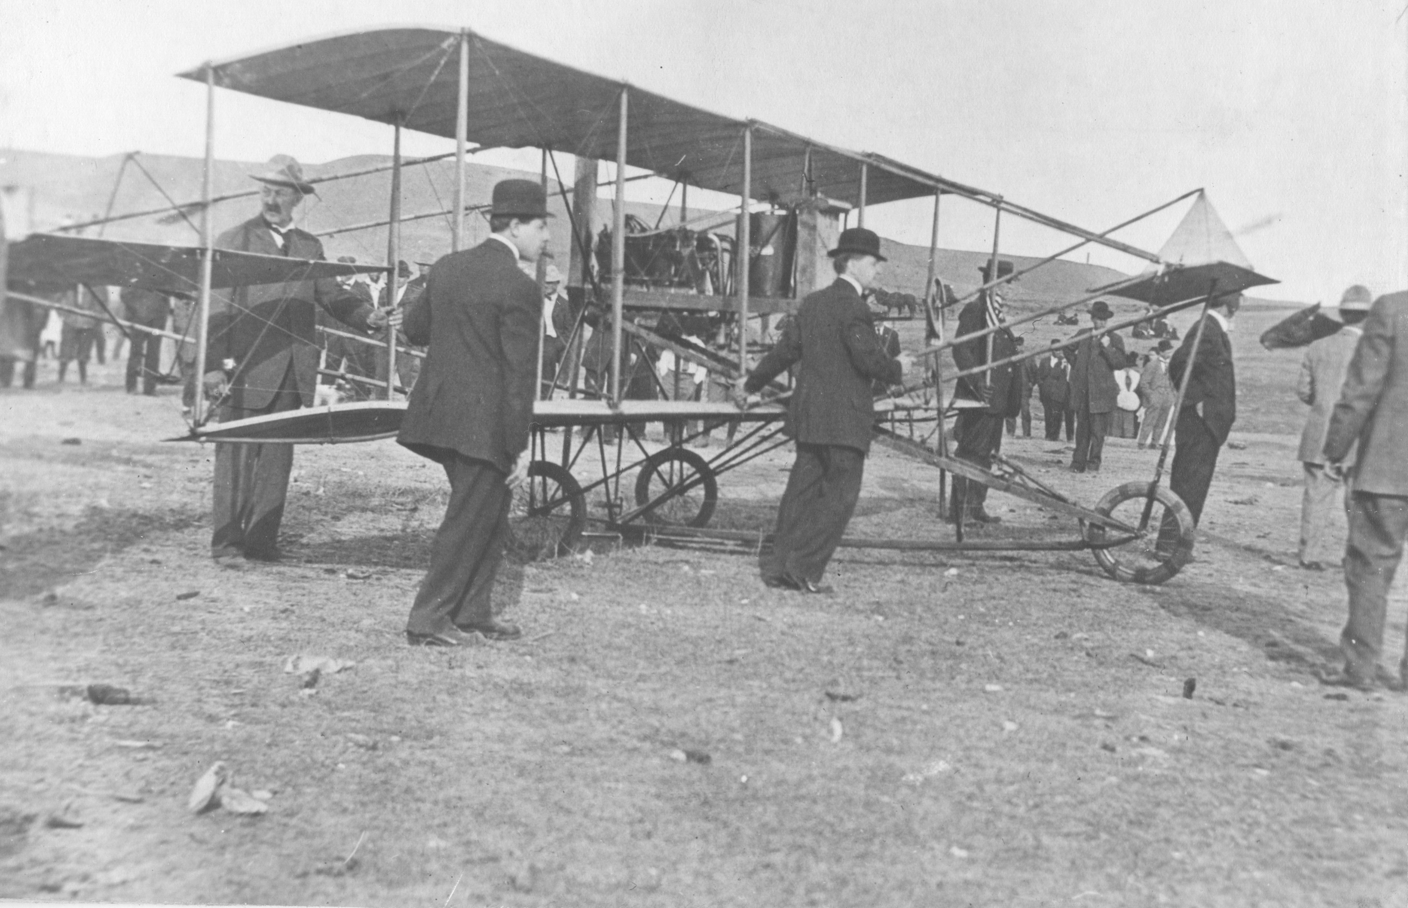
The Curtiss exhibition team was hired by the South Dakota Stockmen’s Association to perform at the annual convention in Rapid City in April 1911. The aircraft was flown by Hugh Robinson. Robert Orr, A History of Aviation in South Dakota, 1957

Slide 8
When was the first non-stop cross-country flight between Sioux Falls and Minneapolis?

Slide 9
July 1919 Lt. Lloyd Peterson and Louis Chaladek bought a plane in Minneapolis and flew to Sioux Falls. Mr. Chaladek was a druggist in Tyndall.
Orr, pg 27

Slide 10
What aviation company was based in Ft. Pierre?

Slide 11
The Ft. Pierre Aero Company was organized on July 8, 1919. A.W. Stevenson and Arnold Rowe, WW1 pilots, flew exhibition shows, passenger flights, and aerial advertising.

Slide 12
What was the first airplane manufacturing company in South Dakota?

Slide 13
Sioux Falls Aircraft Engineering Company, October 1, 1919. The Curtiss Northwest Aerial Corporation of Minneapolis established an assembly plant at Fourth and Main Avenue in Sioux Falls. Orr, p 31

Slide 14
Who was the first director of the Aeroautics Commission?

Slide 15
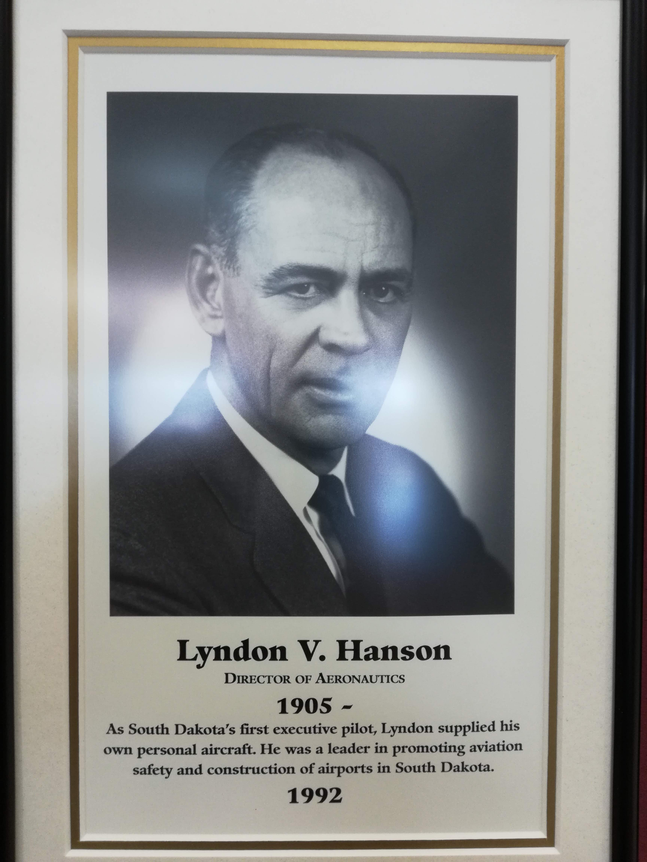
Lyndon Hanson became Executive Secretary/Director in 1945. He served until his retirement in 1974. He was inducted into the Transportation Hall of Honor in 1992.

Slide 16
What was the state’s (Aeronautics Commission’s) first airplane?

Slide 17
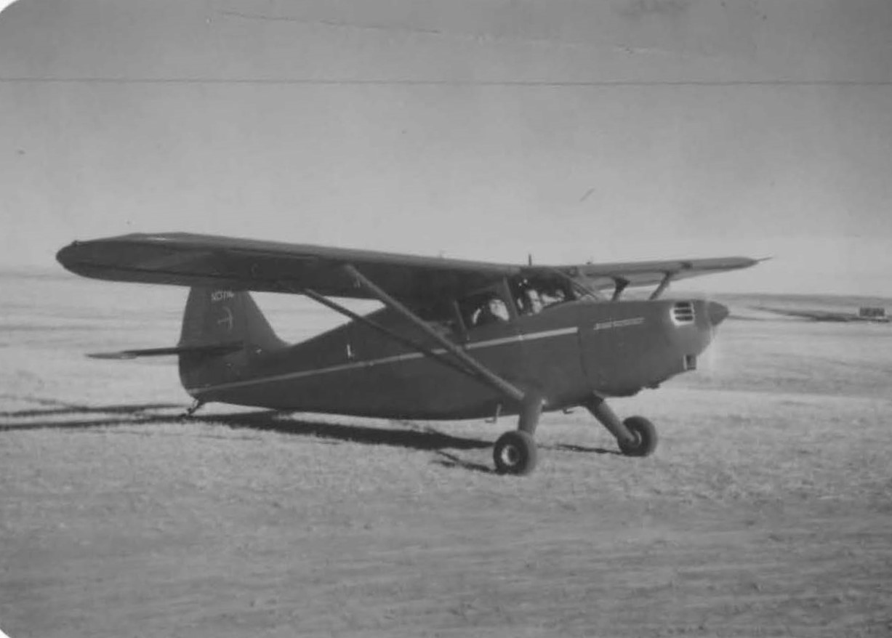
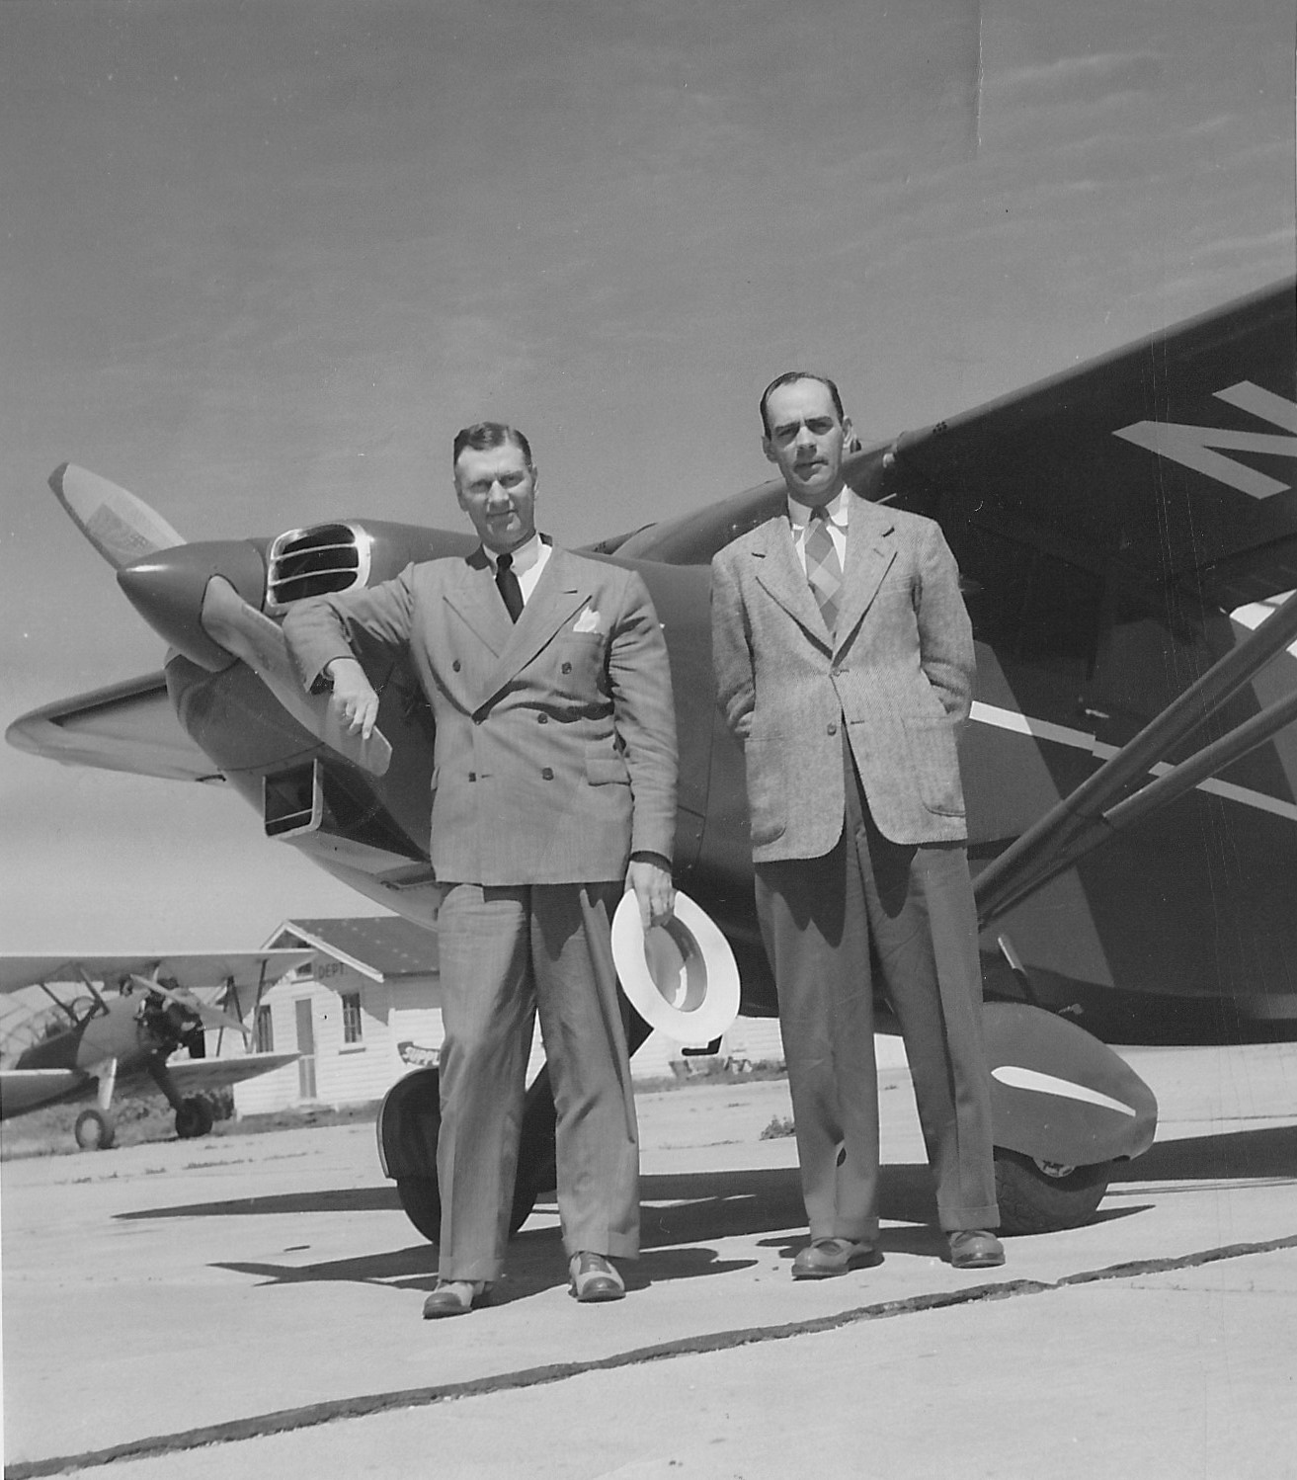
165 hp Stinson Voyager. Governor Mickelson authorized the purchase in July 1947. Prior to that, Hanson had been using his personal Taylorcraft to fly on commission business. Hanson was the first Commission pilot, and Governor Mickelson was his first passenger. Photos from Dave Hanson

Slide 18
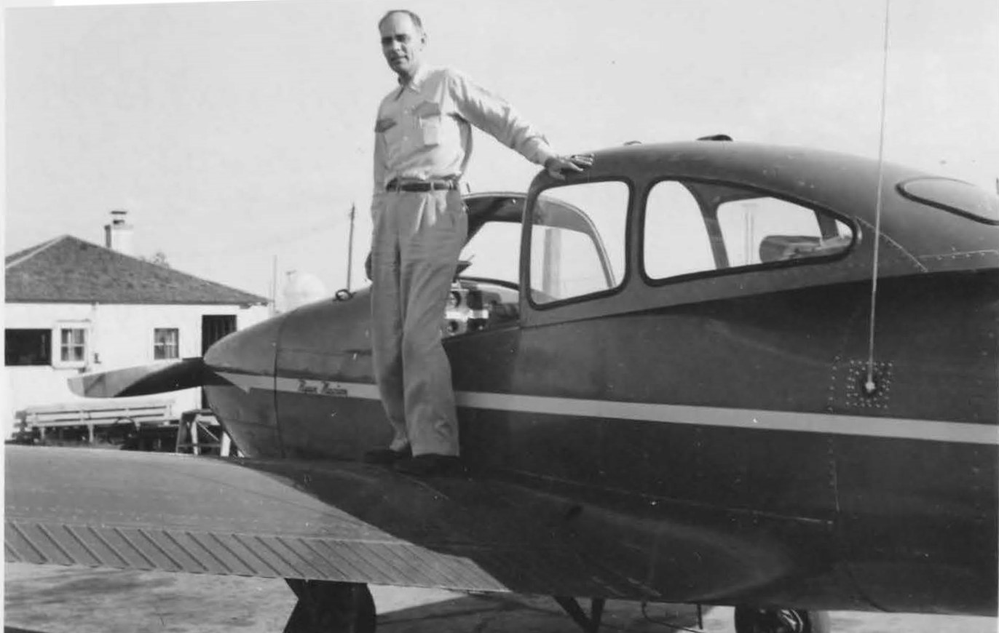
Lyndon Hanson poses on the wing of the second aircraft purchased by the Commission, a 1949 Ryan Navion. The Commission flew it until 1957.
Photo: Dave Hanson

Slide 19
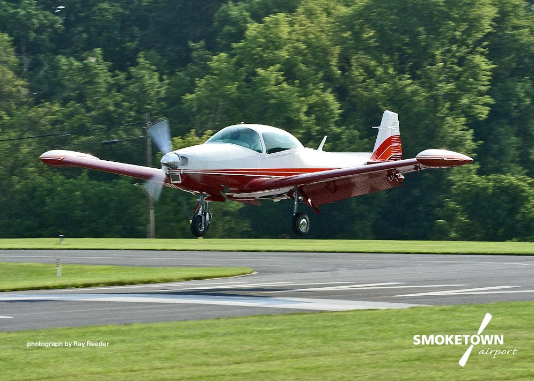
The same Navion, N4969K, is still flying in Tennessee!
Owner Rick Mills

Slide 20
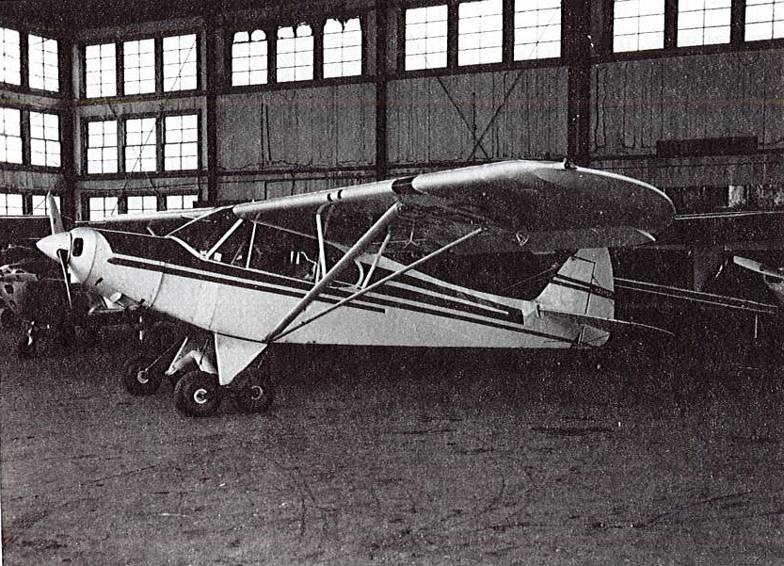
Other Commission aircraft: 1955 Piper PA18 with Whitaker tandem landing gear.

Slide 21
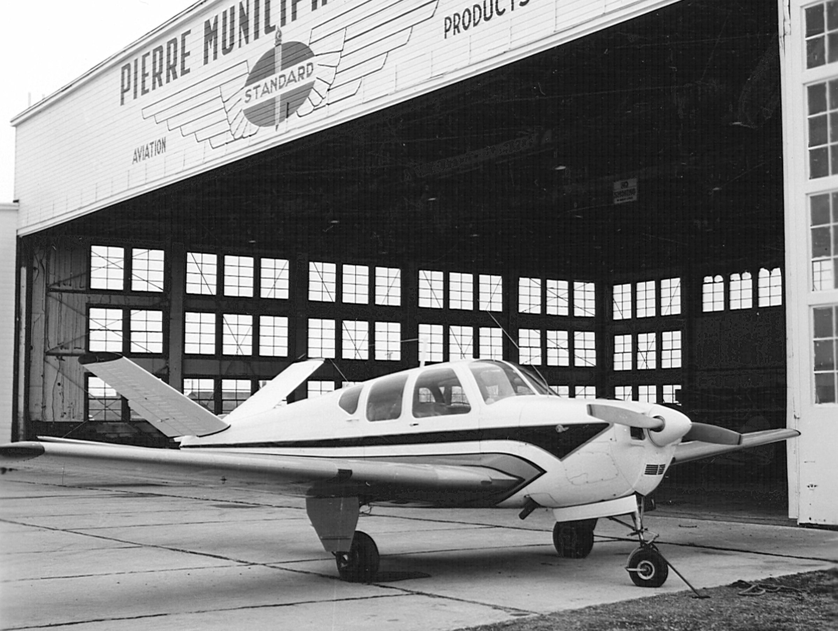
1957 Beechcraft Bonanza H

Slide 22
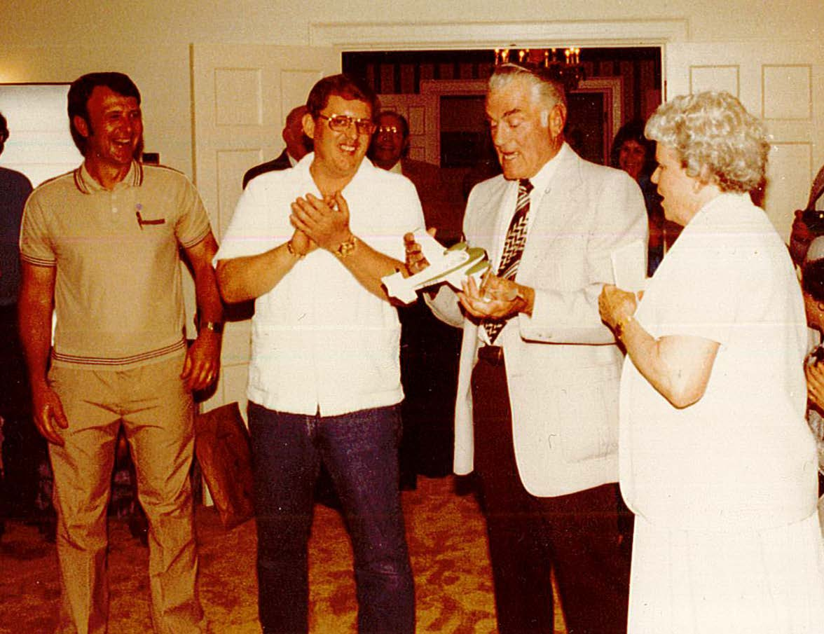
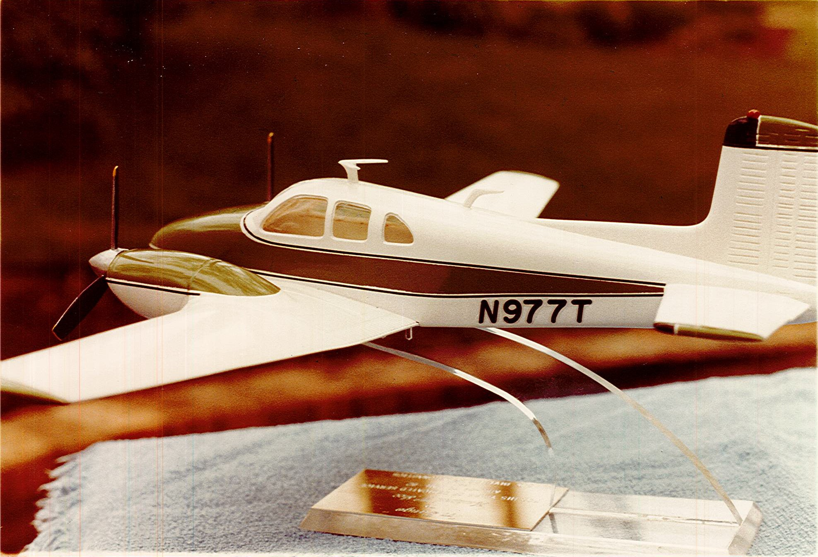
The Commission’s first twin engine airplane was the twin Beech D50C, flown from May 19,1961 to December 6, 1979. This model of the Twin Beech D50C was presented by Governor Janklow to Howard Ice, Aeronautics Commission pilot, at his retirement party in 1983.
Photos: Monte Schneider

Slide 23
Where was South Dakota’s first municipal airport?

Slide 24
Aberdeen The first municipal airport was constructed in 1920 at the Tri-State Fairgrounds north of Aberdeen. The airport had two runways, hangars, fuel and repair services. Fields used prior to that were not purpose built for airplanes. Fairgrounds were used and some private strips were built.
Orr, pg 66
Aberdeen Airport website

Slide 25
What was South Dakota’s first airline?

Slide 26
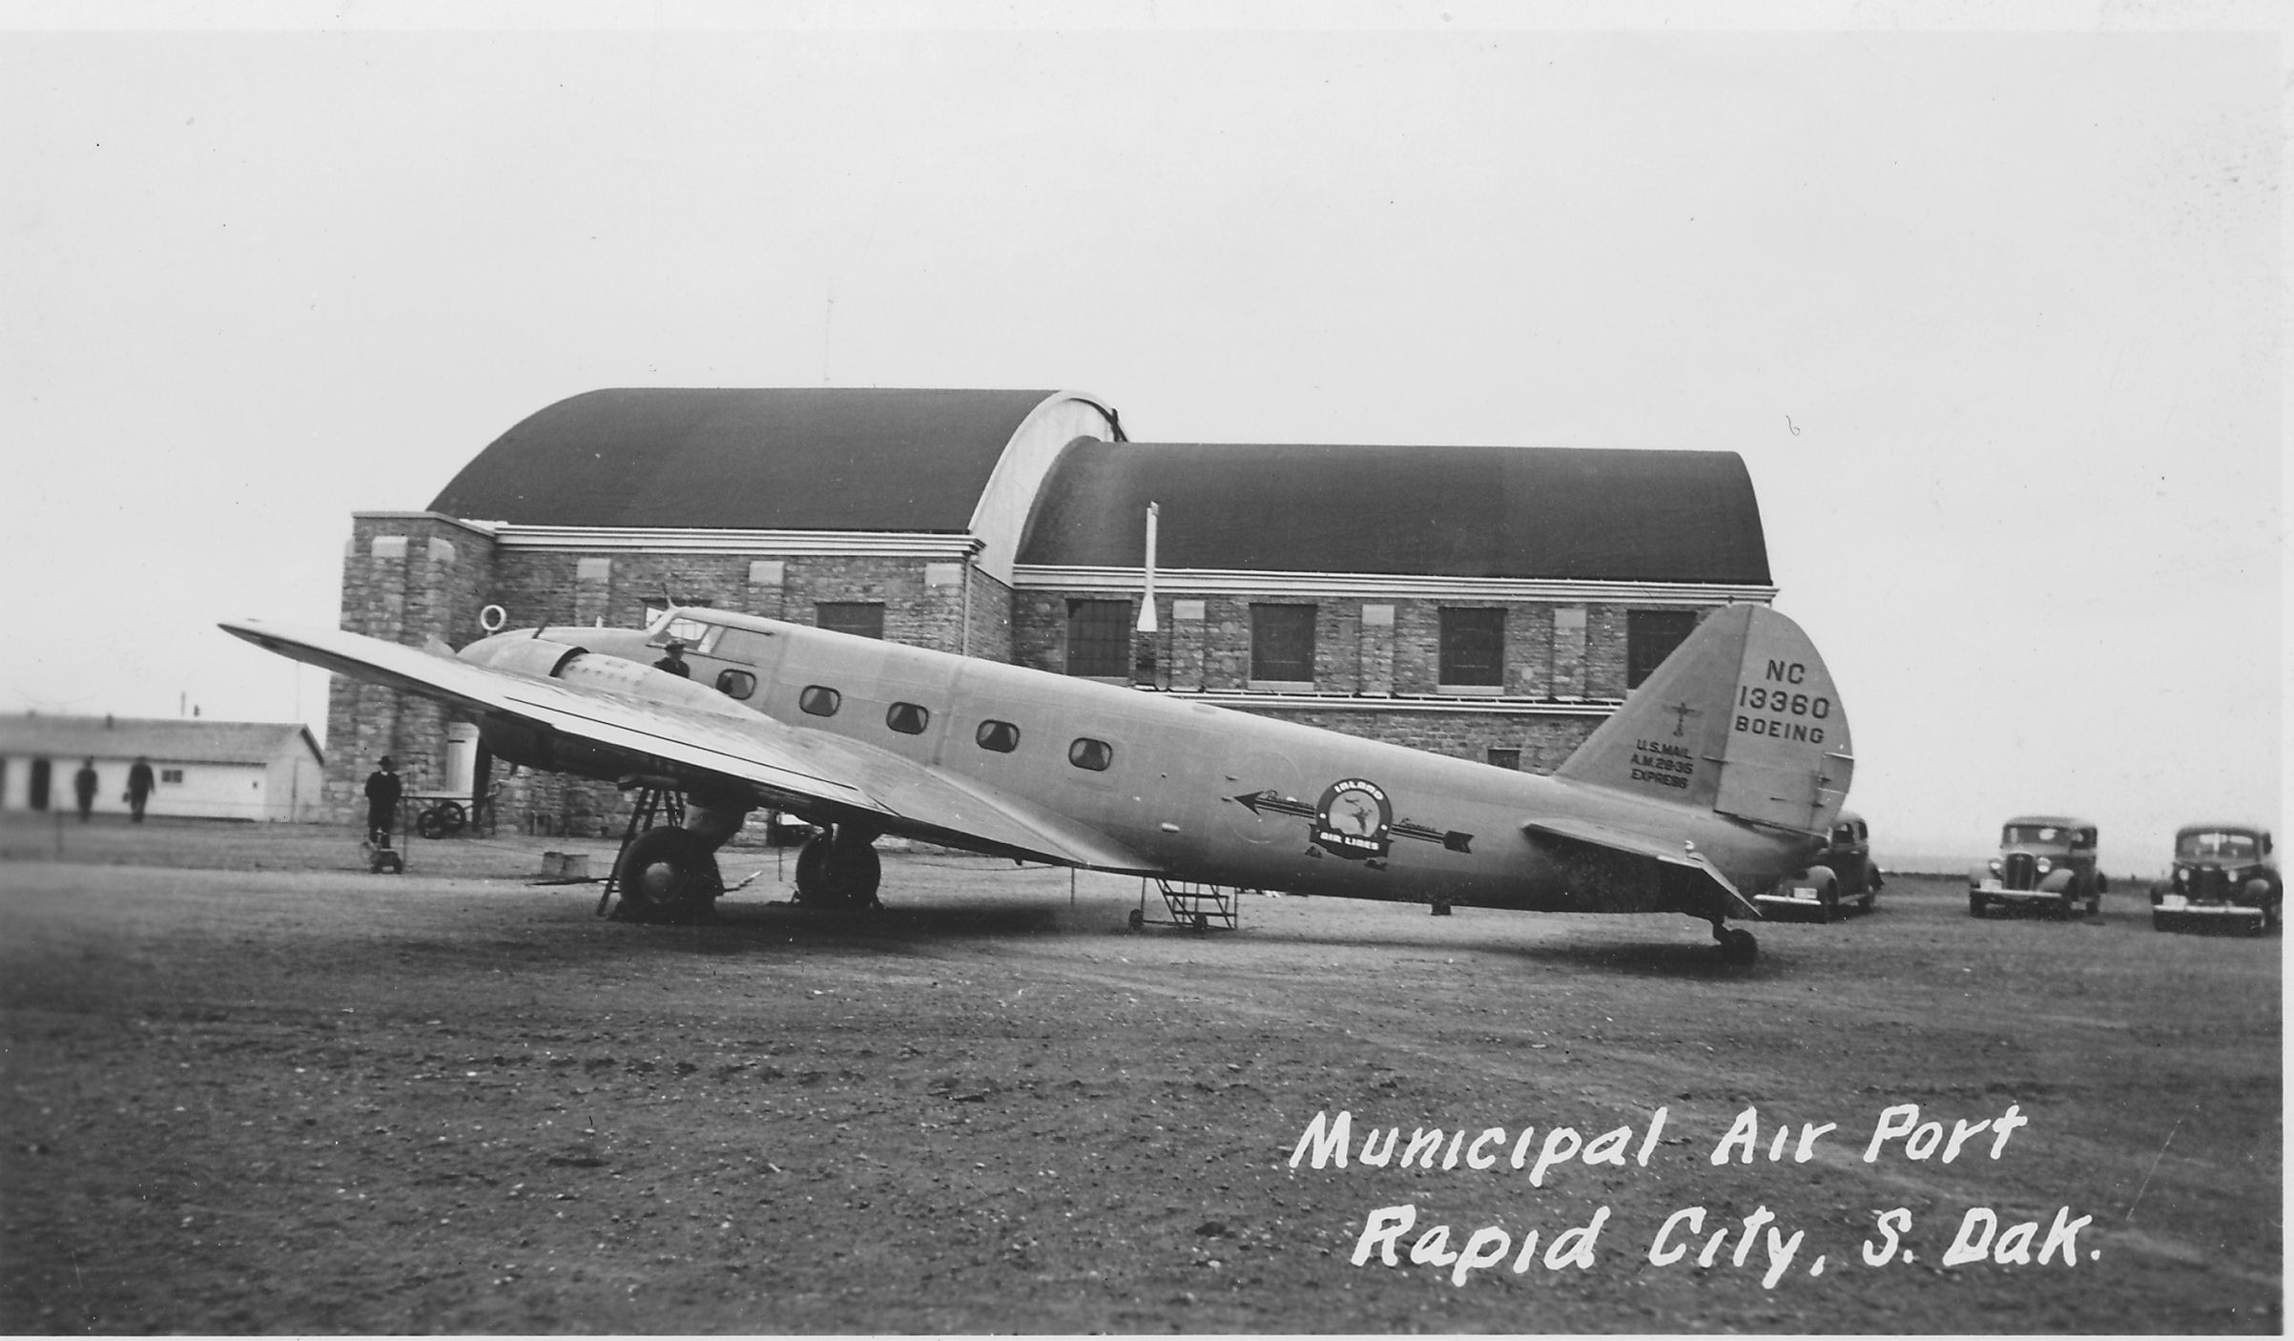
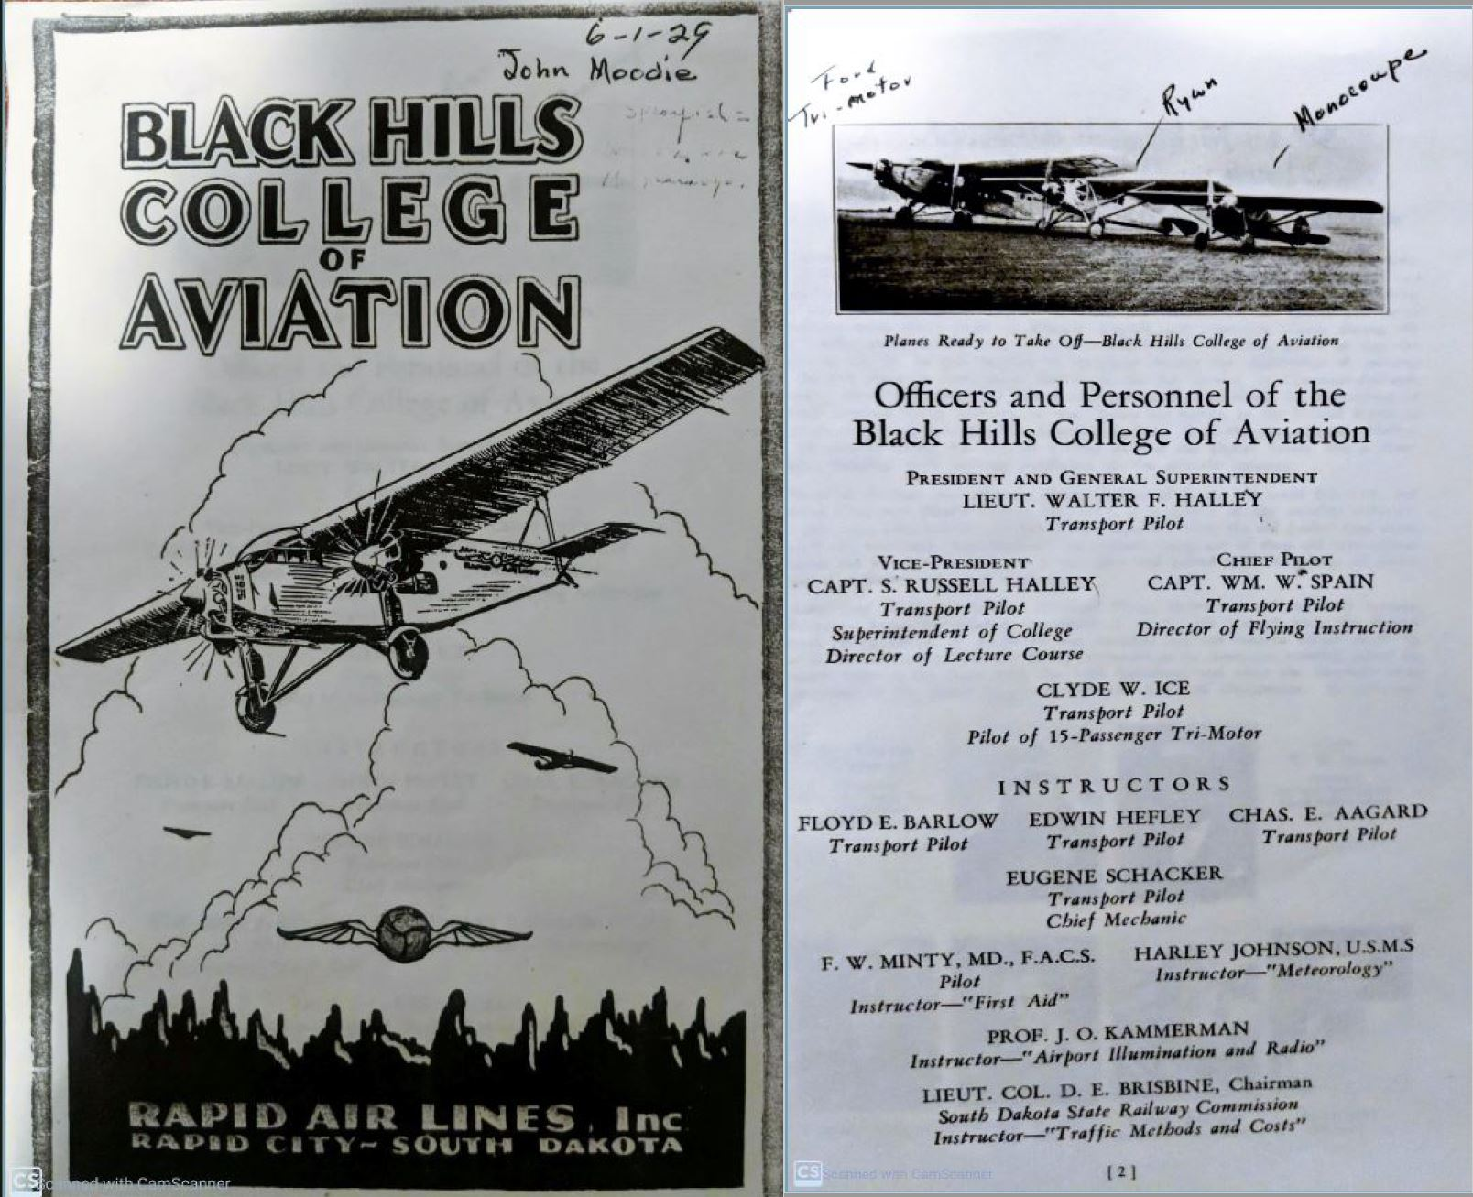
Rapid Air Lines was organized in 1926. It also established aircraft dealerships and opened the Black Hills College of Aviation in 1928.

Slide 27
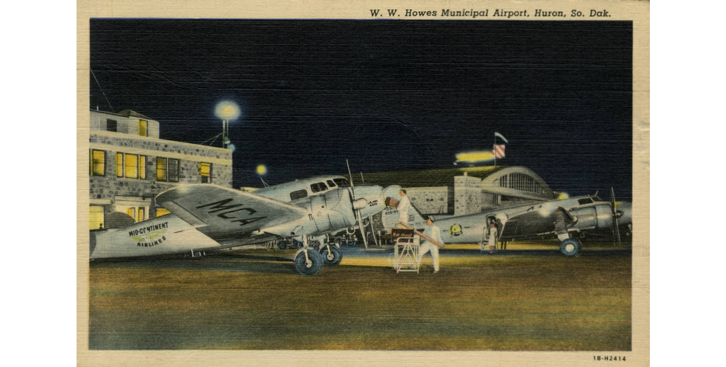
Hanford Airlines first flew in 1937. The name changed to Mid-Continent Airlines in 1938.

Slide 28
Who was the first South Dakotan to learn to fly?

Slide 29
Saxe Gantz witnessed the first flights at Rapid City in April 1911. He took flying lessons in Missouri and built a plane similar to a Curtiss Pusher by August 1911. Frank and Burt Auckerman, Sturgis, also learned to fly and bought a Curtiss Pusher in Hot Springs. Burt is believed to be the first to crash a plane in South Dakota, in 1916.
Orr, pg 14

Slide 30
The SD Aeronautics Commission was formed 1935. How many registered aircraft and pilots were there at that time?

Slide 31
83 pilots, 84 planes
1936 Commission Report to the Governor

Slide 32
How many pilots and aircraft are in South Dakota today (2021)?

Slide 33
1,272 aircraft, 2689 pilots in 2021
Data compiled from SD Aeronautics Commission annual and biennial reports, SDDOT HA50 Aircraft Registration Database, FAA Aviation Statistics and Aeronews newsletters.

Slide 34
In what South Dakota town were propellers manufactured?

Slide 35
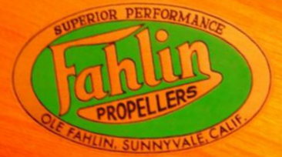
Fahlin propellers were made in Aberdeen in 1927. Ole Fahlin was involved in barnstorming and passenger service and operated a shop at Aberdeen. Fahlin was granted an approved type certificate by the Department of Commerce in 1928. In 1929, the Dakota Fahlin D-5000 propeller was the lightest propeller produced in the US.
Orr, pg 45

Slide 36
When did crop dusting start in South Dakota?

Slide 37
In 1937, Clyde Ice rigged a hopper with a piece of grain spout attached to the side of the plane. Insecticide was poured through a funnel and dropped on a field in the Belle Fourche area. This was the start of aerial application for the region.
Sky Trails – the Life of Clyde Ice.

Slide 38
Who was the first female pilot in South Dakota?

Slide 39
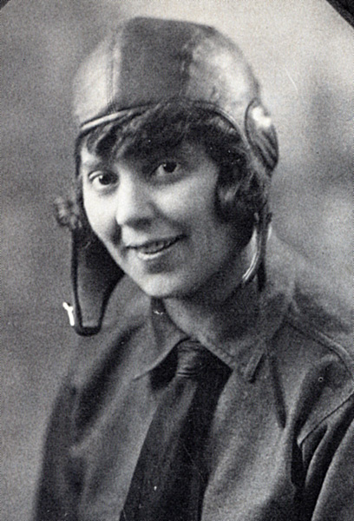
Nellie Willhite attended Dakota Airlines Flight School in November 1927 at Renner. She soloed on January 13, 1928. Her father bought an Eaglerock which she used for private flying.
Robert Orr, pg 37

Slide 40
Aside from airport construction projects, what products did the Commission produce for pilots and airports?

Slide 41
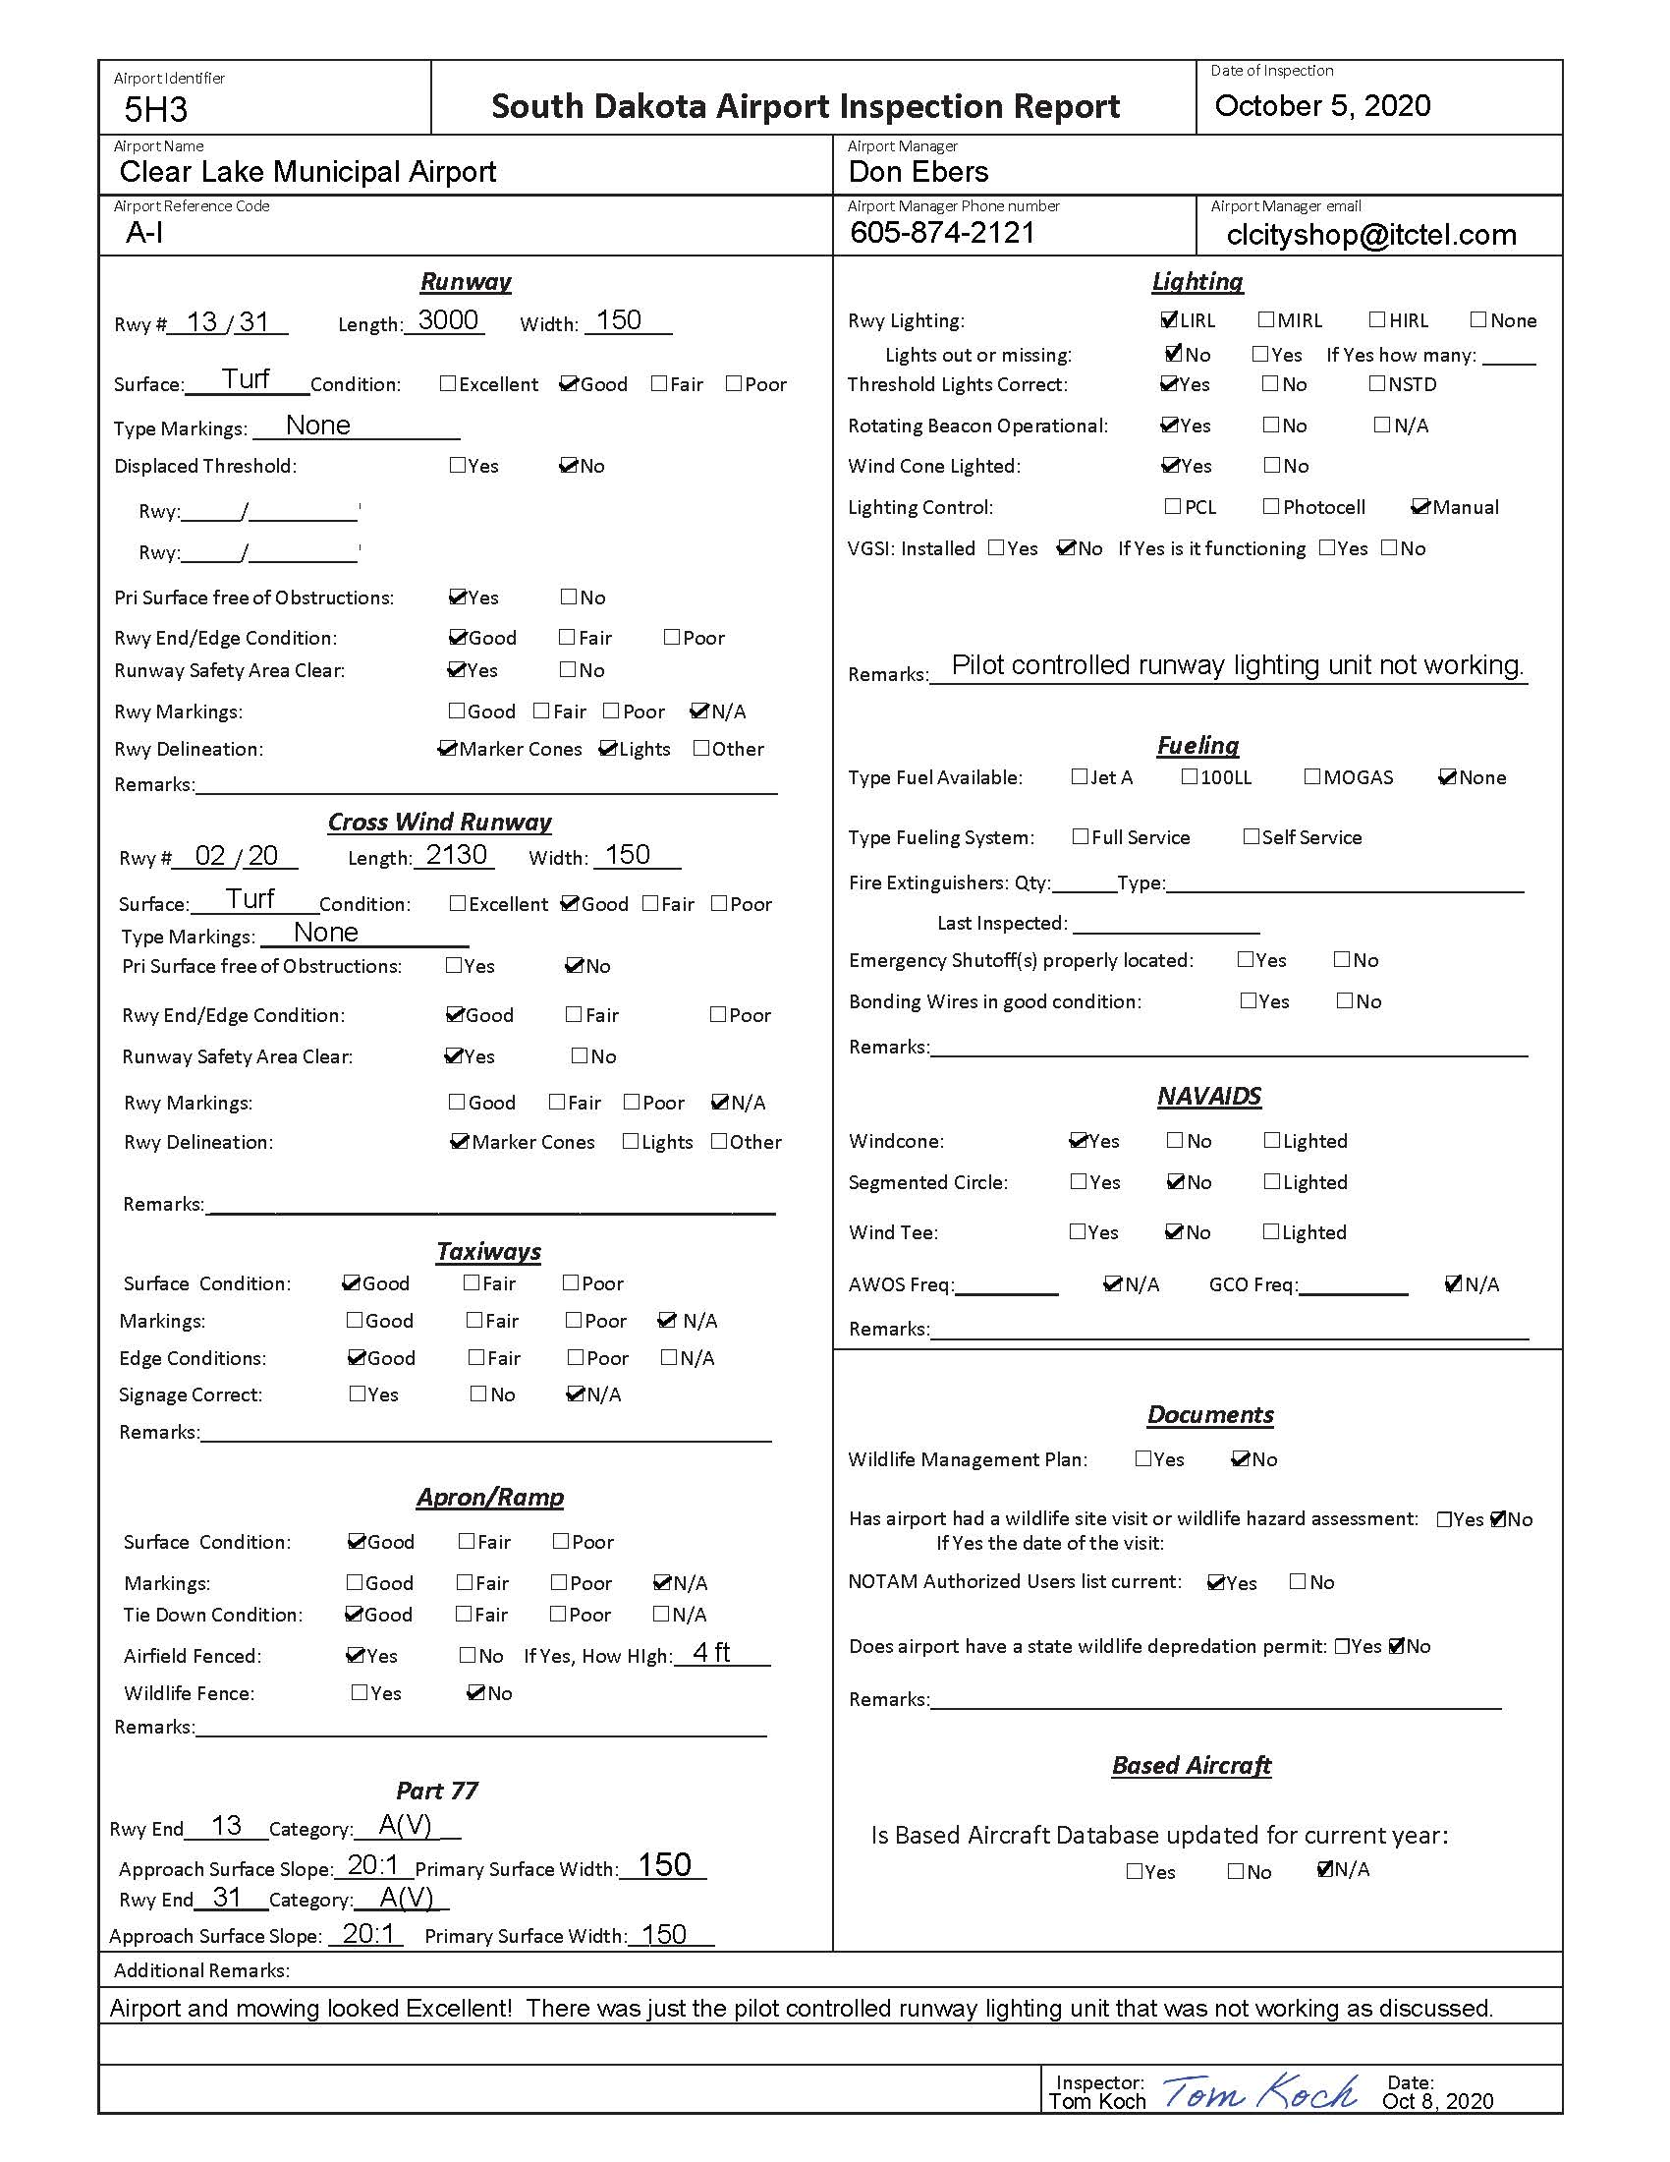
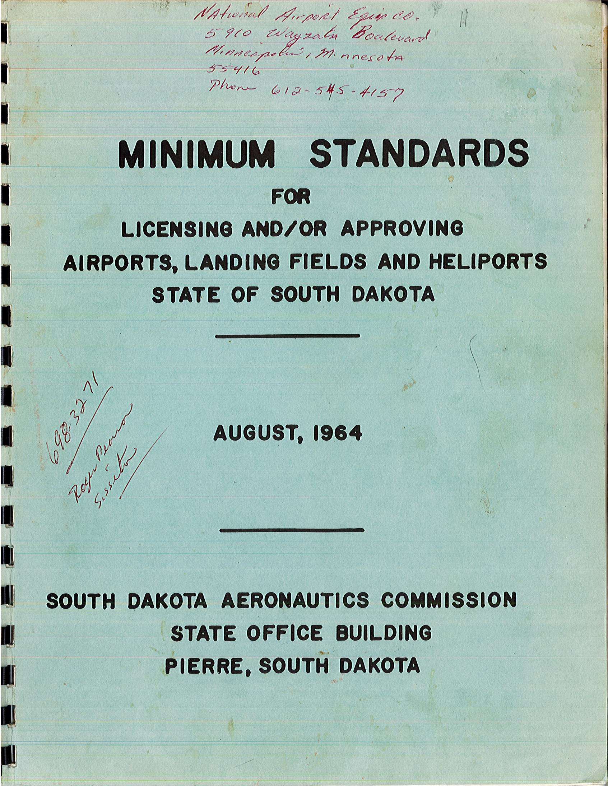
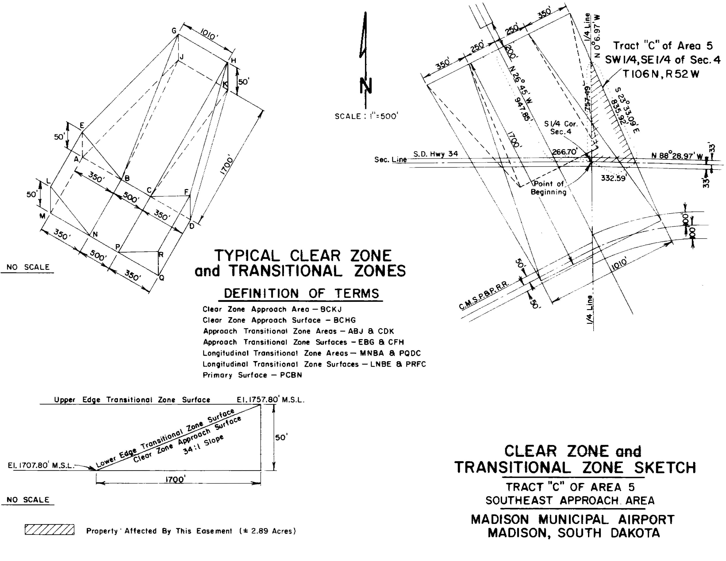
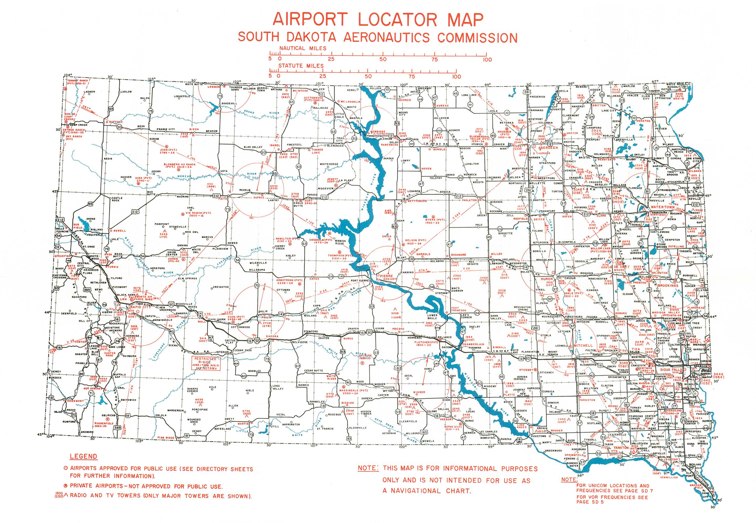
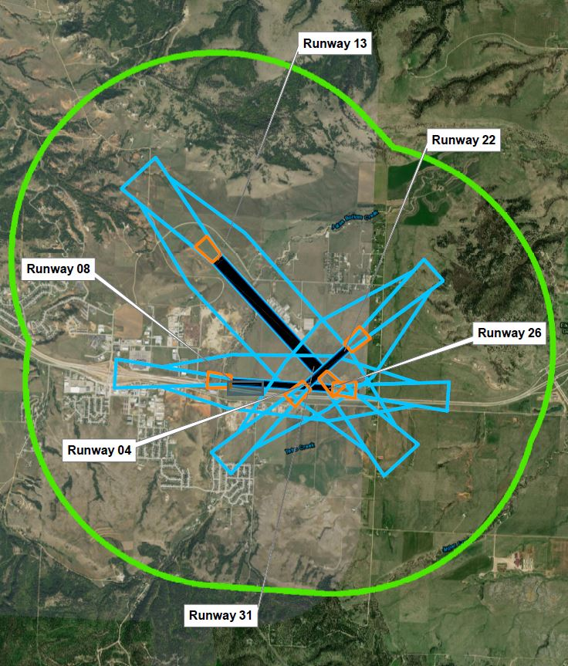
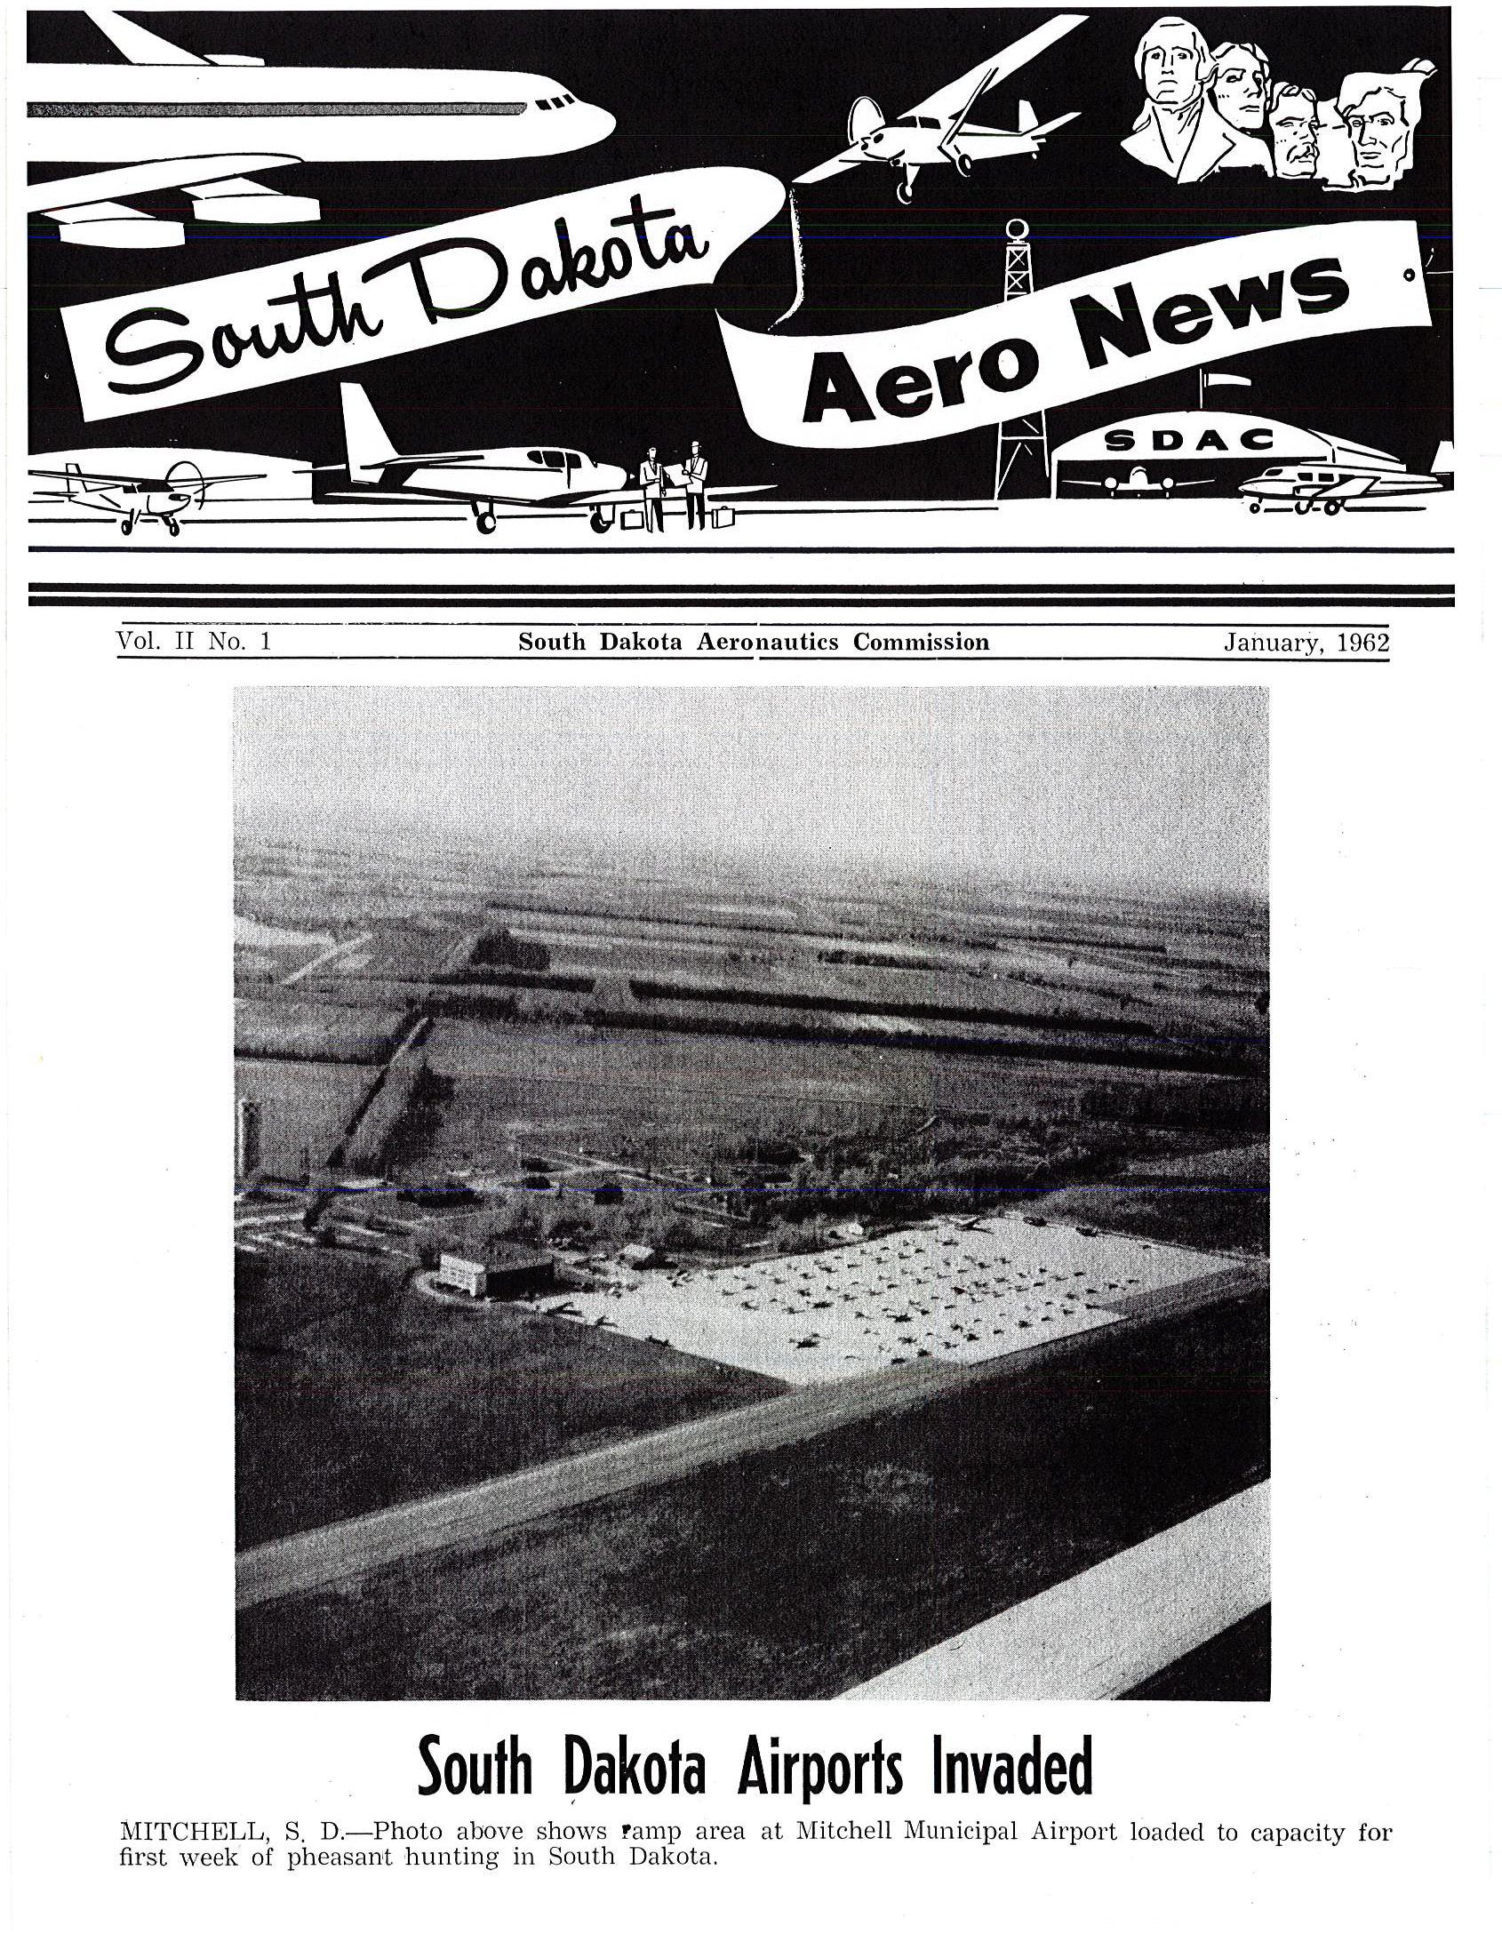
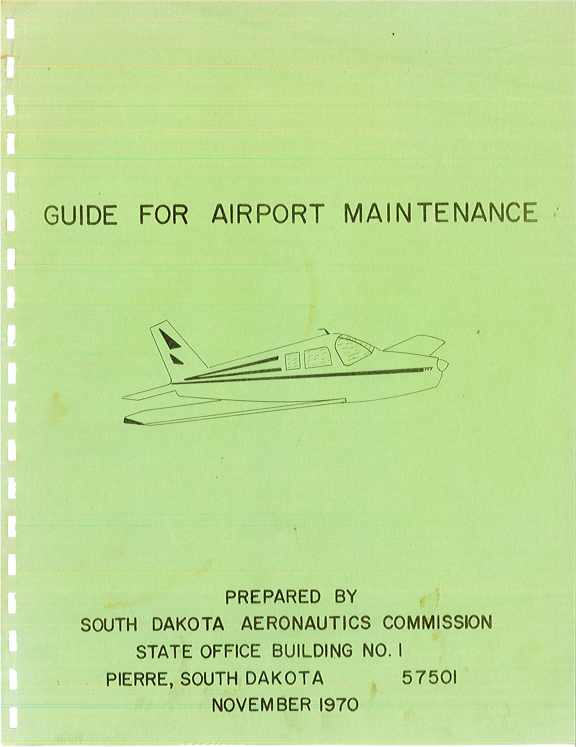
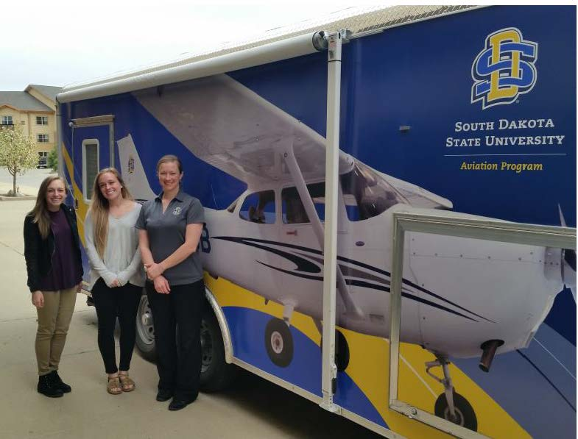
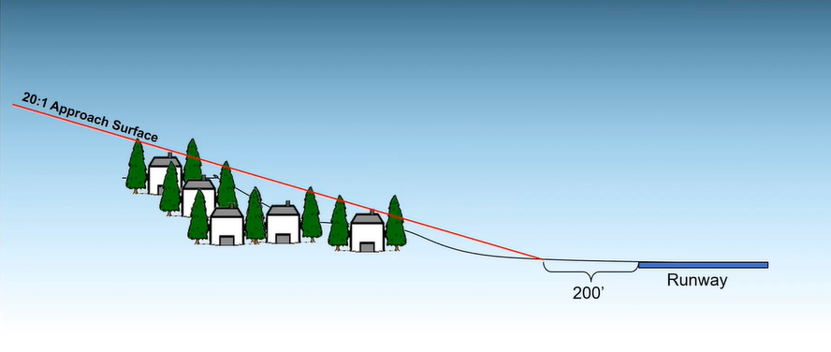
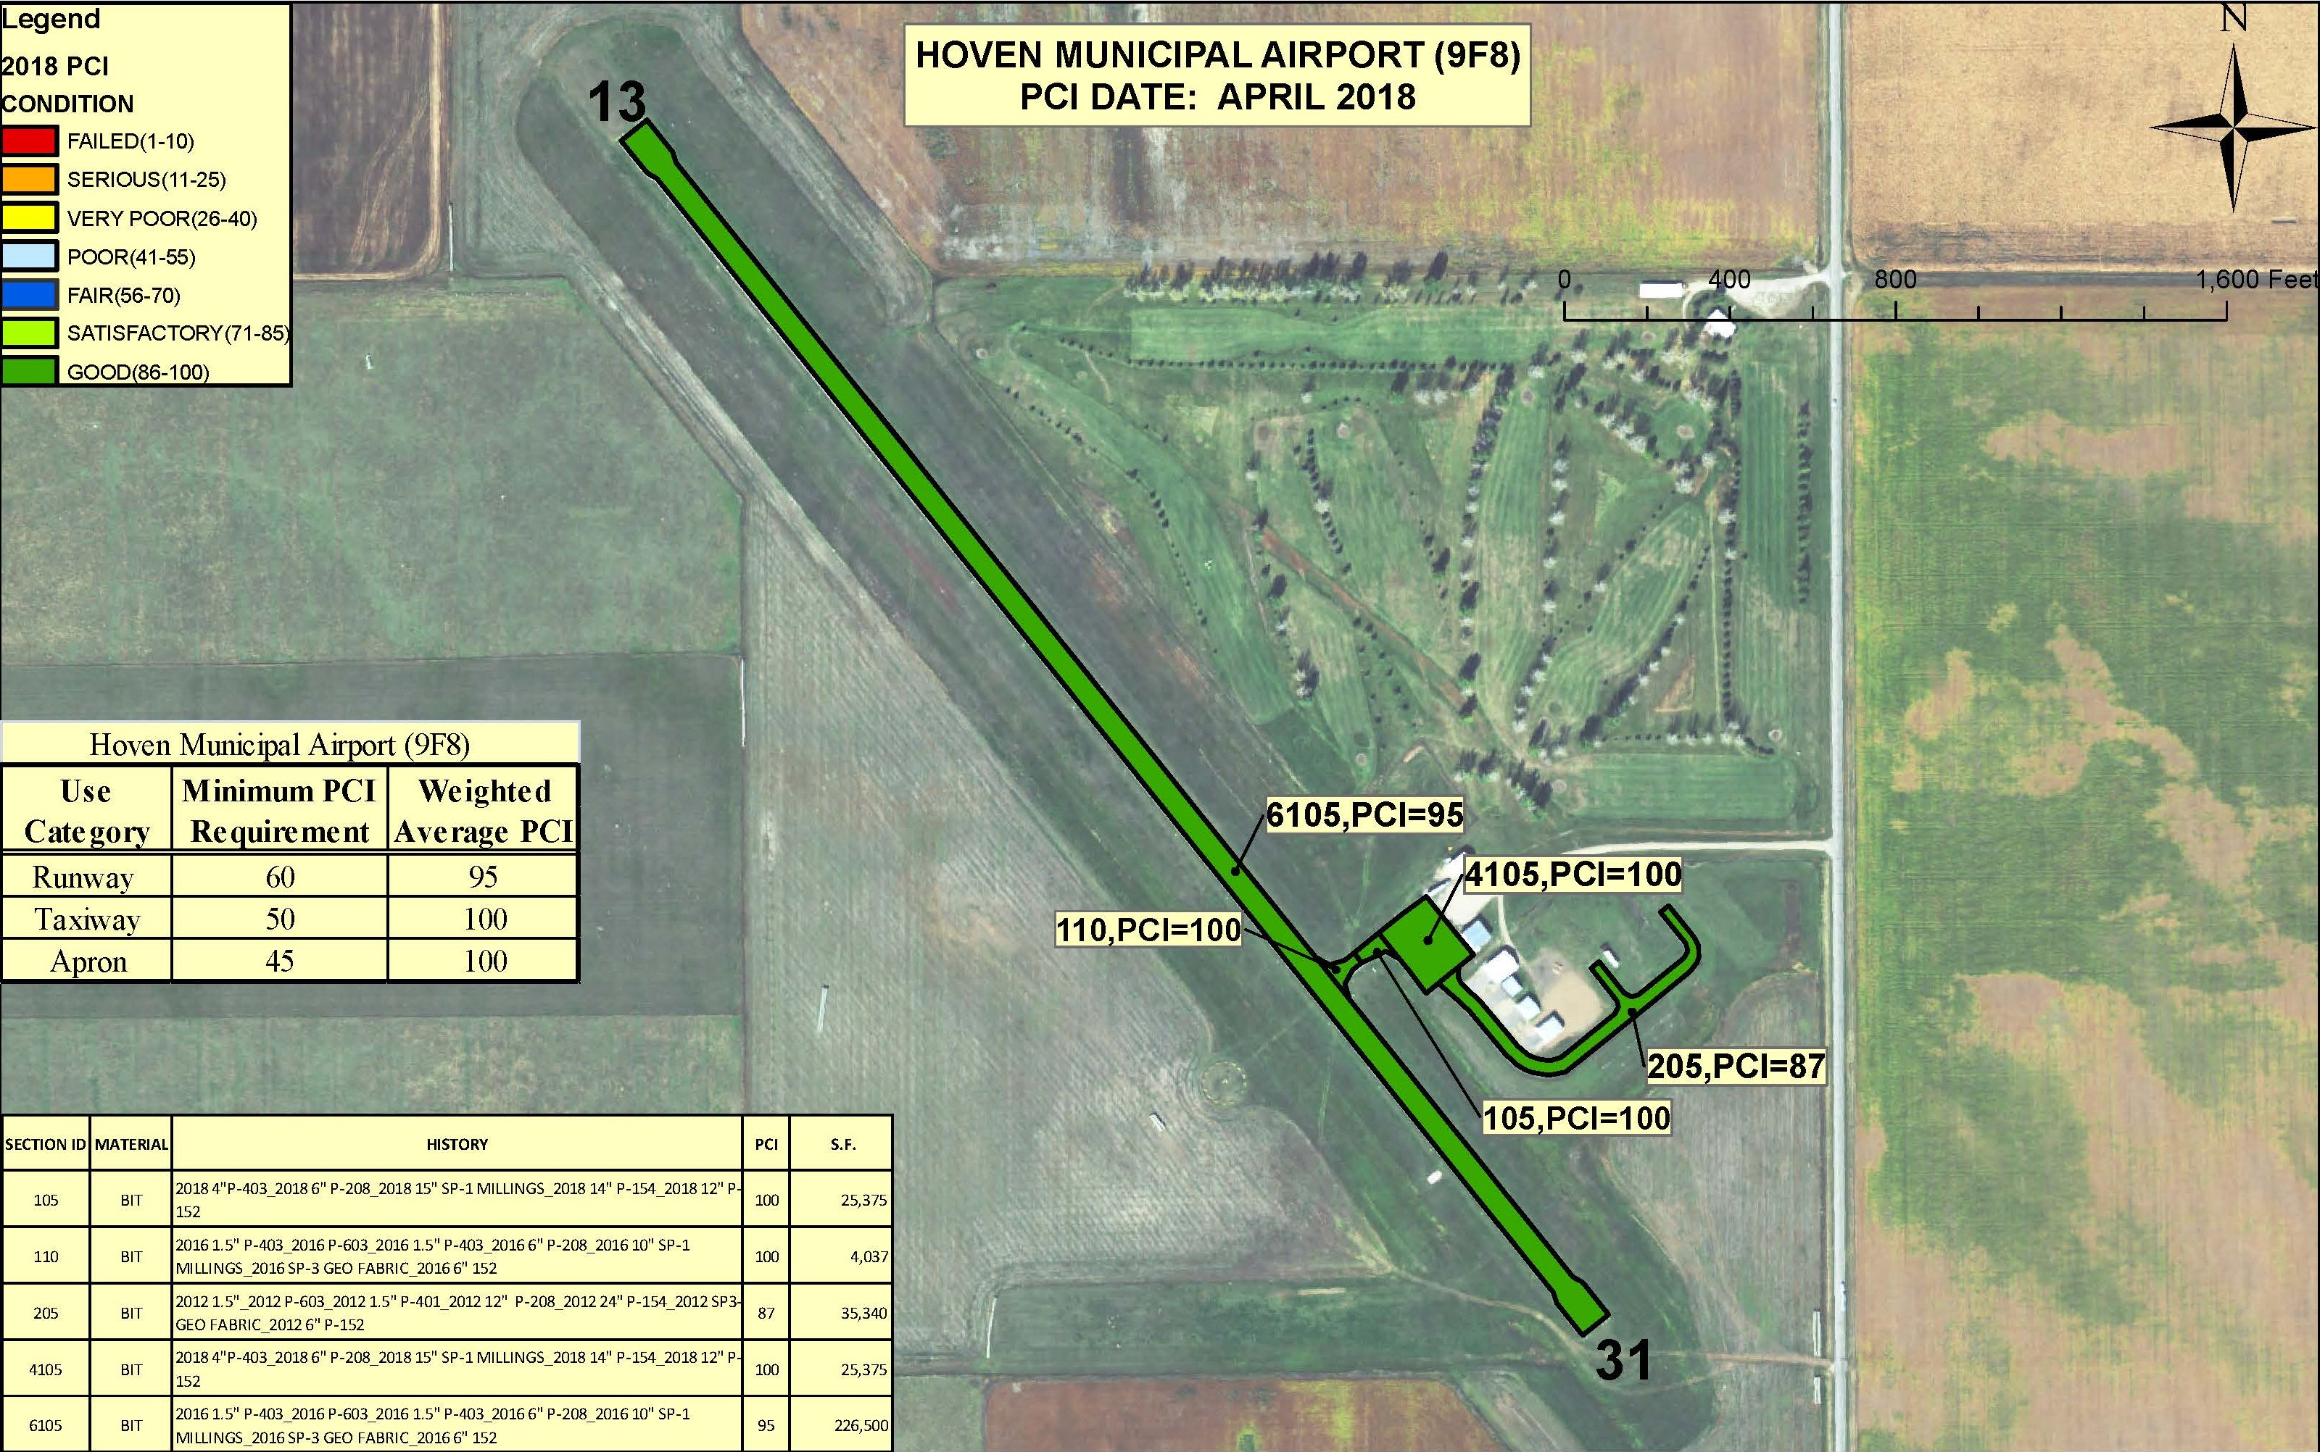
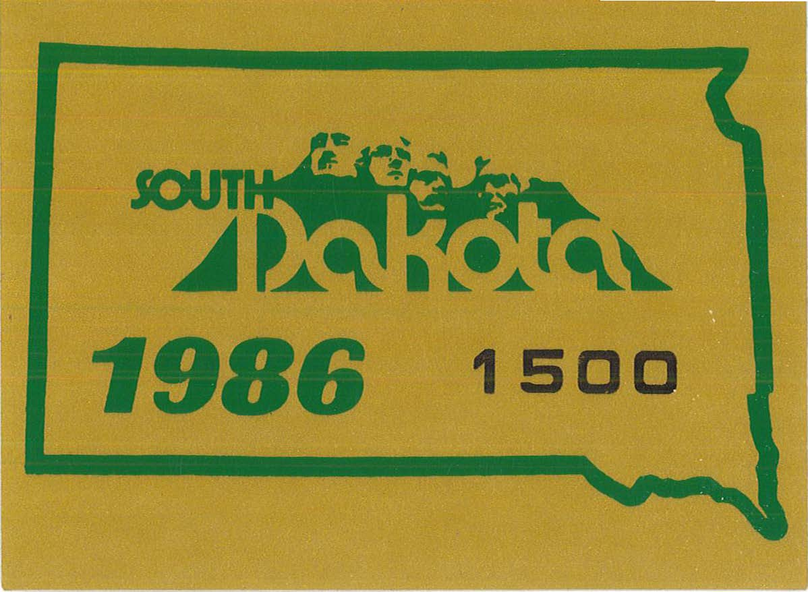
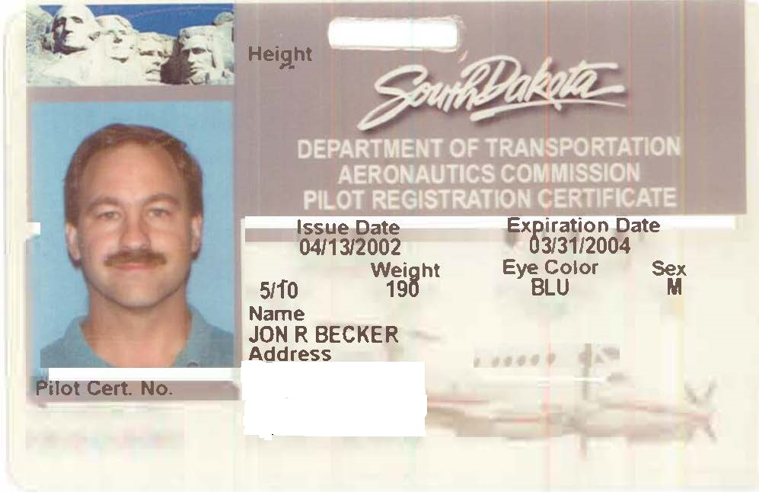
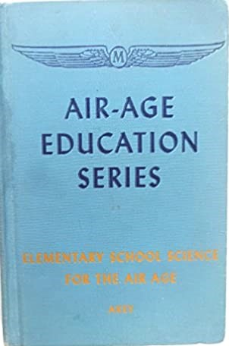
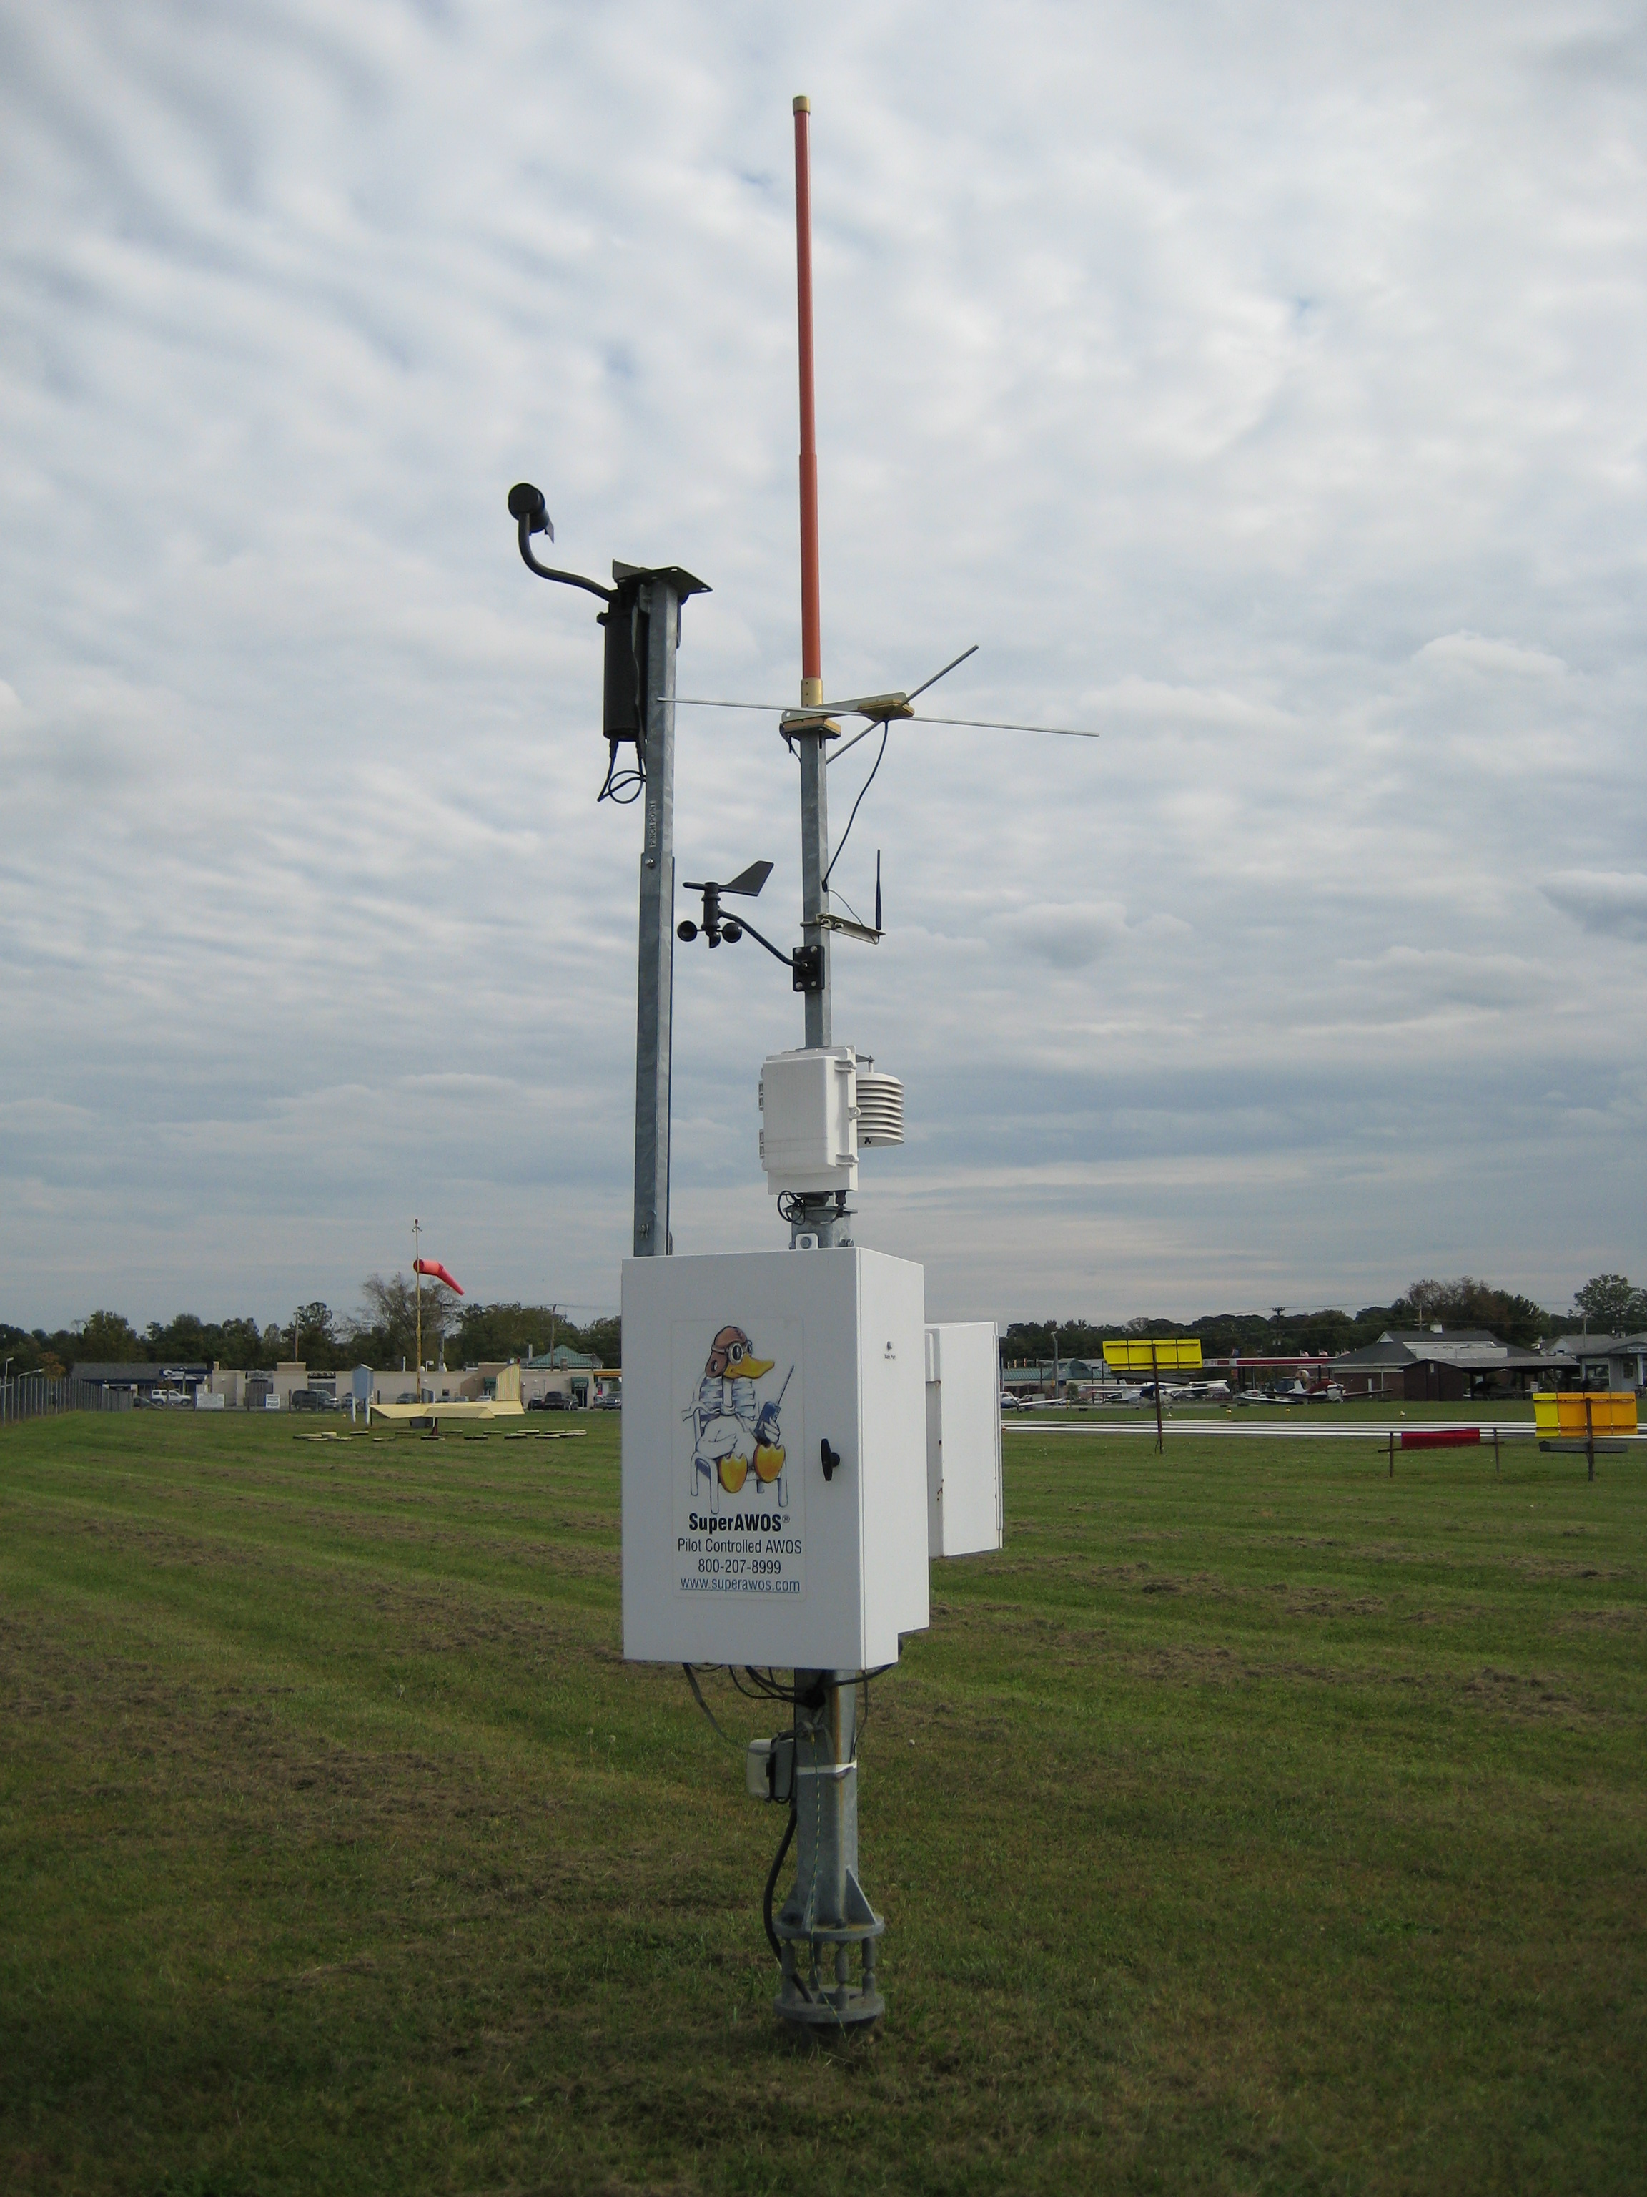
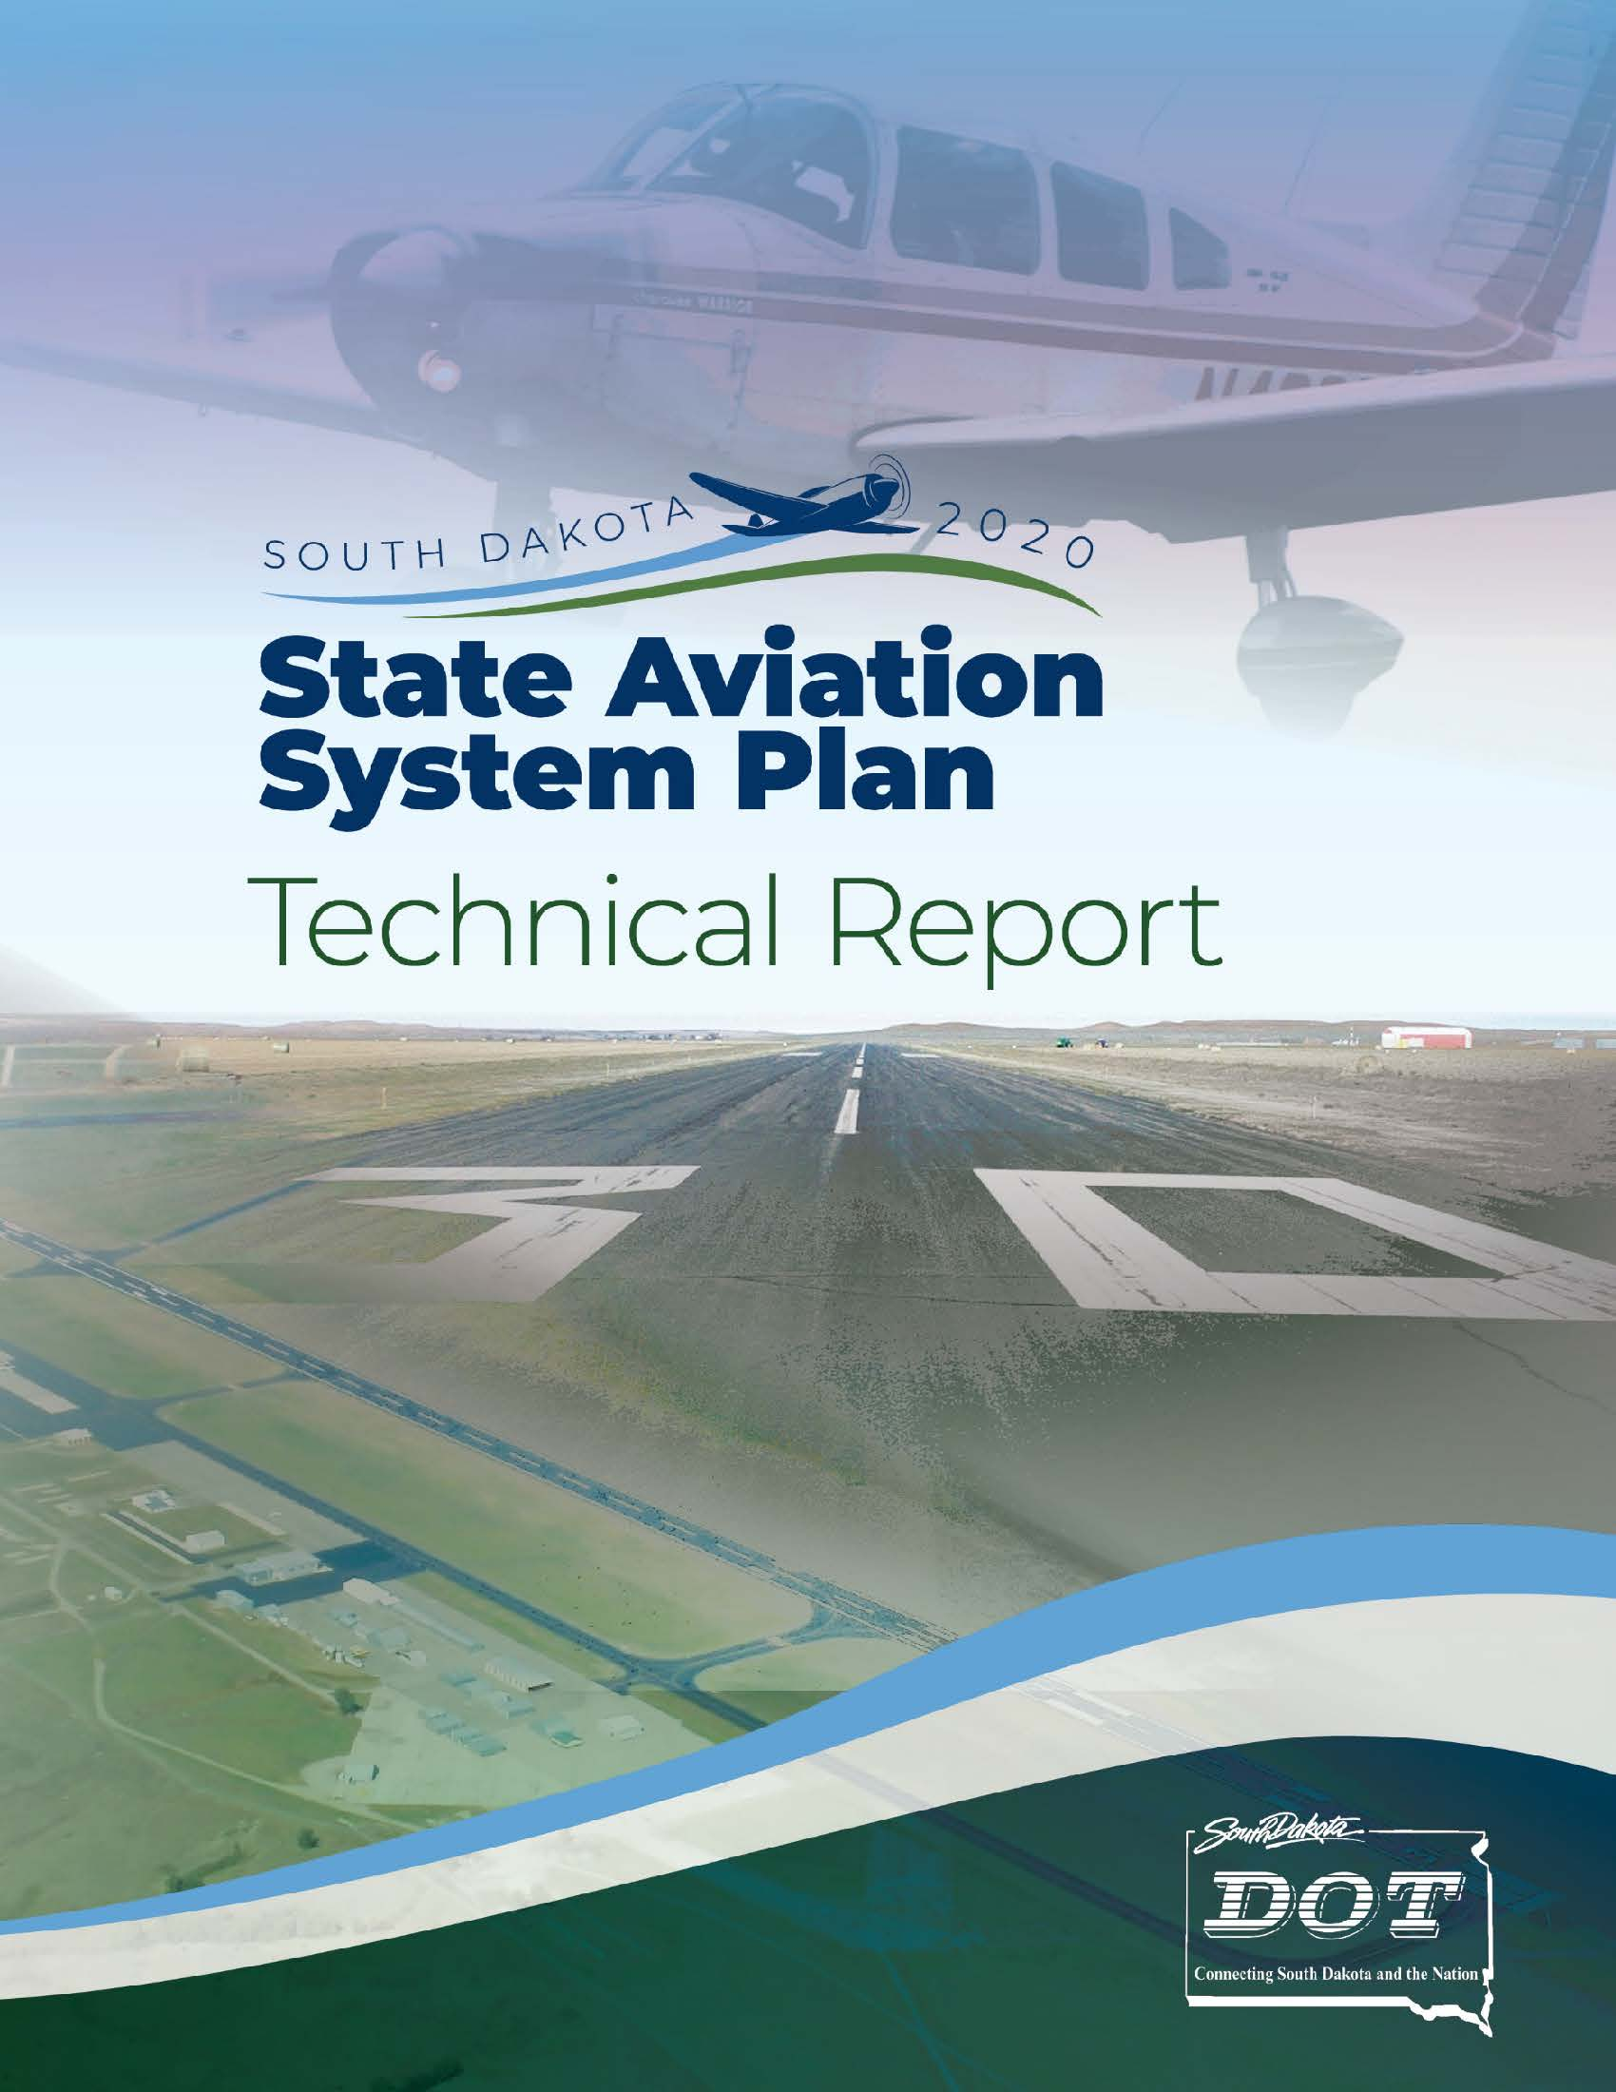
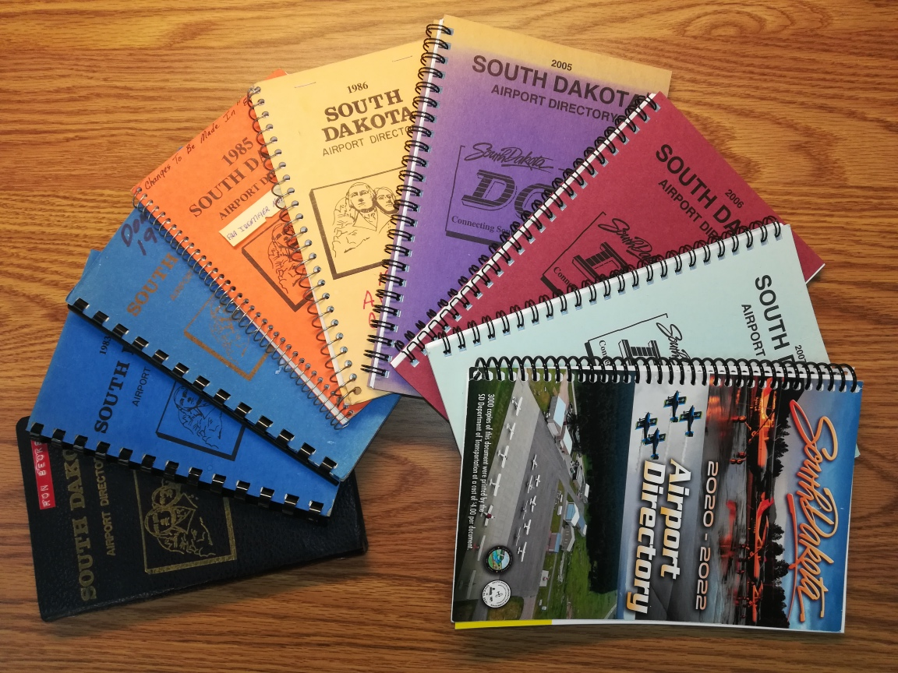
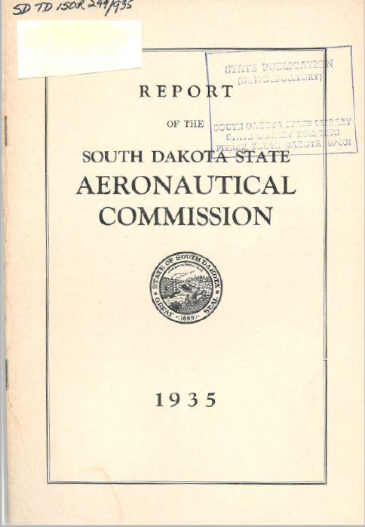
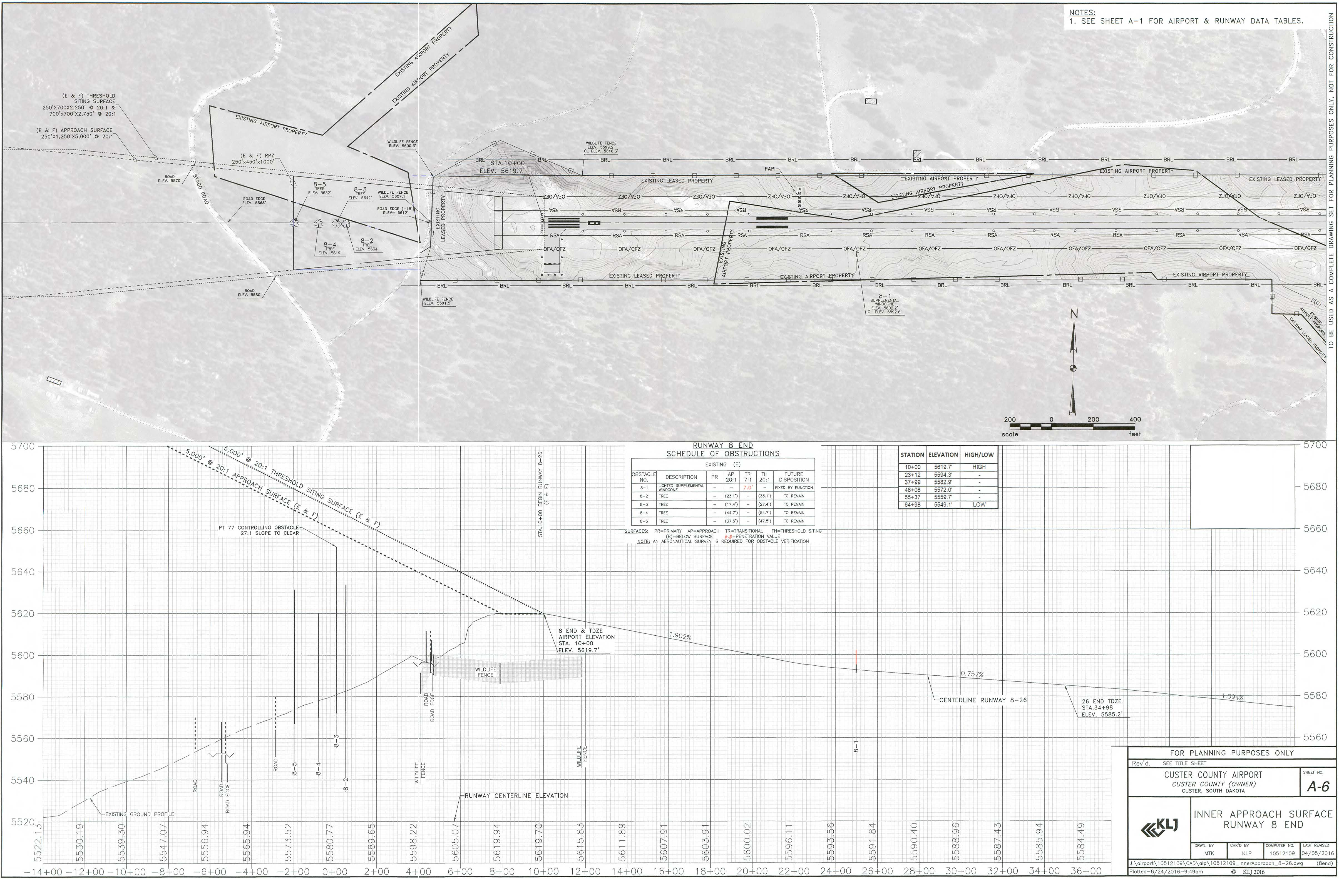
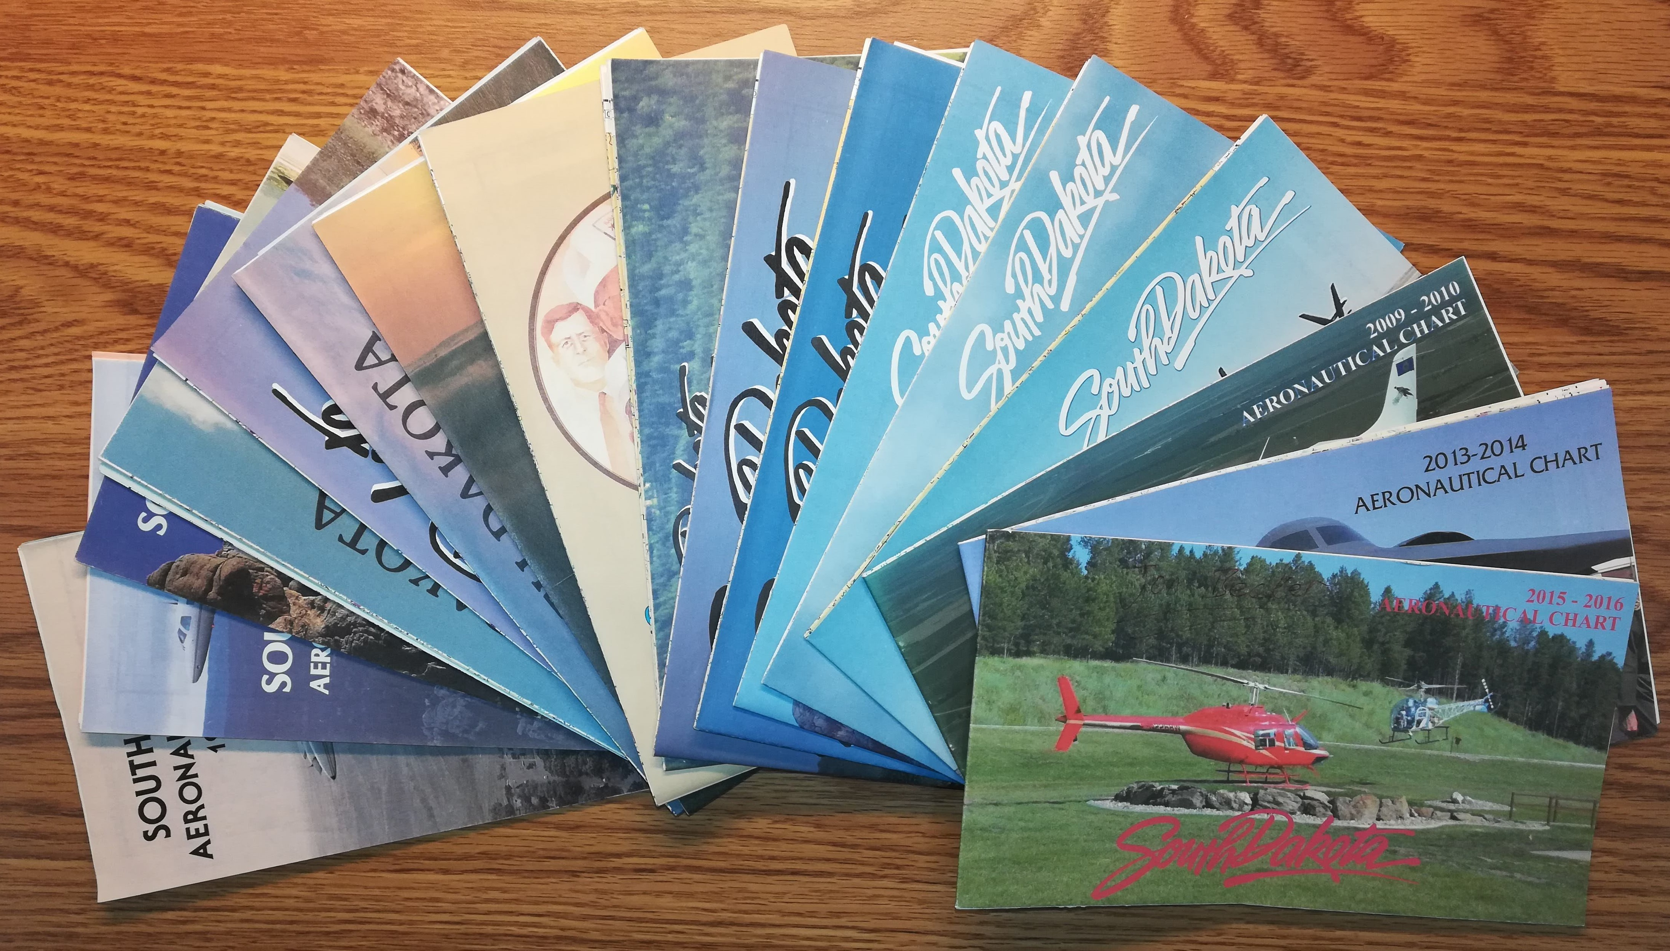

Slide 42
References Robert Orr, A History Of Aviation In South Dakota, 1957 Norma Kraemer, South Dakota’s First Century Of Flight, 2010 Stephen Bucklin, Aviation In South Dakota, South Dakota History, 2015 SD State Historical Society Dave Hanson, Son Of Lyndon Hanson Monte Schneider, Director Of Aeronautics 1973-1983

